Slide 1
Meaning of statistics

Slide 2
Statistics
Statistics is a study of the
Collection
Organization
Analysis
Presentation and
Interpretation of data.
Data
Data is information usually numerically that are collected through observation or experiment.
For example:
Number of anemic patient.

Slide 3
Uses of Statistics
Statistics are used to organize and summarize the information so that the researcher can see what happened in the research study and can communicate the results to others.
Statistics helps in collecting appropriate quantitative data.
To predict the decision regarding future outcomes.
To estimate the unknown quantities.
To establish association between factors.
Quality testing is another use of statistics in every area of life.

Slide 4
Bio Statistics
Bio- statistics is the use of statistics to understand and analyze the data we take from biological experiments.
OR
Statistical methods and techniques applied to biological problems or data is called Bio statistics.

Slide 5
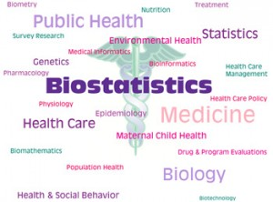
Biostatistics covers applications and contributions not only from health, medicines and, nutrition but also from fields such as genetics, biology, epidemiology, and many others.
It is mainly consists of various steps like generation of hypothesis, collection of data, and application of statistical analysis.

Slide 6
Difference between statistics and Bio- statistics
Statistics is a study of collection, organization, analysis, interpretation and presentation of data in such a way that the data make some sense and easy to understand.
Bio statistics is a study of statistics application in biology . It encompasses the design of biological experiments, the collection and analysis of data from those experiments and the interpretation of the results.

Slide 7
Role of bio-statistician
Identify and develop treatments for disease and estimate their effects
Identify risk factors for diseases.
Design, monitor, analyze, interpret, and report results of clinical studies.
Develop statistical methodologies to address questions arising from medical/public health data.
Improve the health of individual & community

