Slide 1
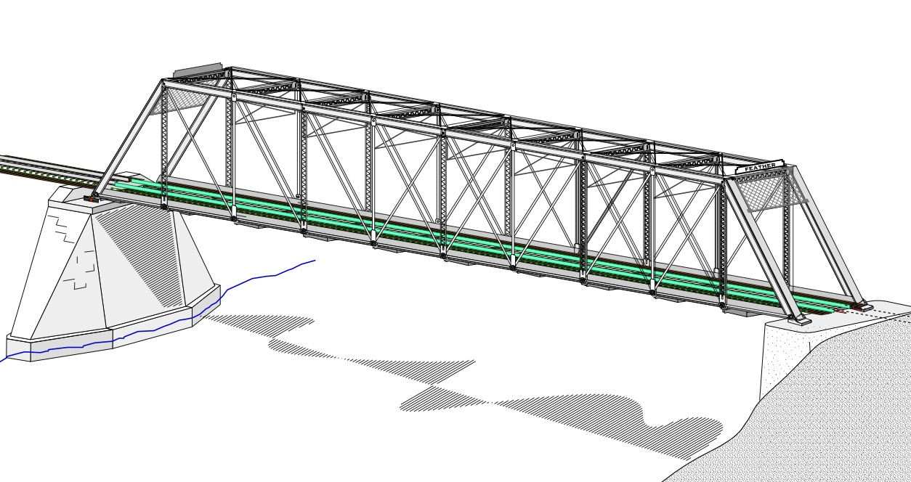
COLLEGE OF ENGINEERING AND TECHNOLOGY UNIVERSITY OF SARGODHA STEEL STRUCTURES (CT-313) (B.S TECHNOLOGY)
LECTURE-19, 20 & 21
DESIGN OF TENSION MEMBERS
Engineer Aqeel Ahmed
Lecturer, CET, UOS, Sargodha
27-Nov-2020

Slide 2
TENSION MEMBERS
DESIGN OF A TENSION MEMBER

Slide 3
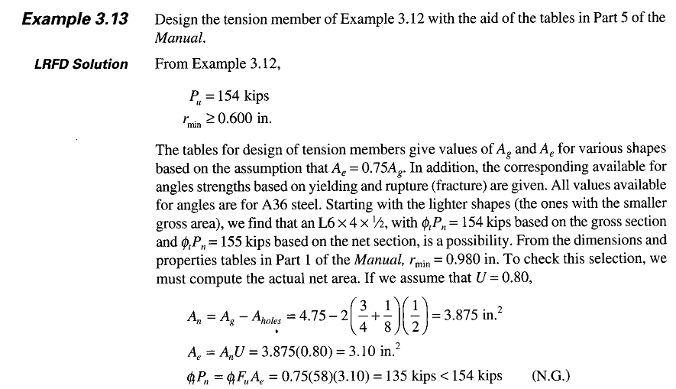
TENSION MEMBERS
DESIGN OF A TENSION MEMBER…………..

Slide 4
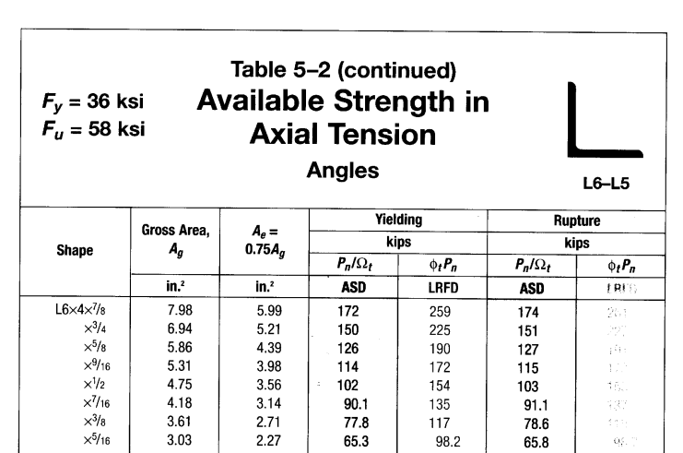
TENSION MEMBERS
DESIGN OF A TENSION MEMBER…………..

Slide 5
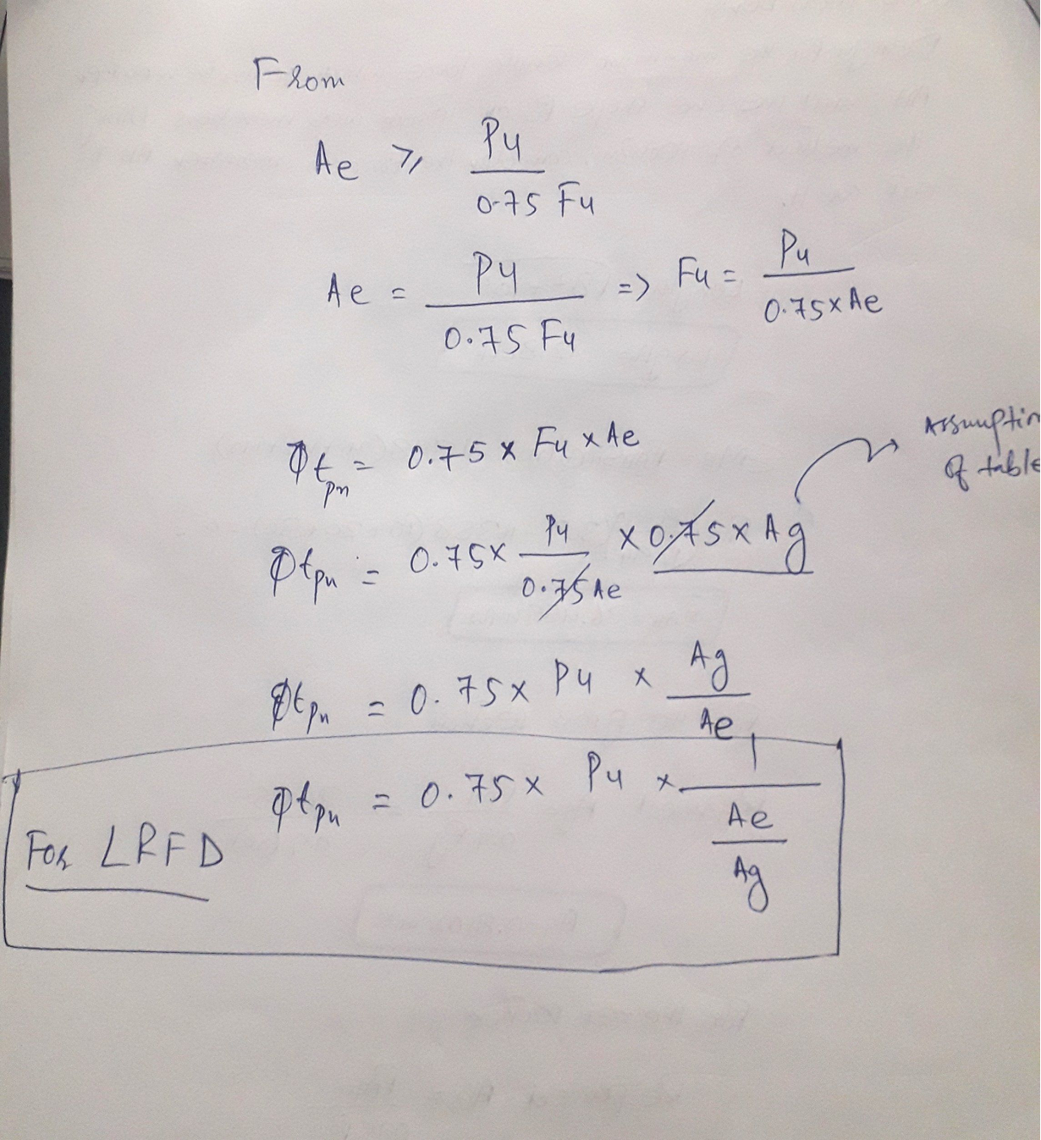
TENSION MEMBERS
DESIGN OF A TENSION MEMBER…………..

Slide 6
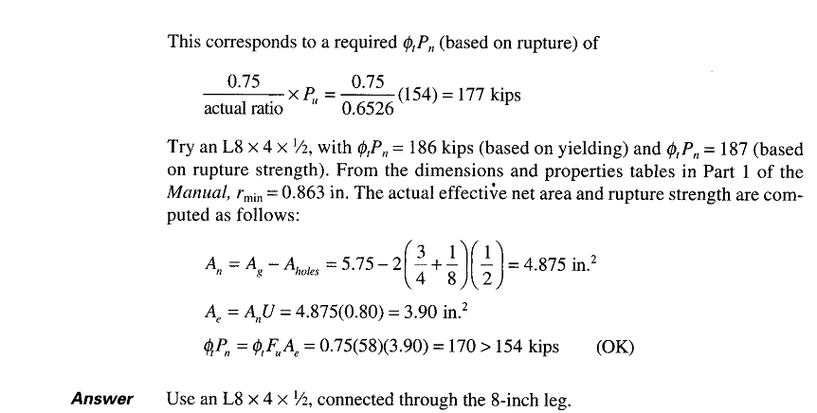
TENSION MEMBERS
DESIGN OF A TENSION MEMBER…………..

Slide 7
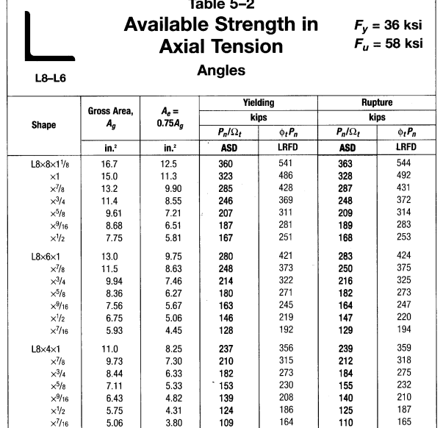
TENSION MEMBERS
DESIGN OF A TENSION MEMBER…………..

Slide 8
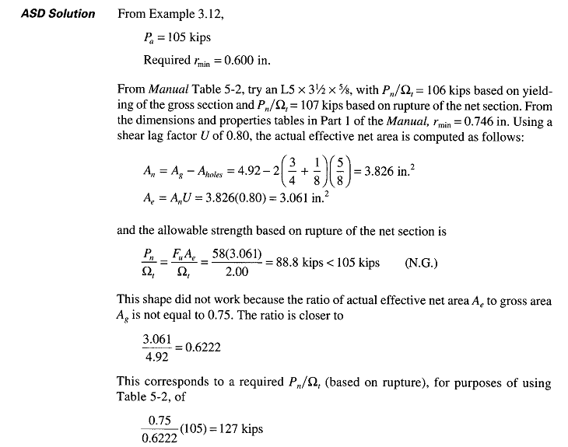
TENSION MEMBERS
DESIGN OF A TENSION MEMBER…………..

Slide 9
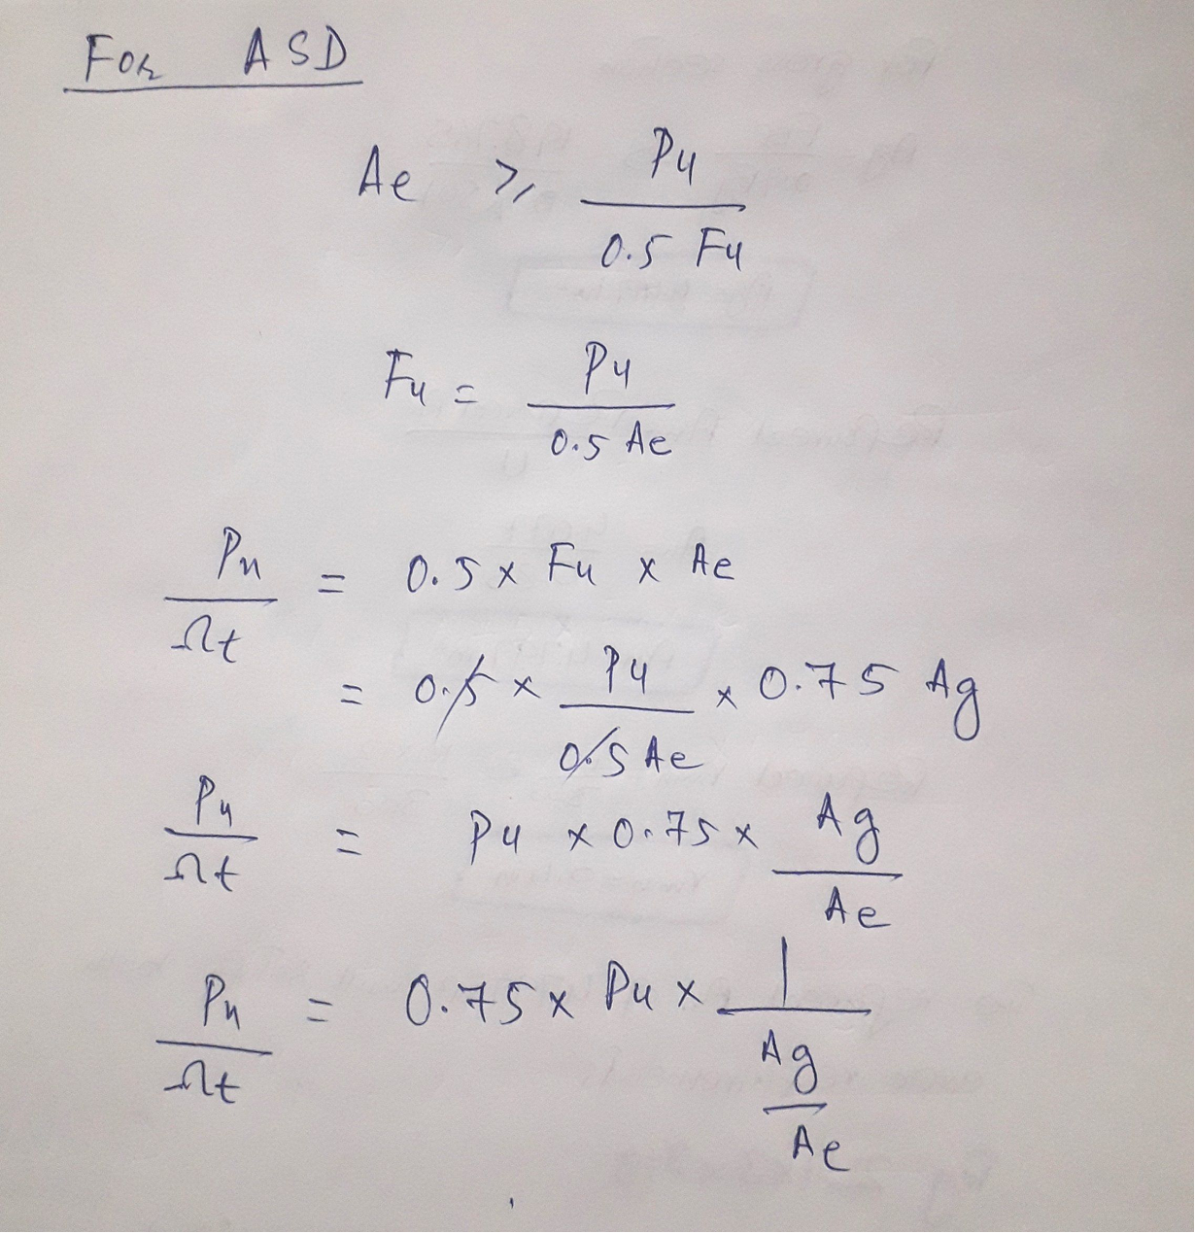
TENSION MEMBERS
DESIGN OF A TENSION MEMBER…………..

Slide 10
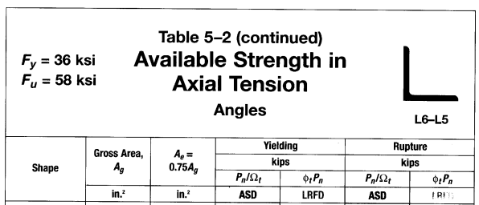
TENSION MEMBERS
DESIGN OF A TENSION MEMBER…………..

Slide 11
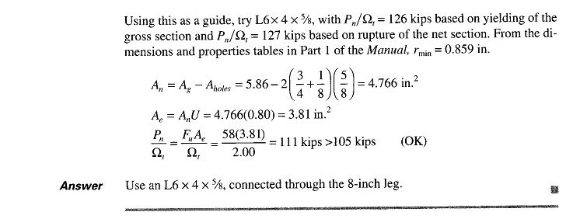
TENSION MEMBERS

Slide 12
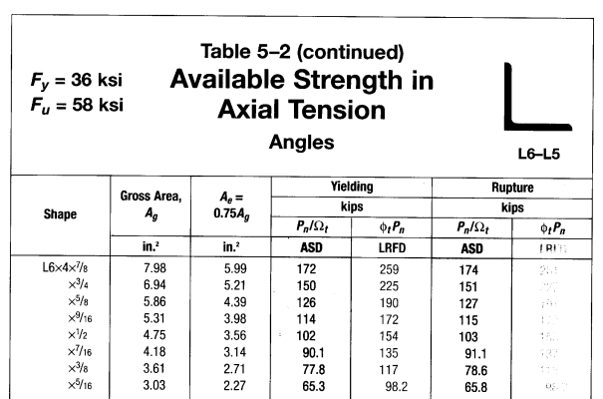
TENSION MEMBERS
DESIGN OF A TENSION MEMBER…………..

Slide 13
TENSION MEMBERS
DESIGN OF A TENSION MEMBER
Note that if the effective net area must be computed, the tables do not save much effort.
In addition, you must still refer to the dimensions and properties tables to find the radius of gyration.
The tables for design do, however, provide all other information in a compact form and the search may go more quickly.
When structural shapes or plates are connected to form a built-up shape, they must be connected not only at the ends of the member but also at intervals along its length.
A continuous connection is not required. This type of connection is called stitching and the fasteners used are termed as stitch bolts.

Slide 14
TENSION MEMBERS
DESIGN OF A TENSION MEMBER
The usual practice is to locate the points of points of stitching so that L/r for any component part does not exceed L/r for the built-up member.
The user note in AISC D4 recommends that built-up shapes whose component parts are separated by intermittent fillers be connected at intervals such that the maximum L/r for any component does not 300.
built-up consisting of plates or combination of plates and shapes are addressed in AISC section J3.5 of chapter J (“Design of Connections”).
In general, the spacing of fasteners or welds should not exceed 24 times the thickness of the thinner plate or 12 inches
If the member is of “weathering” steel subject to atmospheric corrosion, the maximum spaicng is 14 times the thickness or 7 inches

Slide 15
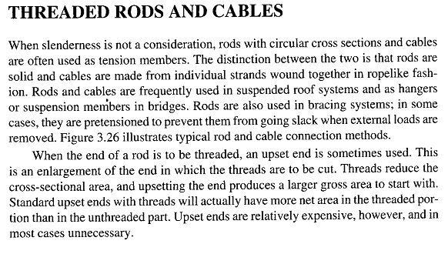
TENSION MEMBERS

Slide 16
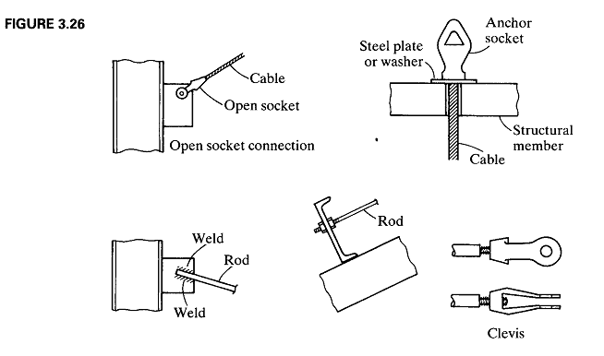
TENSION MEMBERS

Slide 17
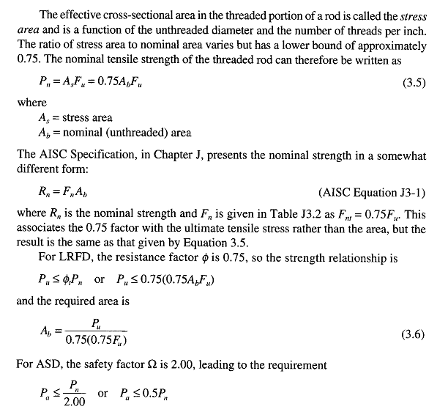
TENSION MEMBERS

Slide 18
TENSION MEMBERS

Slide 19
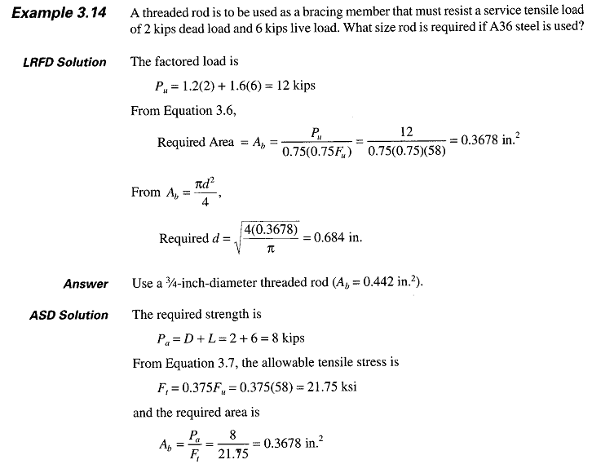
TENSION MEMBERS

Slide 20
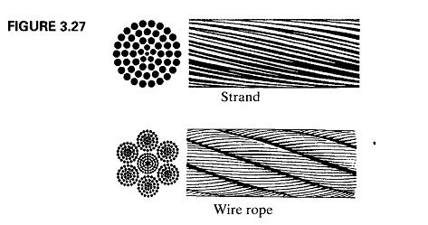
TENSION MEMBERS

Slide 21
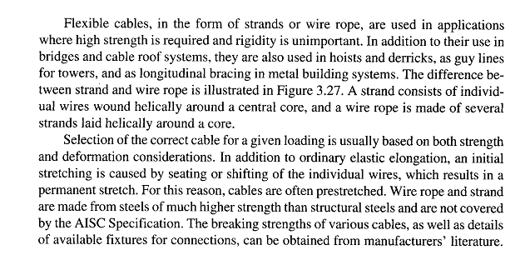
TENSION MEMBERS

