Slide 1
Professional development , competence & expertise

Slide 2
THE LIFELONG PROCESS OF SKILL ENHANCEMENT
Profession
Primary elements of professionalism are specialized skills & training
dynamic & changing skills according to emerging research.
Rationale behind Skill in change ??
Autonomy e…
Protect public from incompetent practitionare and improve their skills In best favor of Pts.

Slide 3
COMPETENCE
a person is either competent or not to perform a particular task.
Professional development encompasses the entire scope of a career, beginning with
pre professional education and continuing throughout the professional life span.
+Acquire & maintain of minimum set professional standards of practice

Slide 4
The Guide for Professional Conduct (GPC) of the American Physical Therapy Association (APTA)takes note of this:
“A physical therapist has a lifelong professional responsibility for maintaining competence through ongoing self-assessment, education, and enhancement of knowledge and skills” (GPC 5.2)

Slide 5
EXPERTISE
“the habitual and judicious use of communication, knowledge, technical skills, clinical reasoning, emotions, values, and reflection in daily practice for the benefit of the individual and community being served.”

Slide 6
3 models??(background knowledge)
Pt centered approach
Collaborative and problem-solving approach to clinical reasoning
Novice Vs Experienced

Slide 7
Core values of professionalism
Accountability
Altruism
compassion/caring
Excellence
integrity
professional duty
social responsibility

Slide 8
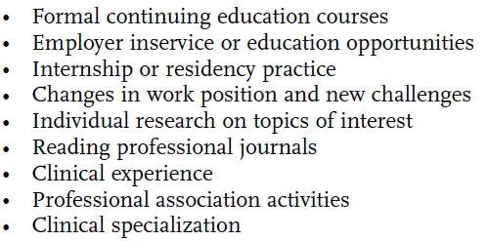
Activities that promote professional development

Slide 9
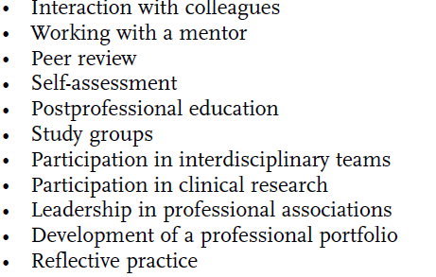

Slide 10
EVALUATION OF COMPETENCE AND PROFESSIONAL DEVELOPMENT
Protecting public from unqualified professionals>> licensure req…
Mandatory continuing education
● Re-examination at set intervals
● Peer review(experienced PT evaluate other ..)
● Compilation of a professional portfolio

Slide 11
Portfolio(evidence of professional growth)
Artist compile portfolio of paintings to show artistic capability..
PT portfolio..insights of PT and unique goals for professional development..
STRENGTH : what can I do really well?
Weakness : What am I less Good at?
Opportunities : opp to achieve my goals
Threats :what might inhibit my progress ? what comes in my way?

Slide 13
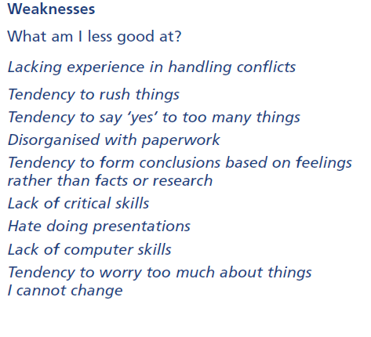

Slide 14
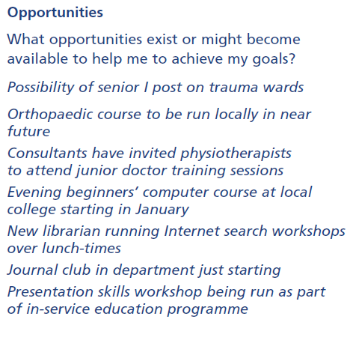

Slide 15
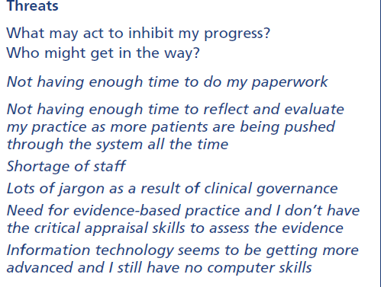

Slide 16
POSSIBLE EVALUATORS OF PROFESSIONAL ACHIEVEMENT
PT
Other think license agency as paid by Govt.
Profession & its organization
Employer(CPT by company or self)

