Slide 1
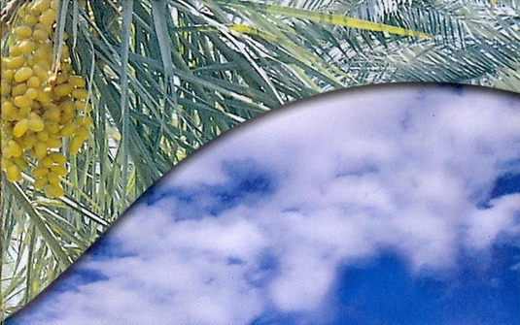
DATE PALM

Slide 2
Botanical name: Phoenix dactylifera L.
Closely related spp are: P. canariensis
P. sylvestris
P. humilis
Family: Palmae
Date has 4-6 m long pinnate leaves called fronds
Has conical mid-rib which tapers along the length of the frond

Slide 3
Trunk is vertical having almost the same girth (100-150 cm)
Also covered with bases of pruned fronds
Being a monocot, tree has adventitious roots of roughly uniform thickness along their length
In cultivated date palm inflorescences are enveloped in spathes
Two types of spathes (Male and female)

Slide 4
Male Spathes
Shorter and wider than female spathes
Contain 10,000 to 15,000 flowers
Sweets
Scented
3 sepals
3 petals
6 stamens

Slide 5
Female spathes
Contain 2000 to 3000 flowers
Longer and thinner than male spathes
Female flower are bead like structure
3 petal
3 sepals
3 carpels with hook like stigma
Only one developed into fruit
Other two universally abort during development

Slide 6
Fruit characters
Fruit vary in size
Weight 2-60 g
Length 18-110 mm
Width 8-32 mm
Single seed
Weight 0.5-4 g
Length 12-36 mm
Width 6-13 mm
Has groove
Hard endosperm composed of cellulose

Slide 7
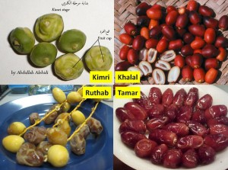
Stages of fruit

Slide 8
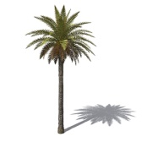
Distribution and history
Cultivated palm is dioecious
Independent male and female trees
It has been cultivated since 3000 BC
Almost all palms are indigenous to hot climate
Commercially grown in Asia and Africa
Iraq, Iran, Pakistan, Saudi Arabia, Morocco, Algeria, Tunis and Egypt
Some in Australia, USA and Mexico
Pakistan – 3rd most important fruit

Slide 9
Area (000 ha)
Production (000 Tonnes)
Total : 566.4
Agriculture Statistics of Pakistan 2008-09

Slide 10
Varieties
Punjab: Hillawi, Khardrawi and Zaidi
Sindh: Aseel
KPK: Dhaki , shakri, hussaini
Balochistan: Berni, Begum jangi
Notes:
:

Slide 11
Soil and Climate
Important climatic factors
Temperature
Rainfall
Humidity
Light
Wind
General requirement for date palm cultivation
High temperature
Much sunlight
Low humidity
Low rainfall
Absence of high winds
All these factors affect the growth and productivity

Slide 12
Tolerate quite low temperatures but the growth will be ceased at below 10ºC
Resistant to heat
May tolerate temperatures up to 58ºC for short period
Prevailing temperature during ripening: 45 – 50ºC
Blooming will occur when temperature rises above 18ºC
Fruit setting and development will take place only if temperature is above 25ºC
Earlier dates are produced where the temperature first rises above 18ºC, where it is attained later – late fruit production
Proper ripening and quality : interaction of temperature and humidity is important

Slide 13
Hot dry regions produce hard and dry dates rather than syrupy dates
High humidity may delay ripening
Rains during pollination and ripening are devastating
Punjab : monsoon rains , a major obstacle to date culture because time of ripening coincides with the rainy season
Soil
Light, deep, well-drained soils are preferable
Rocky, calcareous soils and compact soils are not suitable
May also grown on soil affected by salinity but highly saline soils are not fit

Slide 14
Propagation
Both sexually and asexually
Through seeds doesn’t produce true-to-type fruit
Longer time to bloom
Asexually propagated through suckers ‘aka’ offshoots
Generally emerge from the underground stem or some times from aerial parts
Rooted suckers carefully removed for further propagation
Suckers weighing 18-20 kg or 3-5 years old propagate successfully in orchards
Suckers removal: Feb – March / August – September
Planting system: Square system @ 7 m
Male trees @ 3% are also planted at various locations in orchard

Slide 15
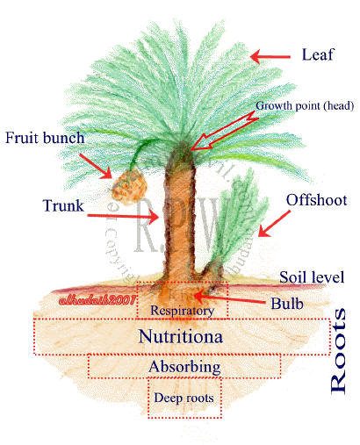

Slide 16
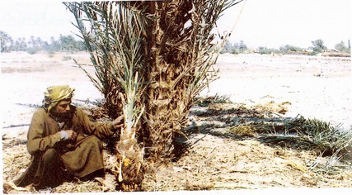
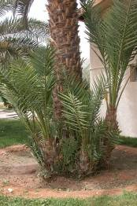
Date Palm

Slide 17
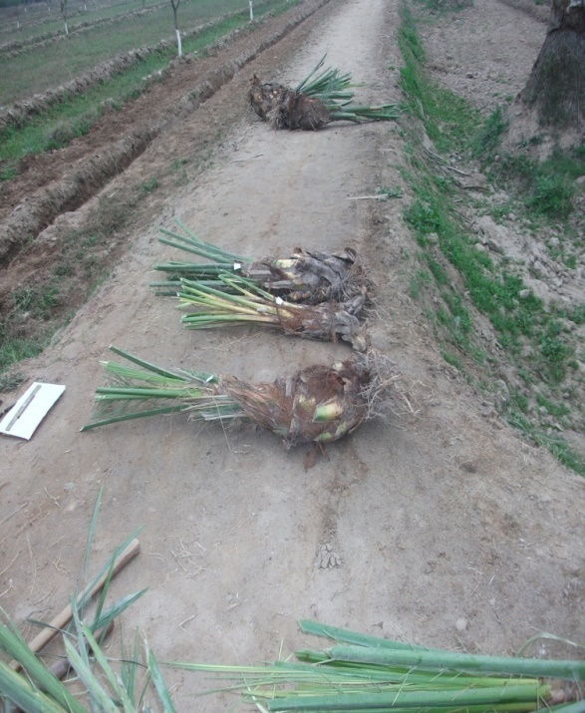
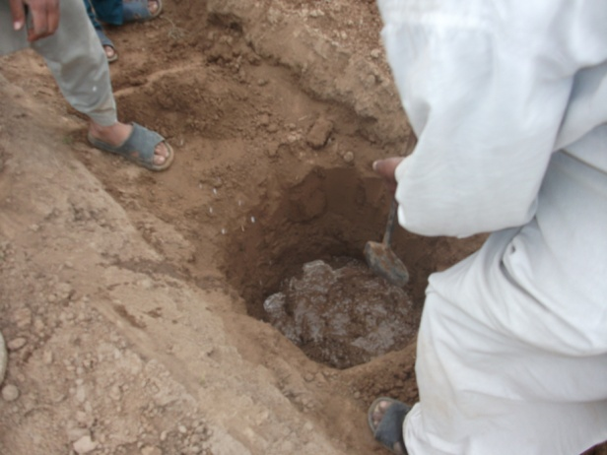
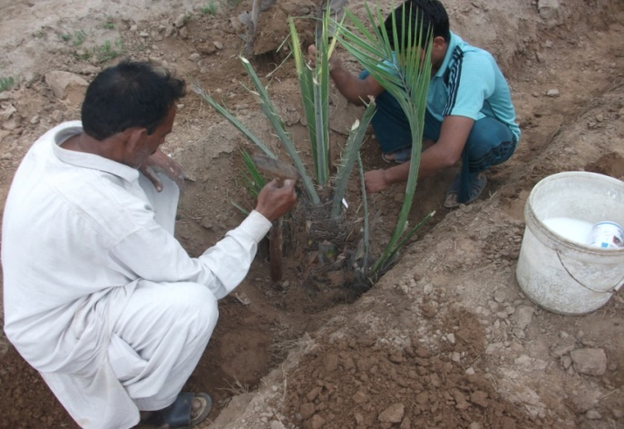
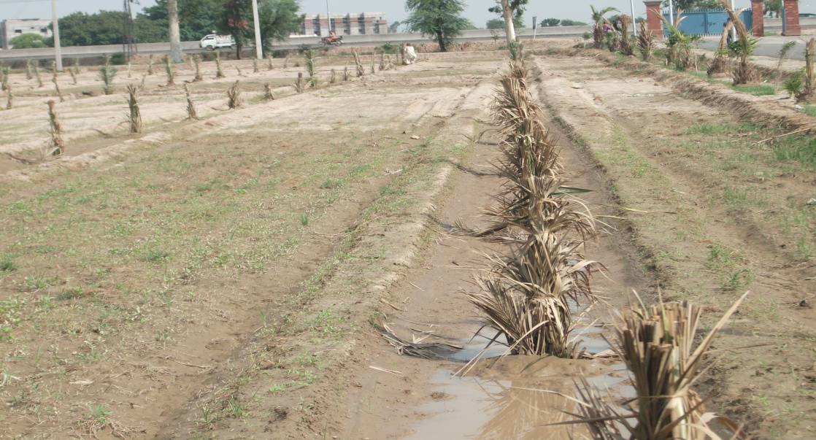

Slide 18
Pollination
Commercial orchards : artificial pollination
Several methods : Manual and Mechanical
Mechanical date pollinators
Spray of nutrients in nutrient solutions
Hand pollination
Pakistan : usually done by hands
Flowering strands separated from mature and ready to open male inflorescence in groups of two and three
Warmed in sunlight fro short time so that when shaken they shed their pollen
A man carrying a bag of male sprigs climbs the tree and pollinate the opened female spathes by shaking the male sprigs
Laborious operation, repeated 4 – 5 times

Slide 19
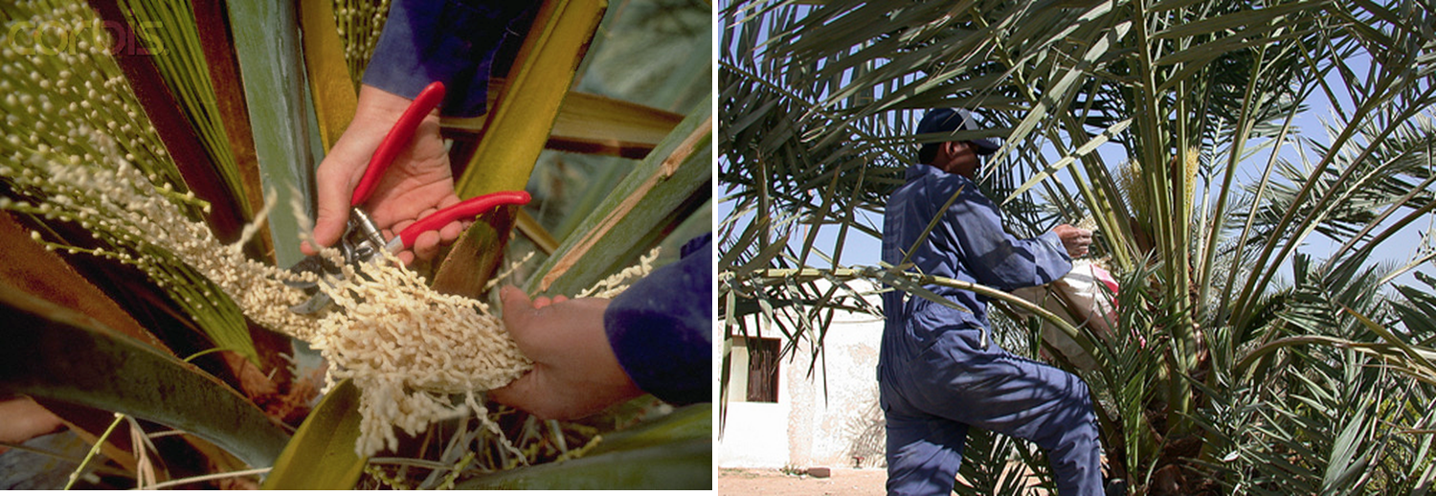

Slide 20
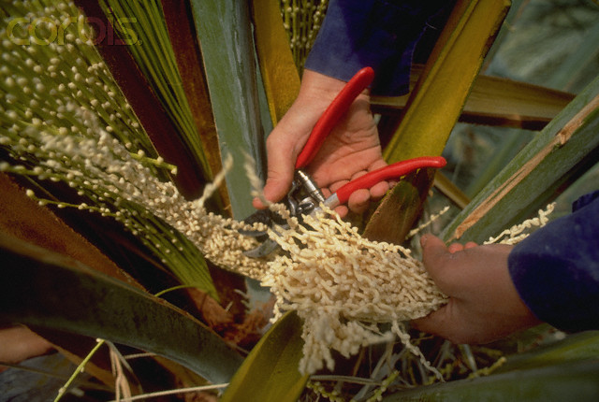
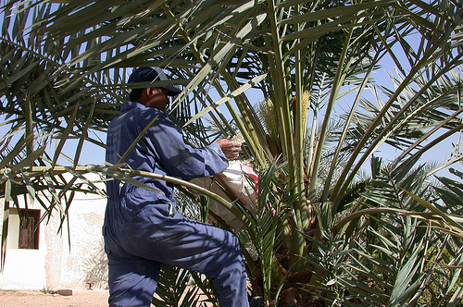
Pollination
Date Palm
Pollination
Dr. Saeed Ahmad. HORT.102 Institute of Horticultural Sciences

Slide 22
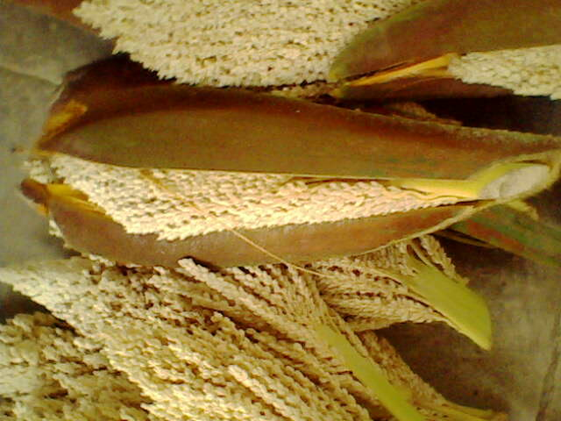
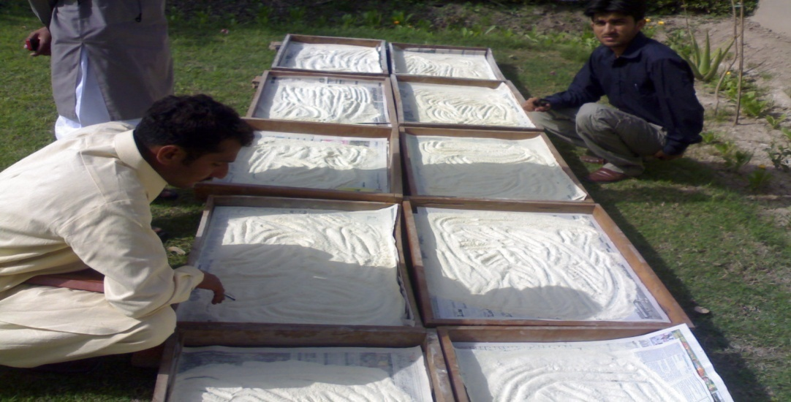
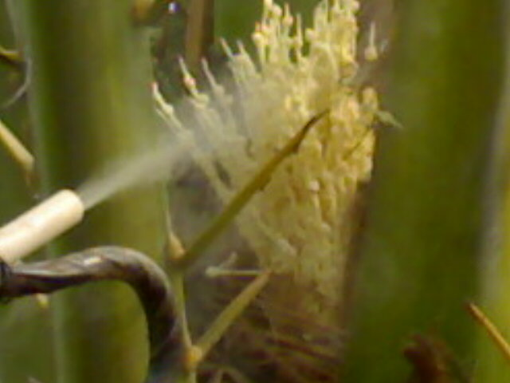
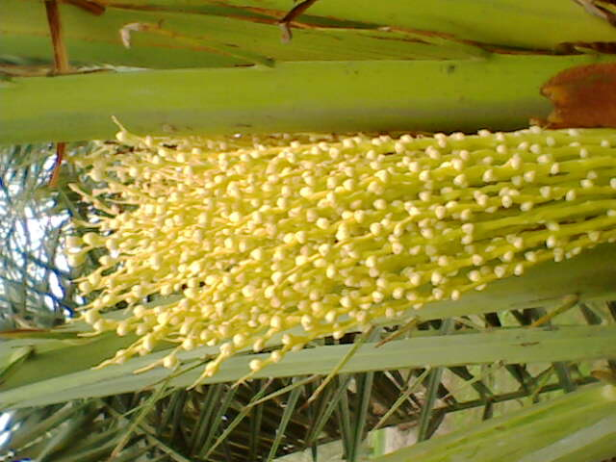
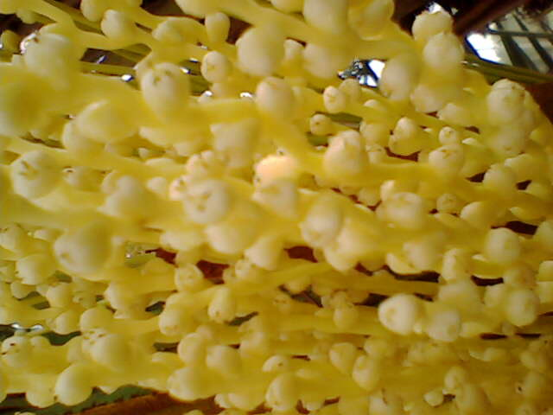
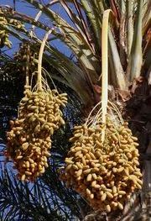
Male Spath
Pollen
Pollination
Fruit Setting
Fruit Setting
Dates

Slide 23
Cultural Practices
Water requirement varies with
climatic conditions
Water table
Soil type
Age of trees
Require more watering during fruit development
Newly planted orchards require daily watering at least for one month
Established orchards require irrigation weekly during fruit development and once a month during rest of the year
Deep cultivation around the trees will damage root system and should be avoided
Shallow ploughing and harrowing is helpful to control weeds

Slide 24
PRUNING:
No systemic pruning except removal of dropped leaves
In some vigorous trees/CVs green fronds are also removed to over come the humid micro-environment around the fruiting branches; e.g. Deglet Noor
Removal of spines from bases of fronds to facilitate pollination and minimizes puncturing of growing fruit
Removal of bunches not practiced

Slide 25
Fertilizers
Before Fruiting
Age of Plant | FYM | Urea | DAP | SoP
At the time of plantation | 20 kg
1 - 2 year old |  | ¼ kg
3 – 4 year old | 10 kg | 1/3 - 1/2 kg | ¼ kg | 100 g
4 – 6 year old | 20 kg | 1 ¾ kg | ½ kg | 1/3 kg
Bearing Trees
Age of Plant | FYM | Urea | DAP | SoP
7 – 10 year old | 35 – 40 kg | 2 kg | ¾ kg | ½ kg
10 – 12 year old | 35 – 40 kg | 2 ½ kg | 1 kg | ½ kg
> 12 year old | 35 – 40 kg | 3 kg | 1 ½ kg | 2 kg

