Slide 1
Evidence Based Physical therapy
Relevant clinical question

Slide 2
First step in evidence based physical therapy
is to ask relevant clinical question

Slide 3
Is It possible to know everything??.
you must admit that you don’t know.
EBM gives you a method to find answers to questions without having any prior knowledge of what you ought to know.

Slide 4
What Will be the benefit of structuring question in a proper manner
By structuring questions well, relevant evidence can be found more efficiently and easily.

Slide 5
How to structure a Question?
effects of Intervention
Experience
Prognosis
Accuracy of Diagnostic test

Slide 6
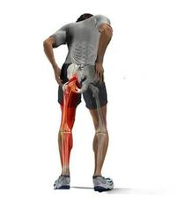
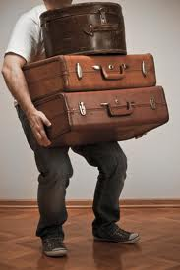
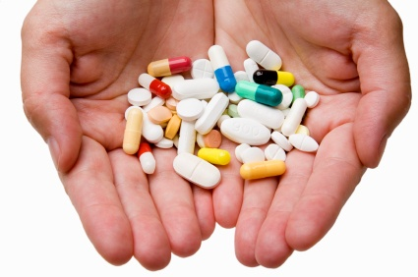
43 yrs old
LBP of acute onset(2 weeks)
Radiating pain to Lt leg
Heavy lifting at work
Gradually become worsen
No neurological deficit
Analgesics, Anti –inflammatory & bed rest
Little improvement
Referred to Physical Therapy for pain relief & physical functional restoration(prevention of disability)
Notes:
BEST Rx for Pts with back pain.What the evidence says about back pain.we are uncertain . Uncertainty prompts (give incentive to action) clinical question .
A precondition for EBPT
Appraise:Estimate or determine the nature, value, quality, ability, extent, or significance of

Slide 7
Qs during patient’s encounter
How this problem effect patient’s daily life
Answered best by patient
Experience , Practice knowledge
Other are best answered by high quality clinical research
finding evidence quickly

Slide 8
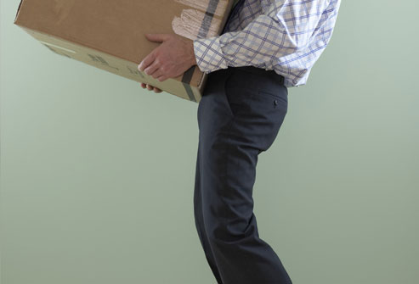
Questions
Is heavy lifting the cause of this man’s problem?
Could this problem have been prevented?

Slide 9
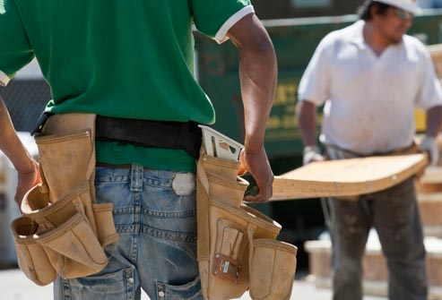
How can I decide whether he has nerve root involvement?
Which tests would be useful to rule out more serious conditions, such as malignancy?
What is his principal underlying concern about the condition?

Slide 10
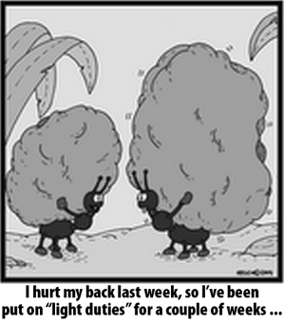

Slide 11
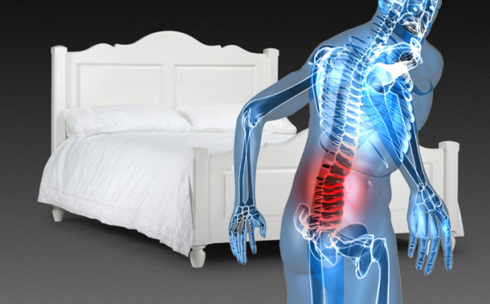
If my aim is to improve his functional capacity , should I advise him to stay active or to rest in bed?
What does he feel about staying in bed or returning to work?
What is the probability that the problem will resolve by itself within a month?

Slide 12
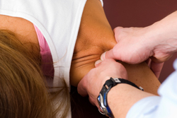
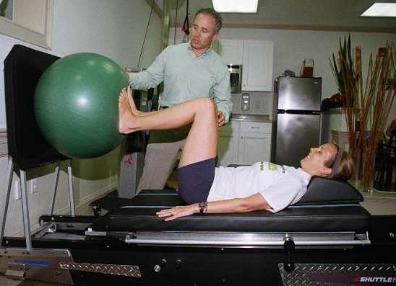
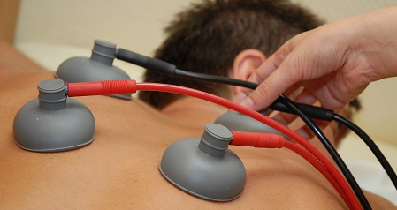
What can I do to relieve his pain during this period?
Is there anything I can do to speed up his recovery?

