Slide 1
Dr. Muhammad Ali-ur-Rasheed
Lecturer , Department of Physiotherapy.
Sargodha Medical College.

Slide 2
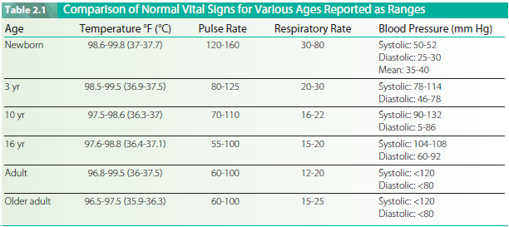

Slide 3
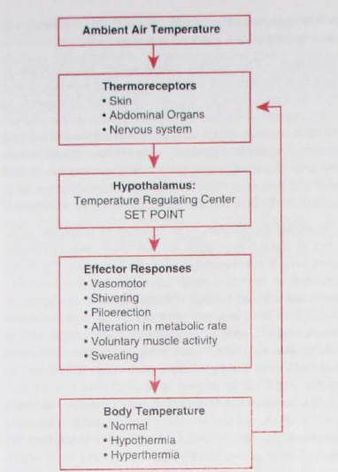

Slide 4
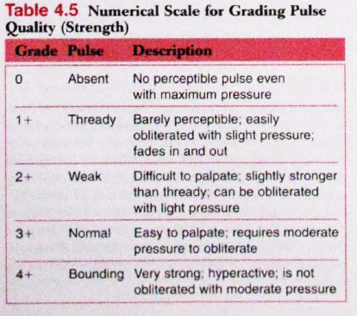

Slide 5
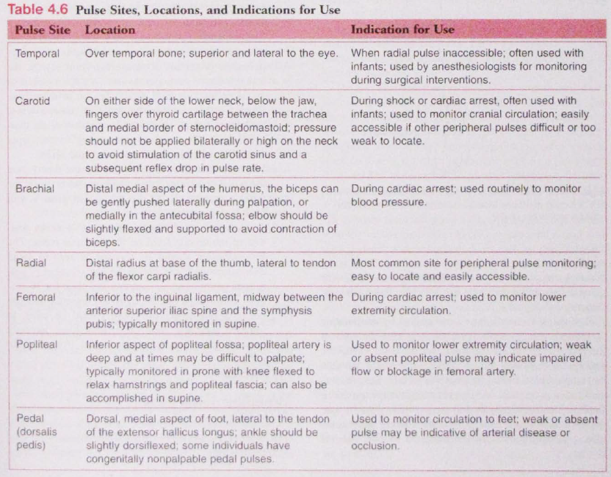

Slide 6
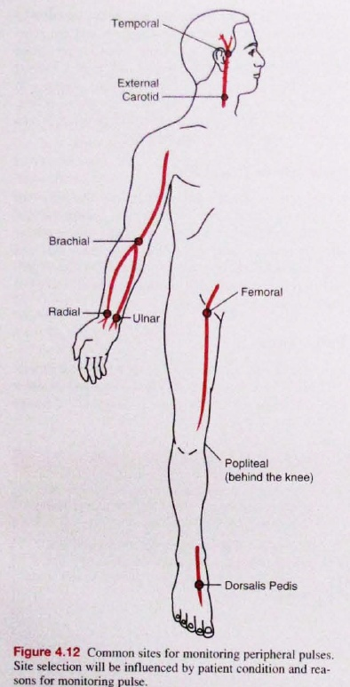

Slide 7
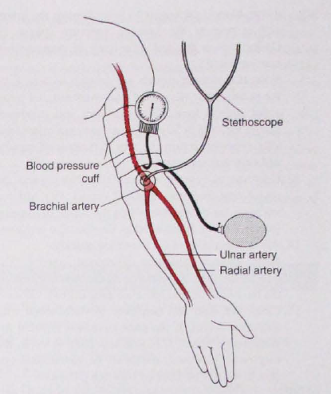

Slide 8
Any Question ???
Thanx

