Slide 1
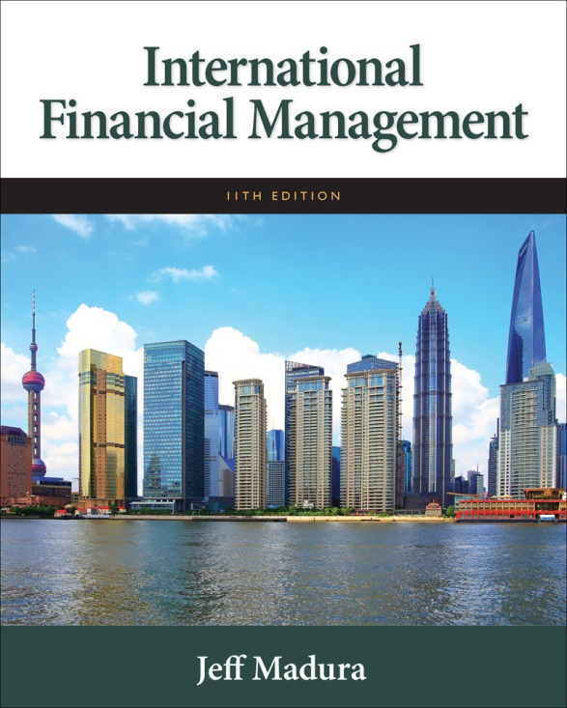

Slide 2
5
Currency Derivatives
Chapter Objectives
Explain how forward contracts are used to hedge based on anticipated exchange rate movements
Describe how currency futures contracts are used to speculate or hedge based on anticipated exchange rate movements
Explain how currency option contracts are used to speculate or hedge based on anticipated exchange rate movements
2

Slide 3
What is a Currency Derivative?
A currency derivative is a contract whose price is derived from the value of an underlying currency.
Examples include forwards/futures contracts and options contracts.
Derivatives are used by MNCs to:
Speculate on future exchange rate movements
Hedge exposure to exchange rate risk

Slide 4
Forward Market
A forward contract is an agreement between a corporation and a financial institution:
To exchange a specified amount of currency
At a specified exchange rate called the forward rate
On a specified date in the future

Slide 5
How MNCs Use Forward Contracts
Hedge their imports by locking in the rate at which they can obtain the currency
Bid/Ask Spread is wider for less liquid currencies.
May negotiate an offsetting trade if an MNC enters into a forward sale and a forward purchase with the same bank.
Non-deliverable forward contracts (NDF) can be used for emerging market currencies where no currency delivery takes place at settlement, instead one party makes a payment to the other party.

Slide 6
Premium or Discount on the Forward Rate
F = S(1 + p)
where:
F is the forward rate
S is the spot rate
p is the forward premium, or the percentage by which the forward rate exceeds the spot rate.

Slide 7
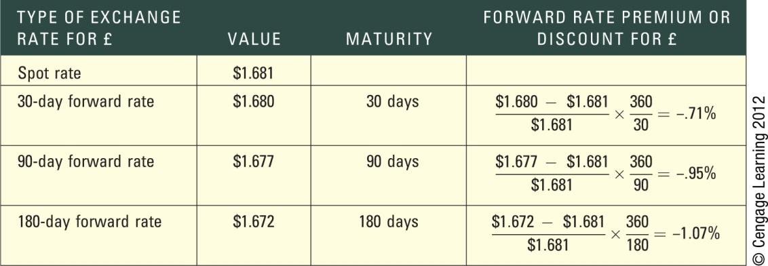
Exhibit 5.1 Computation of Forward Rate Premiums or Discounts

Slide 8
Premium or Discount on the Forward Rate
Arbitrage – If the forward rate was the same as the spot rate, arbitrage would be possible.
Movements in the Forward Rate over Time – The forward premium is influenced by the interest rate differential between the two countries and can change over time.
Offsetting a Forward Contract – An MNC can offset a forward contract by negotiating with the original counterparty bank.
Non-deliverable forward contracts (NDF) can be used for emerging market currencies where no currency delivery takes place at settlement; instead one party makes a payment to the other party.

Slide 9
Currency Futures Market
Similar to forward contracts in terms of obligation to purchase or sell currency on a specific settlement date in the future.
Differ from forward contracts because futures have standard contract specifications:
Standardized number of units per contract (See Exhibit 5.2)
Offer greater liquidity than forward contracts
Typically based on U.S. dollar, but may be offered on cross-rates.
Commonly traded on the Chicago Mercantile Exchange (CME).

Slide 10
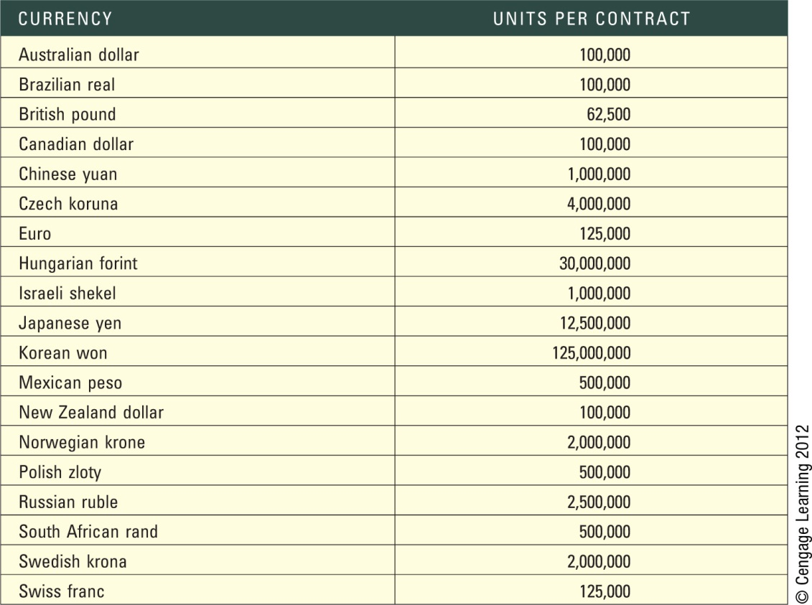
Exhibit 5.2 Currency Futures Contracts Traded on the Chicago Mercantile Exchange

Slide 11
Trading Currency Futures
Firms or individuals can execute orders for currency futures contracts by calling brokerage firms.
Electronic trading platforms facilitate the trading of currency futures. These platforms serve as a broker, as they execute the trades desired.
Currency futures contracts are similar to forward contracts in that they allow a customer to lock in the exchange rate at which a specific currency is purchased or sold for a specific date in the future.

Slide 12
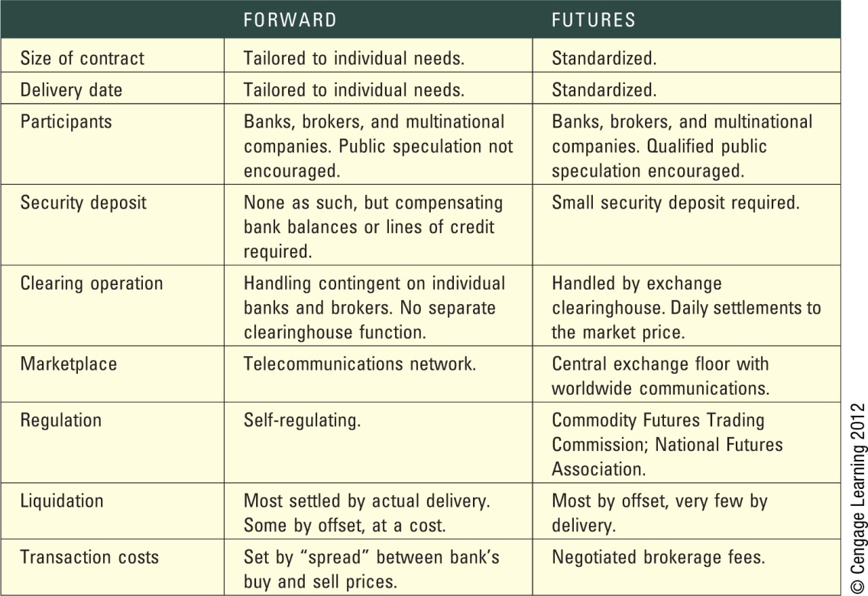
Exhibit 5.3 Comparison of the Forward and Futures Market
Source: Chicago Mercantile Exchange

Slide 13
Trading Currency Futures (cont.)
Pricing Currency Futures - The price of currency futures will be similar to the forward rate
Credit Risk of Currency Futures Contracts - To minimize its risk, the CME imposes margin requirements to cover fluctuations in the value of a contract, meaning that the participants must make a deposit with their respective brokerage firms when they take a position.

Slide 14
How Firms Use Currency Futures
Purchasing Futures to Hedge Payables - The purchase of futures contracts locks in the price at which a firm can purchase a currency.
Selling Futures to Hedge Receivables - The sale of futures contracts locks in the price at which a firm can sell a currency.

Slide 15
Closing Out a Futures Position
Sellers (buyers) of currency futures can close out their positions by buying (selling) identical futures contracts prior to settlement.
Most currency futures contracts are closed out before the settlement date.

Slide 16
Exhibit 5.4 Closing Out a Futures Contract

Slide 17
Speculation with Currency Futures
Currency futures contracts are sometimes purchased by speculators attempting to capitalize on their expectation of a currency’s future movement.
Currency futures are often sold by speculators who expect that the spot rate of a currency will be less than the rate at which they would be obligated to sell it.

Slide 18
Exhibit 5.5 Source of Gains from Buying Currency Futures

Slide 19
Currency Futures Market Efficiency
If the currency futures market is efficient, the futures price should reflect all available information.
Thus, the continual use of a particular strategy to take positions in currency futures contracts should not lead to abnormal profits.
Research has found that the currency futures market may be inefficient. However, the patterns are not necessarily observable until after they occur, which means that it may be difficult to consistently generate abnormal profits from speculating in currency futures.

Slide 20
Currency Options Markets
Currency options provide the right to purchase or sell currencies at specified prices.
Options Exchanges
1982 - exchanges in Amsterdam, Montreal, and Philadelphia first allowed trading in standardized foreign currency options.
2007 – CME and CBOT merged to form CME group
Exchanges are regulated by the SEC in the U.S.
Over-the-counter market - Where currency options are offered by commercial banks and brokerage firms. Unlike the currency options traded on an exchange, the over-the-counter market offers currency options that are tailored to the specific needs of the firm.

Slide 21
Currency Call Options
Grants the right to buy a specific currency at a designated strike price or exercise price within a specific period of time.
If the spot rate rises above the strike price, the owner of a call can exercise the right to buy currency at the strike price.
The buyer of the option pays a premium.
If the spot exchange rate is greater than the strike price, the option is in the money. If the spot rate is equal to the strike price, the option is at the money. If the spot rate is lower than the strike price, the option is out of the money.

Slide 22
Factors Affecting Currency Call Option Premiums
The premium on a call option (C) is affected by three factors:
Spot price relative to the strike price (S – X): The higher the spot rate relative to the strike price, the higher the option price will be.
Length of time before expiration (T): The longer the time to expiration, the higher the option price will be.
Potential variability of currency (σ): The greater the variability of the currency, the higher the probability that the spot rate can rise above the strike price.

Slide 23
How Firms Use Currency Call Options
Firms can use call options to:
hedge payables
hedge project bidding to lock in the dollar cost of potential expenses.
hedge target bidding of a possible acquisition.
Speculate on expectations of future movements in a currency.

Slide 24
Currency Put Options
Grants the right to sell a currency at a specified strike price or exercise price within a specified period of time.
If the spot rate falls below the strike price, the owner of a put can exercise the right to sell currency at the strike price.
The buyer of the options pays a premium.
If the spot exchange rate is lower than the strike price, the option is in the money. If the spot rate is equal to the strike price, the option is at the money. If the spot rate is greater than the strike price, the option is out of the money.

Slide 25
Factors Affecting Put Option Premiums
Put option premiums are affected by three factors:
Spot rate relative to the strike price (S–X): The lower the spot rate relative to the strike price, the higher the probability that the option will be exercised.
Length of time until expiration (T): The longer the time to expiration, the greater the put option premium
Variability of the currency (σ): The greater the variability, the greater the probability that the option may be exercised.

Slide 26
Hedging with Currency Put Options
Corporations with open positions in foreign currencies can use currency put options in some cases to cover these positions.
Some put options are deep out of the money, meaning that the prevailing exchange rate is high above the exercise price. These options are cheaper (have a lower premium), as they are unlikely to be exercised because their exercise price is too low.
Other put options have an exercise price that is currently above the prevailing exchange rate and are therefore more likely to be exercised. Consequently, these options are more expensive.

Slide 27
Speculating with Currency Put Options
Individuals may speculate with currency put options based on their expectations of the future movements in a particular currency.
Speculators can attempt to profit from selling currency put options. The seller of such options is obligated to purchase the specified currency at the strike price from the owner who exercises the put option.
The net profit to a speculator is based on the exercise price at which the currency can be sold versus the purchase price of the currency and the premium paid for the put option..

Slide 28
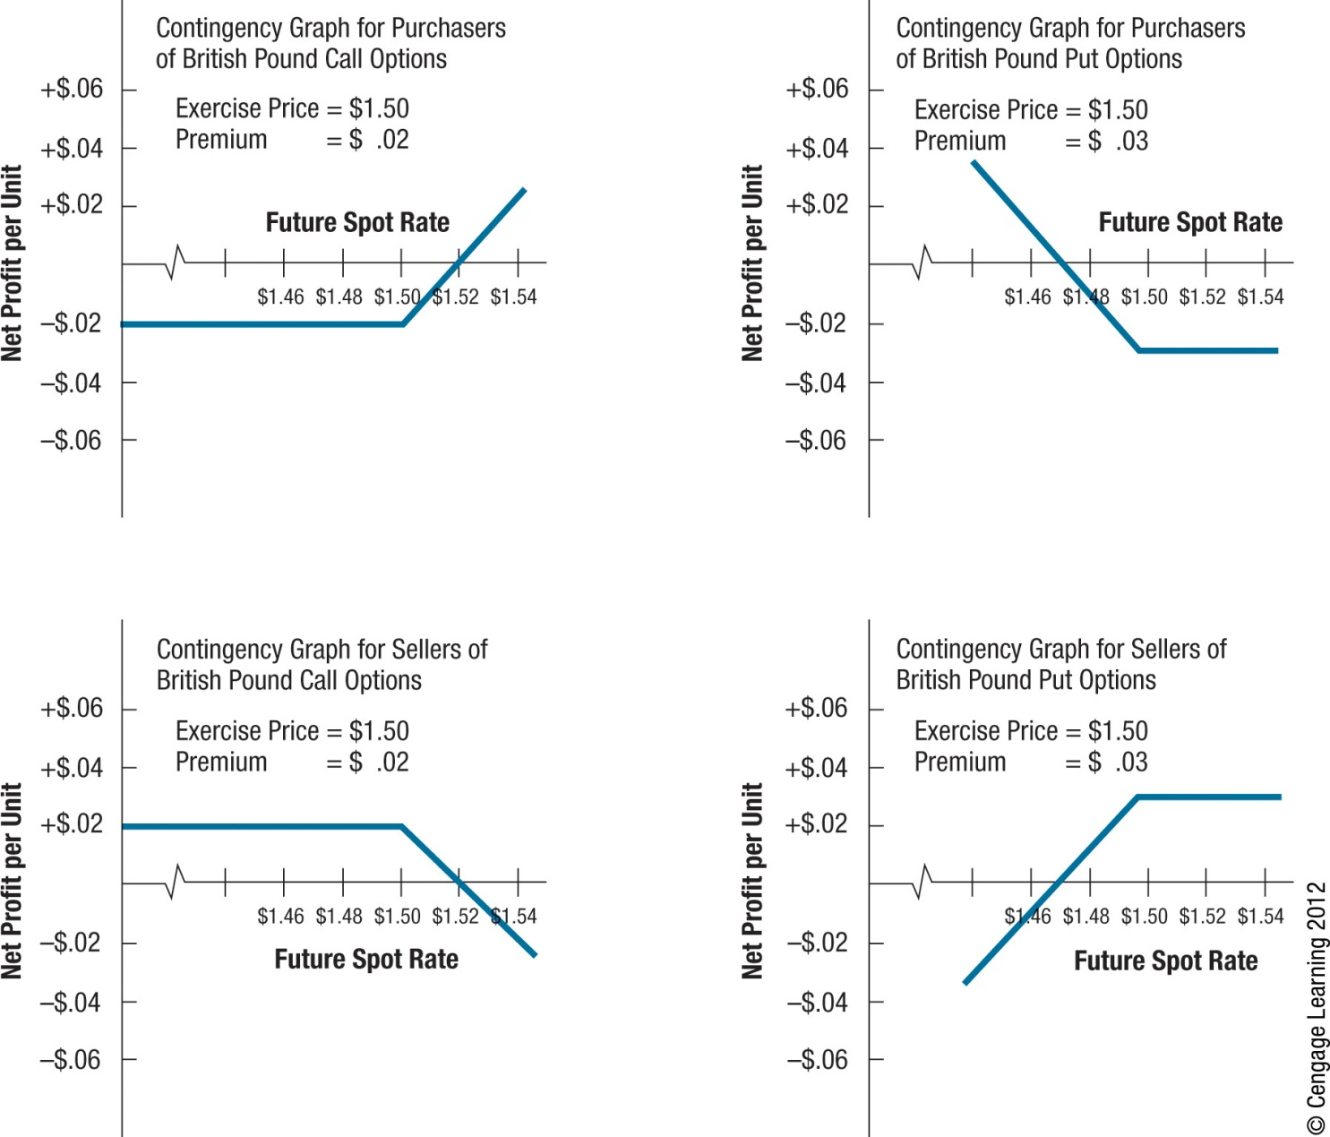
Exhibit 5.6 Contingency Graphs for Currency Options

Slide 29
Conditional Currency Options
A currency option can be structured with a conditional premium, meaning that the premium paid for the option is conditioned on the actual movement in the currency’s value over the period of concern.
Firms also use various combinations of currency options.

Slide 30
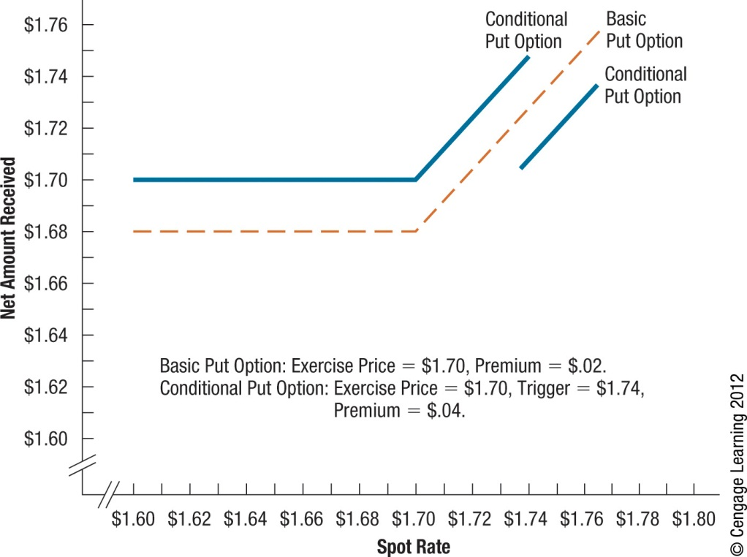
Exhibit 5.7 Comparison of Conditional and Basic Currency Options

Slide 31
European Currency Options
European-style currency options must be exercised on the expiration date if they are to be exercised at all.
They do not offer as much flexibility; however, this is not relevant to some situations.
If European-style options are available for the same expiration date as American-style options and can be purchased for a slightly lower premium, some corporations may prefer them for hedging.

Slide 32
SUMMARY
A forward contract specifies a standard volume of a particular currency to be exchanged on a particular date. Such a contract can be purchased by a firm to hedge payables or sold by a firm to hedge receivables.
Futures contracts on a particular currency can be purchased by corporations that have payables in that currency and wish to hedge against the possible appreciation of that currency. Conversely, these contracts can be sold by corporations that have receivables in that currency and wish to hedge against the possible depreciation of that currency.

Slide 33
SUMMARY (Cont.)
Currency options are classified as call options or put options. Call options allow the right to purchase a specified currency at a specified exchange rate by a specified expiration date. Put options allow the right to sell a specified currency at a specified exchange rate by a specified expiration date. Currency call options are commonly purchased by corporations that have payables in a currency that is expected to appreciate. Currency put options are commonly purchased by corporations that have receivables in a currency that is expected to depreciate.

