Slide 1
Dr. Muhammad Ali-ur-Rasheed
Lecturer , Department of Physiotherapy.
Sargodha Medical College.

Slide 2
Outline
Cranial nerves Assessment

Slide 3
Sources
http://www.osceskills.com/e-learning/subjects/cranial-nerve-examination/
O’ Sullivan
Neurological examination

Slide 4
A mechanic does not need to use every tool on every project

Slide 5
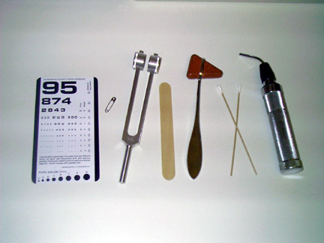
Tools of the trade

Slide 6
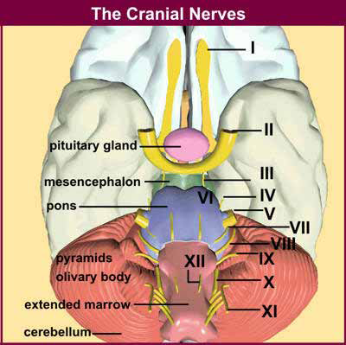
CN

Slide 7
Cranial Nerves
Total number of cranial nerves = 12
Sensory cranial nerves I,II,VIII = 3
Motor cranial nerves III,IV,VI,XI,XII = 5
Mixed cranial nerves V,VII,IX,X = 4

Slide 8
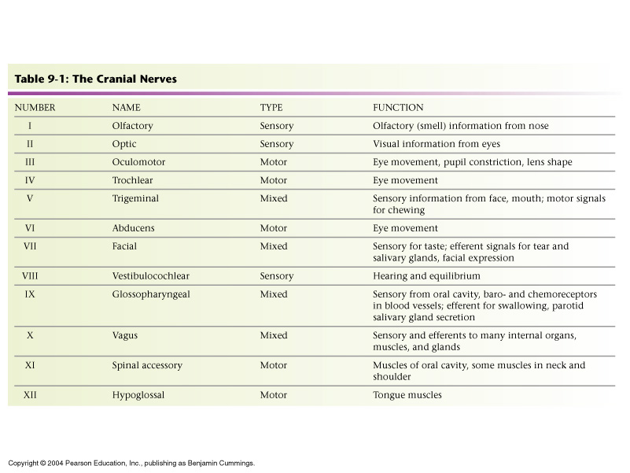
Cranial Nerves
Table 9-1: The Cranial Nerves

Slide 10
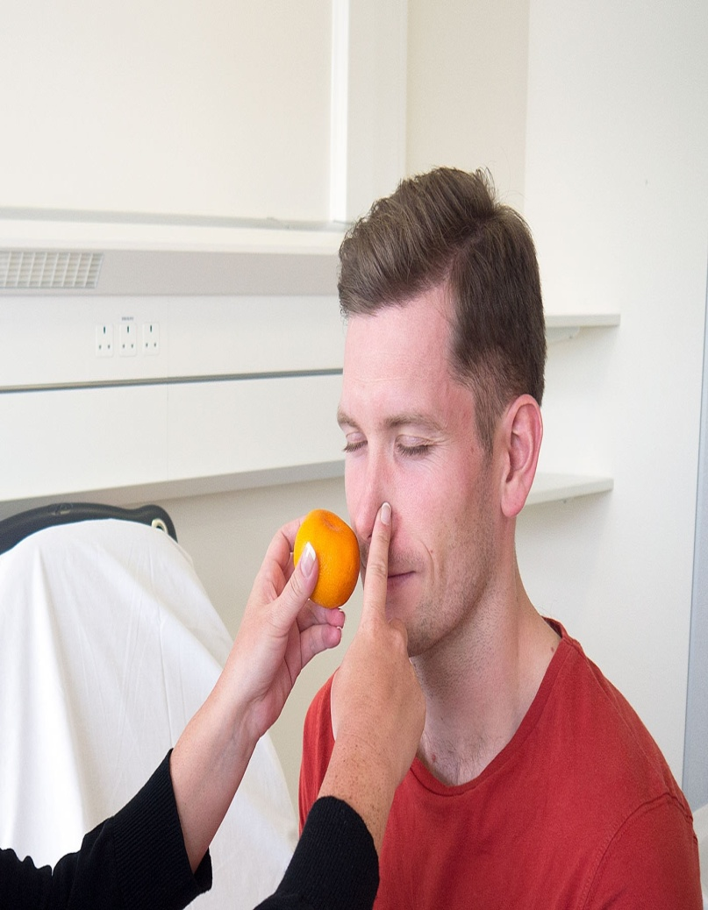
1. Olfactory Nerve
Smell
Allergy
Anosmia
Ammonia
Malingering

Slide 11
Lesion
Frontal lobe tumor
Closed head injuries
Nasal obstruction
Viral infections
Parkinsons disease
Alzheimer’s
Multiple Sclerosis

Slide 12
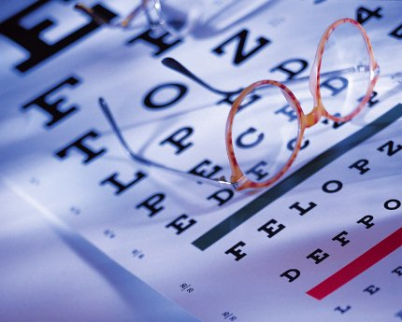
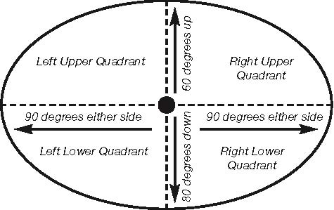
2. Optic
Visual acuity
Snellen chart
Color
Ishara chart
8% of men and 0.5% of women
have congenital X-linked color blindness
Visual fields
Fundoscopy
Pupillary light reflex
Direct & consensual response

Slide 13
III-IV-VI
Oculomotor , Trochlear & Abducent
Muscles extra ocular & intraocular

Slide 14
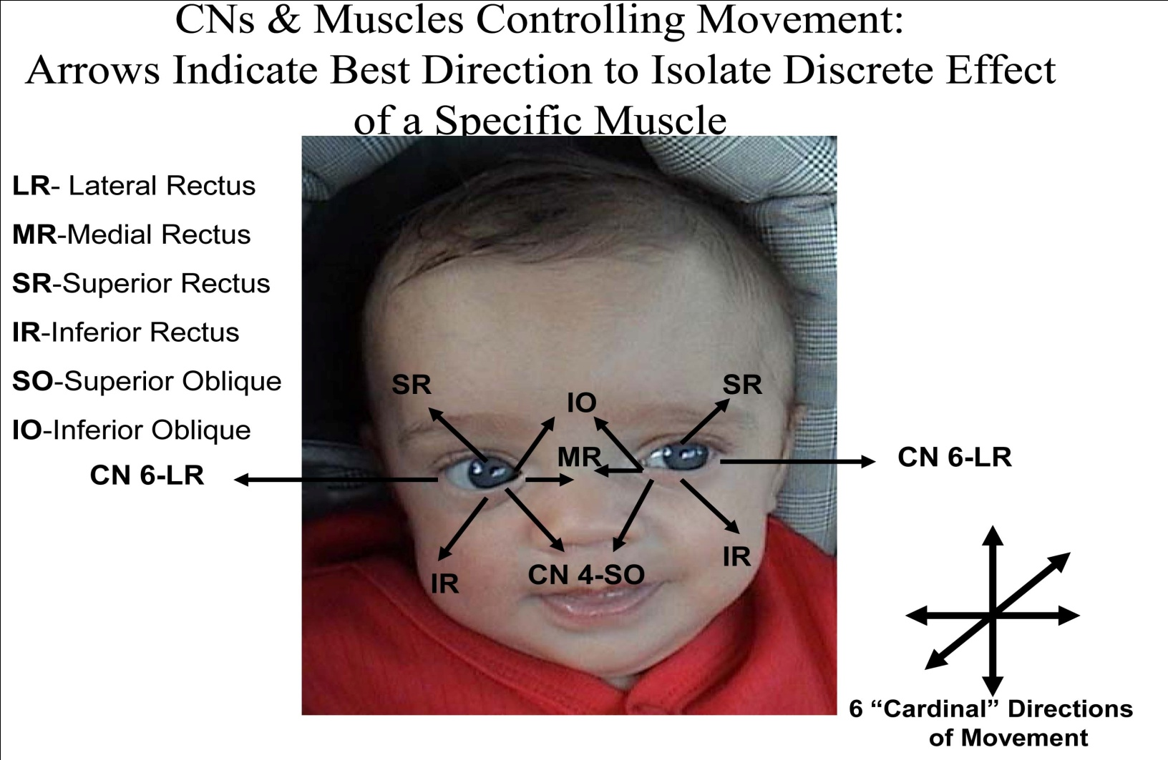

Slide 15
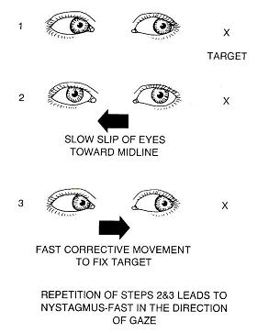
Nystagmus
Dancing eyes
Ptosis
Pupils (PERRLA)
Pupils
Equal
Round
Reactive to
Light and
Accommodation
Accommodation reflex
Convergence or divergence
Saccadic

Slide 16
3rd CN
Vascular disorders
Space occupying lesions or tumors, both malignant and non-malignant
Inflammation and Infection
Trauma
Demyelinating disease (Multiple sclerosis)
Autoimmune disorders such as Myasthenia gravis

Slide 17
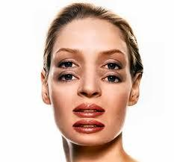
4CN lesion
Vertical diplopia
6th CN lesion

Slide 18
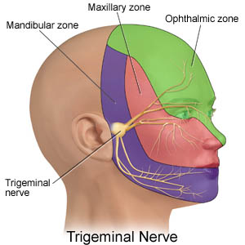
V-Trigeminal
Sensory
Corneal reflex
Muscle of mastication
Clenches of teeth
Masseter and temporal
Jaw with resistance
Both pterigoids
Side movement …opposite pterigoid

Slide 19
SENSORY
It carries all modalities of sensation from the face,
the anterior part of the scalp,
the eye and
somatic sensation from the anterior two-thirds of the tongue.
It also innervates the gum, teeth, mucous membranes of the cheeks, nasal passages, sinuses and the anterior components of the palate and nasopharynx.

Slide 20
Methods of examination
sensation
The major innervation zones of the fifth nerve are easily tested with the cold of the tuning fork (for A-delta fiber sensation),
a cotton wisp for light touch (8–10 μm fibers) and
a pin for C fiber (1 μm) pain.
Corneal reflex

Slide 21
Motor innervation
It has the motor innervation of the masseter, medial and lateral pterygoids,
the anterior belly of the digastric and
mylohyoid muscles
Clenches of teeth
Masseter and temporal
Jaw with resistance
Both pterigoids
Side movement …opposite pterigoid

Slide 22
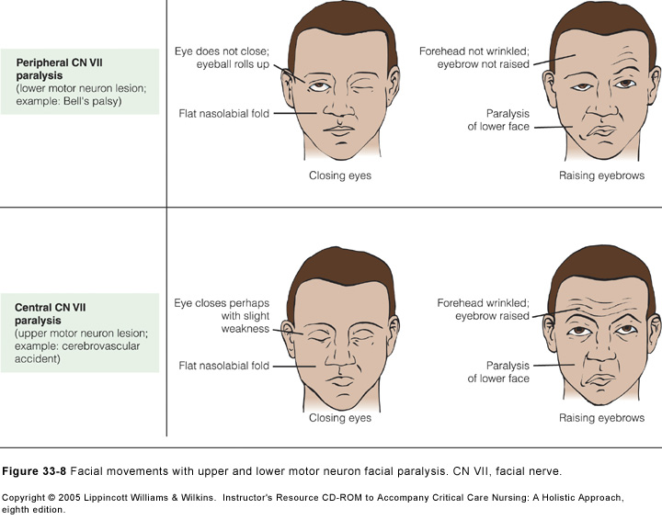
VII-facial nerve
Motor
Sensory
Bell ‘s palsy
Facial palsy

Slide 23
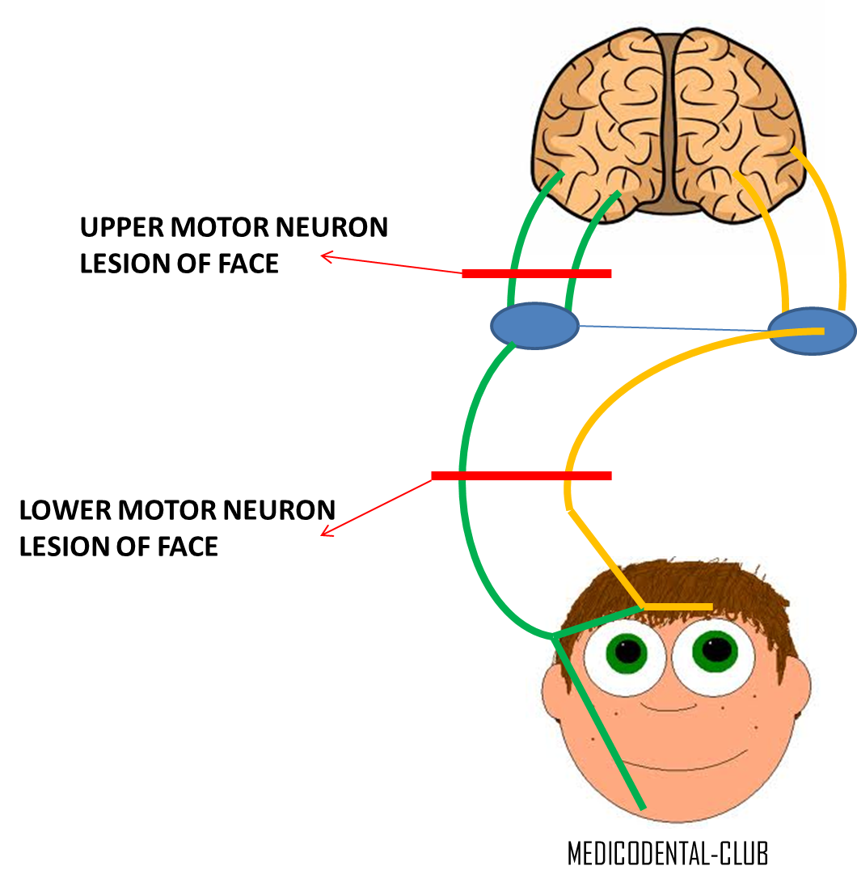
7th CN

Slide 24
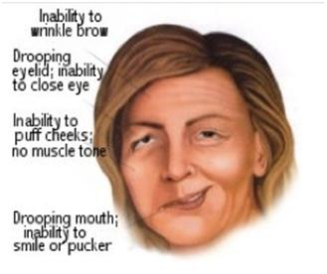
Facial palsy

Slide 25
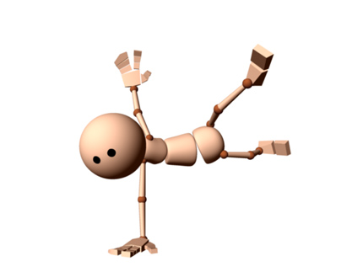
VIII-Vestibulocochlear
Vestibular
Balance
Pendular walking
Fukuda test
Cochlear
Whisper ……
Weber ‘ test

Slide 26
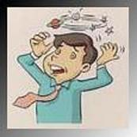
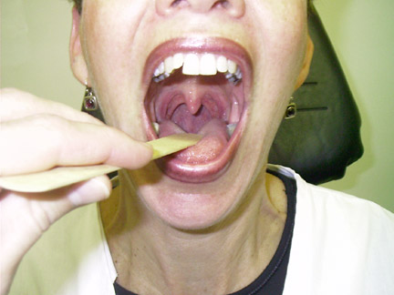
CN IX Glossopharyngeal: moves the pharynx (swallow, speech & gag)
CN X Vagus. voice quality

Slide 27
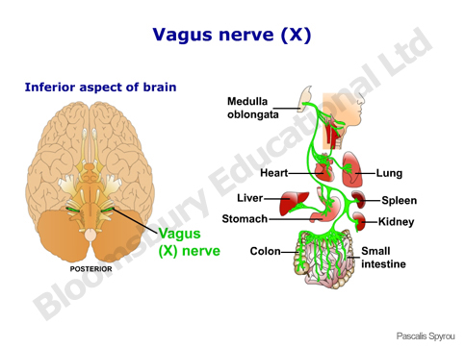
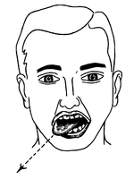

Slide 28
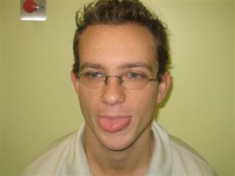
XI-Accessory
Turn heads and elevate
XII-Hypoglossal
Move tongue

Slide 29
Classification of Sensory System
Superficial
Deep
Combined cortical
Spinal pathways
Anterior spinothalamic
Lateral spinothalamic
Posterior column

Slide 30
Types of Sensory Receptors
Mechanoreceptors (Cutaneous sensory receptor)
Deep sensory receptors
Muscle receptors (muscle spindle , GTO , free nerve endings ,& pacinian corpuscles)
Joint receptors (Golgi type ending , free nerve ending ……)
Thermo receptors (cold & warm)
Nocireceptors (free nerve ending , extreme of stimuli)
Electromagnetic (rods & cones)
Chemoreceptor
Taste
Smell
Arterial oxygen
Blood glucose
Blood CO2

Slide 31
Terminology describing common sensory Impairments
Abarognosis
Allodynia
Asterognosis
Dysesthesia
Hyperalgesia
Hyperesthesia
Paresthesia
Thalamic syndrome

Slide 32
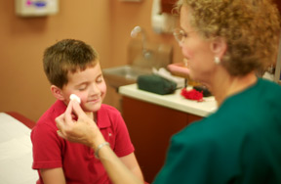
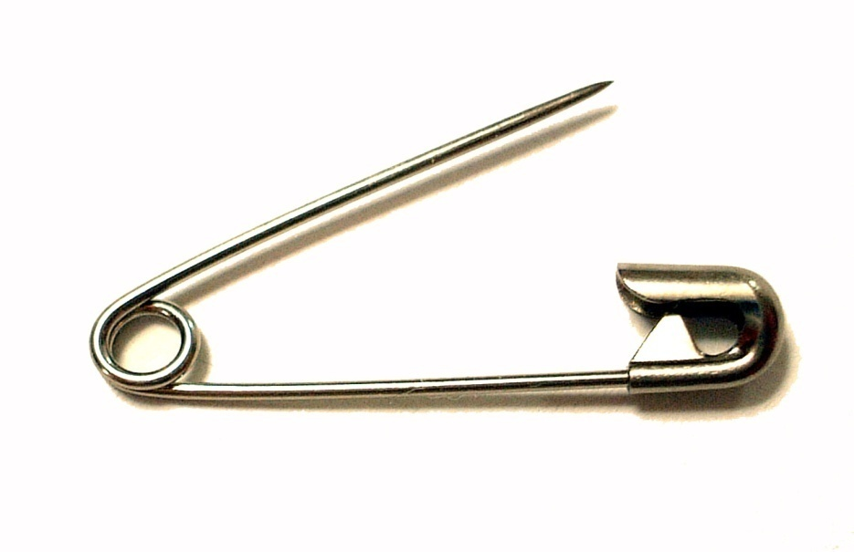
Sensations
Superficial
Pain or crude touch
Light touch

Slide 33
Deep sensation
Kinesthesia
Proprioceptive
Vibration

Slide 34
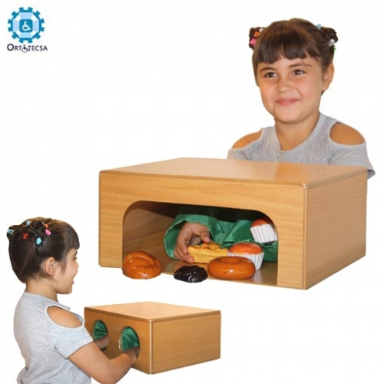
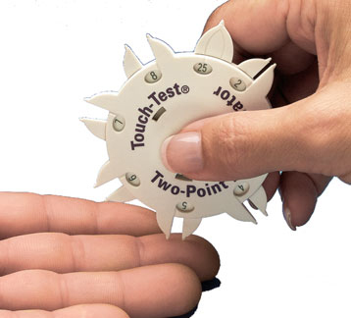
Combined cortical sensation
Stereognosis perception
Tactile localization
Two point discrimination
Double simultaneous stimulation

Slide 35
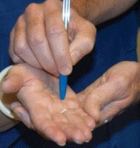
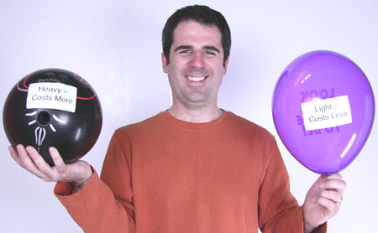
Graphesthesia
Recognition of texture
Barognosis

Slide 36
Extinction
Extinction
To test extinction, have the patient sit on the edge of the examining table and close their eyes.
Touch the patient on the trunk or legs in one place and then tell the patient to open their eyes and point to the location where they noted sensation.
Repeat this maneuver a second time, touching the patient in two places on opposite sides of their body, simultaneously. Then ask the patient to point to where they felt sensation. Normally they will point to both areas. If not, extinction is present.
With lesions of the sensory cortex in the parietal lobe, the patient may only report feeling one finger touch their body, when in fact they were touched twice on opposite sides of their body, simultaneously. With extinction, the stimulus not felt is on the side opposite of the damaged cortex. The sensation not felt is considered "extinguished".

Slide 37
Feedback
Summary
Feedback
What is missing ???

Slide 38
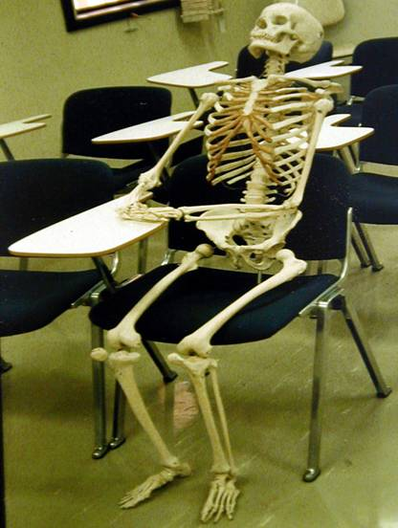
Thanks

