Slide 1
What it means to be a Project Manager?
By: Saba Ashraf
Noon Business School, University of Sargodha

Slide 2
Outline
What a project manager needs to do?
Leadership roles of a Project Manager
Seven traits of good Project Manager
Project life cycle
Difference between project lifecycle and product lifecycle
How involved should the leadership be?
Project definition phase
Identifying stakeholders
Classifying stakeholders
Types of stakeholders
Roles of stakeholders

Slide 3
Regardless of what your business card says, if you’re Project Manager, your company is depending on you to deliver a successful project.

Slide 4
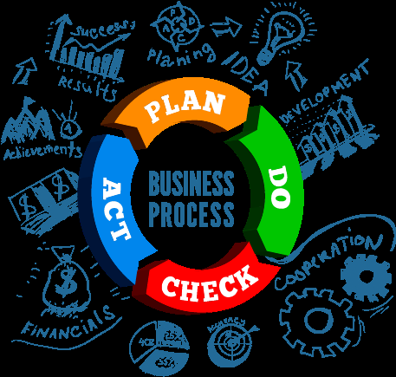
What you need to do?
Learn to plan and act.
Establish goals
Break work into well-defined tasks
Chart the sequence of tasks
Schedule
Coordinate a team
Plan proper means of communication
Reporting (who will report whom)

Slide 5
What you need to do?
Focus of project’s end
Have a clear vision of how the product will turn out upon completion.
Stephen covey writes in his book;
“One key to success is keeping the end result in mind as you decide what to do and how to do”
Be a manager and leader
You should be able to handle authority and responsibility.
Motivate, delegate, mentor, and coach
Develop administrative procedures.
Lead the project with energy and positive attitude.
A project manager who views the responsibility of managing a project as one of guiding, facilitating, negotiating, and coordinating will do better then the one who views it as one of ordering, dictating, and coercing.

Slide 6
The leadership roles of project manager
Interpersonal
Roles
Deal effectively with people with different professional backgrounds.
Listen to others’ opinion when making decision.
Informational Roles
Arrange and lead team meetings
Provide feedback regarding results, quality, and work deliverables.
Decisional Roles
Distinguish between features and benefits.
Prevent ‘scope creep’ and budget ‘slippage’
Solve conflicts and create team unity.
Motivate team members.
Build positive relationship with stakeholders
Create and maintain work schedule.
Communicate the project vision to upper management.
Appropriately allocate resources if project falls behind schedule
Strike a balance between cost, time and results.

Slide 7
Seven traits of good Project Manager
Good Project Manager
Enthusiasm for the project
Ability to manage change
Tolerant of ambiguity
Team building and negotiating skills
Customer-First orientation
Adherence to business priorities
Knowledge to industry and technology

Slide 8
The Project Life Cycle
Initiate
Execute
Close-out
Plan

Slide 9
Stage Gates
The conclusion of a project phase is generally marked by the review of both key deliverables and project performance to date, to determine whether the project should continue.
I
P
E
C
STAGE GATE

Slide 10
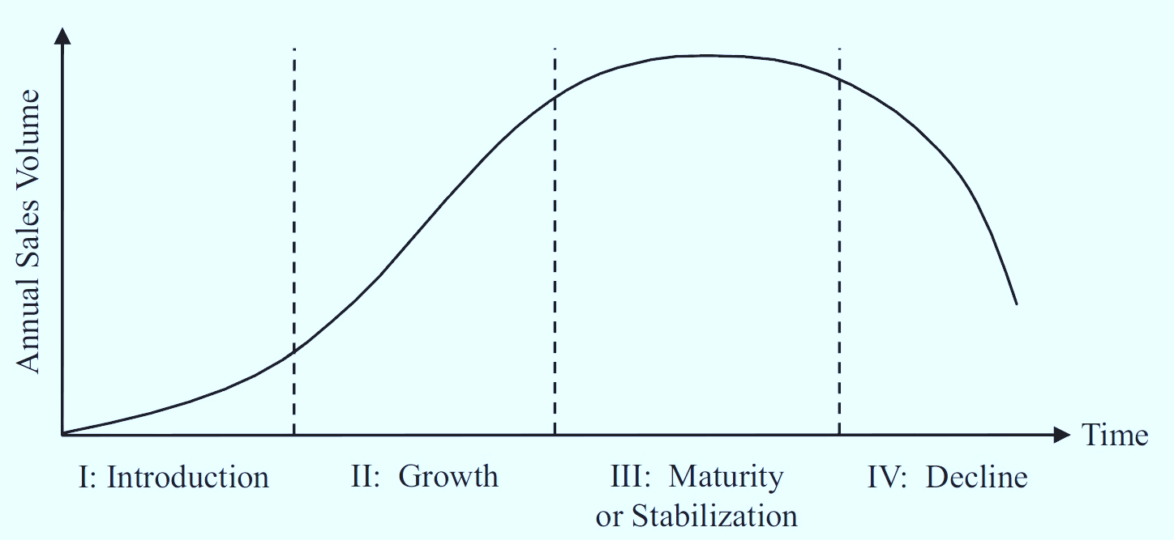
Difference between Project Cycle and Product Cycle
Product Life Cycle
Project Life Cycle

Slide 11
Project Life Cycle Vs Product Life Cycle
Product Life Cycle | Project Life Cycle
Product life cycle is longer than project life cycle. | Project life cycle is shorter than product life cycle.
It may not have definite end. | It has definite end.
Map of product life cycle depends on market conditions. | Predictive and well-defined roadmaps.
Life cycle phases do not overlap. | Life cycle phases ay overlap.
Phases generally occur once in life cycle. | Phases may repeat.
Phases are sequential. | Phases may or may not be sequential.

Slide 12
Project Definition Phase
Identify stakeholders.
Analyse the business problems that the project is trying to solve.
Review the business case that was developed as a part of sanctioning this project to understand the expected benefits.
Clearly define the scope of the project.
Identify all risk and constraints.

Slide 13
How involved should the leadership be?
Project manager needs to develop specific roles and responsibilities for the leadership team.
Project managers may need help of the senior executives to solve conflicts.
Presence of leadership team at the time of the delivery of the project.
Get the involved at early stages so they are ready to act when needed.

Slide 14
Moving back to Definition Phase; Identifying Stakeholders
Other than project manager, the list of stakeholders includes;
Your project sponsor
The manager involved in approvals
The customer (both external and internal)
The project team
PMI identifies stakeholder as individuals and organizations who affect, are affected by, or perceive to be affected by a decision or outcomes of the project.

Slide 15
Classifying Stakeholders the power they can have on project
Authority
They can have in the organization
How that authority allows them to impose their ideas?
Influence
They have in planning and execution of the project
Veto power regarding certain decisions.
Involvement
In the project.
Participation in the steering committee.
Level of concern
In the outcomes of the project

Slide 16
Types of stakeholders
Champion:
A champion is powerful with high level of interest and a positive attitude, (pay attention to this person all time)
Friend:
A friend has low power but a high level of interest and positivity. (use her as a sounding board)
Sleeping giant:
A sleeping giant is someone who supports the project by displaying low level of interest and enthusiasm. (you need to raise her level of interest)
Acquaintance:
Someone with low power and interest but needs to be informed from time to time.
Time bomb:
Someone powerful with high level of interest but has negative attitude. (she must b actively engaged and diffused to prevent major disruption)

Slide 17
Organizational stakeholders
External
Labour Unions
Suppliers
Customers
Internal
Competitor
Owners
Stockholders
Special Interest Groups
Govt. Agencies
Employees
BOD
Environmental action groups
Financial Institutions
Consumer Groups
Potential stakeholders of any project

Slide 18
The Customer
The one who will use the product delivered by the project.
The customer may be department and division of your own organization.
It can also be external.
Customer contributes funding and project requirements

Slide 19
The Project Sponsor The most important ally in the project
This person shares responsibility for project success.
For internal projects: A senior manager within organization is the sponsor.
For external projects: Someone from customer organization who has authority to make decision and provide money for the project.

Slide 20
Roles of the Project Sponsor
Holds the ultimate authority, responsibility, and accountability for the success of the project.
Resolves cross-functional organizational issues.
Promotes innovation to achieve the projects goal.
Provides guidance, support, and direction to the project.
Signs project charter and business case.
Signs project plan and scope of work.
Certifies quality of the implementation.
Contributes to and approves the responsibility matrix.
Assists in preparing project policies and procedures.

Slide 21
Roles of Project Sponsor
Approves project deliverables.
Approves changes to the project scope and provides additional funds for those changes.
Monitors the progress of the project.
Works with steering committee.
Makes business decisions for the project.
Provides user resources to the project.
Shields the project from corporate politics.
Works to resolve conflicts.

Slide 22
The Steering Committee or Governance Board
Steering committee is the group of stakeholders who must approve and agree on project scope, schedule, budgets, plans, and changes.

Slide 23
Roles of Steering Committee
Advises on the business processes.
Monitors the project and maintains priority relative to other projects.
Settles priorities between competing projects.
Provides organizational support.
Provides timely decision.
Resolves major issues of significant risk to the enterprise.
Disposes of issues and change requests that impact the organization.
Executes formal reviews and management reviews.
Approves changes in scope, budget, or schedule.
Provides feedback.
Manage Environmental factors beyond the control of project manager.

Slide 24
Functional Management
Company officials with an interest in your project make up functional management, also known as line management.
These managers are responsible for organizational units within the company such as engineering, marketing, and finance.
Often, they supply people who will be working on project team.

Slide 25
The Working Committee
Critical success factor for a business is to “own” the project.
Implement a working committee of people from the commercial part to develop the business case for the project.
These people need to comes from all areas of the business.
For example; An energy trading company sanctioned a project for implementing a new software program for entering deals and delivering natural gas to its customers.
The application of the working committee the project has the knowledgeable representative from the following fields.

Slide 26
The Working Committee
Gas traders
Risk management
Controls
IT
Accounting
Scheduling and transportation
Credit
Marketing

Slide 27
Working Together: The success formula
As a project manager, it is your responsibility that all the stakeholders are on the same page.
You must continue to review who the stakeholders are and what roles will they play.
You need to coordinate with them and guide them through all the stages of the project.
Your ability to do all this contributes big time to the success of the project.

