Slide 1
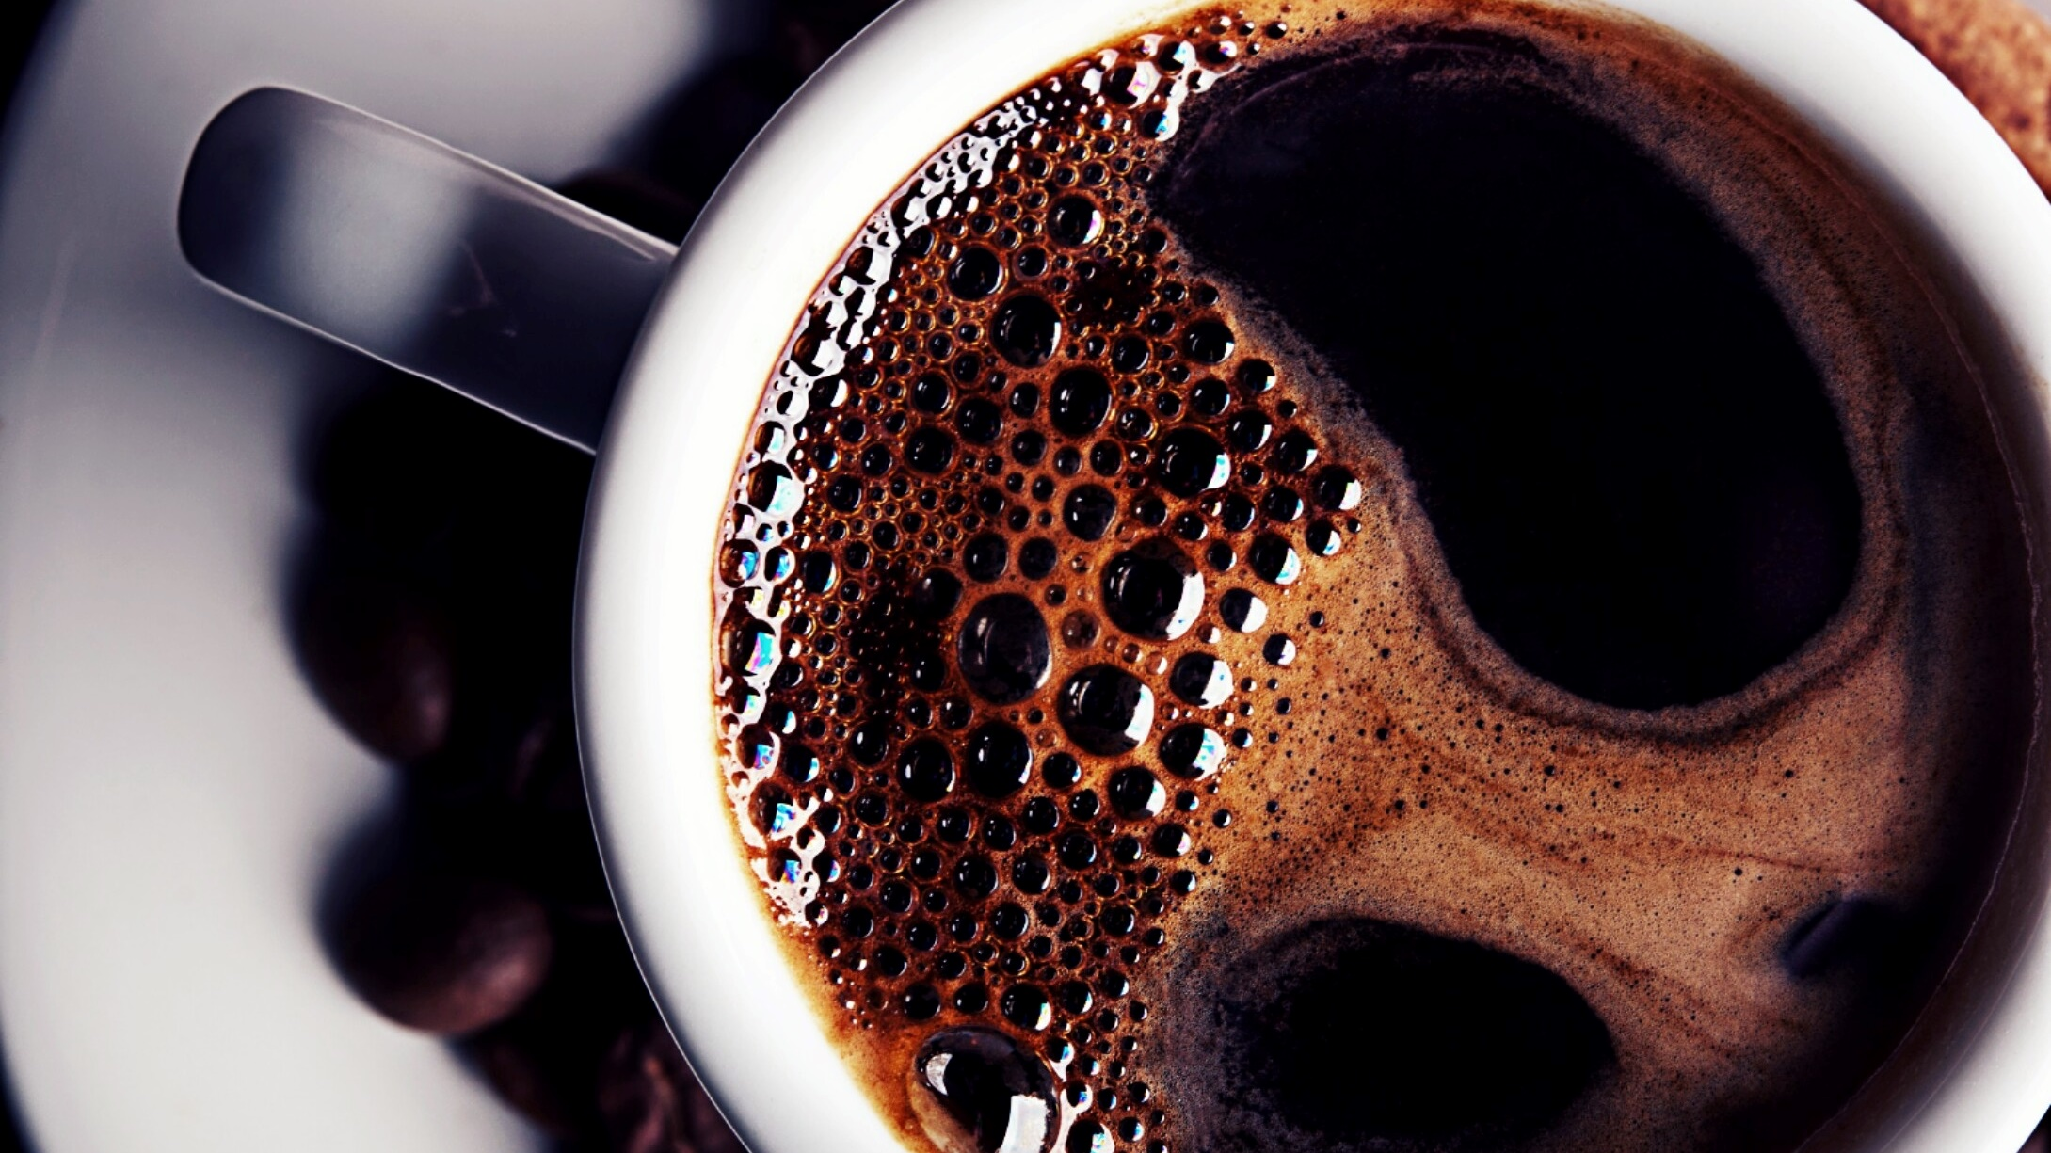
Introduction to Literature
By: Al Mujtaba Cheema

Slide 2
What is Literature?

Slide 3
Types of Literature
Pure Literature
Applied Literature

Slide 4
Functions of Literature
Entertainment/pleasure
Heighten the awareness of the reader
Propaganda
Release/ purification
Escape

Slide 5
What is a Short Story?

Slide 6
Brief fictional prose narrative that is shorter than a novel and that usually deals with only a few characters is known as a short story.

Slide 7
Origin
The evolution of the short story first began before humans could write.
To aid in constructing and memorizing tales, the early storyteller often relied on stock phrases, fixed rhythms, and rhyme.
The short story is one of the oldest types of literature and has existed in the form of legends, mythic tales, folk tales, fairy tales, fables and anecdotes in various ancient communities across the world.
The modern short story developed in the early 19th century.

Slide 8
Common features
Didactic or for pleasure.
No detailed description of background.
A single unified incident is mentioned.

Slide 9
Characters are not fully developed.
No character analysis.
Only a certain aspect of the character’s personality gets changed.
The short story is usually concerned with a single effect conveyed in only one or a few significant episodes or scenes.

Slide 10
Elements of a Short Story
Conflict
Characters
Plot
Theme
Point of view
Setting

Slide 11
Conflict
The struggle between opposing forces in a story or play.
There must be a problem to talk about.
Types of conflict:
External conflict.
Internal conflict.

Slide 12
Characters
The actors who are playing different roles are known as characters.
Types of characters:
Protagonist.
Antagonist.
Static character.
Dynamic character.

Slide 13
Flat character
Round character
Foil character
Stock character

Slide 14
Plot
Sequence of events in a chronological manner.
Types of plot:
Overt plot
Covert plot
Primary plot (single ended, double ended, intrusive)
Secondary plot

Slide 15
Analepsis or Flashbacks
Prolepsis or Flash forwards

Slide 16
Structure of a plot

Slide 17
Point of view
First and third person narrator
Omniscient narrator
Non-intrusive narrative
Intrusive narrator
Heterodiegetic
Homodiegetic

Slide 18
Setting
Setting is the time and place of the story’s action.
It includes ideas, customs, values and beliefs.

Slide 19
Theme
The central idea or message of a story around which it revolves.
Stated theme.
Implied theme.

Slide 20
THE END

