Slide 1
Krebs cycle, Regulation of glycolysis and Krebs cycle, Electron transport and oxidative phosphorylation

Slide 2
Krebs Cycle:
Tricarboxylic acid cycle (i.e., TCA cycle), also known as Citric acid cycle or Krebs cycle.

Slide 3
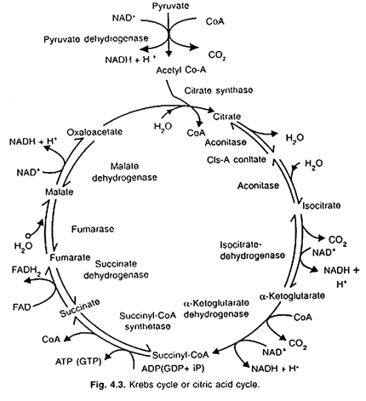

Slide 4
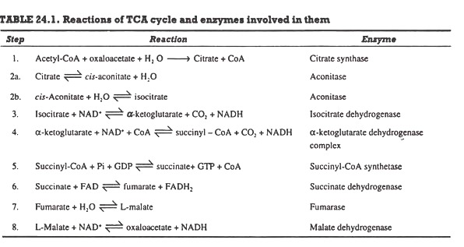

Slide 5
This may be summarised in following equation:

Slide 6
Electron Transport Chain
Complex I (NADH dehydrogenase)
Complex II (succinate dehydrogenase)
Complex III (cytochrome bc1 complex)
Complex IV (cytochrome c oxidase)
ATPASe

Slide 7
Complex I (NADH dehydrogenase).
Electrons from NADH generated in the mitochondrial matrix during the citric acid cycle are oxidized by complex I (an NADH dehydrogenase).
The electron carriers in complex I include a tightly bound cofactor (flavin mononucleotide [FMN], which is chemically similar to FAD and several iron–sulfur centers.
Complex I then transfers these electrons to ubiquinone. Four protons are pumped from the matrix to the intermembrane space for every electron pair passing through the complex.

Slide 8
Ubiquinone
Ubiquinone, a small lipid-soluble electron and proton carrier, is located within the inner membrane. It is not tightly associated with any protein, and it can diffuse within the hydrophobic core of the membrane bilayer

Slide 9
Complex II (succinate dehydrogenase)
Oxidation of succinate in the citric acid cycle is catalyzed by this complex, and the reducing equivalents are transferred via the FADH 2 and a group of iron–sulfur proteins into the ubiquinone pool. This complex does not pump protons

Slide 10
Complex III (cytochrome bc1 complex)
This complex oxidizes reduced ubiquinone (ubiquinol) and transfers the electrons via an iron–sulfur center, two b-type cytochromes (b565 and b560), and a membrane-bound cytochrome c1 to cytochrome c. Four protons per electron pair are pumped by complex III.

Slide 11
Cytochrome c
Cytochrome c is a small protein loosely attached to the outer surface of the inner membrane and serves as a mobile carrier to transfer electrons between complexes III and IV

Slide 12
Complex IV (cytochrome c oxidase)
This complex contains two copper centers (CuA and CuB) and cytochromes a and a 3. Complex IV is the terminal oxidase and brings about the four-electron reduction of O2 to two molecules of H2O. Two protons are pumped per electon pair. Both structurally and functionally, ubiquinone and the cytochrome bc1 complex are very similar to plastoquinone and the cytochrome b6 f complex, respectively, in the photosynthetic electron transport chain.

Slide 14
Energetics of respiration
1 NADH produces 3 ATP
1 FADH2 produces 2 ATP
In GLYCOLYSIS 10 ATP produced
2 UTILIZED and 2 REGENERATE
Also 6 ATP produced by 2 NADH So Remaining ATP = 8 ATP
In Conversion of 2 Molecules of Pyruvate to 2 Acetyl CoA 2 NADH produced which produced 6 ATP
In KREB’S CYCLE 2 ATP produced and 6 NADH which produced 18 ATP and 2 FADH2 which produced 4 ATP
So total ATP produced during KREB’S CYCLE
2 ATP + 18 ATP + 4 ATP = 24 ATP
NADH AND FADH2 produce ATP via ELECTRON TRANSPORT CHAIN
SO DURING RESPIRATION THE TOTAL ENERGY YIELD WILL BE
8 ATP + 6 ATP + 24 ATP = 38 ATP

