Slide 1
Nutritional Importance of Proteins

Slide 2
Proteins have been regarded as 'body-building foods.
10-15% of the total body energy is derived from proteins.
Proteins are the only source of essential Amino Acids.

Slide 3
Functions of proteins
Fundamental basis of cell structure & function.
All the enzymes, several hormones, transport carriers, immuno-globulins etc., are proteins.
Involved in the maintenance of osmotic pressure, clotting of blood, muscle contraction.
Serve as the major suppliers of energy in starvation

Slide 4
Only when
If, enough carbohydrates are not available in diet, Amino Acid are then used for yielding energy--- protein sparing effect of Carbohydrates.
OR
In starvation, when the glycogen and fats stores are exhausted amino acids may act as energy source.

Slide 5
Requirement of proteins
The requirement of protein is dependent on its nutritive value, caloric intake & physiological states (growth, pregnancy lactation) of individual.
For an adult, 0.8-1.0 g protein/kg body weight/day is adequate.
The requirement is almost double for growing children, pregnant & lactating women.

Slide 6
Crude Protein
True protein
(60 to 80%)
Non-protein
nitrogen
Lignified
nitrogen
Essential amino acids
Arginine (Arg)
Histidine (His)
Isoleucine (Ile)
Leucine (Leu)
Lysine (Lys)
Methionine (Met)
Phenylalanine (Phe)
Threonine (Thr)
Tryptophan (Trp)
Valine (Val)
Non-essential
amino acids
Alanine (Ala)
Asparagine (Asn)
Aspartic acid (Asp)
Cysteine (Cys)
Glutamic acid (Glu)
Glutamine (Gln)
Glycine (Gly)
Proline (Pro)
Serine (Ser)
Tyrosine (Tyr)
Amides
Amines
Amino acids
Peptides
Nucleic acids
Nitrates
Ammonia
Urea
Notes:
Crude protein is a useful measure for evaluating diets but it oversimplifies the very complex nitrogenous components of diets.
Although some feedstuffs particularly fresh forages and silages contain substantial amounts of organic NPN, from a practical point of view, NPN in formulated feeds refers to added materials, primarily urea.

Slide 7
RDA FOR Protein Different for different individuals/groups
Infants | 2.4 g/kg body wt/day
Children up to 10 Yrs | 1.75 g/kg body wt/day
Adolescent Boys Girls | 1.6 g/kg body wt/day 1.4 g/kg body wt/day
Adults (Men & Women) | 1.0 g/kg body wt/day
Pregnancy | 2.0 g/kg body wt/day
Lactation | 2.5 g/kg body wt/day

Slide 8
RDA FOR Proteins
WHO / FAO recommends the safe levels of protein intake for an adult as 0.75 g/kg/day.
For the synthesis of body proteins, all the essential amino acids should be supplied in adequate quantities at the same time.

Slide 9
Minimum requirements of EAA
Essential Amino Acid | Requirement (mg/kg/day)
Phenylalanine Valine Methionine Leucine Isoleucine Lysine Theronine Tryptophan | 14 14 14 11 10 9 6 3

Slide 10
Nutrients: Protein
*** Amino acid: building block for protein, protein may contain a chain of several hundred amino acids
Molecular weight of 2-3,000
Amino acids contain an acid group and an amine group
Amino acids are bonded together by peptide bond
About 21 regular occurring amino acids (10 are essential in that they must be in the diet)

Slide 11
Nutrients: Protein
Dietary Essential AA -- an amino acid required by an animal and can not be synthesized by the animal in the amounts needed; and therefore must be present and available in the diet
Arginine
Histidine
Isoleucine
Leucine
Lysine
Methionine – S-containing, Cystine may provide ½ the reqmt
Phenylalanine -- tyrosine may provide ½ of the requirement
Threonine
Tryptophan
Valine
Nonessential AA -- required by the animal but can be produced in adequate amounts

Slide 12
Nutrients: Protein
Limiting amino acid: the essential amino acid in a feed or ration that becomes depleted first during protein synthesis
This restricts further protein synthesis until a new supply of amino acids comes along
Therefore an animal's absolute requirement is not for protein per se, but for required amounts of each essential amino acid
Not the same amounts and proportions of amino acids in ingested food and what is to be synthesized in the body

Slide 13
Nutrients: Protein
Digestion and absorption of proteins
Protein enters the stomach and the low pH:
denatures the protein
activates pepsinogen to form pepsin
Pepsin is a endopeptidase
random cleavage of peptide bonds within the protein molecule
form shorter chains of amino acids

Slide 14
Nutrients: Protein - Digestion and absorption of proteins
Proteins next enter the small intestine
trypsinogen is activated by enterokinase to form trypsin; activated trypsin further activates more trypsinogen
chymotrypsinogen is activated by trypsin to form chymotrypsin
Note: pepsin, trypsin and chymotrypsin are all endopeptidases
Procarboxypeptidase is activated by trypsin to form carboxypeptidase
this is an exopeptidase which cleaves at the carboxyl end

Slide 15
Nutrients: Protein - Digestion and absorption of proteins
With the proteolytic action of all of these enzymes the protein is reduced to free (non-associated) amino acids
AA's are absorbed into the mucosal cell to the blood by active transport; some AA's share the same transport system or use the same carrier
Circulating AA's are taken into peripheral cells facilitated by insulin
*** Important, the animal's requirement is not for protein but for specific proportions of AA's: the proportion of AA's in the proteins which are eaten is not necessarily the same proportion of AA's needed for the proteins to be synthesized.

Slide 16
Nutrients: Protein
Factors that affect protein digest and metabolism
Enzyme inhibitors and other anti-nutritional factors in the feed
trypsin and chymotrypsin inhibitors in some feeds
decrease the activity of these enzymes
moderate heat treatment is effective in reducing the effects of these inhibitors
Heat treatment
Maillard reaction: lysine + sugar + heat yields a Maillard product which is indigestible
in some dried feeds
in some forages that have heated due to molding

Slide 17
Nutrients: Protein
Factors that affect protein digest and metabolism
Amino acid deficiency and or imbalance
brain senses that a deficiency exists thereby reducing intake
Amino acid antagonism: one AA affects the utilization of another
the most common form is competition for active transport sites (arginine and lysine)

Slide 18
Nitrogen Balance

Slide 19
Nitrogen Balance
Positive nitrogen balance:
This is a state in which the nitrogen intake is higher than the output.
Some amount of nitrogen is retained in the body causing a net increase in body protein.
Positive nitrogen balance is observed in growing children, pregnant women or during recovery after serious illness.

Slide 20
Negative nitrogen balance:
In this, the nitrogen output is higher than the input.
Some amount of nitrogen is lost from the body depleting the body protein.
Prolonged negative nitrogen balance may even lead to death.
Observed in children suffering from kwashiorkor or marasmus.

Slide 21
Negative nitrogen balance may occur due to inadequate dietary intake of protein (deficiency of a single essential amino acid) or destruction of tissues or serious illness.
Growth hormone & insulin promote positive nitrogen balance while corticosteroids result in negative nitrogen balance.
Cancer & uncontrolled diabetes cause negative nitrogen balance.

Slide 22
Assessment of nutritional value of proteins
Protein efficiency ratio (PER)
Biological value (BV)
Net protein utilization (NPU)
Chemical score

Slide 23
Protein efficiency ratio (PER)
PER is represented by gain in the weight of rats per gram protein ingested.
Gain in body weight (g)
______________________
Protein ingested (g)
PER =

Slide 24
Biological Value (BV)
BV is defined as the percentage of absorbed nitrogen retained by the body
Nitrogen retained
______________________ x100
Nitrogen absorbed
BV =

Slide 25
For the measurement of BV, the experimental animals, namely weaning albino rats are chosen.
They are first fed with a protein-free diet for 10 days.
Then they are kept on a 10% protein diet to be tested for BV.
Urine & feces are collected for both the periods i.e. protein-free diet & protein diet.

Slide 26
[In-(Fn - Fc)] – (Un-Uc)
_____________________ x100
In – (Fn - Fc)
BV =
In= Nitrogen ingested
Fn= Nitrogen in feces (on protein diet)
Fc= Nitrogen in feces (on protein-free diet)
Un= Nitrogen in urine (on protein diet)
Uc= Nitrogen in urine (on protein-free diet)

Slide 27
Nitrogen is estimated in the diet, feces & urine samples.
BV can be calculated by the following formula:
(N absorbed – N lost in metabolism)
_____________________________________ x100
N absorbed
BV =

Slide 28
Net protein utilization (NPU)
NPU is a better nutritional index than biological value.
Net protein utilization can be calculated as:
Nitrogen retained
_____________________ x100
Nitrogen absorbed
NPU =

Slide 29
Chemical score
This is based on the chemical analysis of protein for composition of essential amino acids which is then compared with a reference protein (egg protein).
The chemical score is defined as the ratio between the quantity of the most limiting essential amino acid in the test protein to the quantity of the same amino acid in egg protein.

Slide 30
Mg of limiting amino acid/g test protein
______________________________________ x100
Mg of same amino acid/g egg protein
Chemical score =

Slide 31
Nutritional value of food proteins
Protein | PER | BV | NPU | Chemical score | Limiting AAs
Egg | 4.5 | 94 | 90 | 100 | Nil
Milk | 3.0 | 84 | 75 | 65 | Sulfur AAs
Fish | 3.0 | 85 | 70 | 60 | Tryptophan
Meat | 2.7 | 75 | 76 | 70 | Sulfur Aas
Rice | 2.2 | 68 | 60 | 60 | Lys, threonine
Wheat | 1.5 | 58 | 47 | 42 | Lys, threonine
Bengal gram | 1.7 | 58 | 47 | 45 | Sulfur AAs

Slide 32
Dietary sources of proteins
The protein content of foods is variable,
Cereals have 6-12%; pulses 18-22%; meat 18-25%, egg 10-14%; milk 3-4% and leafy vegetables 1-2%.
In general, the animal proteins are superior than vegetable proteins as the dietary source.

Slide 33
Recommended dietary allowances (RDA)
The recommended dietary/daily allowances (RDA) represents the quantities of the nutrients to be provided in the diet daily for maintaining good health & physical efficiency of the body.

Slide 34
Factors affecting RDA
Sex:
The RDA for men is about 20% higher than that of women.
Iron is an exception as the requirement is greater in menstruating women.
Additional requirements (20-30% above normal) are needed for pregnant & lactating women.

Slide 35
Age:
In general, the nutrient requirement is much higher in the growing age.
For instance, the protein requirement for a growing child is about 2 g/kg body wt/day compared to 1 g/kg body wt/day for adults.

Slide 36
Protein – energy malnutrition (PEM)
Protein-energy malnutrition (PEM)-sometimes called protein-calorie malnutrition (PCM)- is the most common nutritional disorder of the developing countries.
It is prevalent in infants & pre-school children.
Kwashiorkor & marasmus are the two extreme forms of protein-energy malnutrition

Slide 37
Marasmus
At one end of the spectrum of malnutrition is Marasmus ("to waste"), which results from a continued severe deficiency of both dietary energy and proteins (primary calorie inadequacy and secondary protein deficiency).

Slide 38
Marasmus
Marasmus literally means 'to waste'.
It mainly occurs in children under 1 year age.
Marasmus is predominantly due to the deficiency of calories.
This is usually observed in children given soup of cereals to supplement the mother's breast milk.

Slide 39
The symptoms of marasmus include growth retardation, muscle wasting (emaciation), anemia & weakness.
A marasmic child does not show edema or decreased concentration of plasma albumin.

Slide 40
Marasmus

Slide 41
Kwashiorkor
At the other end of the spectrum is kwashiorkor, where isolated deficiency of proteins along with adequate calorie intake is seen.
Kwashiorkor means sickness of the deposed child i.e. a disease the child gets when the next baby is born.
A classification by WHO is based on body weight as a percentage of standard body weight

Slide 42
Kwashiorkor
Occurrence and causes:
Kwashiorkor is predominantly found in children between 1-5 years of age.
This is primarily due to insufficient intake of proteins, as the diet of a weaning child mainly consists of carbohydrates.

Slide 43
Clinical symptoms:
The clinical manifestations include stunted growth, edema (particularly on legs & hands), diarrhea, discoloration of hair & skin, anemia, apathy & moonface.
Biochemical manifestations:
Decreased plasma albumin concentration (<2 g/dl against normal 3-4.5 g/dl), fatty liver, deficiency of K⁺ due to diarrhea.

Slide 44
Edema occurs due to lack of adequate plasma proteins to maintain water distribution between blood & tissues.
Disturbances in the metabolism of protein, carbohydrate & fat.
Several vitamin deficiencies occur.
Plasma retinol binding protein is reduced.
The immunological response of the child to infection is very low.

Slide 45
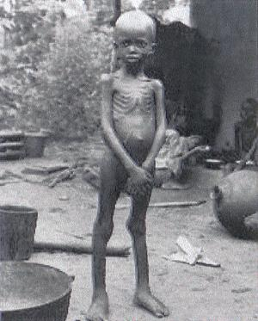

Slide 46
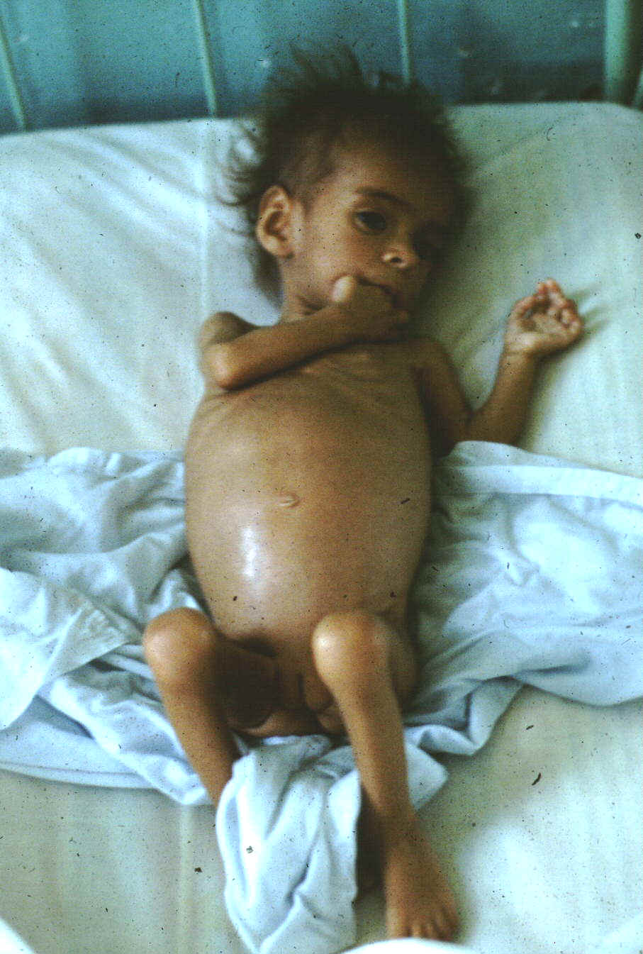

Slide 47
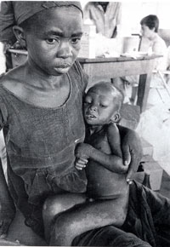
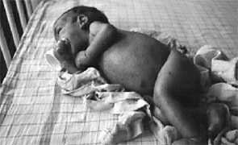

Slide 48
WHO Classification of malnutrition

Slide 50
Treatment:
Ingestion of protein-rich foods or the dietary combinations to provide about 3-4 g of protein/kg body weight/day will control kwashiorkor.
The treatment can be monitored by measuring plasma albumin concentration, disappearance of edema & gain in body weight.

Slide 51
Nutritional anemias
Microcytic anemia-most common, with reduced RBC size. Occurs due to the deficiency of iron, copper & pyridoxine.
Macrocytic anemia-RBC are large & immature.
Mostly due to the deficiency of folic acid & vitamin B12.

Slide 52
Normocytic anemia-Size of the RBC is normal, but their quantity in blood is low.
Mostly found in protein-energy malnutrition.

Slide 53
Thank you

Slide 54
Factors Affecting Nitrogen Balance
1. Growth
In period of active growth, a state of +ive N₂ balance exists.
On an average when a person gains 5 kg, about 1 kg proteins are added to the body.
For this, about 160 g of nitrogen has to be retained, so he / she has to be in positive nitrogen balance.

Slide 55
How to calculate BV
Amount ingested = 127 mg
Amount absorbed = 127 - 4 = 123 mg
Amount retained = 123 - 24 = 99 mg
Therefore BV = 99 /123 x 100 = 81%

Slide 56
Case of another protein "B“
Suppose amount ingested is 100 mg
Absorbed is 5 mg, and
Retained is 4.5 mg, then
BV = 4.5 / 5 x 100 = 90%.
The biological value is better in protein "B".
What common sense tells?

Slide 57
PROTEIN-ENERGY MALNUTRITION (PEM)
It is the most widespread nutritional problem in developing countries.
It is predominantly affecting children.
The prevalence rate varies from 20-50% in different areas depending on socio-economic status and level of education and awareness.

Slide 58
Biochemical Alterations
Metabolic rate is decreased.
Hypo-albuminemia is a characteristic feature, especially in kwashiorkor.
Values less than 2 g/dl is a biochemical marker in cases of kwashiorkor, though in marasmus, this need not be so low.
The level of Retinol Binding Protein (RBP) is also lowered.

Slide 59
Biochemical Alterations
lgG increases due to associated infections.
Fatty liver may be an associated feature in some cases of kwashiorkor, but not in marasmus.
Fatty liver is due to decreased lipoprotein synthesis and decreased availability of VLDL.
FFA in blood tends to be high.

Slide 60
Biochemical Alterations
Glucose tolerance is often normal, but hypoglycemia may be seen in marasmus children.
Hypokalemia and dehydration may be seen when there is diarrhoea.
Hypomagnesemia is a usual finding.
Total body water content increases in kwashiorkor, to an extent of upto 60% weight.

Slide 61
Effects of Protein Calorie Malnutrition
It is monitored by disappearance of edema, rise in serum albumin level and gain in weight
Severe malnutrition in early life can lead to permanent and irreversible physical and functional deficits.
The changes in mental function and intellectual potential due to childhood malnutrition is a controversial topic.
Severe persistent malnutrition may have deleterious effects on the intellectual capacity in later life.

Slide 62
Prolonged deficiency
Prolonged deficiency may result in inadequate synthesis of plasma proteins-specially albumin and fibrinogen. Fibrinogen deficiency may lead to bleeding disorders.
If the deficiency progresses to the point of significant decrease in plasma albumin concentration, edema may develop, and also increased susceptibility to shock.

Slide 63
Resistance to infections may be diminished as a result of impaired capacity for forming gama-globulins antibodies (IgGs).
In severe protein restrictions, certain hormones, protein in nature, such as those of anterior pituitary may not be synthesized in adequate amounts and endocrine abnormalities may appear viz., amenorrhoea (gonadotropin deficiency).

Slide 64
Since enzymes are proteins and must be synthesized in the body, the enzyme content of certain tissues viz. liver cholinesterase, ornithine carbamoyl transferase (OCT) etc. and enzymes in secretions viz. pepsinogen in gastric juice etc, falls in advanced deficiency stage.
This may result in disturbances of functions of various affected organs.

Slide 65
Human body composition
The average human body, weighing 65 kilograms, contains about 11 kilograms of protein, 40 kilograms of water, and 9 kilograms of fat.
The protein provides the "machinery" of the body, including not only the voluntary muscles and the heart muscles, but also the walls of the gut and the blood vessels, as well as the enzymes, the skin, and the hair.

Slide 66
There has been a great deal of research and controversy about how serious partial deficiencies of individual amino acids are in human diets. In poor communities in North Africa wheat has been the traditional staple food, with only small quantities of supplementary foods.

