Slide 1
Weed management
It is difficult to define weed precisely, but one of the most useful is
'a plant growing where it is not wanted'. In general, any plant which is out of place is called weed.
Plants are classified as weeds because they compete for moisture, soil nutrients, and light.
It is quite possible for a plant to be considered a weed in one situation but a desirable plant in another.
Certain plants such as pigweed are essentially always weeds, but others such as Bermuda grass, which is a very undesirable weed in a vegetable field, can be cultivated as a turf and pasture crop.

Slide 2
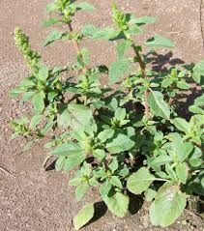
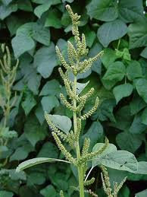
Pigweed

Slide 3
Damage from weeds
Weeds can cause damage in various ways, but the damage can be grouped
into the following five main categories.
Reduction in crop yield
Crop contamination
Host of insects and pests
Poisonous weeds
Lack of aesthetic value

Slide 4
Reduction in crop yield
Because of their great number and rapid growth rate, weeds effectively compete with crop plants for moisture, nutrients, and light, causing costly direct damage in the form of reduced crop yields.
weeds produce large numbers of seeds which remain viable for a long time, making them very hard to eradicate.

Slide 5
2. Crop contamination.
The leaves or seeds of weeds can contaminate food crops. Contamination is minimal with tree fruits but is particularly serious in leafy vegetables. Contamination of grass seed with weed seeds can be troublesome when grass is raised from seed.
3. Hosts for pests. Weeds also harbour insect pests and disease-causing organisms, encouraging their reproduction.

Slide 6
4. Poisonous weeds.
Sometimes poisonous species of weeds cause problems. With horticultural crops, poison ivy can cause serious discomfort to people who are allergic to it. Some species of mushrooms are also deadly poison.
5. Lack of aesthetic value. Weeds are very undesirable from an aesthet-ic point of view because they detract from the appearance of areas such as lawns, gardens, and golf courses. In addition,. when weeds become larger they interfere with gardening operations. With trees, sometimes climbing weeds shade the leaves and cause great damage.

Slide 7
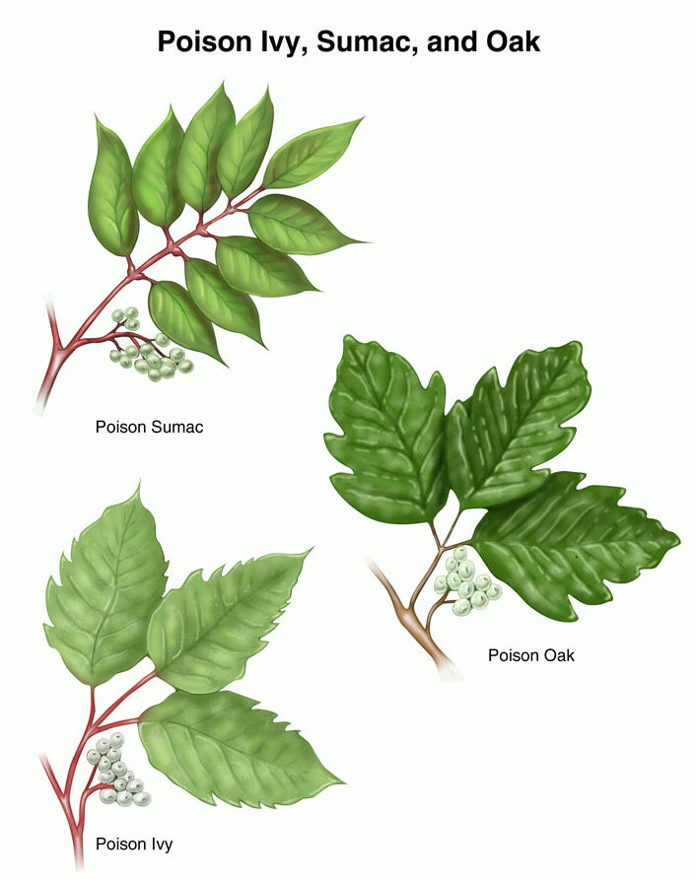

Slide 8
Types of weeds
Weeds can be grouped into annuals, winter annuals or biennials, and perennial's. Those which are very difficult to control and are extremely serious pests are called noxious weeds. These types of weeds are explained below.
Annual weeds.
These weeds are propagated by seeds and can easily be controlled by cultivation and specific herbicides during their early growth. They become more difficult to eliminate if permitted to seed. They generally produce many seeds and unless controlled will disperse seeds many-fold for succeeding seasons. In Pakistan, they fall into two groups.

Slide 9
A. RABI SEASON WEEDS:
Poa annua (Poa grass), Phalaris minor (dumbisitti),Avena fatua (jang/i jawi), Chenopodium album (bathu), Chenopodi-um murale (krund), Fumaria indica (shahtra), Rumex acutus (jangli palak), Asphodelus tenuifolius (piazi) , Anagallis arvensis (billi booti), Convolvulus arvensis (lehli), Coniopus didymus (jangli haloon), and Sisymbrium irio, (khub kalan).

Slide 10
B. KHARIF SEASON WEEDS:
Tribulus terrestris (bhakra), Cyperus rotundus (deela), Euphorbia h,rta (dodhak), Trianthema porthlacastrum (It-sit), Dactyloctenium aegyptica (madhana grass), Solanum nigrum (makku), Ehinochloa colonum Swank, Heliotropium supinum (oant char a ), Datura indica (dhatura), and Euphorbia pilulifera (hazardani).
Biennial weeds.
These weeds grow for two seasons. They germinate in late summer or fall, overwinter, and then resume growth and flower the next spring. They are an especially serious weed problem in the following spring. Typical examples are Capsella bursapastoris (shepherd's purse), Lepidium virginucum (peppergrass ),Stellaria media (chickweed), and Hordeum jubatum (squirrel-tail grass).

Slide 11
Perennial weeds.
Perennial weeds live for many years and are a serious problem for many horticultural crops, especially perennials. Many perennial weeds can propagate themselves both by seed and vegetatively. They are often deep-rooted, very persistent, and able to withstand many efforts to eliminate them. In some cases an entire crop season is lost reclaiming land infested by perennial weeds. Some of them become extremely competitive as individual plants. They include Sorghum halepense (baru grass), Desmostachya bipinnata (dhabb ),Achryanthes aspera (puth kanda), CalotTOpis procera (ak), Cynodon dactylon (khabal grass) and Cyperus rotundus (deela)

Slide 12
MANAGEMENT PRACTICES Weed control
Weeds can be controlled mechanically, competitively, biologically, and chemically. A combination of one or more of these methods can often be more effective than a single one in eradicating weeds in horticultural crops.
1.Mechanical.
Pulling by hand, hoeing, ploughing, and mowing are methods of mechanical weed control. With many crops, hoeing is the standard practice, but where possible it is being replaced by ploughing, either by draft animals or recently with garden tractors. Mulches such as straw, sawdust dried sugar cane leaves not only provide excellent weed control but offer other benefits such as stabilizing soil temperature and conserving moisture. Black plastic sheets (polyethylene) are also very effective in weed control.

Slide 13
2.Competitive.
Competitive
This is the least expensive method of weed control, but it is only possible in a few circumstances. For example, by maintaining a good stand of grass in a lawn, weed problems are reduced because the germinating weeds are not able to compete with the established grass.
Biological.
As the use of chemical pesticides is very controversial, suitable biological control is very much needed. In some instances it has been found very successful. For example, prickly pear was a very serious weed problem in Australia, but was controlled by the introduction of the Argentine moth. Great care must be taken that the insect or the pathogen introduced will not harm desirable plants, animals, or the environment.

Slide 14
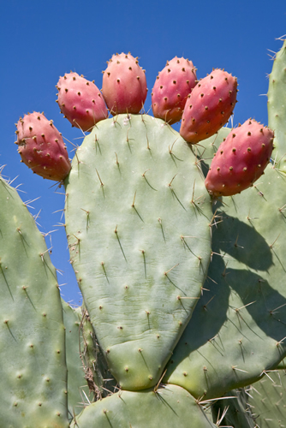
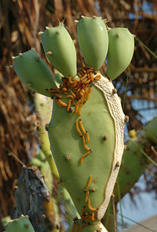
prickly pear
argentine cactus moth

Slide 15
3.Chemical.
The most widely used technique of modern weed control involves chemicals called herbicides, or weed killers. They may kill by con-tact or systemic action. Contact herbicides kill the tissue on contact, while systemic herbicides, which are readily translocated, affect the entire plant. With small weeds the entire plant dies; with large weeds, the foliage dies but the stem usually remains and new shoots may arise later from axillary buds.
Discovery of selective herbicides was a milestone because they can be applied in a mixed stand of plants and kill the undesirable plants without harming the others.

Slide 16
Sr. No | Herbicides & Weedicides | Trade Name
1 | 2,4-D Amine Salt 58% SL | SULTAN
2 | 2,4-D Ethyl Ester 20% WP | BULL FIGHTER
3 | 2,4-D Ethylester 38% EC | FIGHTER
4 | 2,4-D Sodium Salt 80% WP | FIGHTER SS
5 | Ammonium Salt of Glyphosate 71% SG | GAJA-71
6 | Anilofos 24% + 2, 4-D Ethyl Ester 32% EC
7 | Anilofos 30% EC | ANILOGOLD-30
8 | Atrazine 50% WP | ATRAGOLD-50%
9 | Butachlor 5% GR
10 | Butachlor 50% EC | CHEMCHLOR
11 | Butachlor 50% EW | QUICKMIX

Slide 17
Special practices
Dehorning: Severe cutting back of trees and shrubs to keep them from becoming too tall
Pinching: removal of a plant part that is soft enough to be readily broken with fingers
Disbudding: Removal of bud
Stripping, notching, ringing

