Slide 1
HORT 308
MEDICINAL AND AROMATIC PLANTS

Slide 2
Lavender

Slide 3
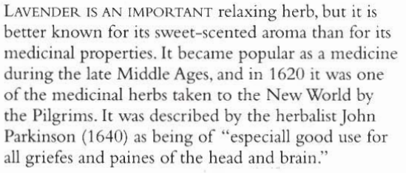
B.N Lavandula officinalis Family: Labiatae

Slide 4
Habitat & Cultivation
Native to France & Western Mediterranean
Cultivated worldwide

Slide 5
Key Constituents
Volatile Oil (3%) containing over 40 constituents
Flavonoids
Tannins
Coumarins

Slide 6
Key Actions
Carminative
Relives muscle spasms
Antidepressant
Antiseptic & antibacterial
Stimulates blood flow

Slide 7
Research
Oil: Proved very low toxicity, antiseptic & antibacterial action, reduce pain & nervous excitability
Flower: Antibacterial, antiseptic, calms nerves, reduces muscle tension and relives cramps

Slide 8
Tradition & Current Uses
Nervous System: Sleeplessness, irritability, headache, migraine & depression
Digestion
Asthma
Essential oil for antiseptic
Head wounds, sores, stings, scabies and lies
5 drops in night bath can give sound sleep & relives muscle tension

Slide 9
Parts Used
Flower (Fresh & Dried)

Slide 10
Key Preparations
Tincture
Essential Oil
Infusion

Slide 11
Pepper Mint

Slide 12
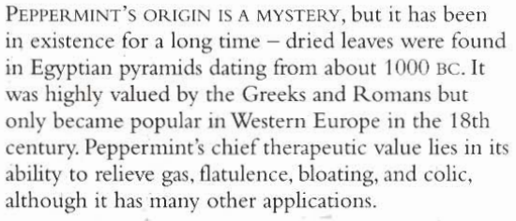
B.N Mentha x piperita Family: Labiatae

Slide 13
Habitat & Cultivation
Grown commercially in Europe
Asia
North America

Slide 14
Key Constituents
Volatile oil 1.5% (Menthol 35-55%, menthone 10-40%)
Flavonoids
Phenolic acids
Triterpenes

Slide 15
Key Actions
Carminative
Relives muscle spasms
Increases sweating
Stimulates secretion of bile
Antiseptic

Slide 16
Research
Proved that volatile oil is antibacterial, antiseptic, antifungal cooling & anesthetic to skin
The whole plant has antispasmodic effect on digestive system, irritable bowl syndromes

Slide 17
Tradition & Current Uses
Digestive problems
Pain relief (skin, headache, migraines linked to digestive system)
Infection: Diluted oil is used as inhalant and chest rub for respiratory infection

Slide 18
Parts Used
Areal parts

Slide 19
Key Preparations
Essential oil
Lotion
Infusion
Tincture
Capsules

