Slide 1
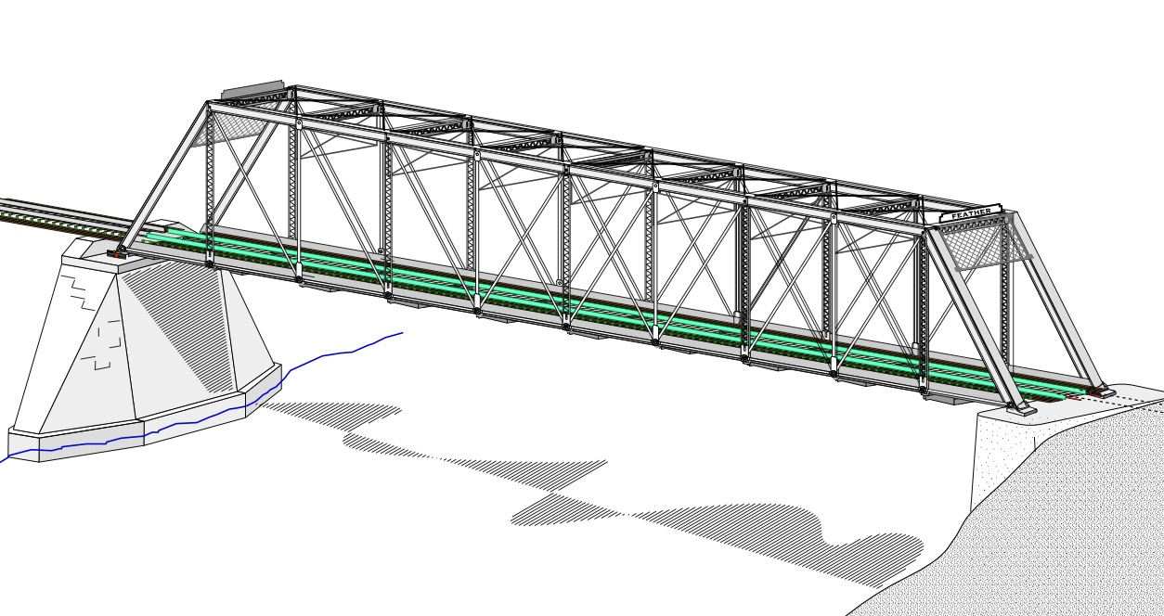
COLLEGE OF ENGINEERING AND TECHNOLOGY UNIVERSITY OF SARGODHA STEEL STRUCTURES (CT-313) (B.S TECHNOLOGY)
LECTURE-40, 41 & 42
FLEXURAL MEMBERS………….
Engineer Aqeel Ahmed
Lecturer, Civil Engineering Department
CET, UOS, Sargodha

Slide 2
STABILITY
If a beam can be counted on to remain stable up to the fully plastic condition, the nominal moment strength can be taken as the plastic moment capacity; that is,
Otherwise Mn will be less than Mp.
As with compression member the instability can be in an overall sense or it can be local.
Overall buckling is illustrated in figure 5.9a. When a beam bends, the compression region (above the neutral axis) is analogous to a column and in a manner similar to a column, it will buckle if the member is slender enough.
Unlike a column, however, the compression portion of the cross-section is restrained by the tension portion and the outward deflection (Flexural buckling ) is accompanied by twisting (torsion).

Slide 3
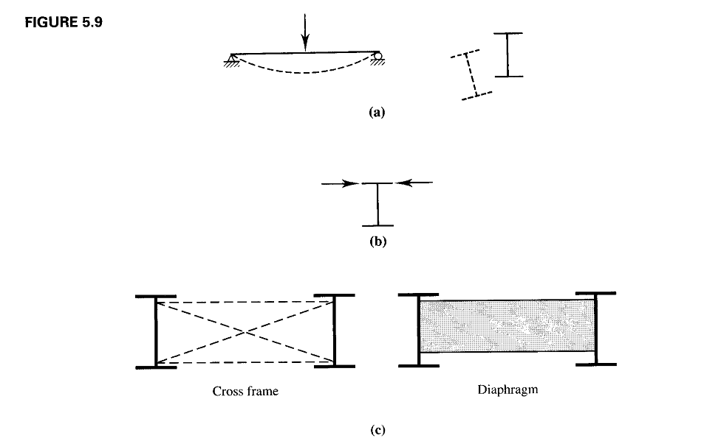

Slide 4
STABILITY………
This form of instability is called Lateral-torsional Buckling (LTB).
Lateral Torsional buckling can be prevented by bracing the beam against twisting at sufficiently close intervals.
This can be accomplished with either of two types of stability bracing: Lateral Bracing illustrated schematically in figure 5.9b and torsional bracing represented in figure 5.9 c.
Lateral bracing, which prevents lateral translation should be applied as close to the compression flange as possible.
Torsional bracing prevents twist directly; it can be either nodal or continuous and it can take the form of either cross frames or diaphragms.
Whether the beam can sustain a moment large enough to bring it to the fully plastic condition also depends on whether the cross-sectional integrity is maintained.

Slide 5
STABILITY…………
This integrity will be lost if one of the compression element of the cross-section buckles.
Thus type of buckling can be either compression flange buckling called flange local buckling (FLB), or buckling of the compression part of the web called Web Local Buckling (WLB).
As discussed in compression members, whether either type of local buckling occurs will depend on the width to thickness ratios of the compression elements of the cross-section.
Figure 5.1 further illustrates the effect of local and lateral-torsional buckling.
Five separate beams are represented on this graph if load versus central deflection.

Slide 6
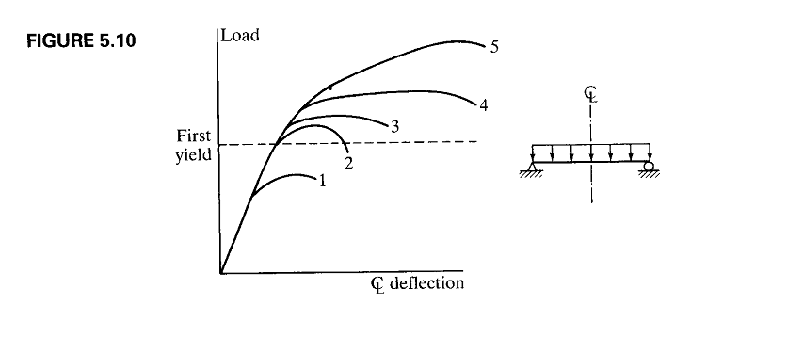

Slide 7
STABILITY…………
Curve 1 is load-deflection curve of beam that becomes unstable (in anyway) and loses its load carrying capacity before first yield (see figure 5.3 b) is attained.
Curves 2 and 3 correspond to beams that can be loaded past first yield but not so far enough for the formation of a plastic hinge and resulting into the plastic collapse.
If plastic collapse can be reached, the load deflection curve will have appearance of either the curve 4 or 5.
Curve 4 is for the case of uniform moment over the full length of the beam and curve 5 is for a beam with a variable bending ,moment (moment gradient)
Safe designs can be achieved with beams corresponding to any of these curves but curves 1 and 2 represent inefficient use of material.

Slide 8
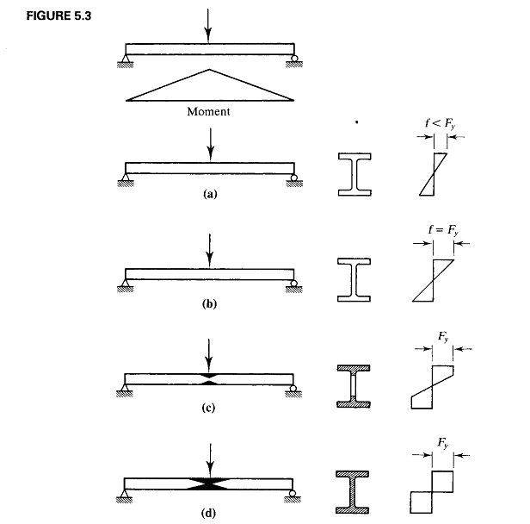

Slide 9
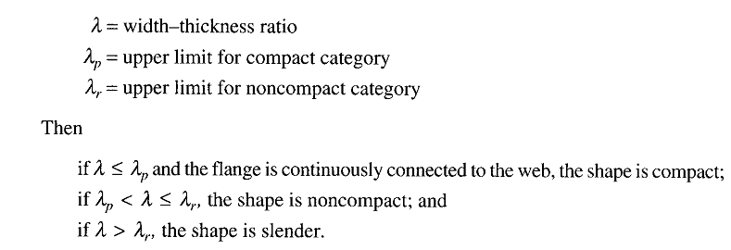
CLASSIFICATION OF SHAPES
AISC classifies cross-sectional shapes as compact, non compact, or slender depending on the values of the width-thickness ratios
For I-shapes, the ratio for the projecting flange (an unstiffened element) is and the ratio for the web (a stiffened web) is
The classification of shapes is found in Section B4 of the specification, “Local Buckling” in Table B4.1. it cab ne summarized as follows:

Slide 10
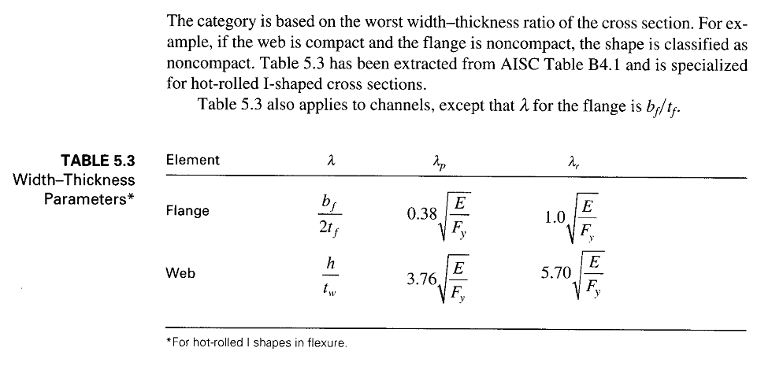
CLASSIFICATION OF SHAPES…….

Slide 11
BENDING STRENGTH OF COMPACT SHAPES
A Beam can fail by reaching Mp and becoming fully plastic or, it can fail by
1. Lateral-torsional buckling (LTB), either elastically or in elastically.
2. Flange Local Buckling (FLB), elastically or in elastically ;
3. Web Local Buckling (WLB), elastically or in elastically.
If the maximum bending stress is less than proportional limit when buckling occurs, the failure is said to be elastic otherwise it is inelastic.
For convenience, we first recognize beams as compact, non compact or slender and then determine the moment resistance based on the degree of lateral support.
The discussion in this section applies to two types of beams
(1) Hot-rolled I shapes bent about the strong axis and loaded in the plane of weak axis
(2) Channels bent about the strong axis and either loaded through the shear center or restrained against twisting.

Slide 12
BENDING STRENGTH OF COMPACT SHAPES….
The shear center is the point on the cross section through which a transverse load must pass if the beam is to bend without twisting.
Emphasis will be on I-shapes. C-shapes are different only in that the width to thickness ratio of the flange is rather than .
We begin with compact shapes, defined as those whose webs are continuously connected with flange and that satisfy the following width-thickness ratio requirements for the flange and web.
The web criterion is met by all standard I and C shapes listed in the manual for Fy < 65Ksi; therefore in most cases only the flange ratio need to be checked.

Slide 13
BENDING STRENGTH OF COMPACT SHAPES….
The built up welded I-shapes can have non-compact slender webs.
Most shapes will also satisfy the flange requirement and will therefore be classified as compact.
The non-compact shapes are identified dimension and properties table with a footnote (Footnote F).
Note that compression members have different criterion than flexural members so a shape could be compact for flexure but slender for compression.
If the beam is compact and has continuous lateral support or if the unbraced length is very short, the nominal moment strength or if the unbraced length is very short, the nominal strength Mn is the full plastic moment capacity of the shape, Mp.
For members with inadequate lateral support, the moment resistance is limited by the lateral-torsional buckling strength either inelastic or elastic.

Slide 15
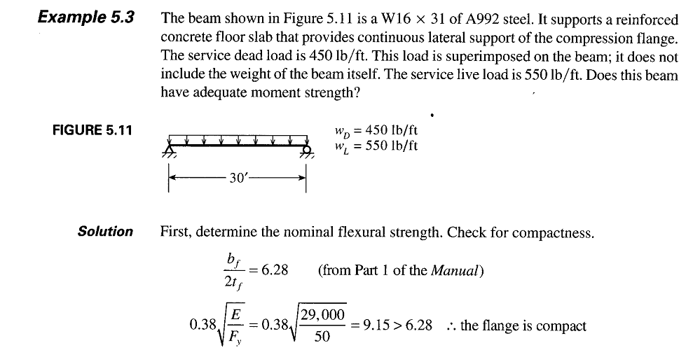

Slide 16
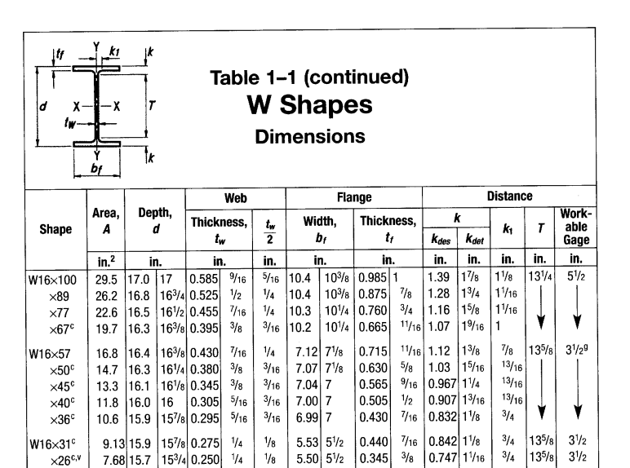

Slide 17
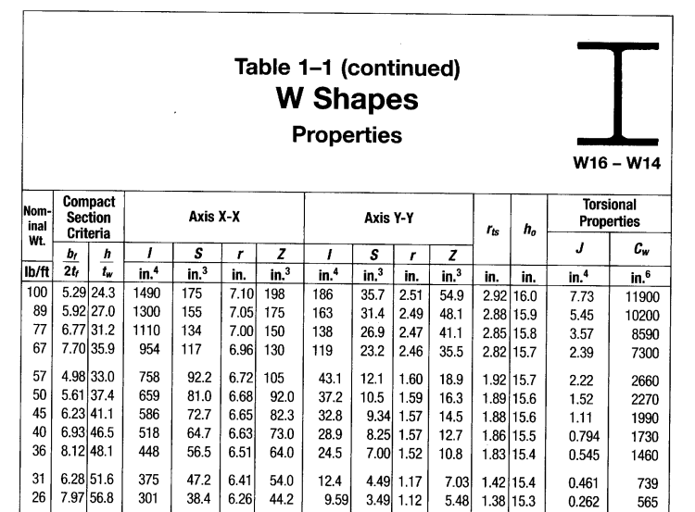

Slide 18
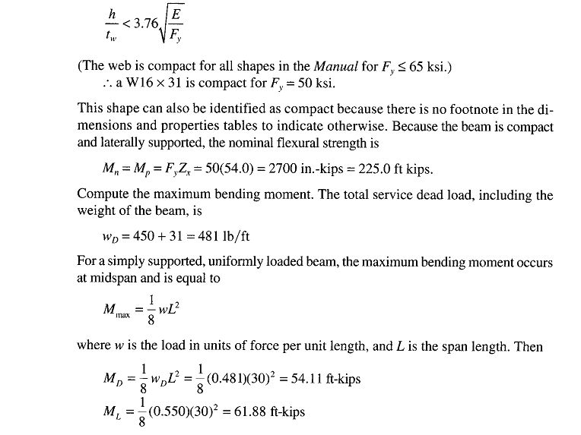

Slide 19
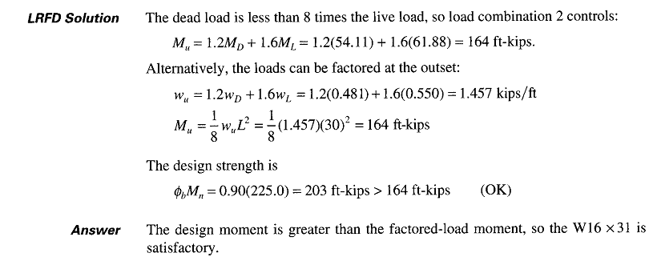

Slide 20
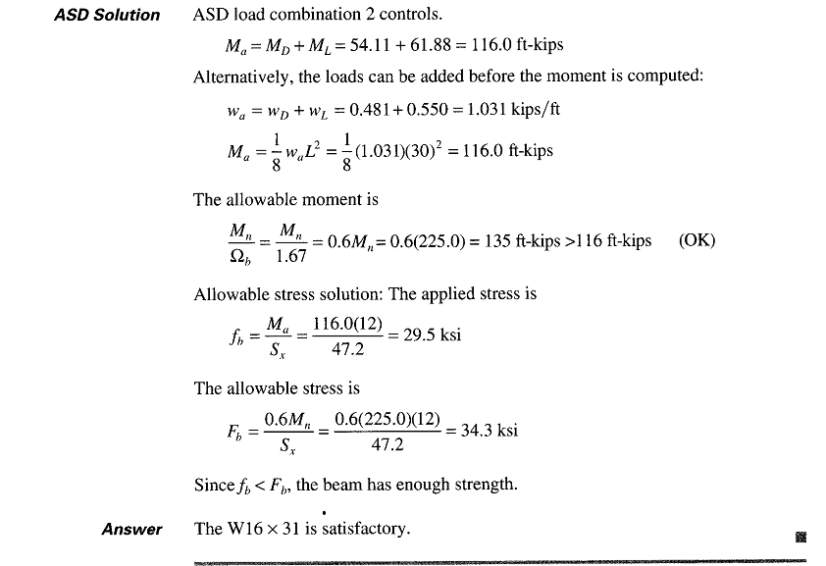

Slide 21
The approach discussed earlier can be used, when designing compact laterally supported shapes.
The moment strength of compact shapes is a function of the unbraced length, Lb, defined as the distance between points of lateral support or bracing.
Here, we indicate the points of lateral support with an “X”, as shown in figure 5.12 .
The relationship between nominal strength, Mn and the unbraced length is shown in figure 5.13.
If the unbraced length is no greater than Lp to be defined presently, the beam is considered to have full lateral support and Mn=Mp.
If the Lb, is greater than Lp but less than or equal to Lr parameter the strength is based on inelastic LTB.
If Lb, is greater than Lr, the strength is based on elastic LTB.

Slide 22
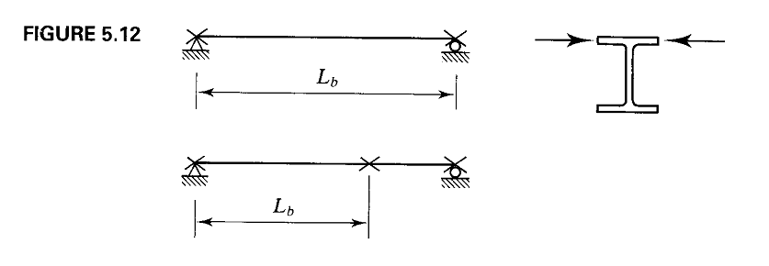

Slide 23
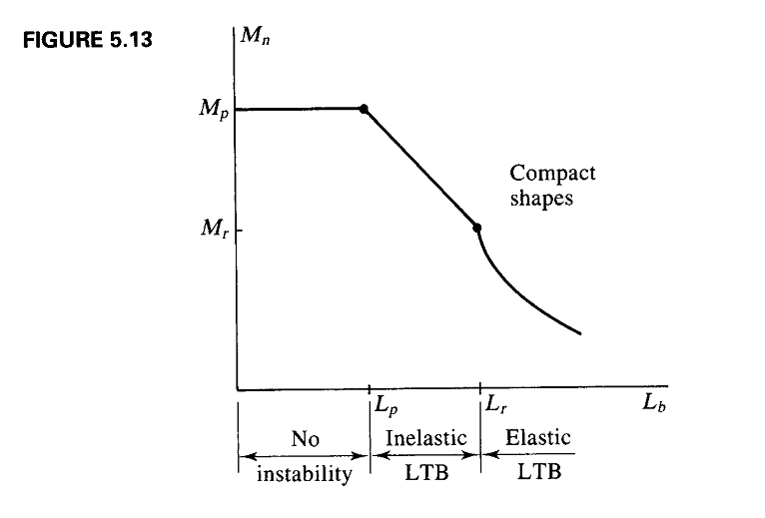

Slide 26
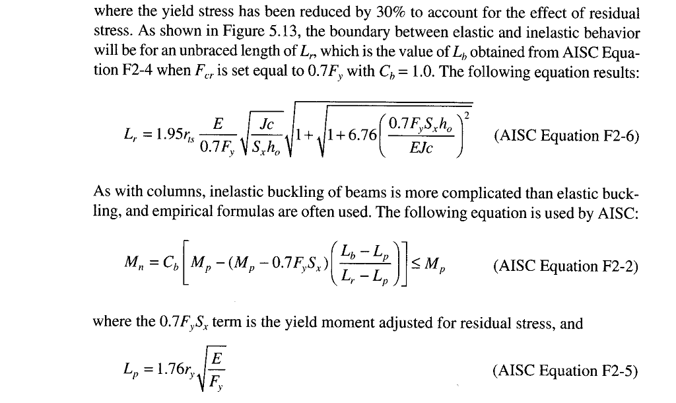

Slide 27
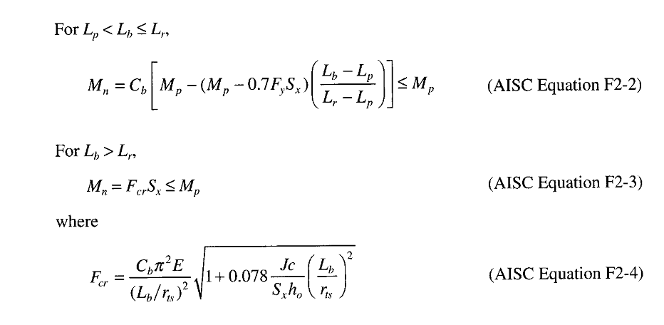

Slide 28
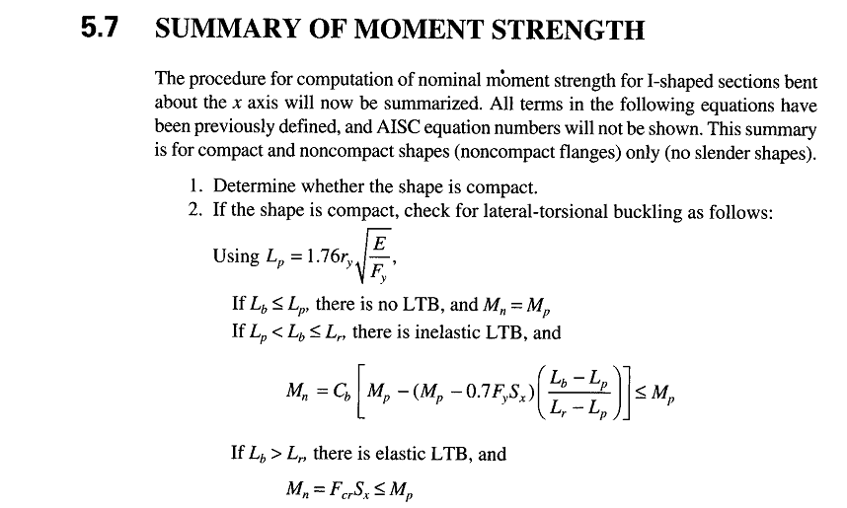

Slide 29
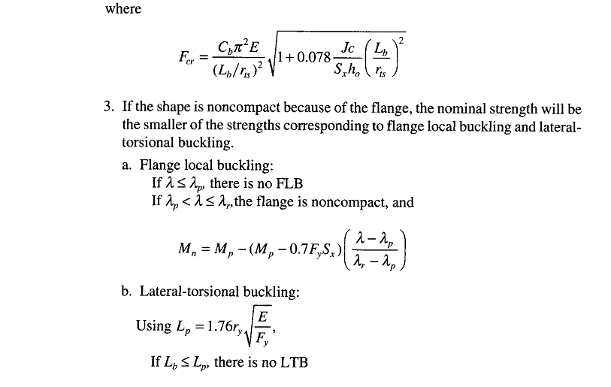

Slide 30
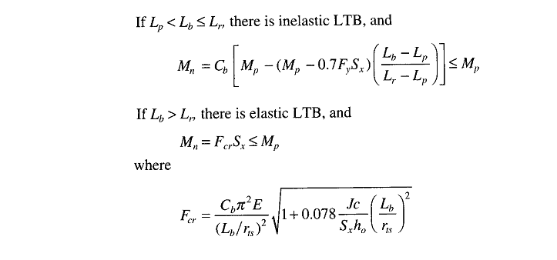

Slide 31
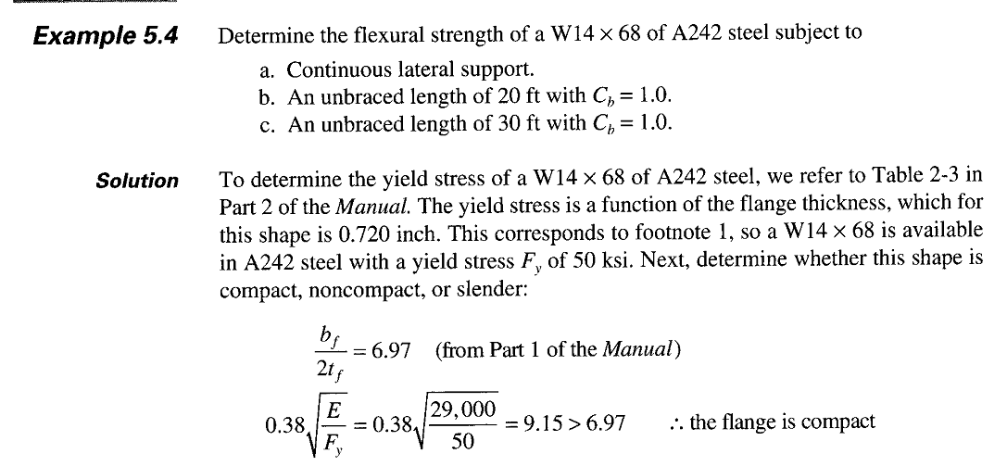

Slide 32
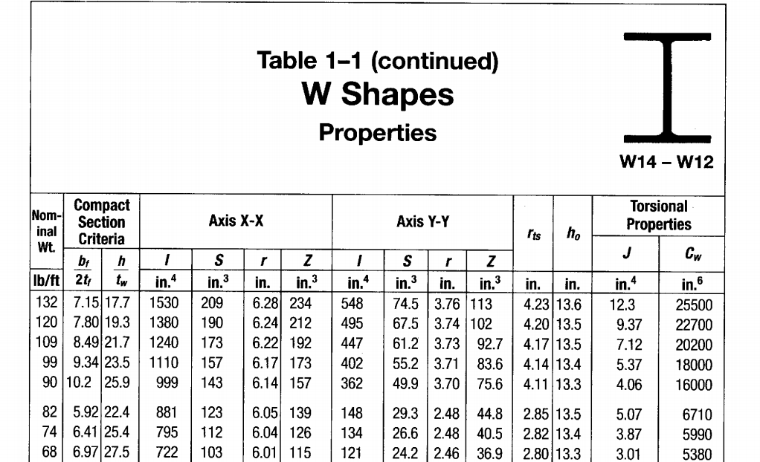

Slide 33
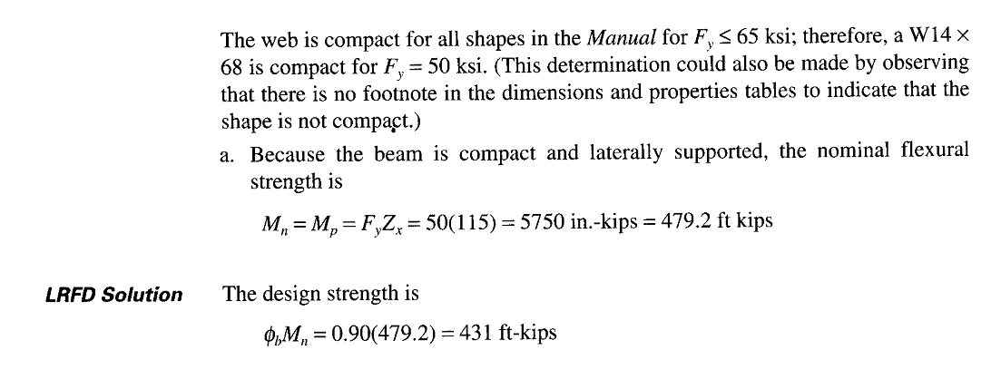

Slide 34
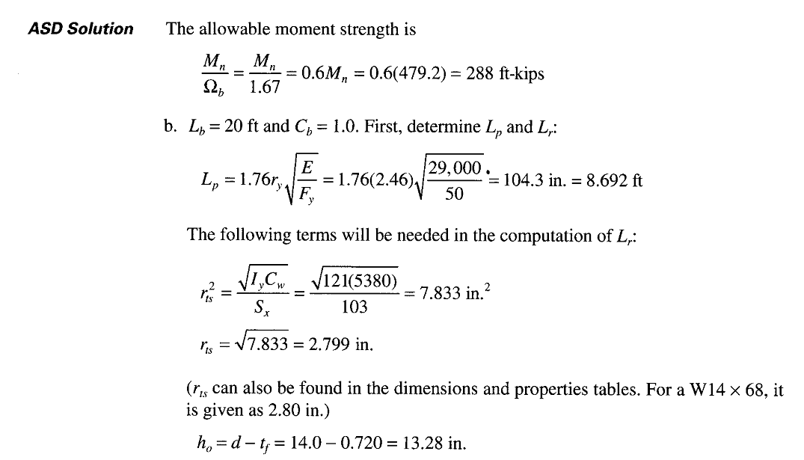

Slide 35
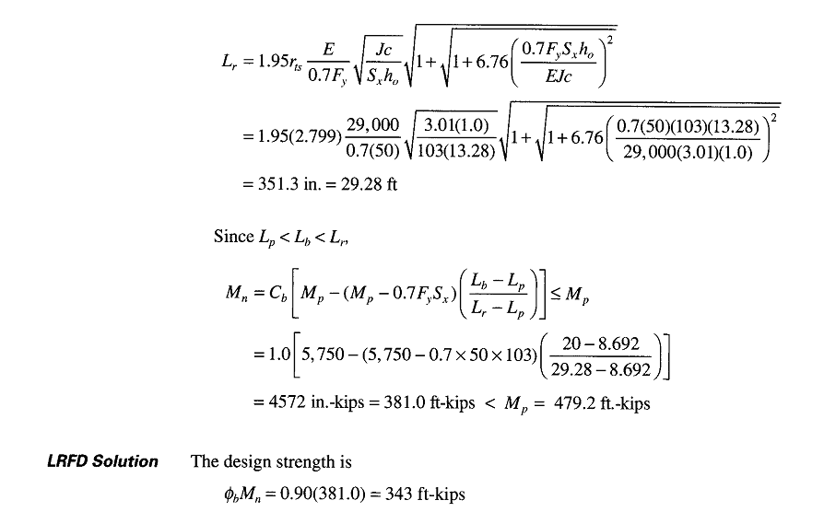

Slide 36
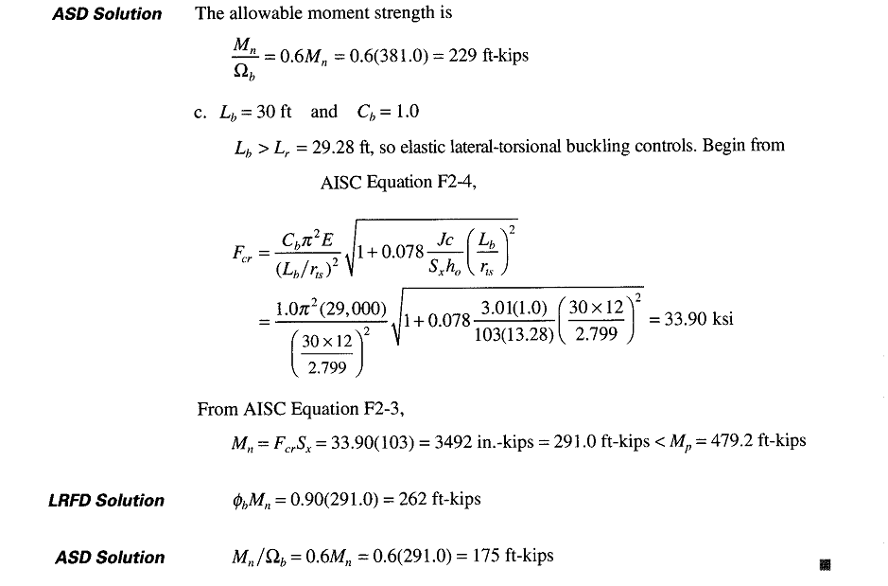

Slide 37
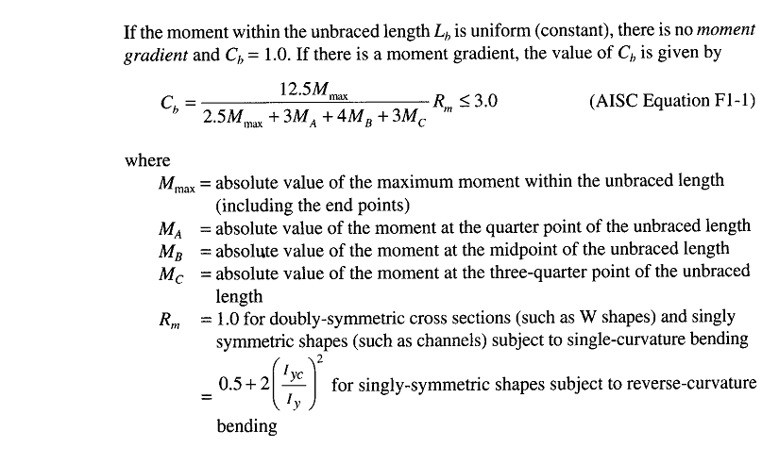
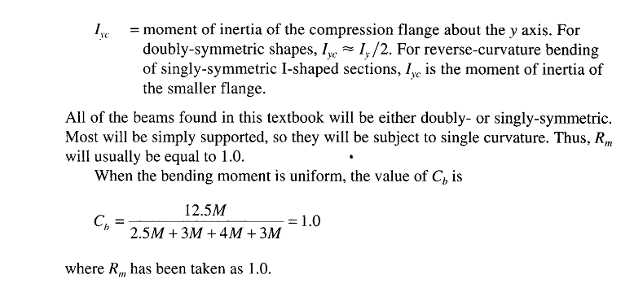

Slide 38
