Slide 1
Ent-302 3(2-1)
Insect Physiology
PRODUCTION OF LIGHT IN INSECT
By:
Dr. M. Asam Riaz
Assistant Professor
Entomology, College of Agriculture, UOS

Slide 2
Production of Light In Insect
Light:
Light is a form of radiation.
But a part of radiation which is electromagnetic spectrum.
This spectrum is visible by naked eye.
Eye can detect only specific wavelength.
Ranges of wavelength is 400-700 nm.
Greater wavelength is called infrared.

Slide 3
Continue…….
Shorter wavelength is called ultraviolet.
So insect produces light which is visible.
And ranges between 400-700nm.

Slide 4
Chemical Mechanism of light production in insect
Mixture of two things(oxygen + pigment).
Combination of these two things are called luciferin.
Enzyme of this chemical are called luciferase.
According to HARVARD MEDICAL SCHOOL REASEARCHERS the adenosine triphosphate gives energy to cells.
Crystals of uric acid are present on cell.

Slide 5
Continue……
When they are activated to make light and strike to the reflective layer they produce light visible to the bugs body.
The mechanism of production of light conduct in abdomen but scientists does not sure the pattern or mechanism is conducted through insect’s nerve cells or oxygen supply.
But scientist have confirmed that insects emit light for different purposes…..

Slide 6
Purpose of light production:
Food purpose.
Mating purpose.
Information about predators.
Informed about prey.
A number of insect produces light but now we explain only firefly.

Slide 7
FIREFLY:
Family: Lampyridea
Order: Coleoptera
Fireflies are characterized by light production but some families of firefly which do not produce light but use pheromones which are attract for mating or some other different purposes.

Slide 8
Continue…
Fireflies are most important insects in summer night.
Active in summer night.
Produced light looks very beautiful and enhance aesthetic value.
In latest report round about 2100 species.
Fireflies mostly found in tropical region.
Fireflies produced light when they are larvae.

Slide 9
Continue….
Pattern and purpose vary for every species of firefly.
Different lights are produced for different purpose.
e.g. firefly produced green light for male and female mating purpose.
Sometimes it is said that fireflies when move they stop production of light because they require energy for moving.

Slide 10
Continue…
This hypothesis given by some people but this hypothesis gives proper answer by a scientist Steven Haddock said that this hypothesis are totally wrong because firefly does not require energy for light production but production of light its behavior when want to mating both male and female produced light not produced light for moving or flying.

Slide 11
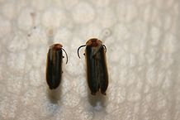
Continue…
Most common species in the world which produced light e.g. photinini, cratomorphini, phausis, pletomini etc.
PHOTININI:
Found in North America, these fireflies belonging to this species were not all fireflies produced light and divided into two categories but only discuss which are produced light.

Slide 12
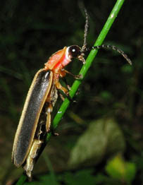
Photinus:
This species are closely related to photinini .
Identification:
its body size about is 1.7 inch.
Produced green light but appear yellowish color.
Active in the mid night.

Slide 13
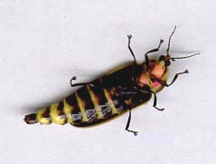
2. Cratomorphini:
Produced yellow color light.
Body is rounded and elongated.
Yellow color light produced in black strips.

Slide 14
3.Phausis:
Commonly known as blue ghost.
Why is it called blue ghost?
Because phausis do not produce light or flash but light produce in specific time when danger so produced specific color light and color are blue and green.
Female of blue ghost are different in color.

Slide 15
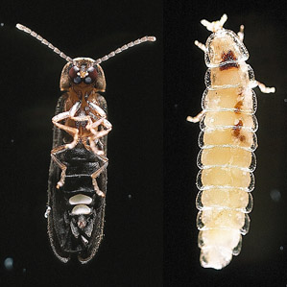
Identification:
Pale yellow and white and less number of wings and cannot fly .
Male has present wings and easily fly.
Size is very small and found in different areas southeastern and US.

Slide 16
4. Pletomini:
The species of pletomini is pleotomus are not common but found very rare.
Furthur 2 types:
Pleotomus pallens.
Pleotomus nigricans.

Slide 17
Continue…..
These are found in south west but scientists are totally confused not properly decision that these are one species or 2 species these are similar or distinct and sometimes they were present in Mexico and some different areas.
Adult does not produce light but this species produces the light of larvae.
Larvae produces light a sequence throughout the night.

Slide 18
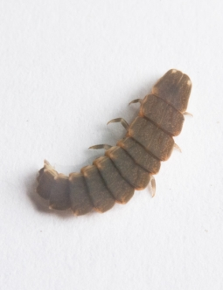
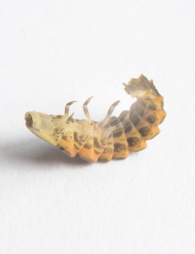
Continue:
This larva is podus and crawling on leaf for food.

Slide 19
5. Lampyrini:
This insect has small sized and active in night and found in UK and Mexico, southwestern.
Female have no wings present on the body and male and female have both glowing organs present on the terminal portion of the body.
In every insect male attract female by some different methods but in this species female emit light to attract the male.

Slide 20
Continue…
An interesting point in this species is that male has ability to emit the light but this cannot do so.

Slide 21
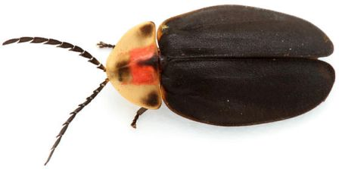
6. Lamprocerini:
Lamprocerini are medium sized and body is flat and these species are found in Gulf states and US.
2 spots are present on the head and antennae setae like and club shape.

Slide 22
7. Photurinae:
Females has greater size as compared to male and produce dark color light and size is about 1 inch.
The produced light which is dark colored which are not difference to the other flies because its light looks like to other fireflies.
Female emit light for mating and attract photinus male fireflies for eating purpose.

Slide 23
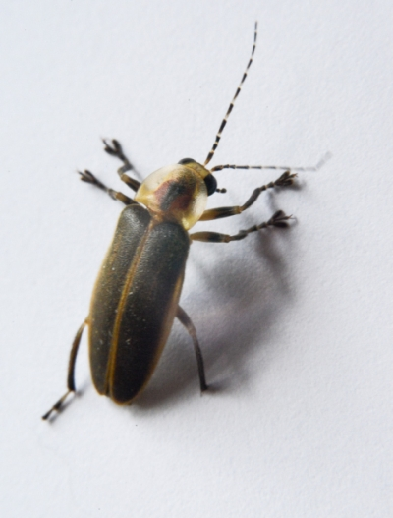
Continue…
Sometimes photrius species are also called femme fatale.

