Slide 1
Still Life
Oil Paint

Slide 2
History
Still Life is a genre which gained prominence in Western Art by the late 16th century and has remained an important genre since then. Still Lifes are categorized by the depiction of ordinary objects which may be natural, like flowers, fruits etc. or man-made, like glasses, musical instruments etc.

Slide 3
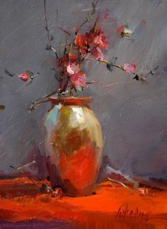
Some tips
Still life painting gives the artist full control over his/her subject. Provided the still life compositions have been set up properly with a steady light source — facing window, or artificial lights — then the artist is free to concentrate on rendering what he/she see.
The first thing to ensure is that the composition is indeed how you want it. Then you will probably want to analyze the tonal values.

Slide 4
What are the 7 elements of art?

Slide 5
The seven elements are line, color, value, shape, form, space, and texture What are the 7 elements of art? The seven elements are line, color, value, shape, form, space, and texture

Slide 6
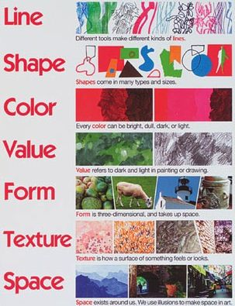
Elements

Slide 7
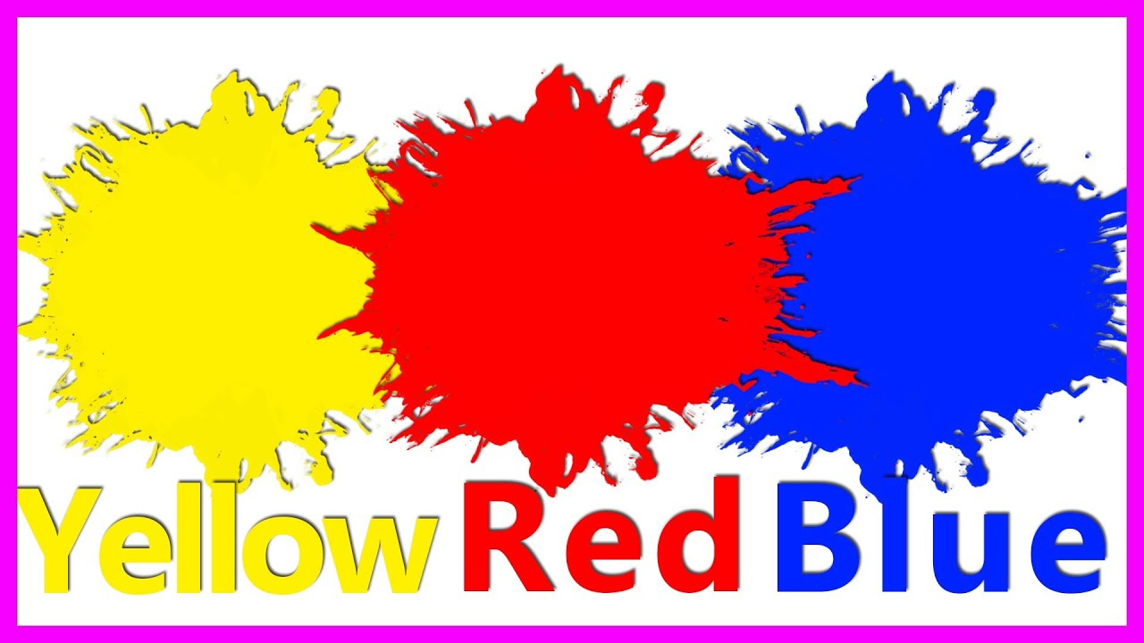
Basic Colours

Slide 8
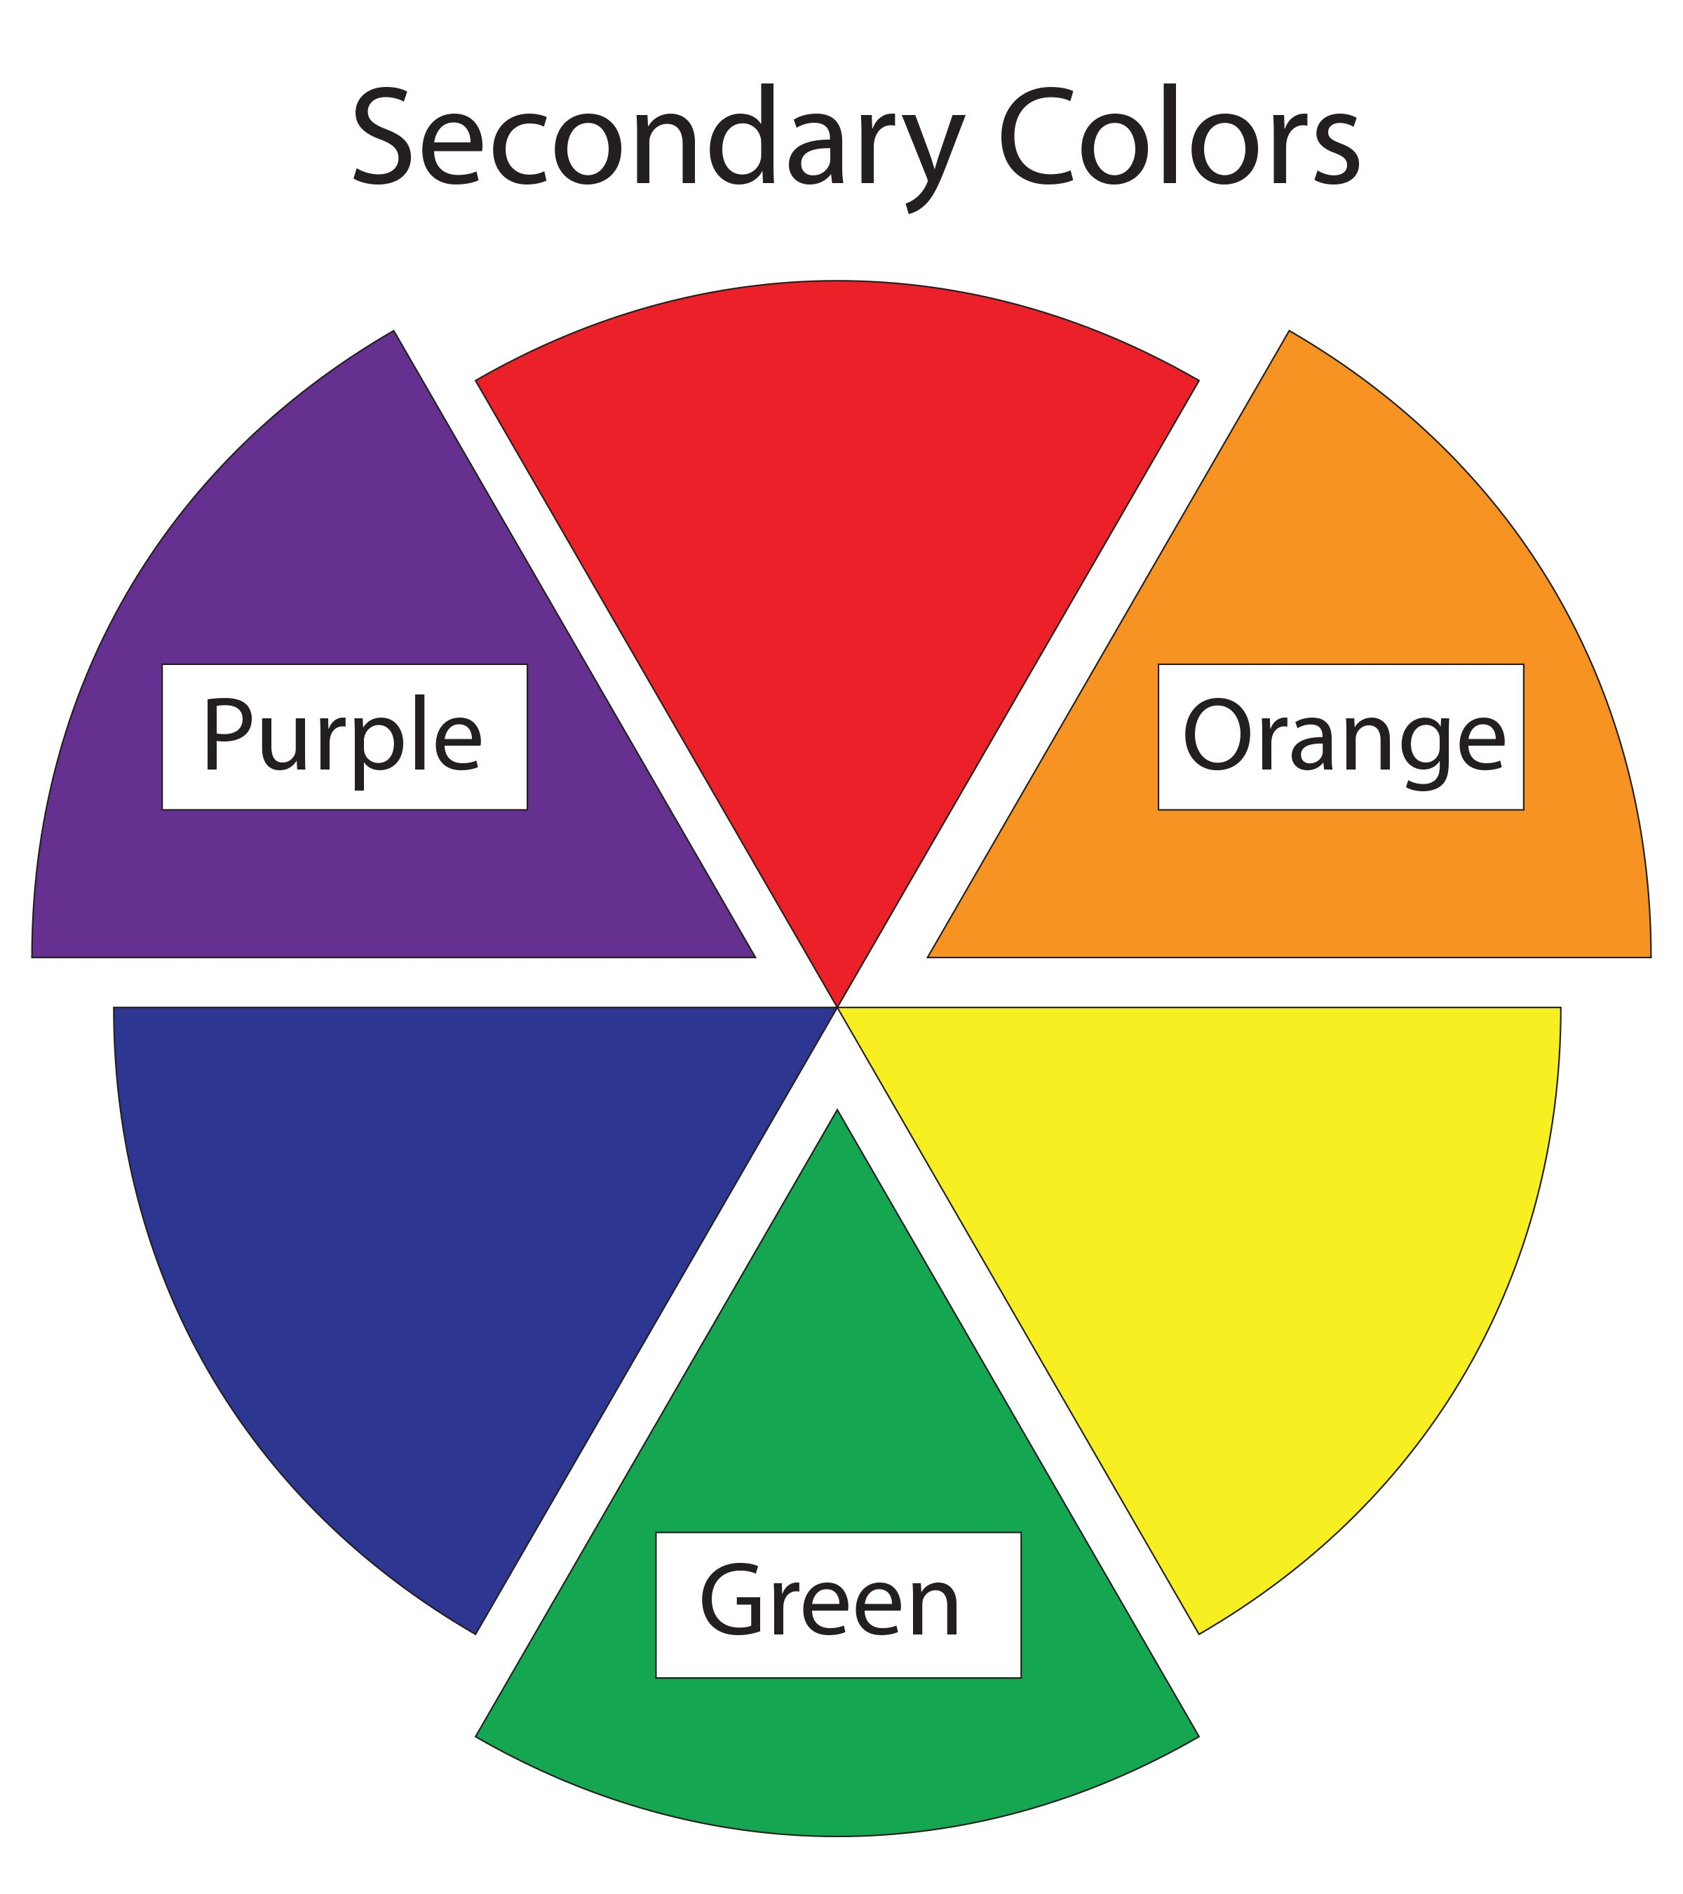
Secondary Colours

Slide 9
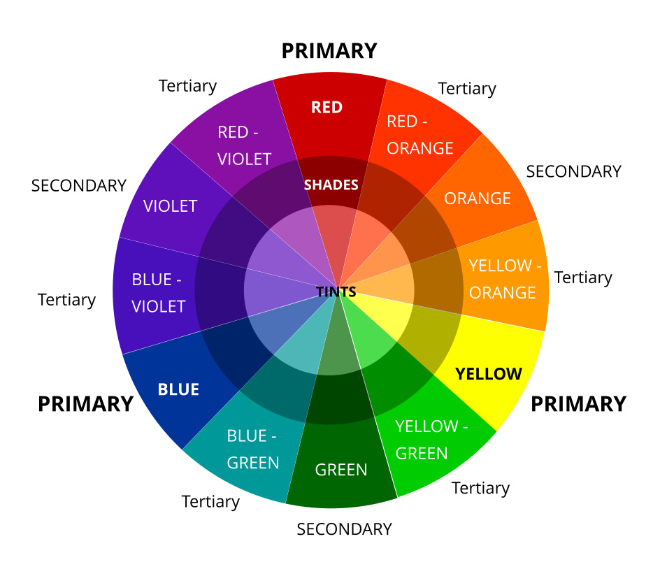
Find complimentary Colours

Slide 10
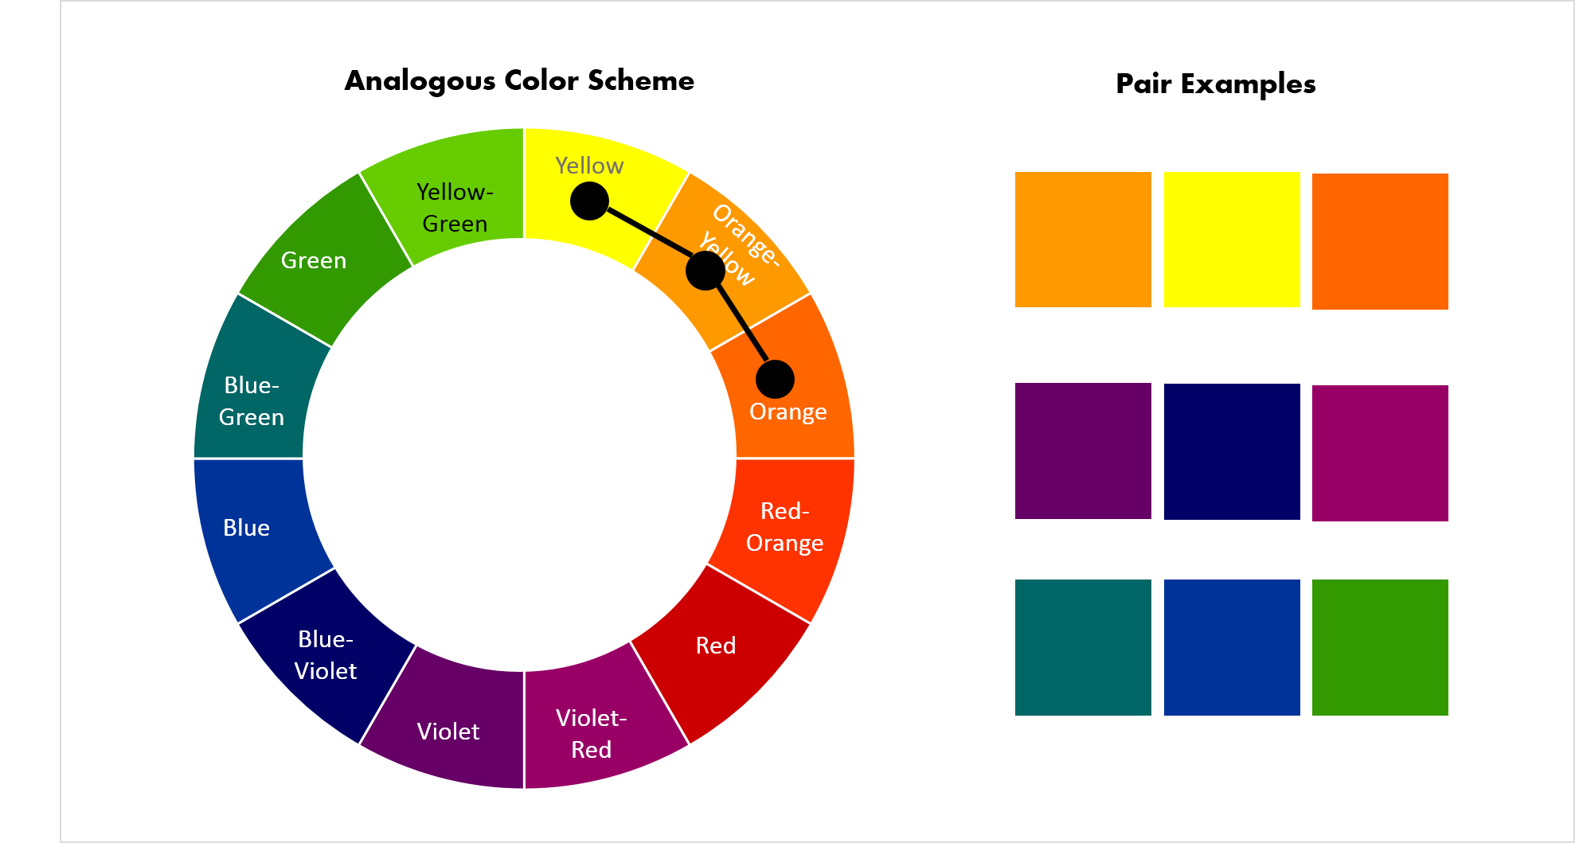
Analogous Colours

Slide 11
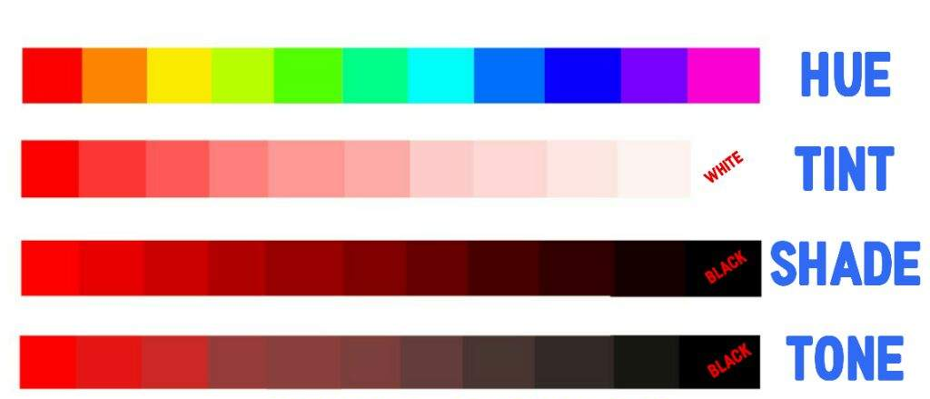
Hue, Tint, Shade and Tone

Slide 12
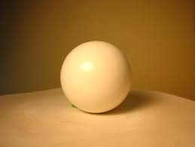
Paint from Dark to Light. Never Use Black. Warm Light, Cool Shadows Warm Colours Advance, Cool Colours Recede. Always have a good sketch to paint from. Only paint in good light. Paint relationships — not isolated things or people. Everything is either light against dark, dark against . Light turns gently into shadow and emerges crisply from the shadow. Every object needs a form shadow Shadows are dark versions of local color. Highlights are never on the starting edge.
Some Rules

Slide 13
Some of the Famous Still life paintings
Most famous still life paintings by renowned artists of the genre including Chardin, Paul Cezanne, Van Gogh and Giorgio Morandi.

Slide 14
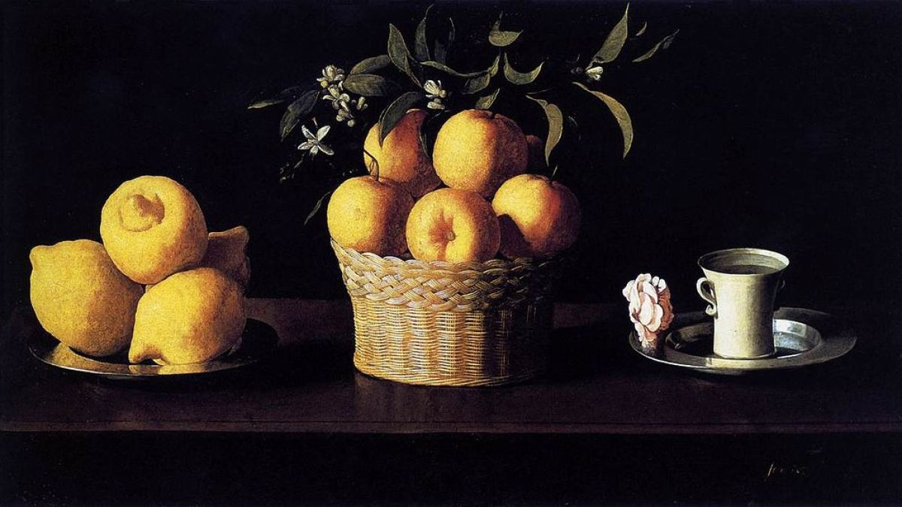
Still Life with Lemons, Oranges and a Rose (1633) – Francisco de Zurbaran

Slide 15
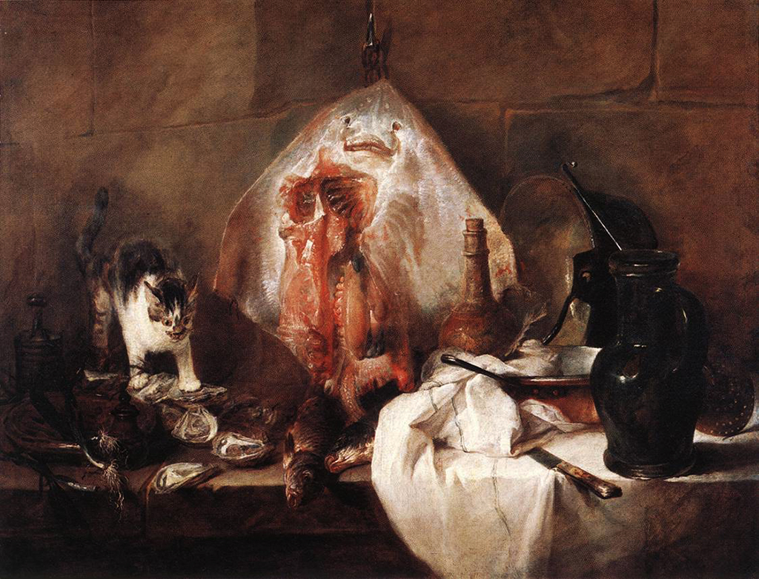
The Ray (1728) – Jean-Baptiste-Simeon Chardin

Slide 16
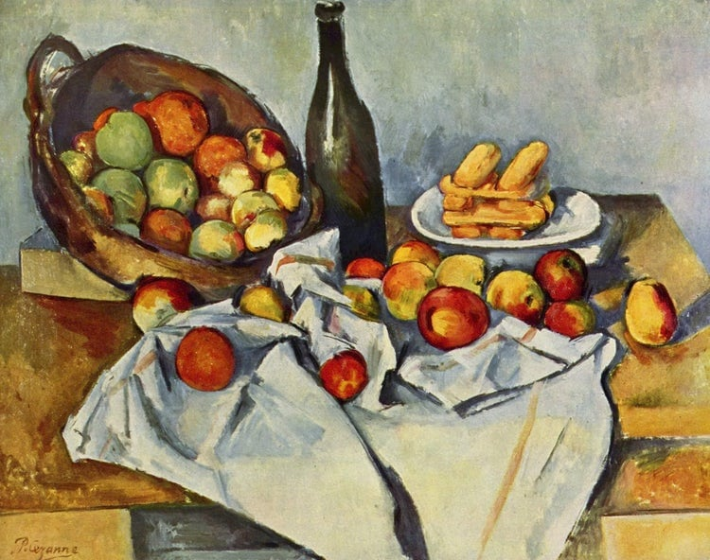
The Basket of Apples is a still life oil painting by French artist Paul Cézanne.

Slide 17
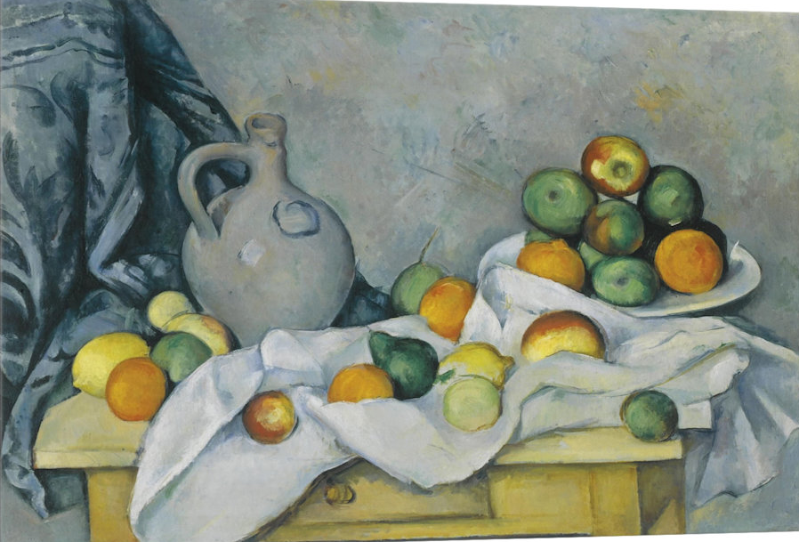
Rideau, Cruchon et Compotier (Jug, Curtain and Fruit Bowl) (1894) – Paul Cezanne. 5

Slide 18
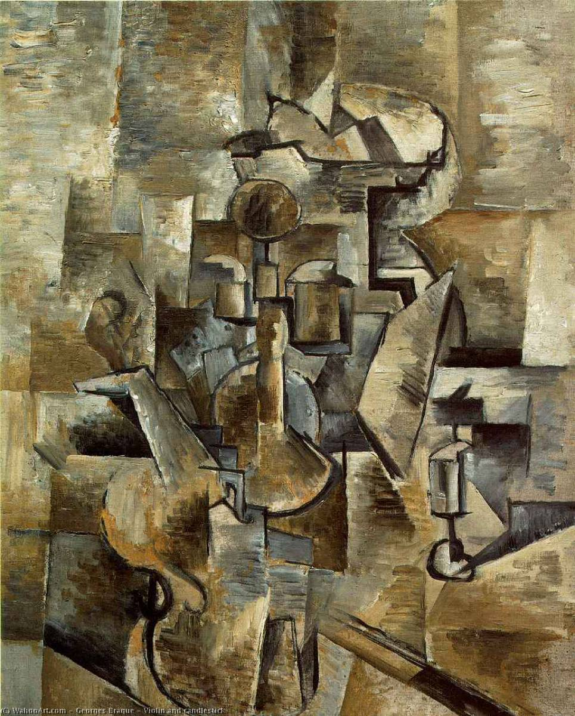
Violin and Candlestick (1910) – Georges Braque4

Slide 19
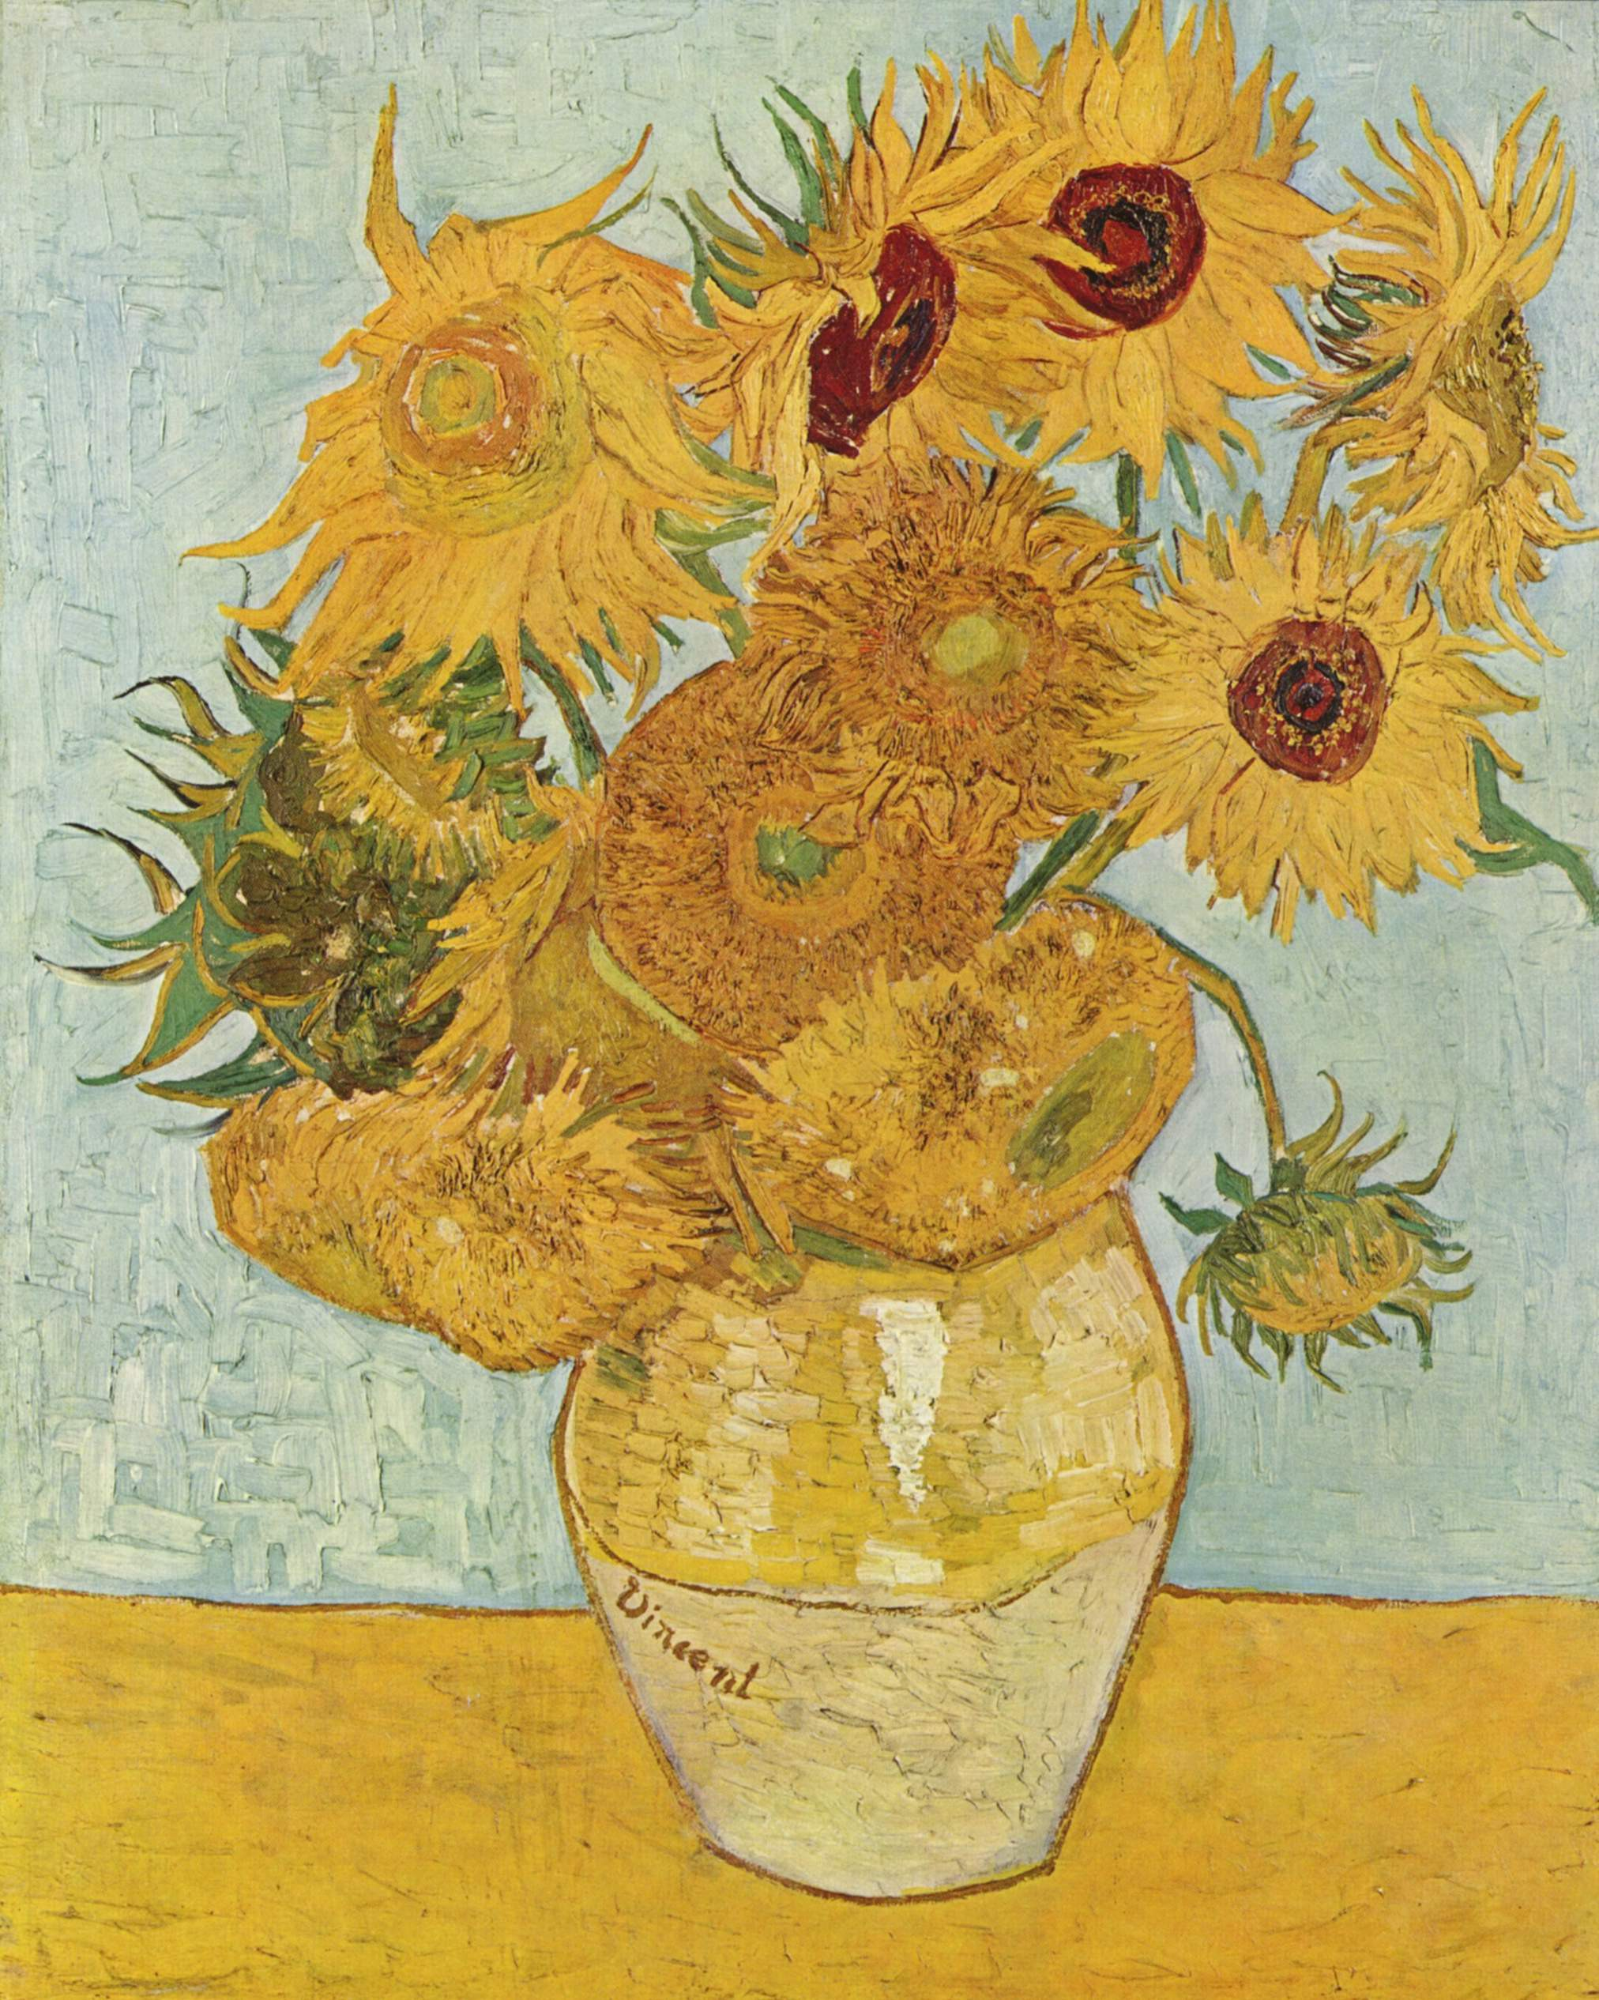
Van Gogh

Slide 20
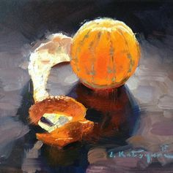
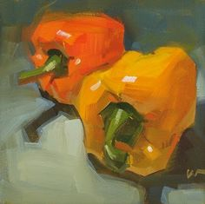
Enjoy some more and discuss

Slide 21
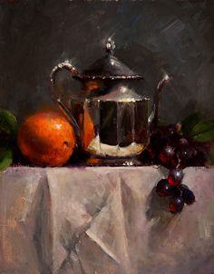
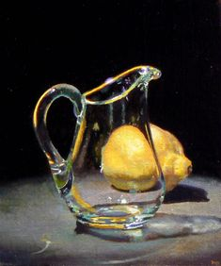

Slide 22
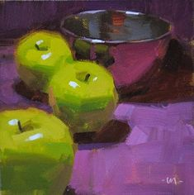
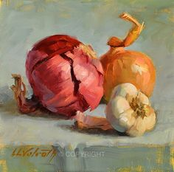

Slide 23
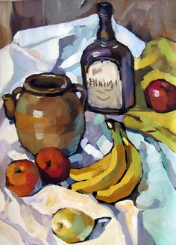
Brush work

Slide 24
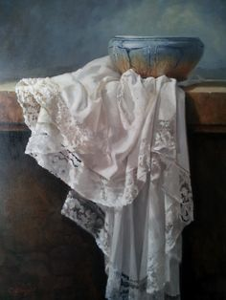
Super Realistic

Slide 25
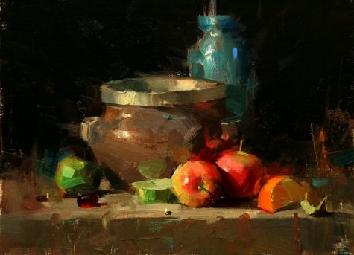
Against the dark

Slide 26
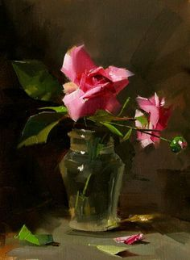
Floral

Slide 27
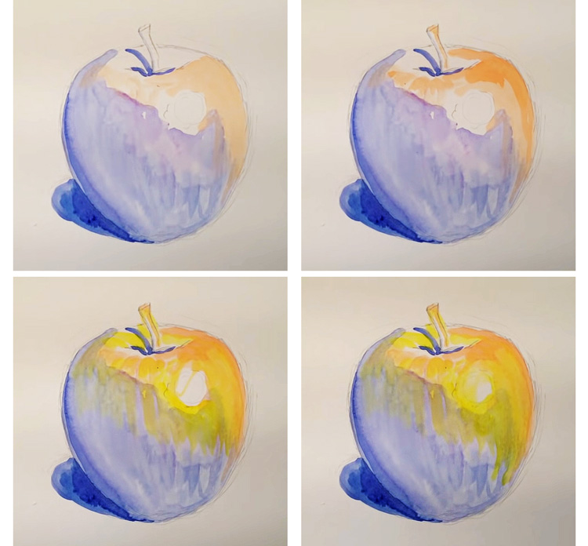
Under painting

Slide 28
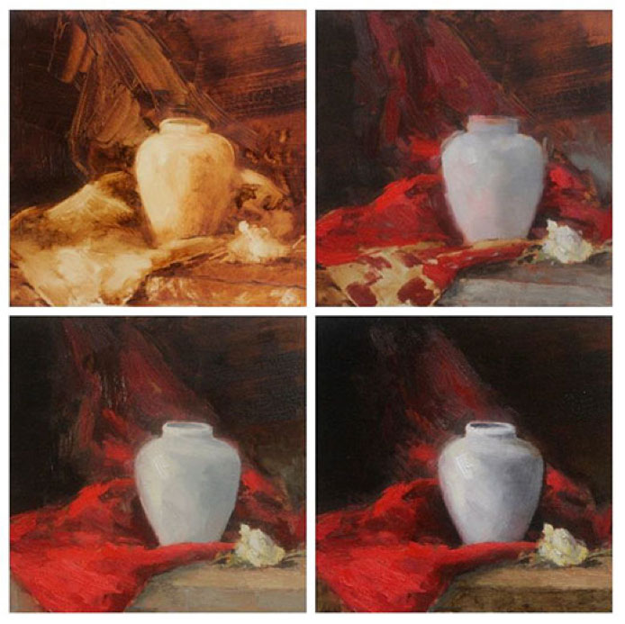
Stages

Slide 29
Your turn

