Slide 1
SAMPLING TECHNIQUES

Slide 2
Step – 5: Deciding on the sample design

Slide 3
To draw valid conclusions from your results, you have to carefully decide how you will select a sample that is representative of the group as a whole.

Slide 4
Probability Sampling
It involves random selection, allowing you to make statistical inferences about the whole group.
Probability sampling means that every member of the population has a chance of being selected.

Slide 5
Non-probability sampling involves non-random selection based on convenience or other criteria, allowing you to easily collect initial data.

Slide 6
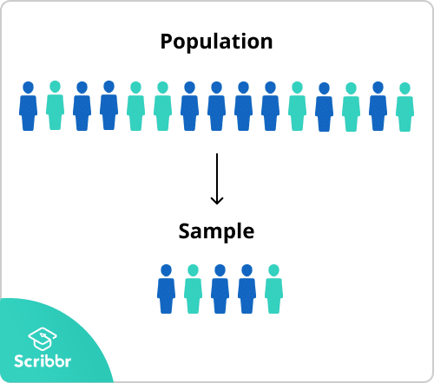

Slide 7
Sampling frame
The sampling frame is the actual list of individuals that the sample will be drawn from.

Slide 8
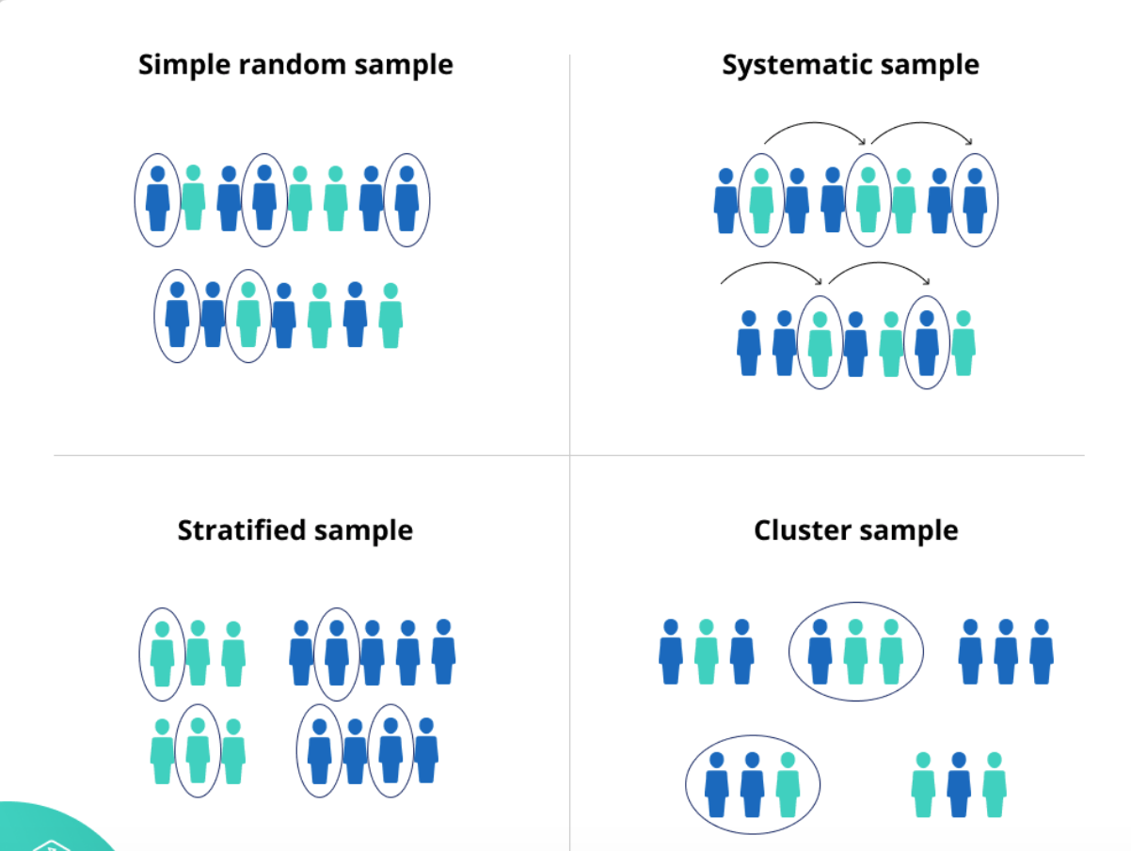
PROBABILITY SAMPLING

Slide 9
In a simple random sample, every member of the population has an equal chance of being selected. Your sampling frame should include the whole population.

Slide 10
Systematic sampling is similar to simple random sampling, but it is usually slightly easier to conduct. Every member of the population is listed with a number, but instead of randomly generating numbers, individuals are chosen at regular intervals.

Slide 11
Stratified sampling involves dividing the population into subpopulations that may differ in important ways. It allows you draw more precise conclusions by ensuring that every subgroup is properly represented in the sample.
To use this sampling method, you divide the population into subgroups (called strata) based on the relevant characteristic (e.g. gender, age range, income bracket, job role).

Slide 12
Cluster sampling also involves dividing the population into subgroups, but each subgroup should have similar characteristics to the whole sample. Instead of sampling individuals from each subgroup, you randomly select entire subgroups.

Slide 13
NON PROBABILITY SAMPLING

