Slide 1
Skin

Slide 2
What is Skin
The skin, the body’s largest organ, is the outer body covering of an animal
It forms a barrier that helps prevent harmful microorganisms and chemicals from entering the body, and it also prevents the loss of life-sustaining body fluids.
It protects the vital structures inside the body from injury and from the potentially damaging ultraviolet rays of the sun.

Slide 3
The skin also helps regulate body temperature, excretes some waste products, and is an important sensory organ.
Both delicate and resilient, the skin constantly renews itself and has a remarkable ability to repair itself after injury.

Slide 4
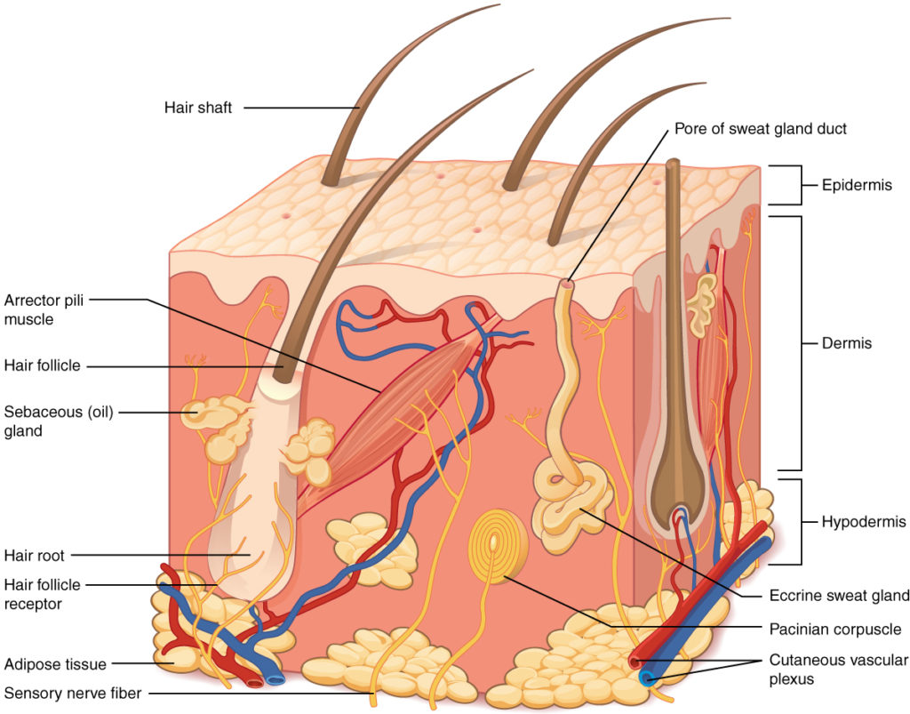

Slide 5
Structure and Function of the Skin
The skin is composed of three major layers
A superficial epidermis and a deeper dermis and hypodermis
The epidermis consists of several layers The top most layer consists of dead cells that shed periodically and is progressively replaced by cells formed from the basal layer
The dermis connects the epidermis to the hypodermis, and provides strength and elasticity due to the presence of collagen and elastin fibers

Slide 6
The hypodermis, deep to the dermis of skin, is the connective tissue that connects the dermis to underlying structures; it also harbors adipose tissue for fat storage and protection.
keratin protein that also makes up hair and nails
Skin consist 90% of keratinized cells

Slide 7
MAJOR LAYERS of the SKIN
EPIDERMIS
The outer layer of skin which is only a few cells thick; it contains pigments and pores, and its surface is made of dead cells that it sheds from the body
DERMIS
The thick sensitive layer of skin or connective tissue beneath the epidermis
Hypodermis
The hypodermis (also called the subcutaneous layer or superficial fascia) is a layer directly below the dermis. The hypodermis consists of well-vascularized, loose, areolar connective tissue and adipose tissue, which functions as a mode of fat storage and provides insulation and cushioning for the integument

Slide 8
Epidermis
The epidermis is composed of keratinized, stratified squamous epithelium. It is made of four or five layers of epithelial cells, depending on its location in the body. It does not have any blood vessels within it (i.e., it is avascular).
Skin that has four layers of cells is referred to as “thin skin.” From deep to superficial, these layers are the
Stratum basale,
Stratum spinosum,
Stratum granulosum, and
Stratum corneum.

Slide 9
Most of the skin can be classified as thin skin. “Thick skin” is found only on the palms of the hands and the soles of the feet.
It has a fifth layer, called the
Stratum lucidum,
located between the stratum corneum and the stratum granulosum
The cells in all of the layers except the stratum basale are called keratinocytes.
A keratinocyte is a cell that manufactures and stores the protein keratin.
Keratin is an intracellular fibrous protein that gives hair, nails, and skin their hardness and water-resistant properties. The keratinocytes in the stratum corneum are dead and regularly slough away, being replaced by cells from the deeper layers

Slide 10
Stratum basale
The stratum basale (also called the stratum germinativum) is the deepest epidermal layer and attaches the epidermis to the basal lamina, below which lie the layers of the dermis.
The cells in the stratum basale bond to the dermis via intertwining collagen fibers, referred to as the basement membrane.
A finger-like projection, or fold, known as the dermal papilla (plural = dermal papillae) is found in the superficial portion of the dermis. Dermal papillae increase the strength of the connection between the epidermis and dermis; the greater the folding, the stronger the connections made

Slide 11
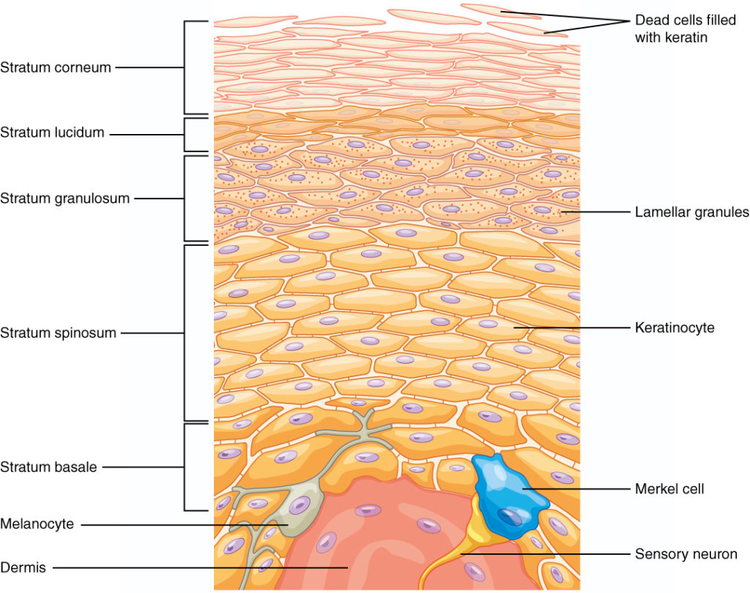

Slide 12
The stratum basale is a single layer of cells primarily made of basal cells.
A basal cell is a cuboidal-shaped stem cell that is a precursor of the keratinocytes of the epidermis.
All of the keratinocytes are produced from this single layer of cells, which are constantly going through mitosis to produce new cells. As new cells are formed, the existing cells are pushed superficially away from the stratum basale
Two other cell types are found dispersed among the basal cells in the stratum basale.
The first is a Merkel cell, which functions as a receptor and is responsible for stimulating sensory nerves that the brain perceives as touch. These cells are especially abundant on the surfaces of the hands and feet.

Slide 13
The second is a melanocyte, a cell that produces the pigment melanin. Melanin gives hair and skin its color, and also helps protect the living cells of the epidermis from ultraviolet (UV) radiation damage
In a growing fetus, fingerprints form where the cells of the stratum basale meet the papillae of the underlying dermal layer (papillary layer), resulting in the formation of the ridges on your fingers that you recognize as fingerprints.
Fingerprints are unique to each individual and are used for forensic analyses because the patterns do not change with the growth and aging processes

Slide 14
Stratum Spinosum
As the name suggests, the stratum spinosum is spiny in appearance due to the protruding cell processes that join the cells via a structure called a desmosome.
The desmosomes interlock with each other and strengthen the bond between the cells.
It is interesting to note that the “spiny” nature of this layer is an artifact of the staining process. Unstained epidermis samples do not exhibit this characteristic appearance.

Slide 15
The stratum spinosum is composed of eight to 10 layers of keratinocytes, formed as a result of cell division in the stratum basale .
Interspersed among the keratinocytes of this layer is a type of dendritic cell called the Langerhans cell,
which functions as a macrophage by engulfing bacteria, foreign particles, and damaged cells that occur in this layer
The keratinocytes in the stratum spinosum begin the synthesis of keratin and release a water-repelling glycolipid that helps prevent water loss from the body, making the skin relatively waterproof.
As new keratinocytes are produced a top the stratum basale, the keratinocytes of the stratum spinosum are pushed into the stratum granulosum

Slide 16
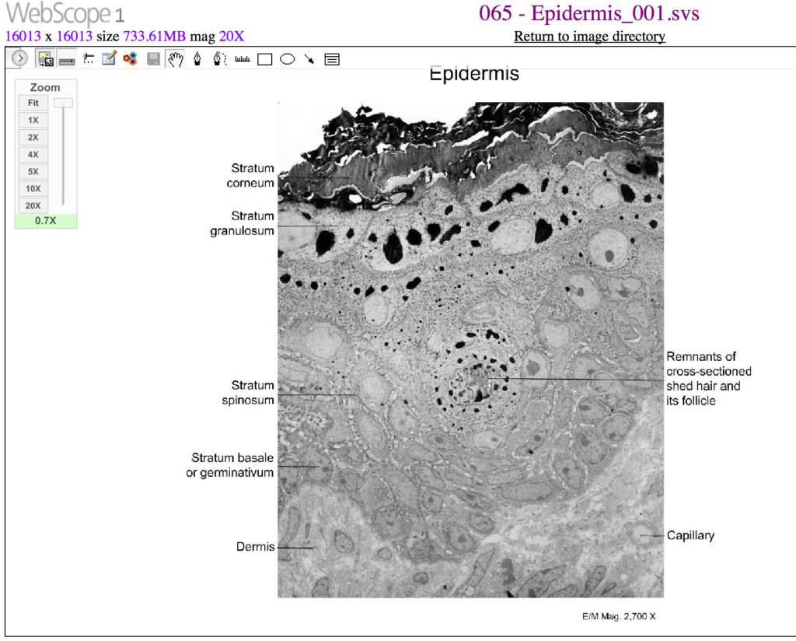

Slide 17
Stratum Granulosum
The stratum granulosum has a grainy appearance due to further changes to the keratinocytes as they are pushed from the stratum spinosum.
The cells (three to five layers deep) become flatter, their cell membranes thicken, and they generate large amounts of the proteins keratin, which is fibrous, and keratohyalin, which accumulates as lamellar granules within the cells

Slide 18
These two proteins make up the bulk of the keratinocyte mass in the stratum granulosum and give the layer its grainy appearance.
The nuclei and other cell organelles disintegrate as the cells die, leaving behind the keratin,
keratohyalin, and cell membranes that will form the stratum lucidum, the stratum corneum, and the accessory structures of hair and nails.

Slide 19
stratum lucidum
.
The stratum lucidum is a smooth, seemingly translucent layer of the epidermis located just above the stratum granulosum and below the stratum corneum.
This thin layer of cells is found only in the thick skin of the palms, soles, and digits.
The keratinocytes that compose the stratum lucidum are dead and flattened
These cells are densely packed with eleiden, a clear protein rich in lipids, derived from keratohyalin, which gives these cells their transparent (i.e., lucid) appearance and provides a barrier to water.

Slide 20
Stratum Corneum
The stratum corneum is the most superficial layer of the epidermis and is the layer exposed to the outside environment .
The increased keratinization (also called cornification) of the cells in this layer gives it its name.
There are usually 15 to 30 layers of cells in the stratum corneum.
This dry, dead layer helps prevent the penetration of microbes and the dehydration of underlying tissues, and provides a mechanical protection against abrasion for the more delicate, underlying layers.

Slide 21
Cells in this layer are shed periodically and are replaced by cells pushed up from the stratum granulosum (or stratum lucidum in the case of the palms and soles of feet).
The entire layer is replaced during a period of about 4 weeks. Cosmetic procedures, such as microdermabrasion, help remove some of the dry, upper layer and aim to keep the skin looking “fresh” and healthy

Slide 22
Dermis
The dermis might be considered the “core” of the integumentary system (derma- = “skin”), as distinct from the epidermis (epi– = “upon” or “over”) and hypodermis (hypo– = “below”).
It contains blood and lymph vessels, nerves, and other structures, such as hair follicles and sweat glands. The dermis is made of two layers of connective tissue that compose an interconnected mesh of elastin and collagenous fibers, produced by fibroblasts

Slide 23
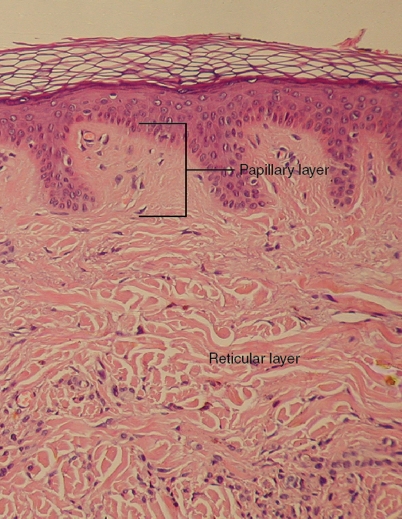

Slide 24
Papillary Layer
The papillary layer is made of loose, areolar connective tissue, which means the collagen and elastin fibers of this layer form a loose mesh.
This superficial layer of the dermis projects into the stratum basale of the epidermis to form finger-like dermal papillae .
Within the papillary layer are fibroblasts, a small number of fat cells (adipocytes), and an abundance of small blood vessels.
In addition, the papillary layer contains phagocytes, defensive cells that help fight bacteria or other infections that have breached the skin.
This layer also contains lymphatic capillaries, nerve fibers, and touch receptors called the Meissner corpuscles.

Slide 25
Reticular Layer
Underlying the papillary layer is the much thicker reticular layer, composed of dense, irregular connective tissue.
This layer is well vascularized and has a rich sensory and sympathetic nerve supply.
The reticular layer appears reticulated (net-like) due to a tight meshwork of fibers. Elastin fibers provide some elasticity to the skin, enabling movement.

Slide 26
Collagen fibers provide structure and tensile strength, with strands of collagen extending into both the papillary layer and the hypodermis.
In addition, collagen binds water to keep the skin hydrated.
Collagen injections and Retin-A creams help restore skin turgor by either introducing collagen externally or stimulating blood flow and repair of the dermis, respectively

Slide 27
Hypodermis
The hypodermis (also called the subcutaneous layer or superficial fascia) is a layer directly below the dermis and serves to connect the skin to the underlying fascia (fibrous tissue) of the bones and muscles.
It is not strictly a part of the skin, although the border between the hypodermis and dermis can be difficult to distinguish.
The hypodermis consists of well-vascularized, loose, areolar connective tissue and adipose tissue, which functions as a mode of fat storage and provides insulation and cushioning for the integument

