Slide 1
Chromosomes and DNA Packaging
Chapter 5

Slide 2
The Problem
Human genome (in diploid cells) = 6 x 10⁹ bp
6 x 10⁹ bp X 0.34 nm/bp = 2.04 x 10⁹ nm = 2 m/cell
Very thin (2.0 nm), extremely fragile
Diameter of nucleus = 5-10 μm
∴DNA must be packaged to protect it, but must still be accessible to allow gene expression and cellular responsiveness

Slide 3
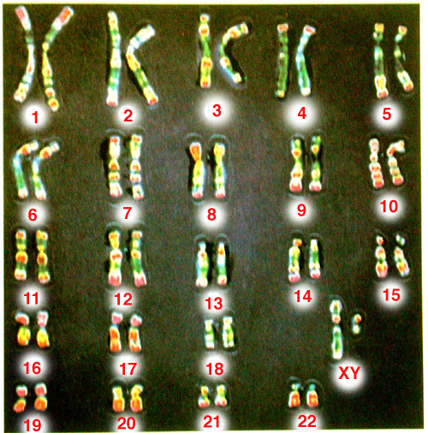
Solution: Chromosomes
Single DNA Molecule and associated proteins
Karyotype
Chromatin vs. Chromosomes
Notes:
Single DNA Molecule and associated proteins
Evident during metaphase of Mitosis and Meiosis
Karyotype---A karyotype is the complete set of all chromosomes of a cell of any living organism. The chromosomes are arranged and displayed (often on a photo) in a standard format: in pairs, ordered by size. Karyotypes are examined in searches for chromosomal aberrations, and may be used to determine other macroscopically visible aspects of an individual's genotype, such as sex (XX vs. XY pair).
Technically, chromosomes are the duplicated, condensed form of chromatin, but the terms are used somewhat interchangeably.

Slide 4
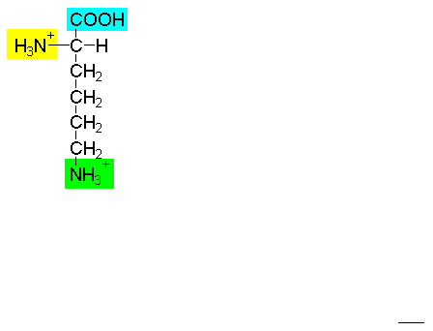
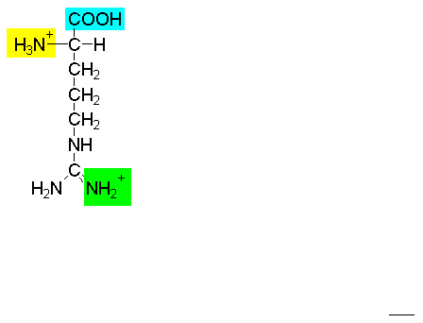
HISTONES
Main packaging proteins
5 classes: H1, H2A, H2B, H3, H4.
Rich in Lysine and Arginine
Notes:
Main packaging proteins---found in eukaryotes and some Archaes
Mass of histones in nucleus = mass of DNA
The (+) charges are instrumental in the recognition process, binding by electrostatic interactions to the phosphate backbone.
HOW CAN THEY BE REMOVED?
Sequence independent contacts mediate interactions between core histones and DNA. DNA is bent araound histone core. Basis for bending is H-bonding between histones and contacts in minor groove (140 H-bonds, primarily between histone and O of phosphates in backbone in minor groove, 7 between R-groups and bases in minor groove). Note: average DNA interacting protein has 20 H-bonds. Basic nature of histones masks negative phosphates, allows bending.
∴binding is strong but in areas with little info, is non-specific.

Slide 5
HISTONES
NOTE: if histones from different species are added to any eukaryotic DNA sample, chromatin is reconstituted. Implication?
Very highly conserved in eukaryotes in both
Structure
Function
Protection
Must allow gene activity
Notes:
NOTE: if histones from different species are added to any eukaryotic DNA sample, chromatin is reconstituted. Implication?
Very highly conserved in eukaryotes in both
Structure—very similar aa composition, most substitutions are conservative.
Function
Protection
Must allow function
QUESTION: CAN THEY AFFECT GENE EXPRESSION?

Slide 6
Variability in Histones
WEAVER: TABLE 13.1
Notes:
H₄---Only 2 variations ever discovered. Ex Cow and Pea differ at only 2 positions out of 102 total aa (Arg for Lys and Val for Ile, both conservative subs).
H3—also highly conserved
H2A, H2B---Some variation between tissues and species
H1-like histones
H1—Varies markedly between tissues and species
H1º--Variable, mostly present in non-replicating cells
H5---Extremely variable—only present in transcriptionally inactive cells of some species

Slide 7
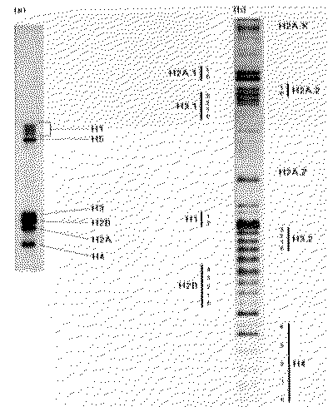
HISTONES
Fairly uniform, some variability
Why variable if only function is packaging?
Notes:
Fairly uniform, some variability
Why variable if only function is packaging?

Slide 8
Variations In Histones
How can cells introduce changes in protein structure and thus protein function?
Mutations
Post transcriptional modifications—ex alternate splicing
Post translational modifications
Acetylation
Methylation
Ser-Thr O-phosphorylation
His N-phosphorylation
NOTE: These processes are dynamic. They give the cell another means to regulate gene expression
Notes:
How can cells introduce changes in protein structure and thus protein function?
Mutations—but must retain the original gene or function (ex lysosyme). ∴occurs after gene duplication
Histone H1 shows greatest sequence variation.
Post transcriptional modifications—ex alternate splicing
Post translational modifications—Histone heterogeneity by post-translational modification
chargeMost change charge on protein and have important effects on chromatin structure
NOTE: These processes are dynamic. Groups can be added and removed, ∴affecting the interaction of histones and DNA. They give the cell another means to regulate gene expression

Slide 9
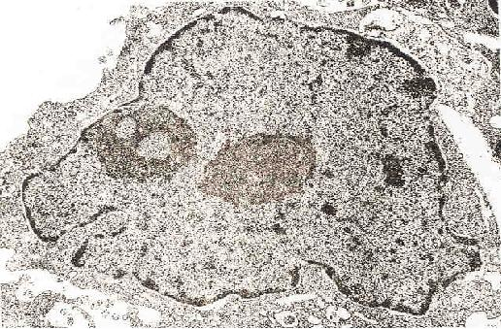
DNA is complexed with proteins and organized as chromatin in the interphase nucleus:

Slide 10
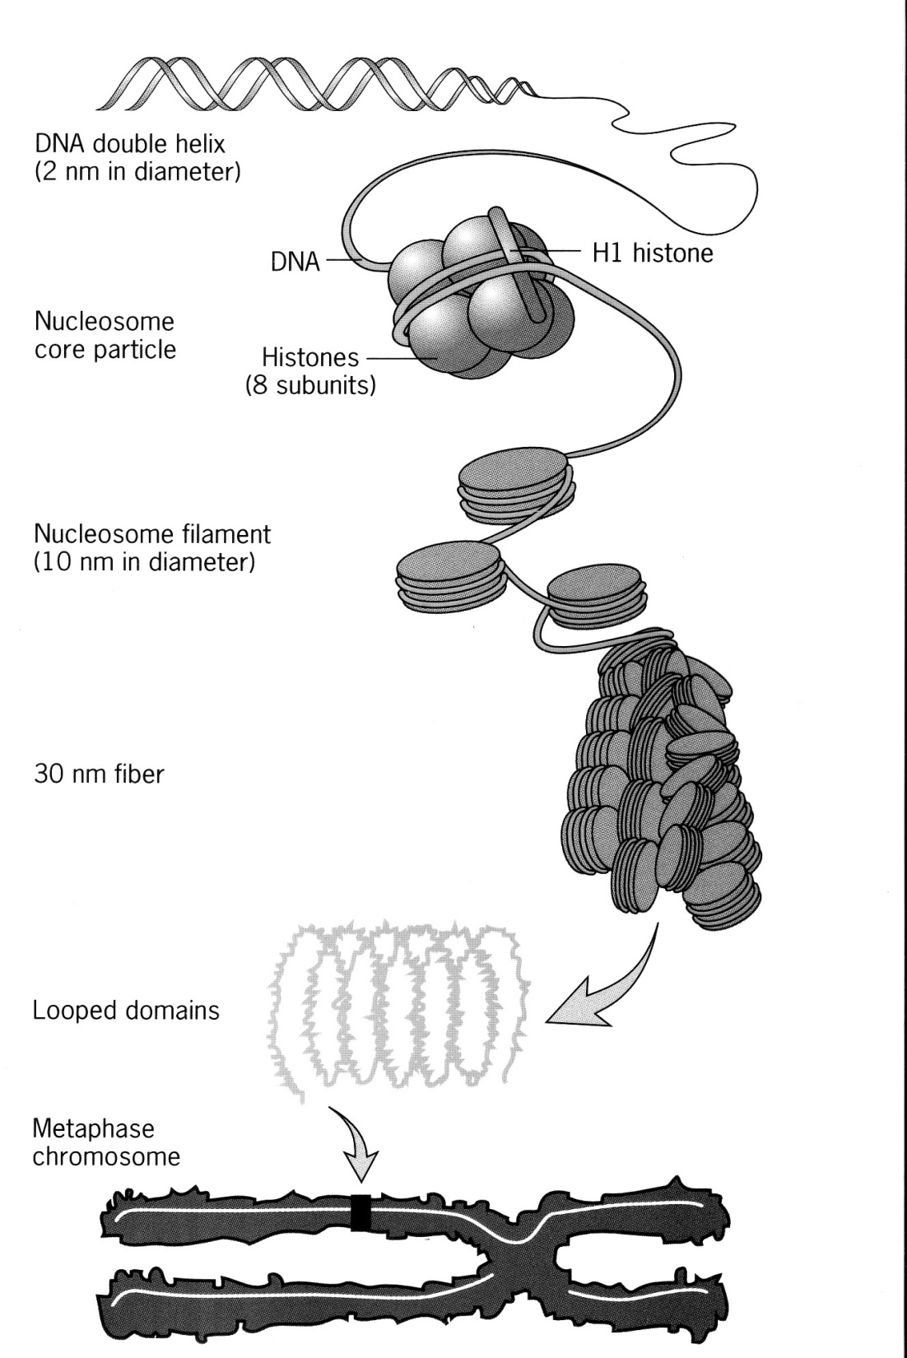
Fig. 9
Orders of chromatin structure from naked DNA to chromatin to fully condensed chromosomes...

Slide 11
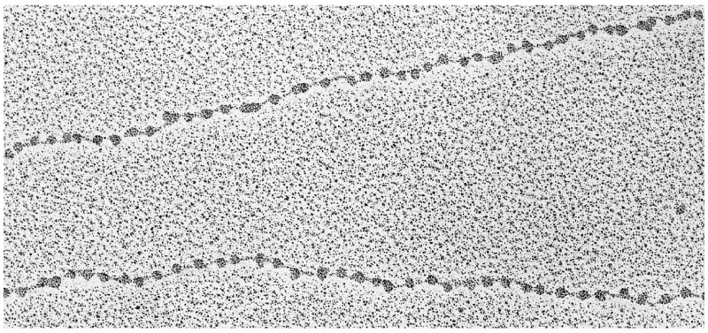
Beads on a String—10 nm Fiber

Slide 12
10 nm filament; nucleosomes
protein
purification
H1
Basic (arg, lys);
+ charges bind
to - phosphates
on DNA
H3
histones
(= 1g per g DNA)
H2A
DNA
H2B
H4

Slide 13
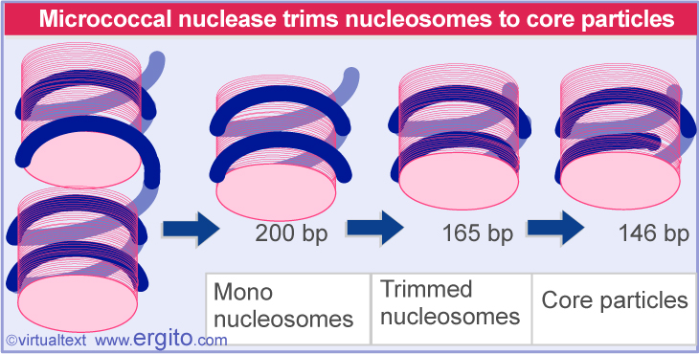
deoxyribonuclease I
(DNase I) digestion
nucleosomes
Separate DNA from protein
proteins
DNA
Core Particle
H1
146 nt fragments
2H3
2H2A
the histone
octamer
Conclude: histones in a
nucleosome protect 146 nt
from DNase I attack.
2H2B
2H4
Notes:
Fundamental unit>>> the 10 nm fiber “beads on a string called nucleosomes. Nucleosomes are ~200 bp (range up to 260 [sea urchin sperm]). Consist of
Histone H1
2 each of Histones H2A, H2B, H3, and H4.
DNA fragment
Further digestion: H1 falls off below ~160, can’t remove below 146.
Core particle:
Histone octamer
146 bp DNA
Linker region: variable, DNA to which H1 is attached.

Slide 14
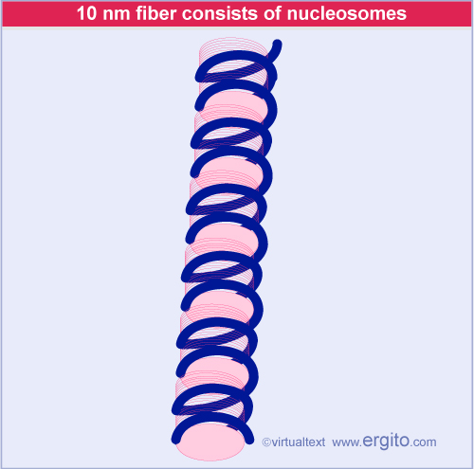
10 nm Fiber
A string of nucleosomes is seen under EM as a 10 nm fiber
Notes:
Figure: 20.17
Title:
Chromatin is a thread of nucleosomes
Caption:
The 10 nm fiber in partially unwound state can be seen to consist of a string of nucleosomes. Photograph kindly provided by Barbara Hamkalo.

Slide 15
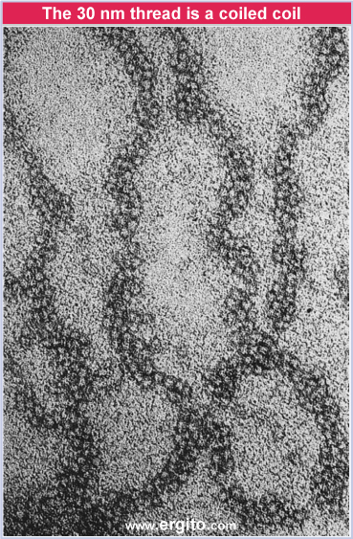
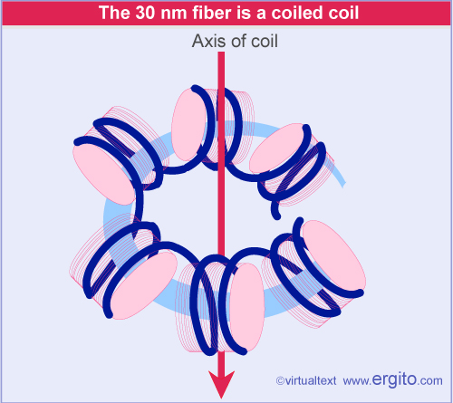
30 nm Fiber
30 nm fiber is coil of nucleosomes with 6/turn
Notes:
Figure: 20.19
The next level of compaction
Title:
The 30 nm thread is a coiled coil
Caption:
The 30 nm fiber has a coiled structure. Photograph kindly provided by Barbara Hamkalo.

Slide 16
The 30 nm Fiber (Compacts DNA 7X more)

Slide 17
Fig. 9
Orders of chromatin structure from naked DNA to chromatin to fully condensed chromosomes...

Slide 18
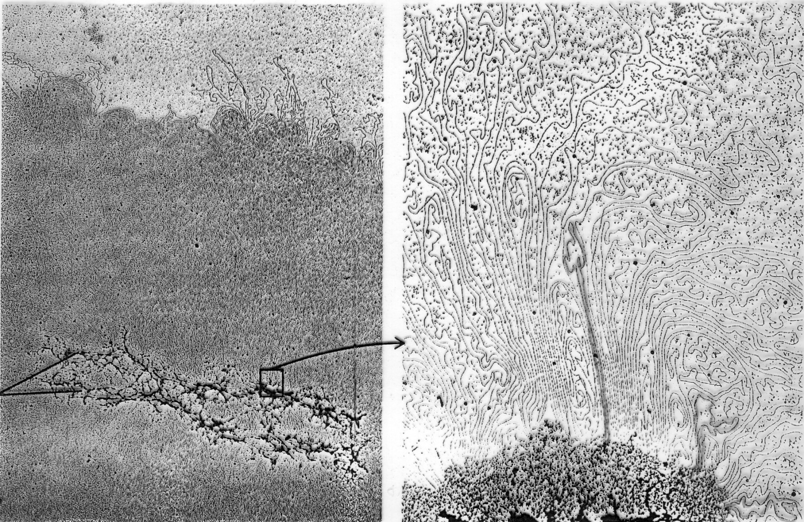
Acid extraction removes histones from meta-phase chromosomes, leaving nonhistones...
Low power high power
DNA
loops
Scaffold
protein
Major non-histone proteins = topoisomerases!

Slide 19
Different forms of chromatin show differential gene activity.
heterochromatin
euchromatin

Slide 20
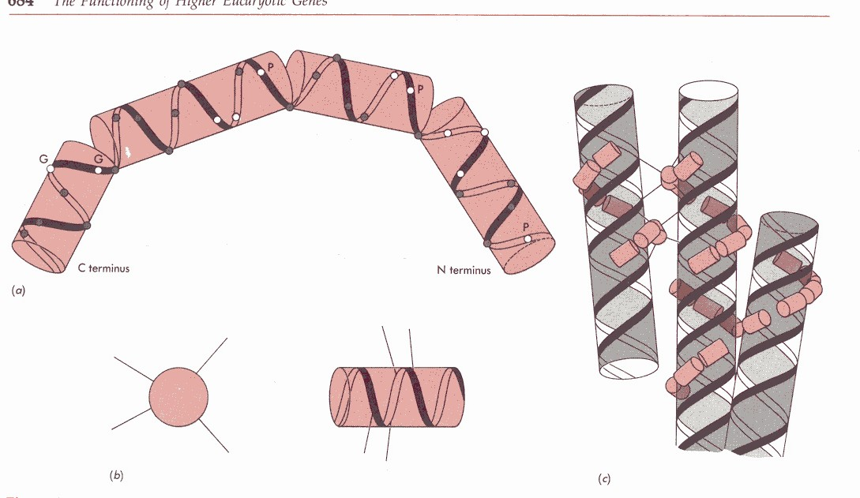
Protamines
In sperm heads, DNA must be further compressed
Protamines
~2/3rd basic amino acids, (mostly Arg)
Greater degree of compaction associated with:
Fit in DNA
Salt bridges between Arg residues in both the contact helix and adjacent helices
Notes:
In sperm heads, DNA must be further compressed
Protamines
Are shuttled to nucleus of developing spermatocytes, where they displace histones
~2/3rd basic amino acids, (mostly Arg)
Greater degree of compaction associated with:
Fit in DNA groove in double helix
Salt bridges between Arg residues in both the contact helix and adjacent helices.
Maximum compaction. No need for gene expression.
Built for speed

Slide 21
Other DNA Associated Proteins
Gene expression in a dynamic environment
DNA associated non-histones:
Palindromes
α-helices
Symmetrical dimers
Interaction between R-groups and specific bases
Role of basic amino acids
Notes:
As important as packaging is, the name of the game is gene expression.
∴proteins of a greater specificity required. Basis of recognition is nt sequence.
Gene expression in a dynamic environment
Some general themes for DNA associated non-histones:
Recognition sequence often Palindromes
Proteins characterized by α-helices
Proteins are generally symmetrical dimers
Interaction between R-groups and specific bases is the basis for recognition
Role of basic amino acids—form salt bridges with phosphate groups

Slide 22
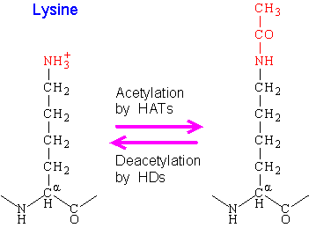
back
Notes:
Post-translational modification
Acetyl group (CH₃COO–) covalently bound to basic amino acid in histones
Neutralizes positive charge
Eliminates ionic interaction with DNA
Decreases chromatin condensation
Associated with active transcription
Sometimes Methyl group added (-CH₃₊) by Histone Methyl Transferase

Slide 23
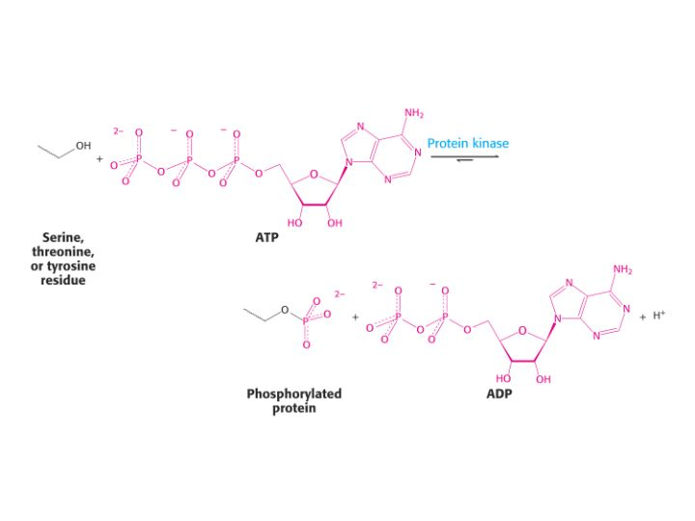
Phosphorylation (Ser and Thr)
back
Notes:
Phosphorylation of Serine and Threonine hydroxyl groups.

Slide 24
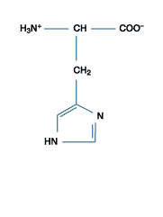
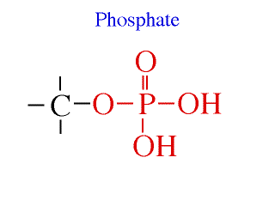
Histidine: N-phosphorylation
How will this affect His’s ability to participate in weak interactions?
Back

Slide 26
Euchromatin (E) vs Heterochromatin (H)
Fig. 11
E
H
DNase
Being more condensed (tightly packed), heterochromatin is resistant to DNase digestion.

Slide 27
Hypothesis:
Transcriptionally active DNA (i.e., an active gene) is in euchromatin.
E
H
nascent transcripts
Can test with DNase I, which should preferentially digest active genes in a cell...

Slide 28
An Experiment:
chick red blood cells
chick RBC nuclei
chromatin extraction
total chromatin
digest with DNase I for different times…
partially digested chromatin; extract undigested DNA
denature DNA, “spot” on filter
make 2
of these...
Increasing time of digestion
Fig. 12

Slide 29
Radiolabel, denature cloned globin and other gene
DNA to use as *probe.
Allow *probe DNA to hybridize to complementary
sequences on filters… expose, develop autoradio-
graph...
Increasing time of digestion
globin gene probe
ovalbumin gene
probe
DNA from digested RBC chromatin
Fig. 13

Slide 30
Conclusions:
Compared to globin gene DNA, ovalbumin gene
DNA in RBC chromatin resists DNase digestion.
Globin gene DNA in RBC chromatin must be
more accessible to DNase (less condensed,
more euchromatic) than ovalbumin DNA.

Slide 31
Histones—Degrees of Conservation
H4---Only 2 variations ever discovered
H3—also highly conserved
H2A, H2B---Some variation between tissues and species
H1-like histones
H1—Varies markedly between tissues and species
H1º--Variable, mostly present in non-replicating cells
H5---Extremely variable
Notes:
H₄---Only 2 variations ever discovered. Ex Cow and Pea differ at only 2 positions out of 102 total aa (Arg for Lys and Val for Ile, both conservative subs).
H3—also highly conserved
H2A, H2B---Some variation between tissues and species
H1-like histones
H1—Varies markedly between tissues and species
H1º--Variable, mostly present in non-replicating cells
H5---Extremely variable—only present in transcriptionally inactive cells of some species

Slide 32
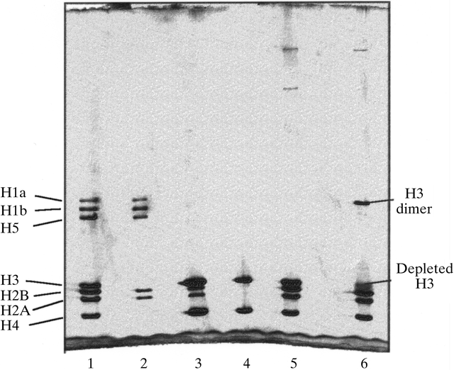
Notes:
Figure 1 A 20% SDS-PAGE gel of the proteins present in the various stages of histone octamer purification. All samples were precipitated with trichloroacetic acid, washed with acetone and dissolved in reducing buffer containing 2-mercaptoethanol, with the exception of the sample in lane 6, which was not reduced in this way. Lane 1, the supernatant at the end of stage 1 (retained); lane 2, the supernatant at the end of stage 2 (discarded); lane 3, the pellet at the end of stage 2 (retained); lane 4, the pellet at the end of stage 3 (discarded); lane 5, the reduced protein from the supernatant at the end of stage 3; lane 6, the non-reduced protein from the supernatant at the end of stage 3 (crystallized).

Slide 33
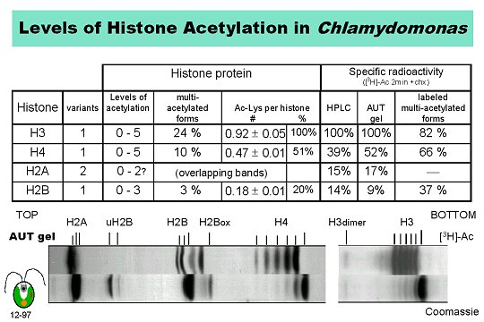
Post-Translational Modifications

Slide 34
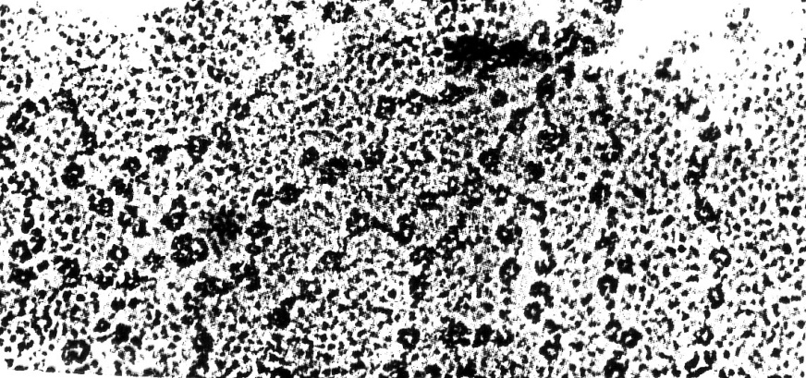
Dissection of interphase nuclei...
low [salt] extraction
10 nm filament;
nucleosomes
30 nm solenoid fiber
[salt]

