Slide 1
Rendering

Slide 2
rendering
Rendering or image synthesis is the automatic process of generating a photorealistic or non-photorealistic image from a 2D or 3D model either by means of a computer program or manually. The resulting image is referred to as the render.

Slide 3
Design rendering
In the world of three-dimensional design, rendering refers to the process of adding physical attributes and details, such as color, shading, texture, and lamination, to a grid frame (or wire frame) that in return creates realistic images on a screen

Slide 4
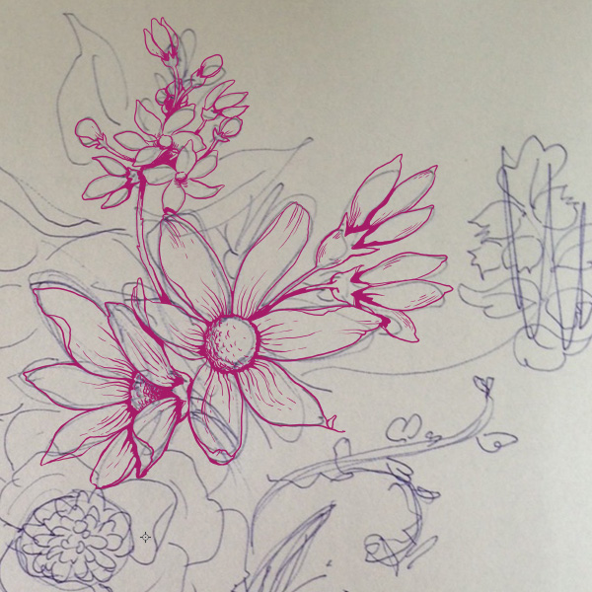
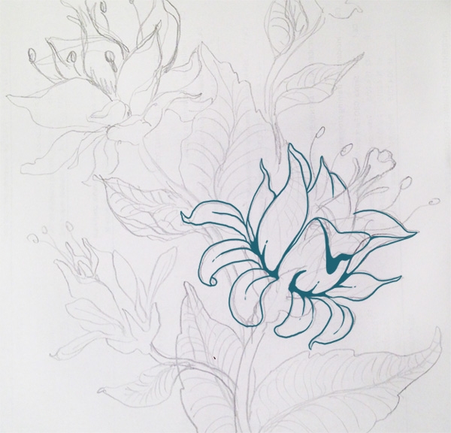
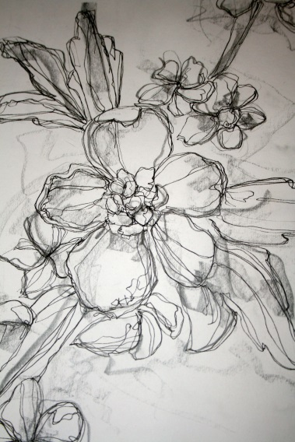

Slide 8
