Slide 1
Chapter 1: Introduction to Project Management

Slide 2
What Is a Project?
A project is “a temporary endeavor undertaken to create a unique product, service, or result”
Projects end when their objectives have been reached or the project has been terminated
Projects can be large or small and take a short or long time to complete

Slide 3
Examples of IT Projects
A team of students creates a smartphone application
A company develops a driverless car
A global bank acquires other financial institutions and needs to consolidate systems and procedures

Slide 4
Project Attributes
A project
has a unique purpose
is temporary
is developed using progressive elaboration
requires resources, often from various areas
should have a primary customer or sponsor
The project sponsor usually provides the direction and funding for the project
involves uncertainty

Slide 5
Project and Program Managers
Project managers work with project sponsors, project team, and other people involved in a project to meet project goals
Program: group of related projects managed in a coordinated way to obtain benefits and control not available from managing them individually
Program managers oversee programs; often act as bosses for project managers

Slide 6
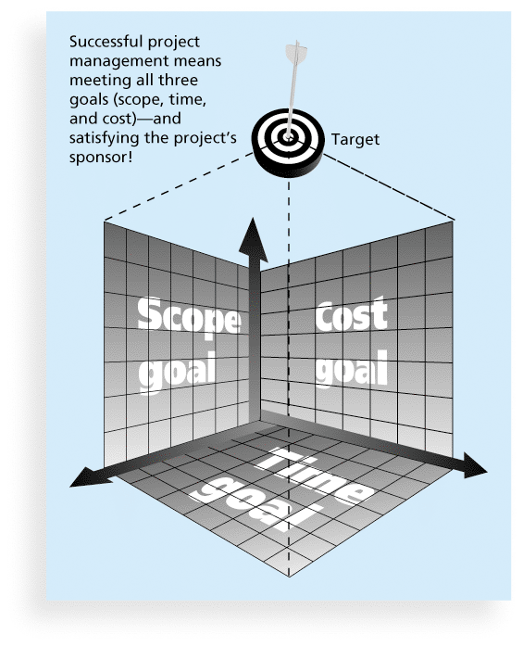
Figure 1-1 The Triple Constraint of Project Management

Slide 7
What is Project Management?
Project management is “the application of knowledge, skills, tools and techniques to project activities to meet project requirements”
Project managers strive to meet the triple constraint (project scope, time, and cost goals) and also facilitate the entire process to meet the needs and expectations of project stakeholders

Slide 8
Project Life Cycle
Defining:
i. Goals
ii. Specifications
iii. Tasks
iv. Responsibilities
Planning:
i. Schedules ii. Budgets iii. Resources
iv. Risk v. Staffing

Slide 9
Executing:
i. Status reports(time,cost) ii. Changes
iii. Quality iv. Forecasts
Closing:
i. Train Customer
ii. Transfer Documents
iii. Release Resources
iv. Evaluation
v. Lesson Learnt

Slide 10
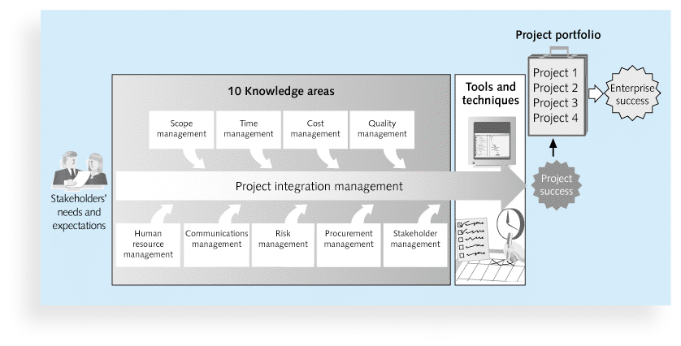
Figure 1-2 Project Management Framework

Slide 11
1. Project scope management involves defining and managing all the work
required to complete the project successfully.
2. Project time management includes estimating how long it will take to complete
the work, developing an acceptable project schedule, and ensuring
timely completion of the project.
3. Project cost management consists of preparing and managing the budget for the project.
4. Project quality management ensures that the project will satisfy the stated or
implied needs for which it was undertaken.
5. Project human resource management is concerned with making effective use
of the people involved with the project.

Slide 12
6. Project communications management involves generating, collecting, disseminating,
and storing project information.
7. Project risk management includes identifying, analyzing, and responding to
risks related to the project.
8. Project procurement management involves acquiring or procuring goods and
services for a project from outside the performing organization.
9. Project stakeholder management includes identifying and analyzing stakeholder
needs while managing and controlling their engagement throughout
the life of the project.
10. Project integration management is an overarching function that affects and is
affected by all of the other knowledge areas.

Slide 13
Project Stakeholders
Stakeholder is any individual, group or organization that can affect, be affected by, or perceive itself to be affected
Stakeholders include
the project sponsor
the project manager
the project team
support staff
customers
users
suppliers
opponents to the project

Slide 14
Project Management Tools and Techniques
Project management tools and techniques assist project managers and their teams in various aspects of project management
Some specific ones include
Project charter, scope statement, and WBS (scope)
Gantt charts, network diagrams, critical path analysis, critical chain scheduling (time)
Cost estimates and earned value management (cost)

Slide 15
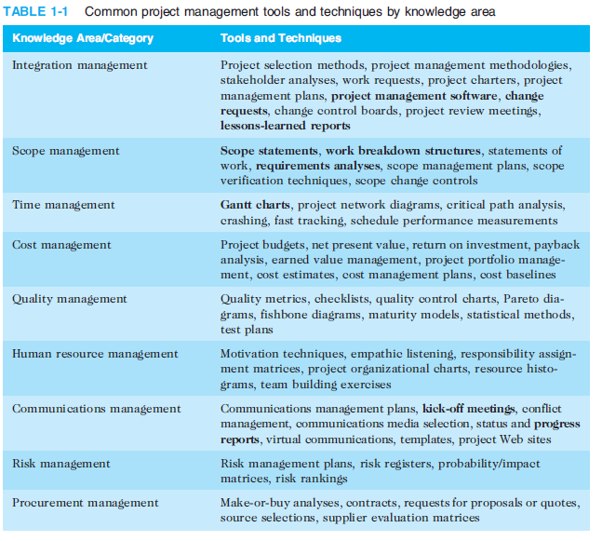

Slide 16
Project Success
There are several ways to define project success:
The project met scope, time, and cost goals
The project satisfied the customer/sponsor
The results of the project met its main objective, such as making or saving a certain amount of money, providing a good return on investment, or simply making the sponsors happy

Slide 17
What Helps Projects Succeed?*
1. Executive support
2. User involvement
3. Clear business objectives
4. Emotional maturity
5. Optimizing scope
6. Agile process
7. Project management expertise
8. Skilled resources
9. Execution
10. Tools and infrastructure

Slide 18
10 Project Management Knowledge Areas
Knowledge areas describe the key competencies that project managers must develop
Project managers must have knowledge and skills in all 10 knowledge areas (project integration, scope, time, cost, quality, human resource, communications, risk, procurement, and stakeholder management)

Slide 19
Top Three Reasons Why Federal Technology Project Succeed
Adequate funding
Staff expertise
Engagement from all stakeholders

Slide 20
Program and Project Portfolio Management
A program is “a group of related projects managed in a coordinated way to obtain benefits and control not available from managing them individually”
A program manager provides leadership and direction for the project managers heading the projects within the program
Examples of common programs in the IT field include infrastructure, applications development, and user support

Slide 21
Project Portfolio Management
As part of project portfolio management, organizations group and manage projects and programs as a portfolio of investments that contribute to the entire enterprise’s success
Portfolio managers help their organizations make wise investment decisions by helping to select and analyze projects from a strategic perspective

Slide 22
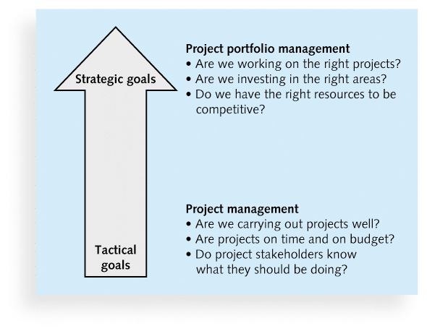
Figure 1-3. Project Management Compared to Project Portfolio Management

Slide 23
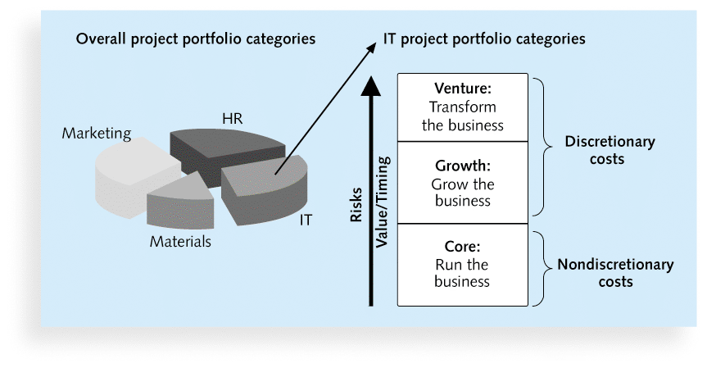
Figure 1-4. Sample Project Portfolio Approach

Slide 24
The Role of the Project Manager
Job descriptions vary, but most include responsibilities like planning, scheduling, coordinating, and working with people to achieve project goals
Remember that 97% of successful projects were led by experienced project managers, who can often help influence success factors

Slide 25
Suggested Skills for Project Managers
The Project Management Body of Knowledge
Application area knowledge, standards, and regulations
Project environment knowledge
General management knowledge and skills
Soft skills or human relations skills

Slide 26
Table 1-3 Ten Most Important Skills and Competencies for Project Managers
1. People skills
2. Leadership
3. Listening
4. Integrity, ethical behavior, consistent
5. Strong at building trust
6. Verbal communication
7. Strong at building teams
8. Conflict resolution, conflict management
9. Critical thinking, problem solving
10. Understands, balances priorities

Slide 27
Different Skills Needed in Different Situations
Large projects: Leadership, relevant prior experience, planning, people skills, verbal communication, and team-building skills were most important
High uncertainty projects: Risk management, expectation management, leadership, people skills, and planning skills were most important
Very novel projects: Leadership, people skills, having vision and goals, self confidence, expectations management, and listening skills were most important

Slide 28
Importance of Leadership Skills
Effective project managers provide leadership by example
A leader focuses on long-term goals and big-picture objectives while inspiring people to reach those goals
A manager deals with the day-to-day details of meeting specific goals
Project managers often take on the role of both leader and manager

Slide 29
Careers for IT Project Managers
In a 2014 survey, IT executives listed the “ten hottest skills” they planned to hire for in 2015
Project management was second only to programming and application development
Even if you choose to stay in a technical role, you still need project management knowledge and skills to help your team and organization

Slide 30
The Project Management Profession
The profession of project management is growing at a very rapid pace
It is helpful to understand the history of the field, the role of professional societies like the Project Management Institute, and the growth in project management software

Slide 31
History of Project Management
Some people argue that building the Egyptian pyramids was a project, as was building the Great Wall of China
Most people consider the Manhattan Project to be the first project to use “modern” project management
This three-year, $2 billion (in 1946 dollars) project had a separate project manager and a technical manager

