Slide 1
Chapter 4
The components of the system unit

Slide 2
The System Unit
The system unit is a case that contains electronic components of the computer used to process data.
System units are available in a variety of shapes and sizes.
The case of the system unit is made of metal or plastic and protects the internal electronic components from damage.
All computers and mobile devices have a system unit

Slide 3
System Unit

Slide 4
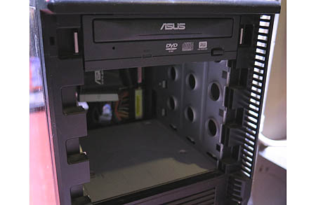
The system Unit
The inside of the system unit on a desktop personal computer includes:
Drive bay(s):- A drive bay is a standard-sized area for adding hardware to a computer. Most drive bays are fixed to the inside of a case, but some can be removed.
Power supply
Sound card
Video card
Processor
Memory

Slide 5
The system Unit

Slide 6
The System Unit
The motherboard is the main circuit board of the system unit – A computer chip contains integrated circuits.
A computer chip is a small piece of semi conducting material, usually silicon, on which integrated circuits are etched.
An integrated circuit contains many microscopic pathways capable of carrying electrical current.
Each integrated circuit can contain millions of elements such as resistors, capacitors, and transistors.

Slide 7
The System Unit

Slide 8
Processor
The processor, also called the central processing unit (CPU), interprets and carries out the basic instructions that operate a computer – Contain a control unit and an arithmetic logic unit (ALU) Multi-core, Dual-core, & Quad-core processor.

Slide 9
Processor

Slide 10
Processor

Slide 11
Processor
The control unit is the component of the processor that directs and coordinates most of the operations in the computer.
The arithmetic logic unit (ALU) performs arithmetic, comparison, and other operations.

Slide 12
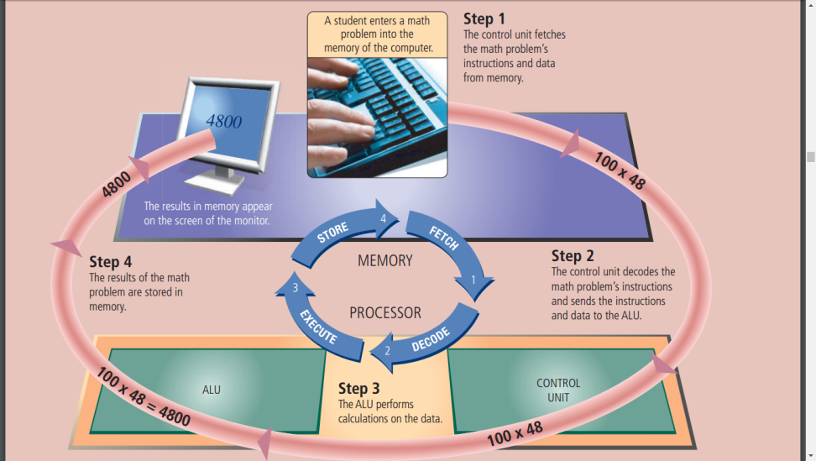
Processor
For every instruction, a processor repeats a set of four basic operations, which comprise a machine cycle

Slide 13
Processor
Most current personal computers support pipelining
– Processor begins fetching a second instruction before it completes the machine cycle for the first instruction

Slide 14
Processor
The processor contains registers, that temporarily hold data and instructions.
The system clock controls the timing of all computer operations.
The pace of the system clock is called the clock speed, and is measured in gigahertz (GHz).
The leading manufacturers of personal computer processor chips are Intel and AMD.

Slide 15
Processor
Parallel processing uses multiple processors simultaneously to execute a single program or task
– Massively parallel processing involves hundreds or thousands of processors.

Slide 16
Data Representation
Analog signals are continuous and vary in strength and quality.
Digital signals are in one of two states: on or off
Most computers are digital.
The binary system uses two unique digits (0 and 1)
Bits and bytes

Slide 17
Data Representation
A computer circuit represents Eight bits grouped together as a the 0 or the 1 electronically by unit are called a byte. A byte the presence or absence of an represents a single character in electrical charge the computer

Slide 18
Data Representation
ASCII (American Standard Code for Information Interchange) is the most widely used coding scheme to represent data

Slide 19
Data Representation

Slide 20
Memory
Memory consists of electronic components that store instructions waiting to be executed by the processor, data needed by those instructions, and the results of processing the data.
Stores three basic categories of items:
The operating system and other system software
Application programs
Data being process and the resulting information

Slide 21
Memory
Each location in memory has an address
Memory size is measured in kilobytes (KB or K), megabytes (MB), gigabytes (GB), or terabytes (TB)

Slide 22
Memory
The system unit contains two types of memory:
Volatile memory
Loses its contents when power is turned off
Examples include RAM.
Nonvolatile memory
Does not lose contents when power is removed
Example includes ROM, flash memory.

Slide 23
Memory
Three basic types of RAM chips exist:
Dynamic RAM (DRAM)
Static RAM (SRAM)
Magnetoresistive RAM (MRAM) stores data using magnetic charges instead of electrical charges.
Manufacturers claim that MRAM has greater storage capacity, consumes less power, and has faster access times than electronic RAM.

Slide 24
Memory
RAM chips usually reside on a memory module and are inserted into memory slots.

Slide 25
Memory
The amount of RAM necessary in a computer often depends on the types of software you plan to use.
The more RAM a computer has, the faster the computer will respond.

Slide 26
Memory
Memory cache speeds the processes of the computer because it stores frequently used instructions and data.
L1 cache is built directly in the processor chip.
L1 cache usually has a very small capacity, ranging from 8 KB to 128 KB.
L2 cache is slightly slower than L1 cache but has a much larger capacity, ranging from 64 KB to 16 MB.

Slide 27
Memory
Read-only memory (ROM) refers to memory chips storing permanent data and instructions
A PROM (programmable read-only memory) chip is a blank ROM chip that can be written to permanently.
EEPROM can be erased.

Slide 28
Memory
Flash memory is a type of nonvolatile memory that can be erased electronically and rewritten
– CMOS (complementary metal-oxide semiconductor) technology provides high speeds and consumes little power.
CMOS can keep the calendar, date, and time current even when the computer is off.

Slide 29
Memory
Access time is the amount of time it takes the processor to read data, instructions, and information from memory .
– Measured in nanoseconds.

Slide 30
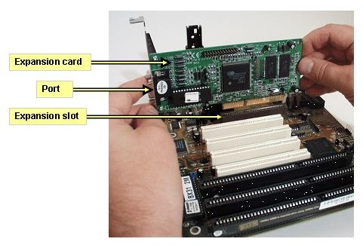
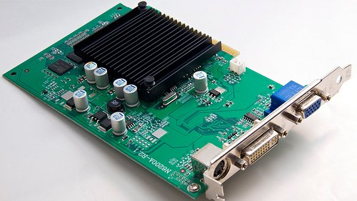
Expansion Slots and Adapter Cards
An expansion slot is a socket on the motherboard that can hold an adapter card.
An adapter card enhances functions of a component of the system unit and/or provides connections to peripherals
– Sound card and video card

Slide 31
Expansion Slots and Adapter Cards
With Plug and Play, the computer automatically can configure adapter cards and other peripherals as you install them

Slide 32
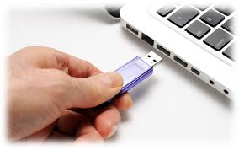
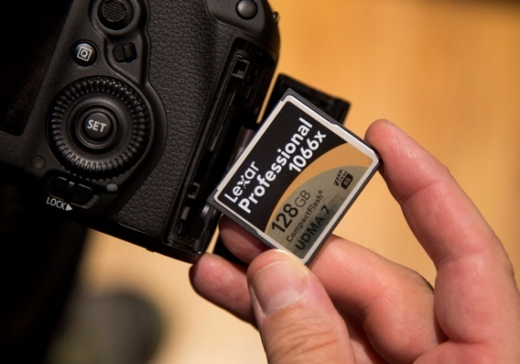
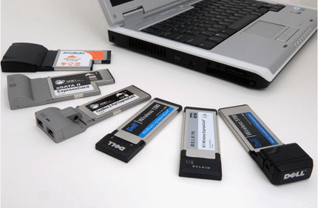
Expansion Slots and Adapter Cards
Removable flash memory includes:
– Memory cards, USB flash drives, and PC Cards/Express Card modules

Slide 33
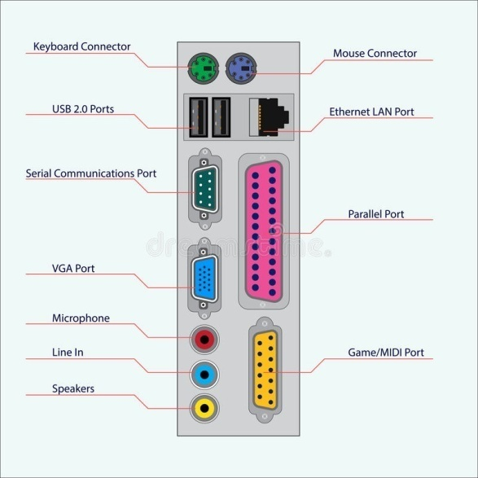
Ports and Connectors
A port is the point at which a peripheral attaches to or communicates with a system unit (sometimes referred to as a jack)
A connector joins a cable to a port.

Slide 34
Ports and Connectors
On a notebook computer, the ports are on the back, front, and/or sides.

Slide 35
Ports and Connectors
A USB port can connect up to 127 different peripherals together with a single connector
– You can attach multiple peripherals using a single USB port with a USB hub.

Slide 36
Ports and Connectors
Other types of ports include:
Firewire Bluetooth
SCSI port
eSATA port
IrDA port
Serial port
MIDI port

Slide 37
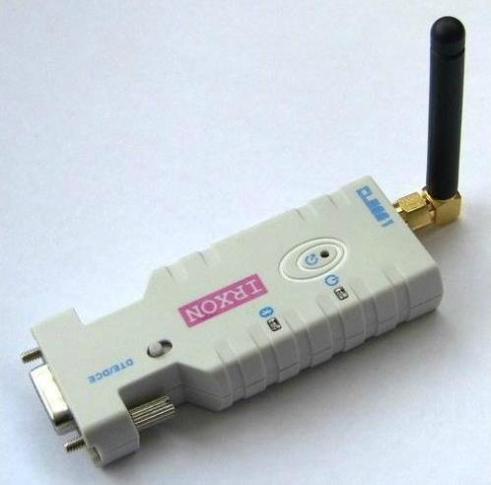
Ports and Connectors
Bluetooth wireless port
Bluetooth technology uses radio waves to transmit data between two devices.
Bluetooth devices have to be within about 33 feet of each other.
Many computers, peripherals, smart phones, PDAs, cars, and other consumer electronics are Bluetooth-enabled, which means they contain a small chip that allows them to communicate with other Bluetooth-enabled computers and devices

Slide 38
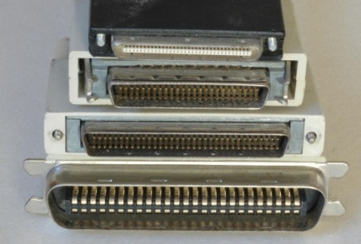
Ports and Connectors
SCSI Port
A special high-speed parallel port, called a SCSI port, allows you to attach SCSI (pronounced skuzzy) peripherals such as disk drives and printers.
SAS (serial-attached SCSI) is a newer type of SCSI that transmits at much faster speeds than parallel SCSI.
Some computers include a SCSI port. Others have a slot that supports a SCSI card.

Slide 39
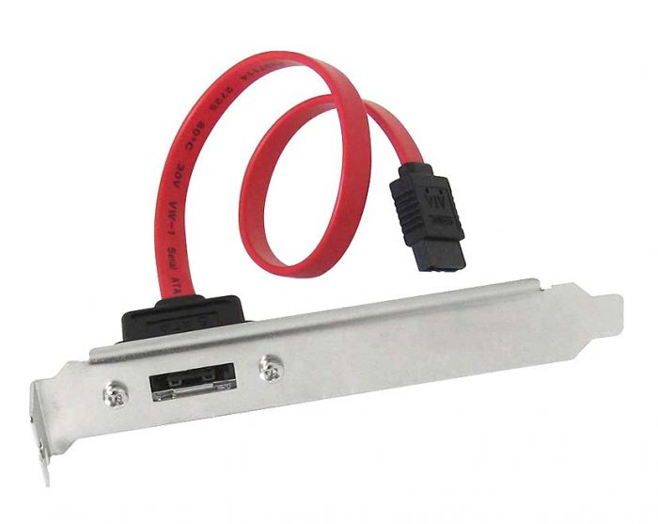
Ports and Connectors
eSATA Port
An eSATA port, or external SATA port, allows you to connect a high-speed external SATA (Serial Advanced Technology Attachment) hard disk to a computer.

Slide 40
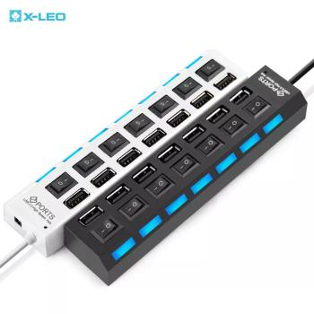
Ports and Connectors
IrDA Port (Infrared data association)
Some devices can transmit data via infrared light waves. For these wireless devices to transmit signals to a computer, both the computer and the device must have an IrDA port.
To ensure nothing obstructs the path of the infrared light wave, you must align the IrDA port on the device with the IrDA port on the computer, similarly to the way you operate a television remote control.
Devices that use IrDA ports include a smart phone, PDA, keyboard, mouse, and printer.

Slide 41
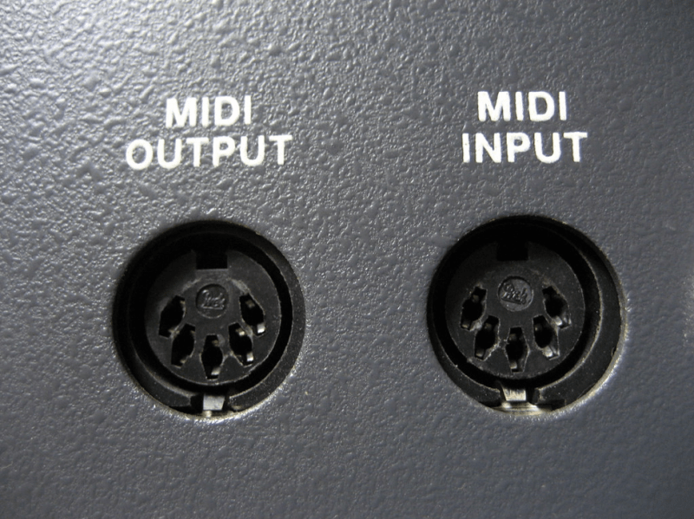
Ports and Connectors
MIDI Port
A special type of port that connects the system unit to a musical instrument, such as an electronic keyboard, is called a MIDI port.
Short for Musical Instrument Digital Interface, MIDI (pronounced MID-dee) is the electronic music industry’s standard that defines how devices, such as sound cards and synthesizers, represent sounds electronically.

Slide 42
Buses
A bus allows the various devices both inside and attached to the system unit to communicate with each other
System bus
Data bus
Address bus
Word size is the number of bits the processor can interpret and execute at a given time.

Slide 43
Bays
A bay is an opening inside the system unit in which you can install additional equipment – A drive bay typically holds disk drives.

Slide 44
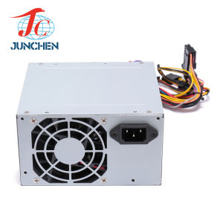
Power Supply
The power supply converts the wall outlet AC power into DC power Some external peripherals have an AC adapter, which is an external power supply.

Slide 45
Keeping Your Computer or Mobile Device Clean
Clean your computer or mobile device once or twice a year Turn off and unplug your computer or mobile device before cleaning it.
Use compressed air to blow away dust.
Use an antistatic wipe to clean the exterior of the case and a cleaning solution and soft cloth to clean the screen

