Slide 1
Tactics & Strategies of
Public Relations

Slide 2
Tactics
Financial public relations
Consumer/lifestyle public relations
Crisis communication
Internal communications
Government relations
Media relationsSocial Media/Community Marketing -

Slide 3
1. Audience targeting
A fundamental technique used in public relations is to identify the target audience and to tailor messages that are relevant to each audience

Slide 4
2. The public in public relations
Internal PUBLICS
External Publics

Slide 5
3.Messaging
Messaging is the process of creating a consistent story around: a product, person, company, or service.

Slide 6
4.Social media marketing
Digital marketing is the use of Internet tools and technologies such as search engines, new media relations, blogging, and social media marketing.
Interactive PR allows companies and organizations to disseminate information without relying solely on mainstream publications and communicate directly with the public, customers and prospects.

Slide 7
The Public Relations Society of America, which has been developing PR strategies since 1947, identified 5 steps to measure online public relations effectiveness.

Slide 8
5 steps to measure online public relations effectiveness.
Engagement:
Impressions:
Items:
Mentions:
Reach:

Slide 9
Engagement

Slide 10
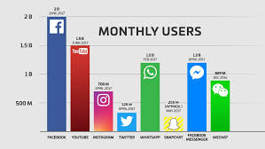
Impressions

Slide 11
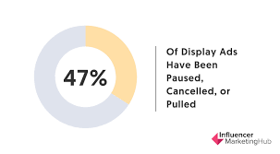
Items

Slide 12
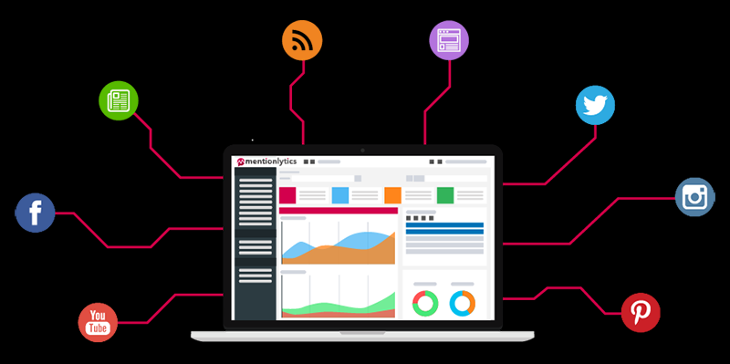
Mentions

Slide 13
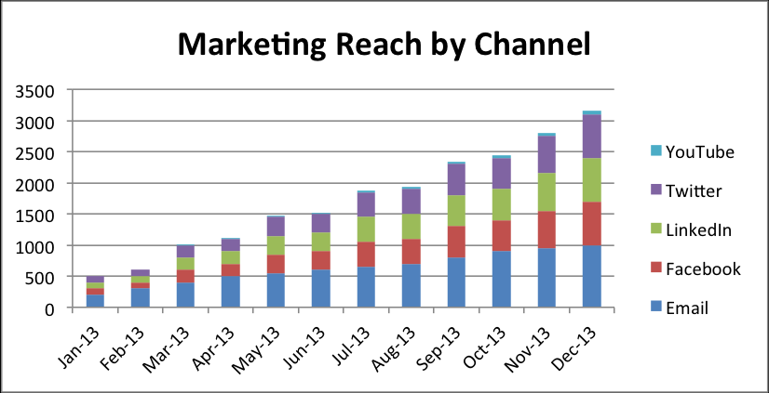
Reach

