Slide 1
Smoking & Chewing Products

Slide 2
Human beings have always chewed or smoked various substances for pleasure, for some physiological effect, in connection with religious ceremonies or in an effort to seek a flight from reality.
Although a few of these such as chewing gum are harmless, the majority of the materials that are smoked or chewed have a distinct stimulating or even narcotic effect.
This is due to the presence of various alkaloids.
Betel, Cola and tobacco are less immediately harmful to the user than opium, cannabis and coca.
The latter are true narcotics that contain alkaloids, which are detrimental even in small amounts.
If used in greater quantities they may lead the addict to a low state of depravity and degradation by causing stupor, coma, convulsions and even death.

Slide 3
Tobacco
Tobacco, Nicotiana tabacum, has become an important commodity worldwide even as evidence mounts of the serious side effects on health through its carcinogenic properties.
Tobacco is native to the Neotropical region.
The Amerindians originated the use of tobacco in connection with religious ceremonies.
The plant had spread over North America in Pre-Columbian times.
Tobacco was introduced into Europe in 1156, but at first was grown only for ornamental and medicinal values.
Jean Nicot, for whom the genus was named, was responsible for its development in France.
From there it spread rapidly over the rest of Europe and into Africa, Asia and Australia.
Some evidence suggests that tobacco was used in Ancient Egypt.

Slide 4
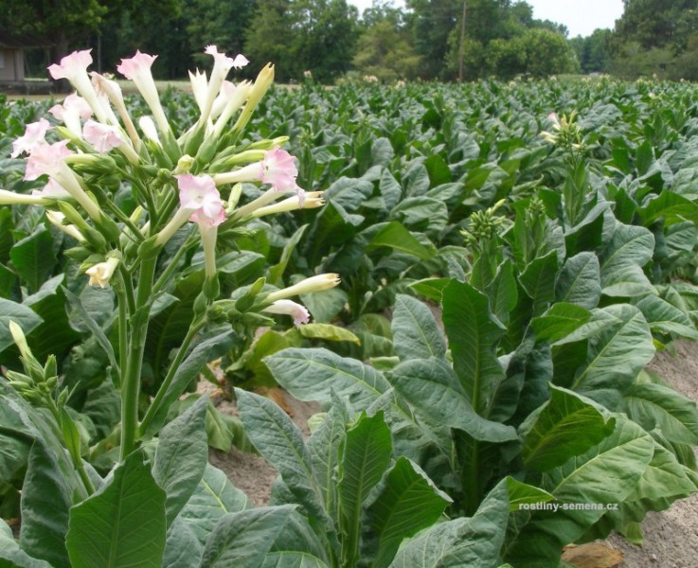
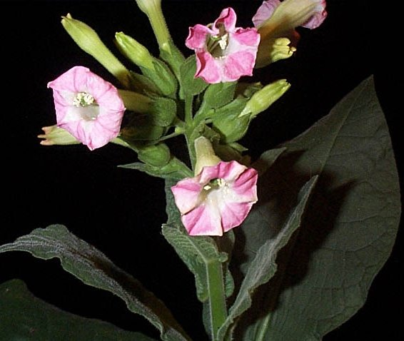
The slight narcotic and soothing properties of tobacco come from the alkaloid nicotine.
This active principle is absorbed by the mucous membranes of the nose and throat.
Essential oils and other aromatic substances that develop during the curing and fermentation process cause the aroma and flavor.

Slide 5
Tobacco Types
Out of the some 50 species of tobacco known, only two have gained commercial importance.
Nicotiana tabacum accounts for most of the production.
This was the native tobacco of the West Indies and most of Central and South America.
There have been over 100 horticultural varieties developed.
Nicotiana rustica is a smaller and hardier species with yellow flowers.
It is thought to have originated in Mexico and still grows wild in parts of North America.
This species was cultivated and smoked by Amerindians in Eastern North America in Pre-Columbian times.
This tobacco was used both for insecticidal and smoking purposes.

Slide 6
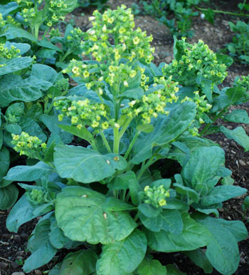
Nicotiana rustica

Slide 7
Betel
The chewing of betel nuts, or areca nuts, has been and still is widespread especially in Asia.
The widespread occurrence of the habit indicates its antiquity. Herodotus first described it in 340 B.C. In India, where it is called Pan over 100-thousand tons of the nuts are used annually.
There it plays an important role in the daily life of the inhabitants.
Betel nuts are the seeds of the betel nut palm, Areca catechu.
It is native to Malaya but is extensively cultivated wherever the nuts are used.
Chewing the betel nut can be quite a complex process. A simple and most usual method involves the use of only three ingredients: betel nuts, betel leaves and lime.
Often mixtures of the nuts with cloves, cinnamon, cardamom, nutmeg or other spices are utilized. Another way of chewing betel involves the addition of tobacco.

Slide 8
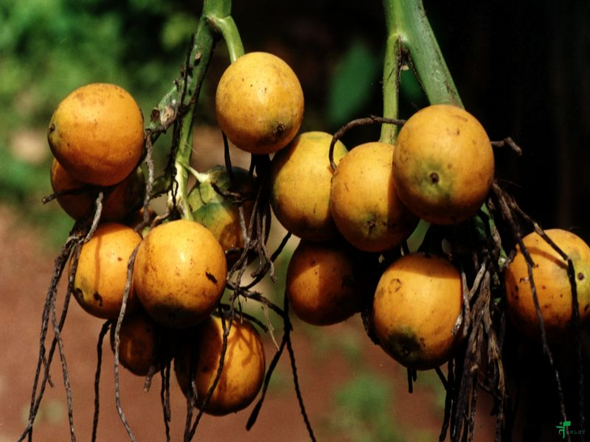
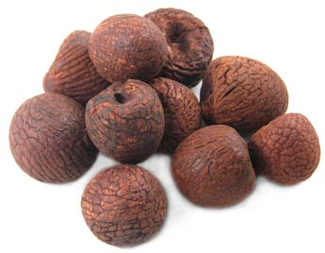
Areca catechu

Slide 9
Cola
Seeds of the cola tree, Cola nitida, are known as cola or kola nuts.
They are extensively used in many parts of tropical Africa for chewing.
It grows wild in the forests of tropical West Africa.
It is also cultivated in this region and the adjacent Sudan, and has been introduced into Brazil, India, Jamaica and parts of tropical Asia.
Cola has played an important role in the social, religious and commercial life of the Africa natives.
It is reported to lower hunger and fatigue.
Cola is a very complex caffeine-containing product. It not only contains two percent caffeine, but an essential oil and a glucoside, kolanin, as well.

Slide 10
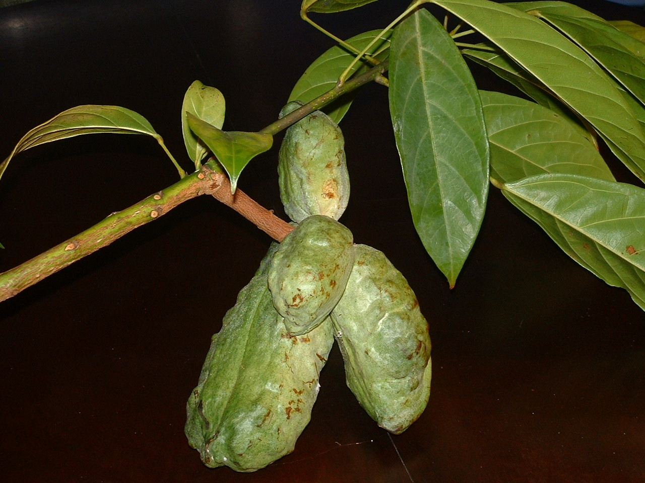
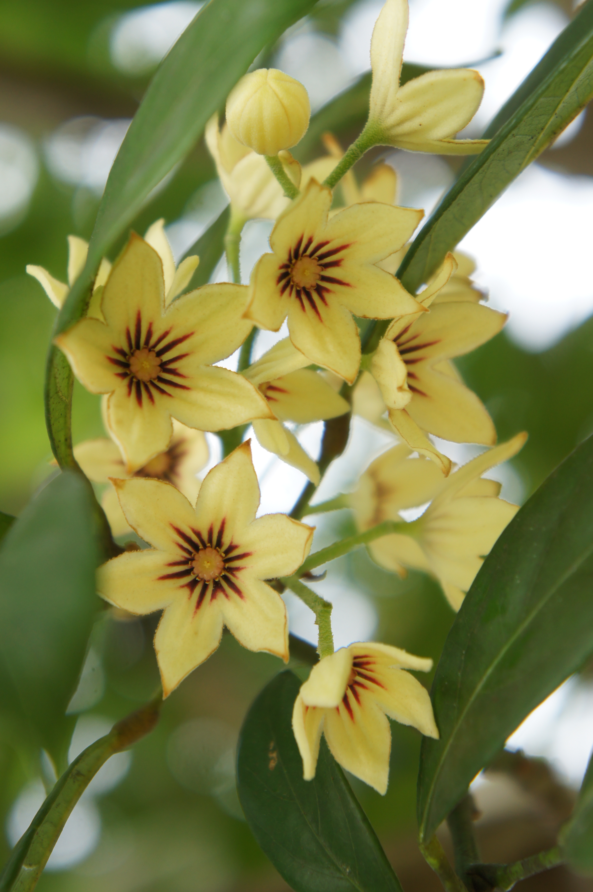
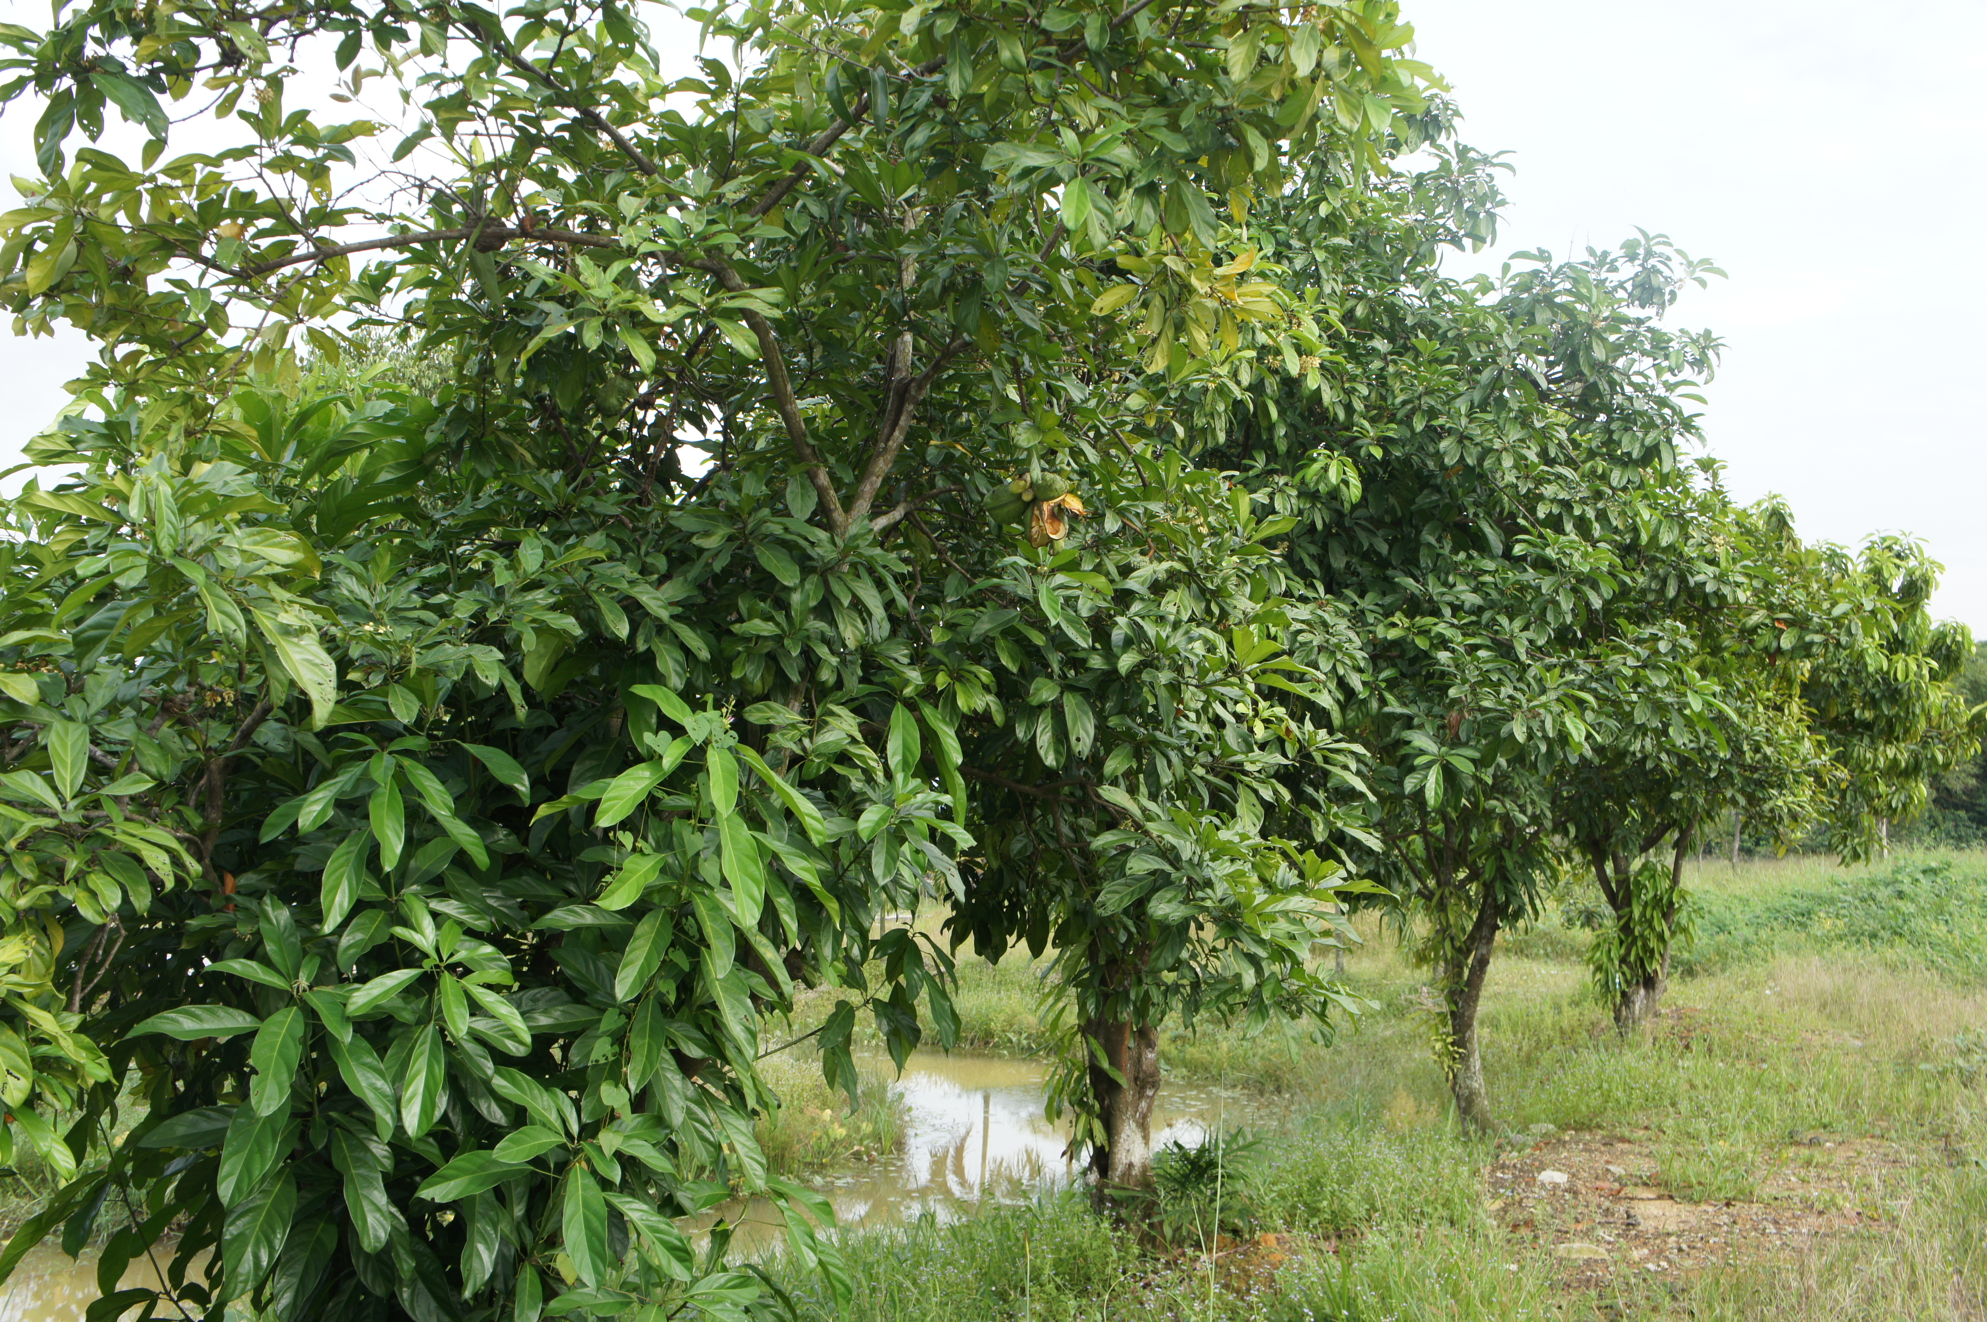
Cola nitida

