Slide 1
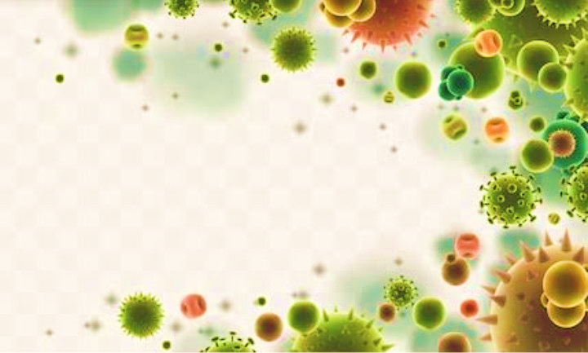
Reproduction in bacteria

Slide 2
content
Introduction
Reproduction types
Vegetative reproduction
Asexual reproduction
Sexual reproduction

Slide 3
INTRODUCTION
Bacteria are the small , prokaryotic microorganisms
They are the simplest and oldest organisms
They were discovered by Anton Leeuwenhoek in 1676
In the five kingdom classification, they are placed in kingdom Monera

Slide 4
REPRODUCTION TYPES
Bacteria reproduce at tremendous speeds. Some bacteria can reproduce often as once every 20 minutes. Bacteria reproduce using three methods:
Vegetative reproduction
Asexual reproduction
Sexual reproduction

Slide 5
VEGETATIVE REPRODUCTION
Vegetatively bacteria reproduces by the following methods:
FISSION
BUDDING
SEGMENTATION

Slide 6
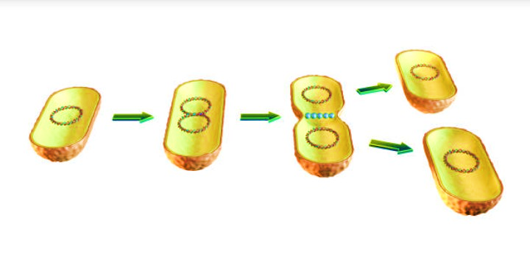
FISSION
It is very common and simple type of reproduction
In this process, the single cell divides into two cells by a process called binary fission
After division each half (daughter cells) behave as independent individual cell
The daughter cells repeatedly divide to multiply in numbers
By this method a single bacterium may produce 16 million bacteria in 12 hours

Slide 7
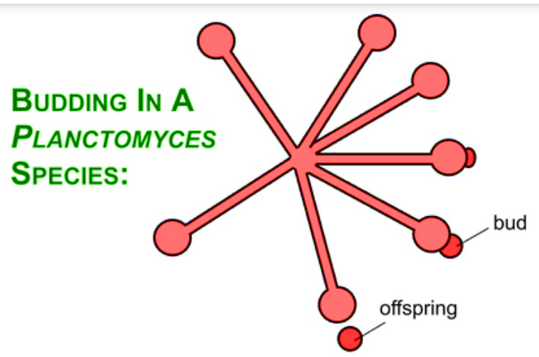
BUDDING
It is also another type of vegetative reproduction found in bacteria
In this type one small outgrowth comes out from the bacterial cell
The outgrowth enlarges and on maturity , separates from mother cell and behaves as an independent cell

Slide 8
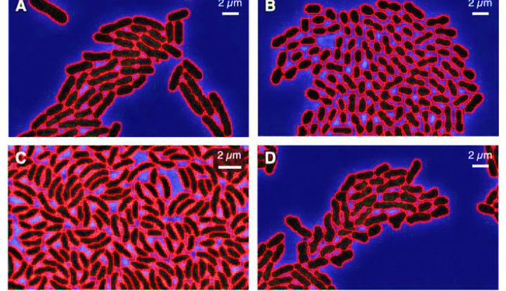
SEGMENTATION
Some other species of bacteria reproduce vegetatively by process called segmentation
In this case, the protoplast of the bacterial cell, at some stages , divides to form very tiny body called gonidia
The cell wall ruptures and liberated tiny gonidia grow into new bacterial cell under suitable conditions

Slide 9
ASEUAL REPRODUCTION
These are forms of asexual reproduction in bacteria
Endospore formation
Conidia formation
Myxospore formation
Cysts formation

Slide 10
ENDOSPORE FORMATION
Under unfavorable condition, endospore formed
They are a special type of reproductive bodies which are produced by bacterial cells
At the time of endospore formation, the bacterial cell enlarges and loses its flagella
The protoplasm concentrates in the middle portion of the cell and develops a thick wall around it which is known as endospore
sometimes two endospores are formed in the same cell
Examples-Bacillus, clostridium , etc

Slide 11
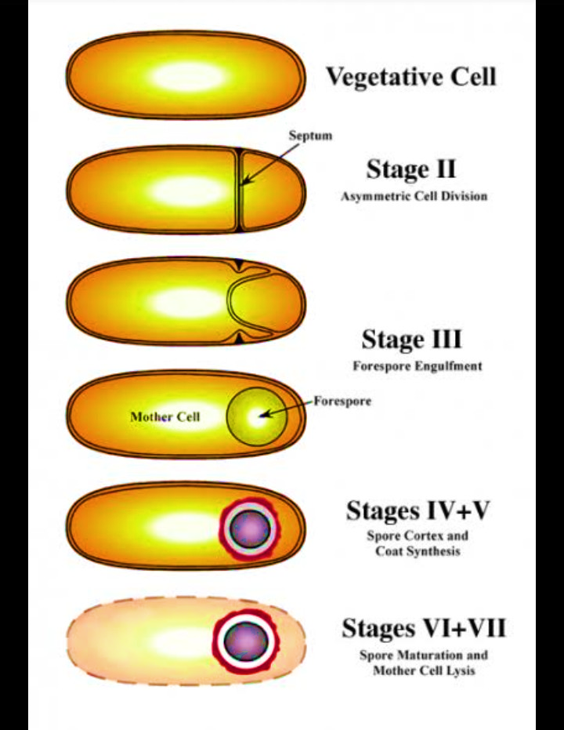

Slide 12
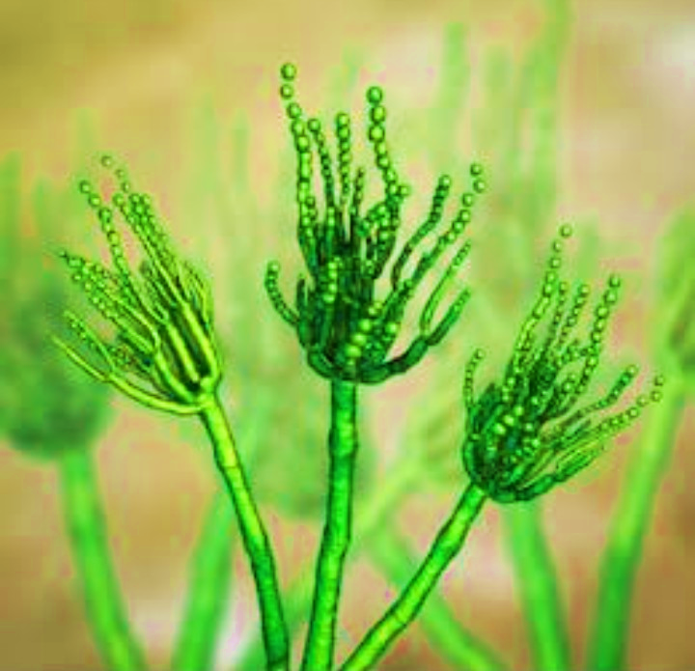
CONIDIA
Streptomyces, an important member of Actinomycetes produce conidia by the formation of a transverse septum at the apex of the filament
The part of this filament which bears conidia is called conidiophore
After detachment from the mother and getting contact with substratum, the conidium germinates and gives rise to new mycelium
Conidia produced externally in chains on the aerial filaments of fungus-like bacteria

Slide 13
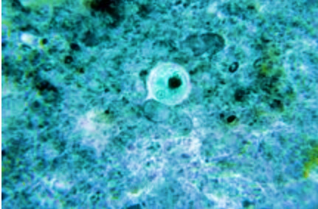
CYSTS FORMATION
In some species of azatobacter, the entire cell is transformed into resistant structure called cyst
At the time of cyst formation, vegetative cell first becomes deflagellated, attains spherical shape and get surrounded by multilayered coat

Slide 14
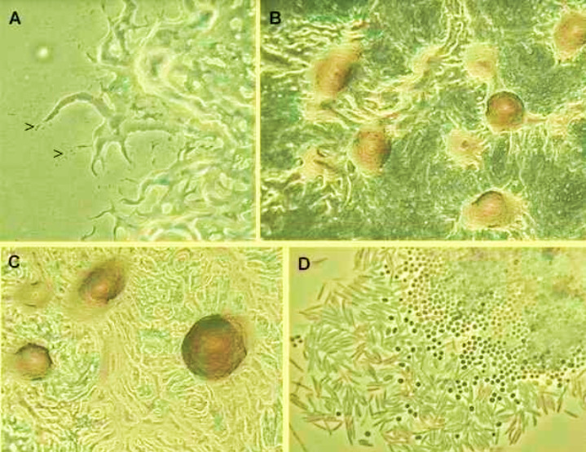
MYXOSPORE FORMATION
Myxospores are the spores of myxococcus and other myxobacteria
These spores develop from fresh vegetative cells which are not divided of their genetic material

Slide 15
SEXUAL REPRODUCTION
Bacteria do not reproduce sexually in the normal sense as eukaryotes as they have no gametes, no alteration of generation and no meiosis. Genetic recombination however, takes place in bacteria by these three mechanisms
Conjugation
Transduction
transformation

Slide 16
CONJUGATION
During conjugation transfer of DNA takes place between bacterial cells. It requires cell-to-cell contact. One bacterium connects itself to another through a protein tube structure called pilus
Joshua Lederberg and Edward Tatum first described conjugation in 1946. they discovered the f- factor, which moves between E.coli cells
F- factor is a plasmid( plasmids are cellular extra chromosomal DNA). These plasmids carry antibiotic resistance genes called R factors. These also allow movement of DNA from a donor to recipient cell. This is the process of conjugation

Slide 17
bacterial conjugation involves various steps like mating pair formations, conjugal DNA synthesis, DNA transfer and maturation
After a stable mating Pair is formed DNA replication starts it produces a single stranded copy of F- factor DNA
This DNA strand transferred to recipient cell. Here, it is copied to make a double stranded DNA molecule, this then form the plasmid
Towards the end of conjugation, the mating pair is broken and both donor and the recipient cell carry an identical episomal copy of F- factor

Slide 18
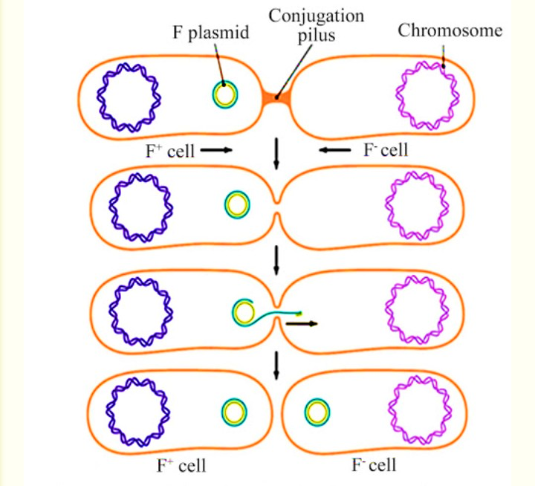

Slide 19
TRANSDUCTION
this is the second way by which DNA is transferred between bacterial cells. It takes place through a phage particle
Joshua Lederberg and Norton zinder discovered transduction in 1956
Phage inject their DNA into recipient cell and kill the host cell(lytic growth)
Some phages do not always kill the host cell( temperate phage), these can be inherited by daughter host cells
This acquiring of a temperate prophage by a recipient cell is a form of transduction

Slide 20
TRANSDUCTION IS OF TWO TYPES:
GENERALIZED TRANSDUCTION:
During this process any bacterial gene can be transferred from a donor cell to a recipient cell. This may be done through bacteriophage and it carries only bacterial DNA and no viral DNA. This is the packaging of bacterial DNA into viral envelope. if the virus replicates it fills the nucleocapsid with genetic material
SPECIALIZED TRANSDUCTION:
I is the process by which a particular set of bacterial genes is transferred to another bacterium. the gene that get transferred are the donor genes. The bacteriophage can pickup a subset of chromosomal genes and transfer them to bacteria

Slide 21
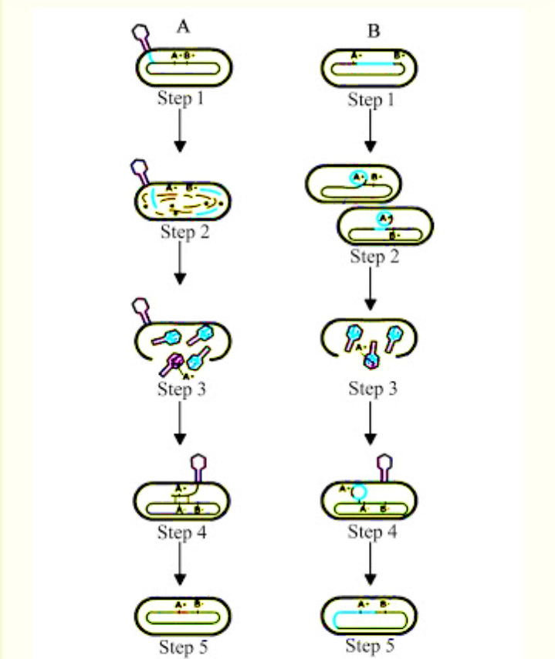

Slide 22
TRANSFORMATION
Bacteria also exchange DNA by transformation
Free DNA from outside of living bacterial cell, which is released from the dead and lysed bacterial cells is transported into the cytoplasm in some bacteria
Bacteria that undergo transfer of DNA by this method are called naturally competent
O. Avery et al for the first time performed this type of DNA transformation of Streptococcus pneumonia
E.coli ia an example of naturally competent for DNA transformation
The double stranded DNA gets bound to the cell surface of a recipient by a protein receptor
strand of DNA gets transported through cell envelope. It can recombine with similar DNA sequence present in the recipient cell
This happens on natural DNA transformation

Slide 23
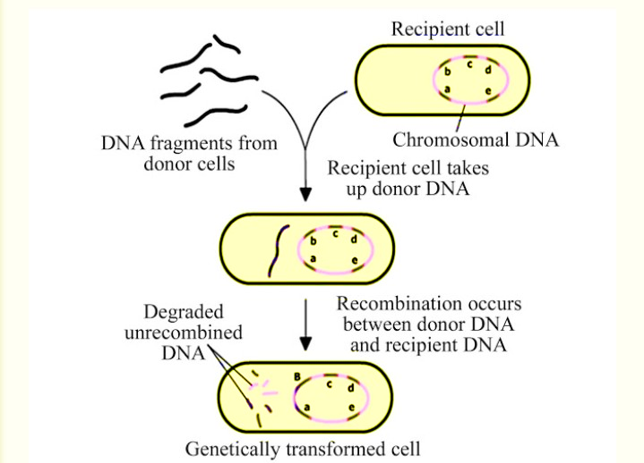

Slide 24
REFRENCES
https://www.biologydiscussion.com/
https://en.wikipedia.org/wiki/English
https://premabotany.blogspot.com

