Slide 1
Dr. Muhammad Ali-ur-Rasheed
Lecturer , Department of Physiotherapy.
Sargodha Medical College.

Slide 2
NEUROLOGICAL PHYSICAL THERAPY INCLUDING CLINICAL PRACTICE

Slide 3
COURSE DESCRIPTION:
MEDICAL TERMINOLOGY REGARDING NEUROLOGICAL SYSTEM
Brain, Spinal cord, CNS Support Structures, Neurons, PNS and Spinal Level Reflexes
NEUROLOGICAL EXAMINATION:
History, System review and Test and measures
INTERVENTIONS:
Introduction to Theories of Neurological Rehabilitation
Remediation & facilitation approaches
Bobath-NDT
Motor relearning program(MRP)
Kabat, Knott, Voss (PNF)
Constraint induced movement therapy (CIMT)
Motor Control / Motor Learning Approach, Neural plasticity/ adoptability, Balance, Role of sensory system, Skill acquisition, Postural Control, Mobility Function, Task-Related Training Approach, Compensatory Training Approach and Normal Reach, Grasp and Manipulation
`

Slide 4
NEUROLOGICAL DYSFUNCTIONS
CVA (Stroke), Traumatic Brain Injury (TBI), Spinal Cord Injury (SCI), Degenerative Diseases (Progressive CNS disorders), Multiple Sclerosis (MS), Parkinson’s Disease (PD), Post Polio Syndrome (PPS), Cerebellar Disorders, Vestibular Disorders, Cranial Nerves Disorders and Poly Neuropathies
NEUROMUSCULAR DISORDERS
CASE HISTORIES
Principles of assessment and outcome measures, Documentation in SOAP notes format, Evidence based neurological Physical Therapy Treatment protocols

Slide 5
RECOMMENDED TEXT BOOKS:
physical rehabilitation, susan b. o'sullivan
Neurological Physiotherapy Bases of evidence for practice Treatment and management of patients described by specialist clinicians by Cecily Partridge
Neurological Physiotherapy A problem-solving approach By Susan Edwards, second edition.
Neurologic examination By Robert j. Schwartzman , first edition

Slide 6
Basic
Nervous system
CNS
PNS
ANS
Sympathetic
Parasympathetic
Brain
Spinal cord

Slide 7
Brain parts
Fore brain
Mid brain
Hind brain
Neurons and neuroglia
Spinal cord
Tracts
Dermatome
Myotome
Sclerotome

Slide 8
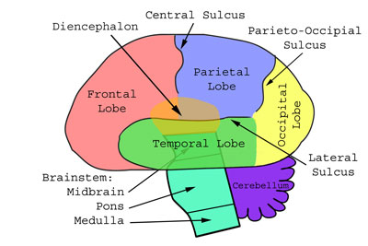
Notes:
Horizontal section through head

Slide 9
Frontal Lobe
The frontal lobe contains most of the dopamine-sensitive neurons in the cerebral cortex.
The dopamine system is associated with reward, attention, memory, and planning.
The ability to recognize future consequences resulting from current actions, to choose between good and bad actions.
Higher mental functions.

Slide 10
The parietal lobe
Integrates sensory information from different areas, particularly determining spatial sense
Visuo spatial processing.
The occipital lobe
visual processing center

Slide 11
The Temporal lobe
It is involved in auditory perception and is home to the primary auditory cortex.
It is also important for the processing of semantics in both speech and vision.
The temporal lobe contains the hippocampus and plays a key role in the formation of long-term memory

Slide 12
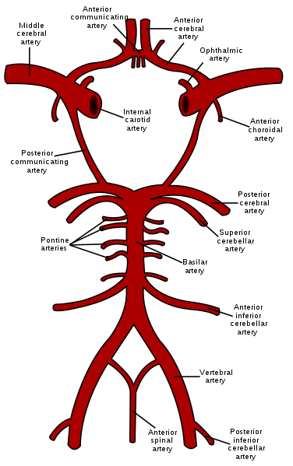

Slide 13
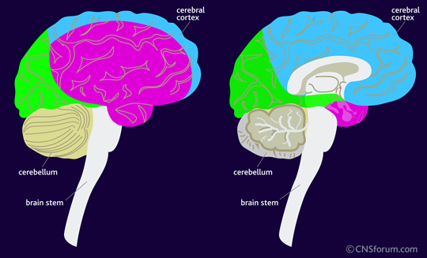
Middle cerebral artery (pink); lateral surface Posterior cerebral artery (green); and anterior cerebral artery (blue).

Slide 14
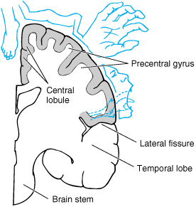

Slide 15
Cerebral blood flow
Unconsciousness occurs in 5-10 seconds if the blood supply of brain completely cut off.
Neuronal function ceases after 1 minutes
Irreversible changes start to occurs after 4 minutes
Can be delayed if the patient’s body has been cooled

Slide 16
Model of Disablement
WHO | Nagi | NCMRR | ICF
Disease | Pathology | Patho physiology | Health /disease
Impairment | Impairment | Impairment | Body structure & function/Impairment
Disability | Functional limitation | Functional limitation | Activity / activity limitation
Handicap | Disability | Disability | Participation /participation restriction
 |  | Societal limitation

Slide 17
Scale
SMMSE
Standardized Mini Mental State examination

Slide 18
Any Question ???
Thanx

