Slide 2
FATS AND OILS
FST-403
B. Sc. (Hons). Food and Science and technology
INSTITUTE OF FOOD SCIENCE AND NUTRITION
UNIVERSITY OF SARGODHA, SARGODHA

Slide 3
LECTURE OUTLINE
Oil bearing seeds
Applications
Storage

Slide 4
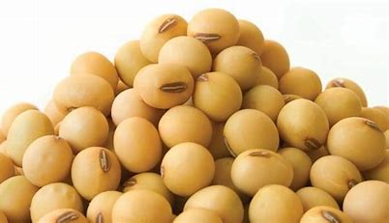
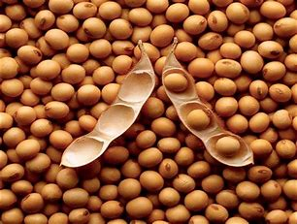
OIL BEARING SEEDS
Following are some oil seeds with their applications
Soybean oil: This is obtained from the seed of the soybean plant. It is the oil produced in largest quantity. It is the dominant edible oil in the United States. It is composed of 61% polyunsaturated fatty acids, 25% monounsaturated fatty acid.
Applications:
About 48% of soybean oil is used in margarine, shortening, cooking and salad oils, mayonnaise

Slide 5
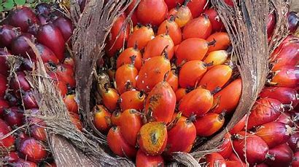
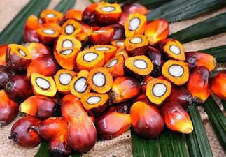
OIL BEARING SEEDS
Palm oil: This is produced from the fruits of palm trees. lt is the most efficient oil-producing plant. Palm oil has been balanced fatty acid composition in which the level of saturated fatty acids is almost equal to that of the unsaturated fatty acids. Palmitic acid (44-45%) and oleic acid (39-40%) are the major component acids
Applications such as cooking/frying oils, margarines. shortenings, speciality tins and spray dried products.

Slide 6
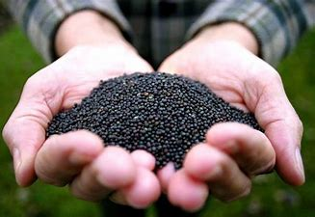
OIL BEARING SEEDS
Canola oil: This is edible oil obtained from it relatively new variety of rape seed plant. lt occupies the third position in order of production of oils and fats. Canola oil has a low level of saturated fatty acids (about 6%)
Application: lt is used majorly in shortening, margarine cooking and frying tilts

Slide 7
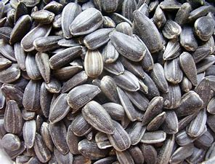
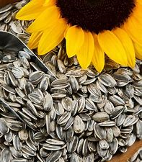
OIL BEARING SEEDS
Sun flower oil: lt is the Fourth of the most popular vegetable oils and in some countries, it is grown in limited geographical locations. It has total saturated fat content less than 10%. 55-75% oleic acid and I5-35% linoleic acid.
Application: lt is excellent for cooking, making salad dressing, margarine but not for frying due to its poor oxidation stability

Slide 8
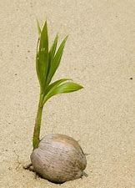
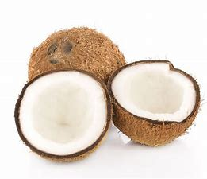
OIL BEARING SEEDS
Coconut oil: This is obtained from copra, which is dried coconut meat from the coconut palm known as Cocos nucifera. It is classified as a fat because it is solid at room temperature. It has high level of saturated fatty acids (80%).
Applications: Such as milk fat substitute in filled milk (evaporated milk), as non-dairy creamers, in the production of infant and sports foods.

Slide 9
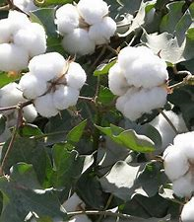
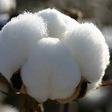
OIL BEARING SEEDS
Cotton seed oil: This oil is obtained from the seed of the cotton plant. The oil is a by-product and is dependent on the use of cotton in textiles therefore the oil is traded only to at small extent.
Application : It is used in the preparation of some shortening, margarine, as a salad oil and for deep-frying some snack items

Slide 10
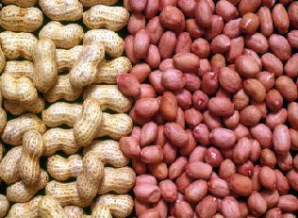
OIL BEARING SEEDS
Groundnut (peanut) oil: Groundnut oil is commonly known us peanut, earthnut, and groundnut. Groundnut oil is unsaturated with a roasted nutty flavor. It contains a high proportion of oleic. linoleic and palmitic acid.
Application: In the preparation of shortenings, margarines and mayonnaise.

Slide 11
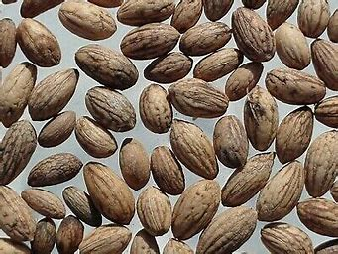
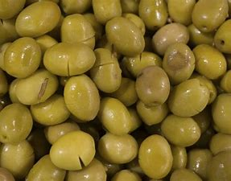
OIL BEARING SEEDS
Olive oil: It is obtained from the fruits of the olive tree. It is a mixture of triacylglycerol, with some lice fatty acids, majorly palmitic, palmitoleic, oleic and linoleic acids. lt contains about 71% oleic acid.
Application: Applications in food, skin and healthcare industries

Slide 12
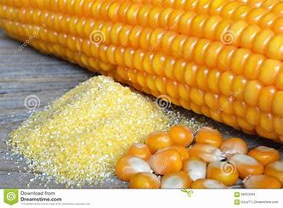
OIL BEARING SEEDS
Corn oil :It has a pleasing flavor and contains relatively low levels (less than 15%) of saturated fatty acids. Very low levels α-linolenic acid and high levels of polyunsaturated fatty acids. Mostly germ portion is high in oil.
Application: The primary use of this oil is in corn margarines, cooking/salad oil.

Slide 13
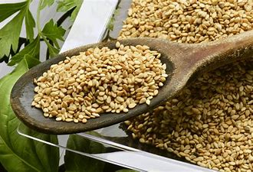
OIL BEARING SEEDS
Sesame seed oil: This is obtained from sesame seed, which has high oil content (42-56%). It is highly resistant to oxidation and displays several medicinal effects. Sesame seed oil is classier as a polyunsaturated oil with about 82% unsaturated fatty acid.
Application: It is used as cooking oil.

Slide 14
OIL BEARING SEEDS
Some of other oils also include
Rice brain oil
Flaxseed (linseed) oil
Safflower oil
Tomato seed oil
Chilli seed oil
Water melon seed oil

Slide 15
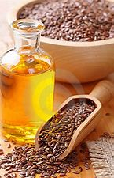
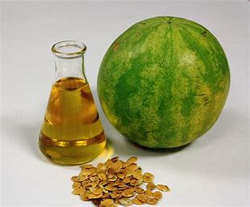
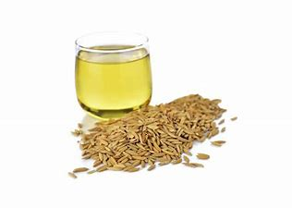
OIL BEARING SEEDS

Slide 16
OIL BEARING SEEDS STORAGE
Storage: In most rural operations, sun-drying reduces the moisture content of oil seeds to below 10 percent. Adequate ventilation or aeration of the seeds or nuts during storage ensures low moisture levels and microbial development is avoided. This is important in the storage of groundnuts which are highly susceptible to aflatoxin contamination through the growth of Aspergillus flavus. Since aflatoxins and pesticides are not removed by rural extraction techniques, microbial contamination and the application of insecticides should be avoided.

Slide 17
Thank You ☺

