Slide 1
Vitamin B12

Slide 2
Vitamins
A vitamin is an organic compound and an essential nutrient that an organism requires in limited amount.
Types:
Vitamin A
Vitamin B
Vitamin C
Vitamin D
Vitamin E
Vitamin K

Slide 3
B - Complex
Vitamin B1
Vitamin B2
Vitamin B3
Vitamin B5
Vitamin B6
Vitamin B7 (Biotin)
Vitamin B9 (Folic acid)
Vitamin B12

Slide 4
Introduction of B12
Vitamin B12 is a water-soluble vitamin that is naturally present in some foods,
added to others, and available as a dietary supplement and a prescription medication.
Vitamin B12 is present in many animal products like Fish meat, Poultry meat, Egg, Beef and Motton.
It is one of eight B vitamins.
It is also called cobalamin.

Slide 5
Structure
Largest and most Structurally complicated.
It contains the biochemically rare element cobalt (chemical symbol Co)
First natural product consisting Cobalt.
Vitamin B12 is water soluble, heat stable and red in colour.
It contains 4.35 % cobalt by weight.
It contains 63 carbon, 14 nitrogen and one cobalt atoms.
Four pyrrole rings co-ordinated with cobalt atom is called a corrin ring.
The 5th valency of the cobalt is covalently linked to a substituted benzimidazole ring.This is then called cobalamin.
The sixth valency of the cobalt is satisfied by any of the following groups: cyanide, hydroxyl, adenosyl or methyl.

Slide 6
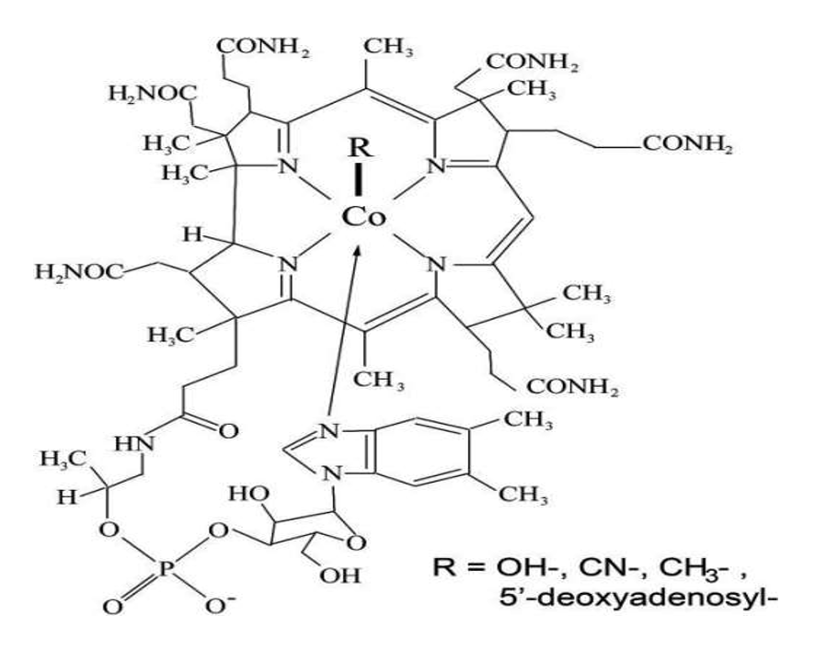
Basic Structure of Vit.B12

Slide 7
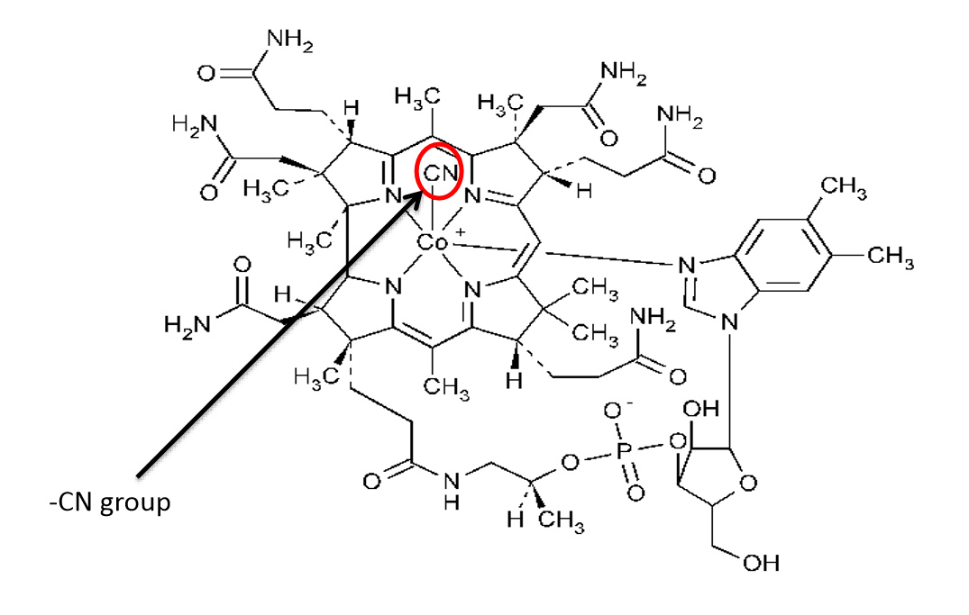
Cyanocobalamin
When cyanide is added at the R position, the molecule is called cynocobalamine.

Slide 8
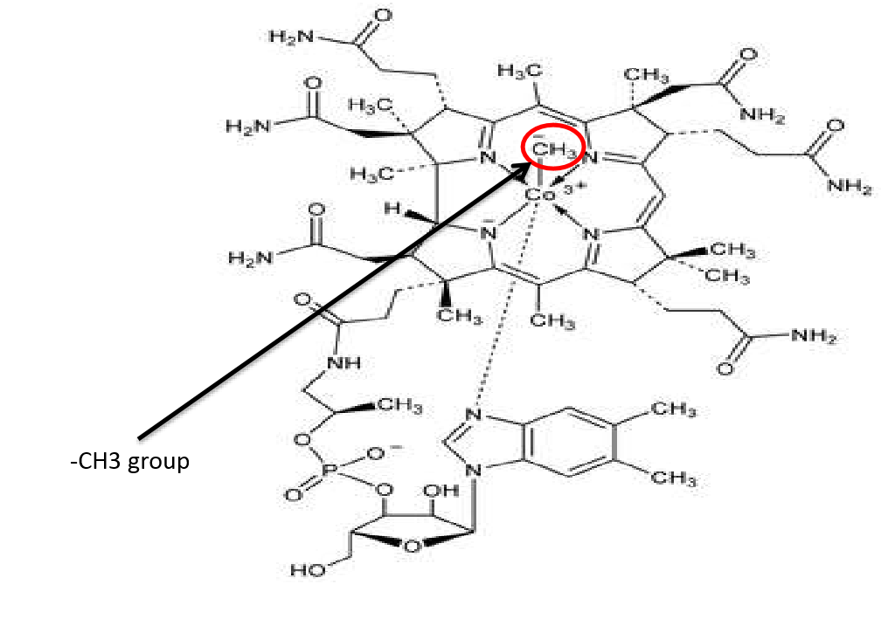
Methylcobalamin
When the methyl group replaces adenosyl group, it is know as methylcobalamin.
This is the major form seen in blood circulation as well as cytoplasm.

Slide 9
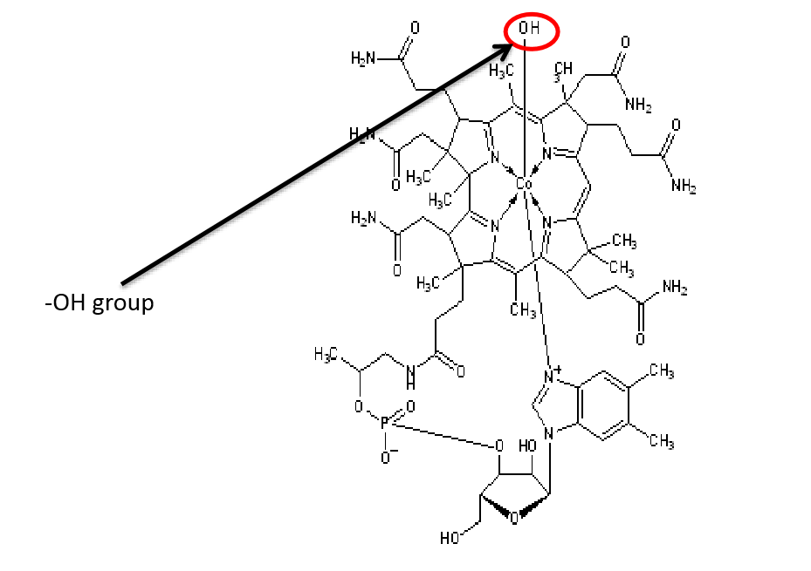
Hydroxycobalamin
When hydroxyl group is attached at the R position, it is called hydroxycobalamin.
When taken up by the cells, these groups are removed and deoxyadenosylcobalamin is formed.

Slide 10
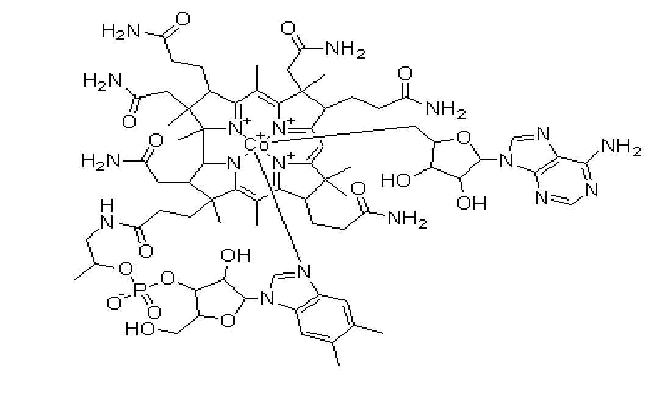
5’-deoxyadenosylcobalamin

Slide 11
Absorption
• Two mechanisms exist for cobalamin absorption.
• Passive absorption-occurring equally through buccal, duodenal and ileal mucosa; it is rapid but extremely inefficient, <1 percent of an oral dose being absorbed by this process.
• Active absorption-The normal physiologic mechanism is active; it occurs through the ileum and is efficient for small (a few micrograms) oral doses of cobalamin and is mediated by gastric intrinsic factor (IF).
• Dietary cobalamin is released from protein complexes by enzymes in the stomach, duodenum, and jejunum
• It combines rapidly with a salivary glycoprotein that belongs to the family of cobalamin-binding proteins known as haptocorrins (HCs).
• In the intestine, the haptocorrins are digested by pancreatic trypsin and the cobalamin transferred to intrinsic factor(IF).

Slide 12
Metabolic Role
B12 plays a vital role in the catabolism of odd-chain fatty acids, threonine, methionine, and the branched chain amino acids (leucine, isoleucine, and valine).
The degradation of each of these compounds produces the same metabolite, Propionyl CoA.
Transportation
Three plasma transport proteins have been identified.
Transcobalamin I and III (differing only in carbohydrate structure) are secreted by white blood cells.
Although approximately 90 percent of plasma vitamin B12 circulates bind to these proteins, only transcobalamin II is capable of transporting vitamin B12 into cells.

Slide 13
Storage of Cobalamin
The liver contains 2000 to 5000 mcg of stored vitamin B12.
Since daily losses are 1 to 3 mcg/day.
The body usually has sufficient stores of vitamin B12 so that vitamin B12 deficiency develops more than 3 years after vitamin B12 absorption.

Slide 14
Vitamin B12 values
NIH , US says
Daily dietary requirement of Vitamin B12 is 2.4 mcg for young adult.
Foods Values
Chicken 0.4mcg/100g
Beef 3.2 mcg/100g
Salmon 3.0 mcg/100g
Eggs 1.3 mcg/100g
Vitamin B12 benefits
It benefits your
Mood
Energy level
Heart
Skin
Hairs

Slide 15
Sources of Vitamin B12
Shellfish
Fish (Mackerel)
Crab
Red meat
Liver(Beef)
Eggs
Milk (Low Fat)
For Vegetarians:
Cereal
Soy Products
Fortified Foods

Slide 16
Characteristics of Vitamin B12
Vitamin B12 is very stable at high temperatures.
PH is ranged from 4.5 to 5.0.
While the strong acidic and highly alkaline environment loses its vitamin activity.
This vitamin is rapidly degraded in the light, and therefore it is necessary to keep it in the dark.
Vitamin B12 is well soluble in water, ethanol and methanol & insoluble in acetone, chloroform, ether.
Odorless & Tasteless.
No fungi, plants, or animals (including humans) are capable of producing vitamin B12.Only bacteria and archaea have the enzymes needed for its synthesis.

Slide 17
Importance of Vitamin B12
• For the formation of red blood Cells.
• For the good health of brain cells and the Nervous system, together with Vitamin C & Methionine.
• To defend against Stress.
• To avoid discouragements & dismay.
• To get good functioning of the mind.
• For the good health of the cells of the bones.
• For proper growth.
• For cell renewal, along with folic acid and other nutrients.
• For the absorption of Vitamin A and Iron.
• Reduce the levels of hemocystenin in the blood.
• Along with folic acid, pantothenic acid, vitamin C and other nutrients, it is involved in the metabolism of Fats and Carbohydrates.

Slide 18
Deficiency
If you have vitamin B12 deficiency you could become anemic.
A mild deficiency may not cause any symptoms if untreated it may cause Weakness Constipation Vision loss and Heart problems etc.
• Megaloblastic Anemia
• Growth problem
• Nervous problem
• Tendency suffer from infections
• Problem of memory and learning
• Soreness of the mouth or tongue
• Tiredness, despondency, discouragements, weight loss, loss of appetite
• Greenish skin tone
• Suspected degenerative diseases, such as Multiple sclerosis, Osteoporosis.
• Suspicion of mental problems, such as Schizophrenia.

Slide 19
Risk factors of Deficiency
Being old age
Being Vegetarian
Diabetes mellitus
Helicobacter pyloric infection

