Slide 1
Elements of Design
The elements of design create every object around us. Nothing can exist without these ingredients. The discipline of learning the power of these elements and formatting them within the principles of design is the responsibility of the designer.

Slide 2
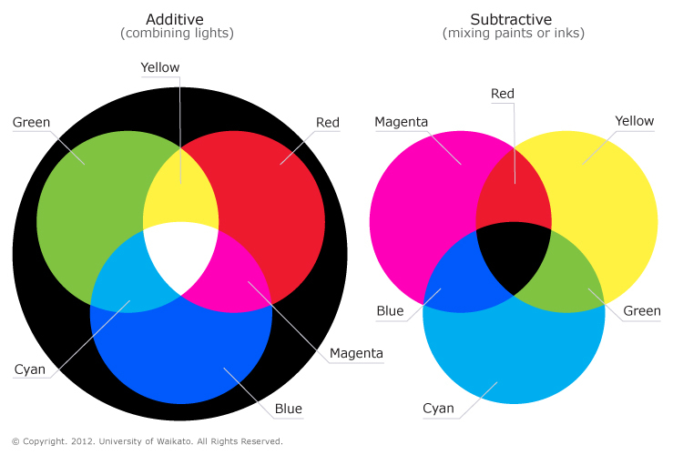
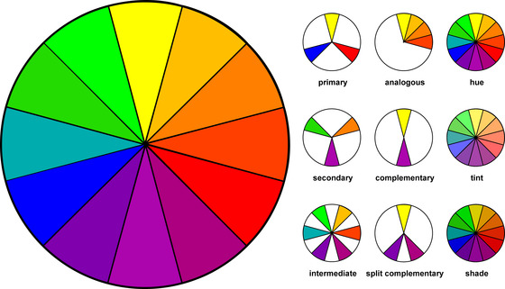
Color
typically known as hue. This word represents a specific color or light wavelength found in the color spectrum, ranging circularly from red to yellow, green, blue and back to red.

Slide 3
Line
Line - is a line just a series of points? Or is it the best way to get from point "A" to point "B"? As a geometric conception, a line is a point in motion, with only one dimension - length. Line has both a position and a direction in space. The variables of line are: size, shape, position, direction, number, interval and density. Points create lines, lines create shapes or planes and volume.

Slide 4
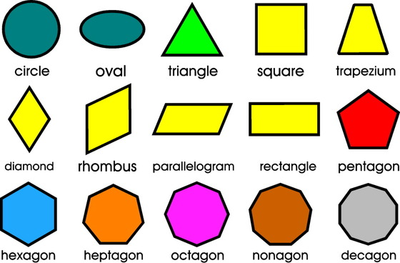
Mass or Forms
Mass - Here, mass is interchangeable with volume. A mass is a solid body or a grouping of visual elements (line, color, texture, etc.) that compose a solid form. Volume is a three-dimensional form comprising length, width, and depth. Three-dimensional forms contain points (vertices), lines (edges), and planes (surfaces). A mass is the two-dimensional appearance of a three-dimensional form.

Slide 5
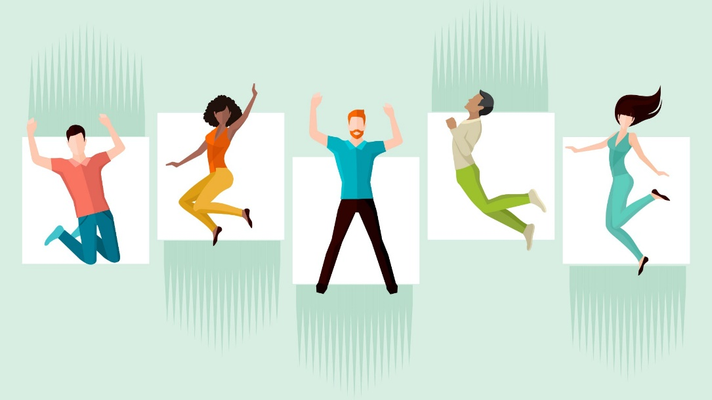
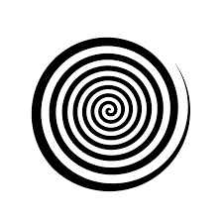
Movement
Movement - Also known as motion. This element portrays the act or process of changing place or direction, orientation, and/or position through the visual illustration of starting or stopping points, blurring of action, etc. This is not animation, although animation is an end product of movement, as well as other elements of design.

Slide 6
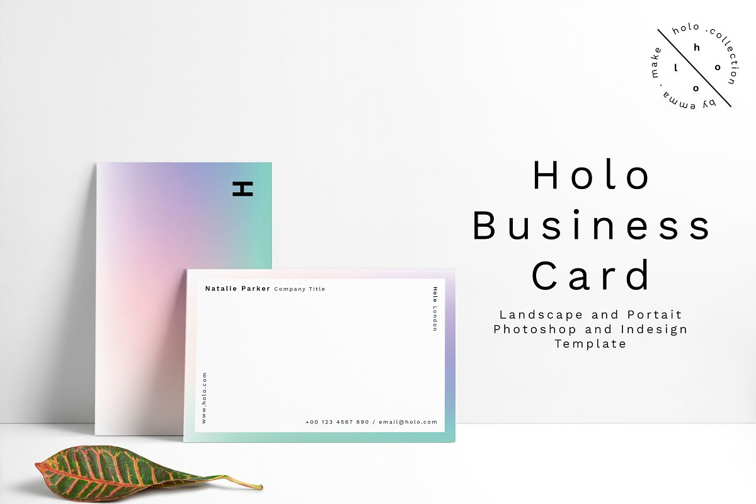
Space
Space - A two- or three-dimensional element defined by other elements of design.

Slide 7
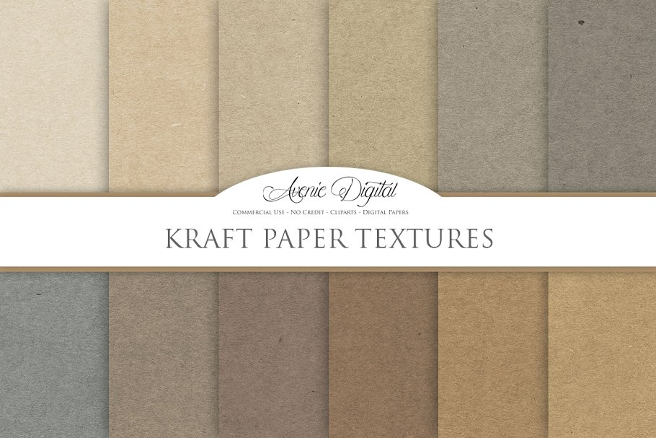
Texture
Texture - A technique used in two-dimensional design to replicate three-dimensional surfaces through various drawing and media techniques. On three-dimensional surfaces, it is experienced by touch or by visual experience.

Slide 8
Type or Typography
Type - Also known as typography, and it is considered an element in graphic design. Although it consists of elements of design, it is - in itself - often an element in the form of visual communication.

Slide 9
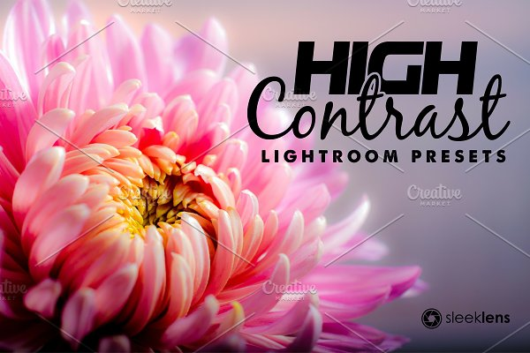
Value
Value - Another word for the lightness or darkness of an area. Brightness measured in relationship to a graded scale from white to black.

Slide 10
The principles of design are tools used to format the elements of design.

Slide 11
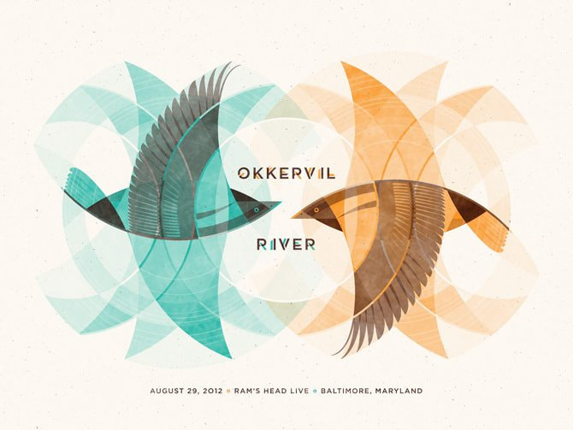
Balance
Balance - The elements of design converge to create a design or arrangement of parts that appear to be a whole with equilibrium.

Slide 12
Contrast
Contrast - The "automatic principle." Whenever an element is placed within a format, contrast is created in the various elements. Can be emphasized with contrast in size, shape, color, texture, etc., etc. Offers variety within a visual format.

Slide 13
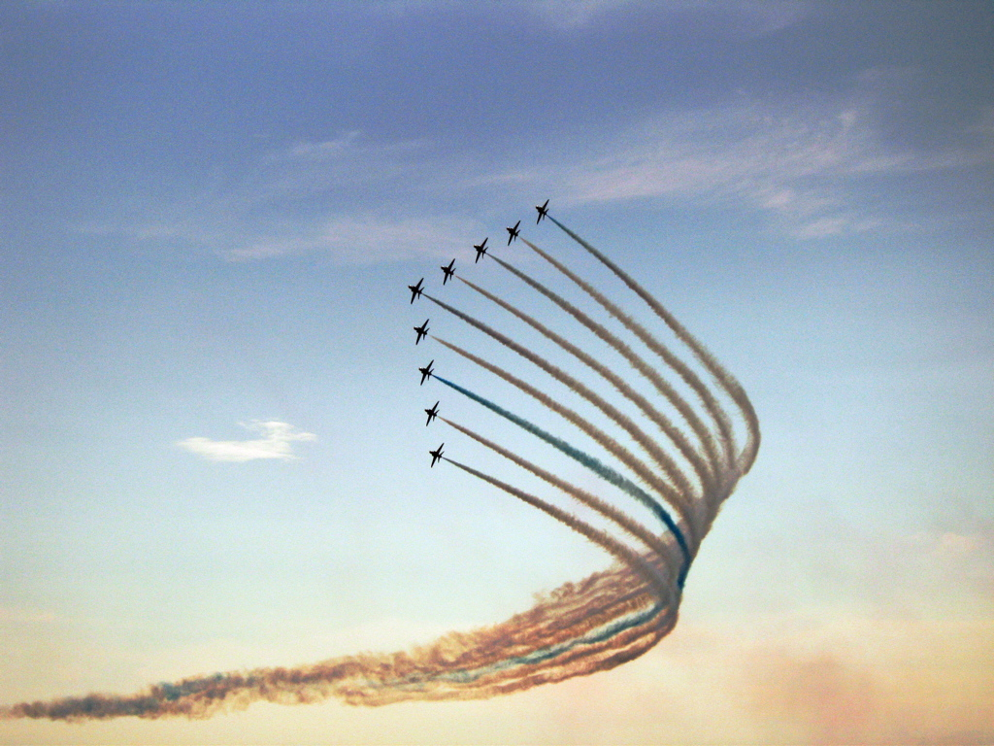
Direction
Direction - Utilizing movement to create the visual illusion of displacement.

Slide 14
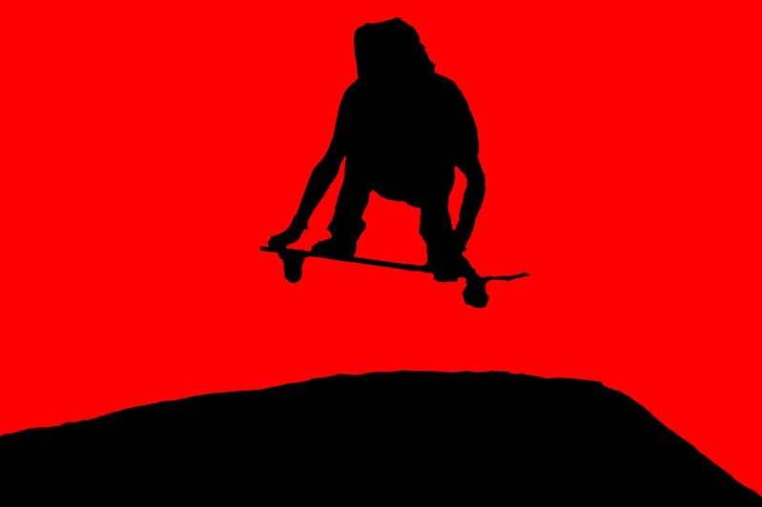
Economy
Economy - An principle operating on the "slim." Especially important when dealing with clients, where their product or service is more important than the elaboration of design elements. Can also be considered "precise," or "simplistic." Or, it can be considered great design.

Slide 15
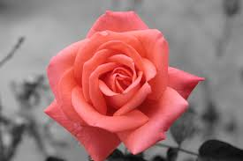
Emphasis
Emphasis - Also known as dominance. This condition exists when an element or elements within a visual format contain a hierarchy of visual importance.

Slide 16
Proportion
Proportion - A two- or three-dimensional element defined by other elements of design.

Slide 17
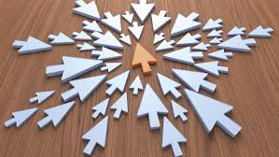
Rhythm
Rhythm - A recurrence or repetition of one or more elements within a visual format, creating harmony.

Slide 18
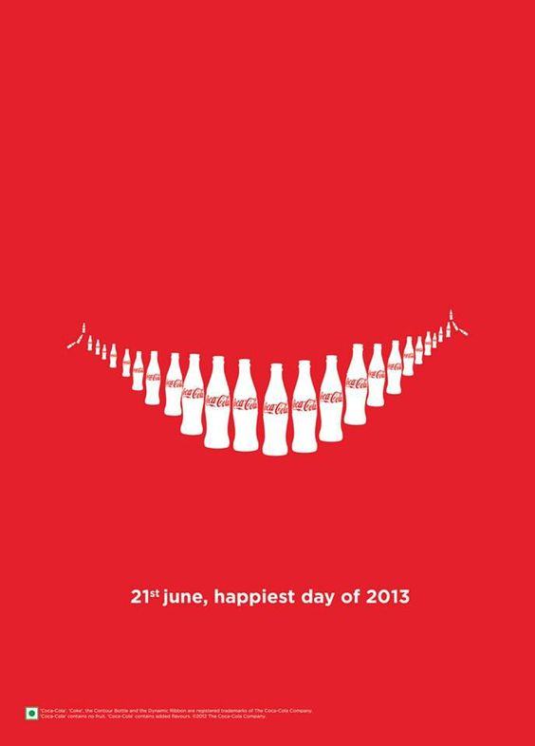
Unity
Unity - "Oneness," "Harmony," "Gestalt." The condition of completeness with the use of all visual elements within a format.

