Slide 1
Column Chromatography

Slide 2
Introduction
Packed or Poured
Loading
Developing or eluting the column
Bed volume - total volume of solvent and adsorbing material taken up by the column
Void volume – liquid phase volume
Elution volume - amount of solvent required to remove a particular analyte from the column

Slide 5
Operation of a Chromatographic Column
Column heights of 20 to 50 cm
Column inside diameters may vary from 0.5 to 5 cm

Slide 7
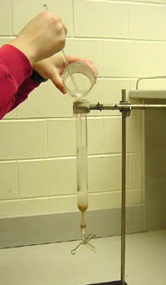
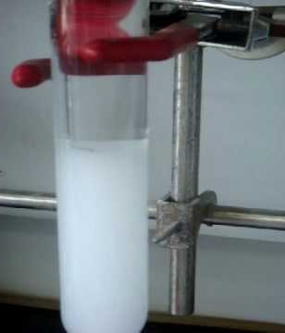
Packing the Column
Slurry

Slide 8
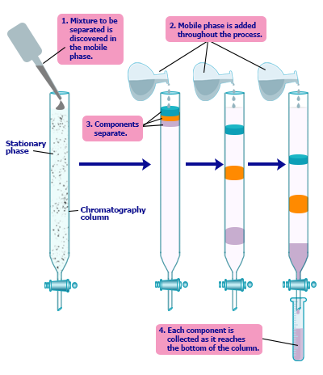
Loading the Column
Concentrated sample
Solid should be dissolved

Slide 9
Eluting the Column
Flow rate
Continual elution- single solvent or buffer
Stepwise elution - an incremental change of solvent
Gradient elution- gradual change in solvent composition

Slide 10
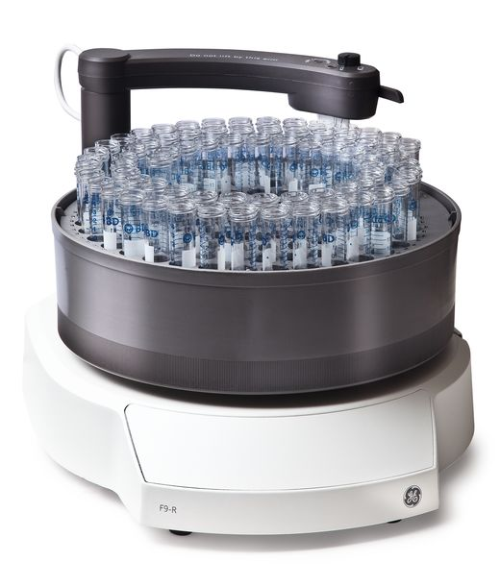
Collecting the Eluent
Flasks or tubes
Fraction collector

Slide 11
Detection of Eluting Components
Spectrophotometer

