Slide 1
Overview of Engineering Standards

Slide 2
Agenda
What is a standard?
Why standards matter?
How are standards developed?
Types of standards
Consideration of standards in process and system design
Geometric Dimensioning & Tolerancing Standards
Quality Standards
Ergonomics and Safety Standards
Accessibility Standards

Slide 3
What is a standard?
The National Standards Policy Advisory Committee defines standards as:
"A prescribed set of rules, conditions, or requirements concerning definitions of terms; classification of components; specification of materials, performance, or operations; delineation of procedures; or measurement of quantity and quality in describing materials, products, systems, services, or practices."

Slide 4
Why Standards Matter?
Standards play a critical role in industrial practice and commerce, and in our daily lives.
Without standards, most things that we take for granted, such as electronic communications and interoperability of devices, would not be possible.
Adherence to standards results in several benefits such as safety, quality, interchangeability of parts or systems, and consistency in products and processes across international borders.

Slide 5
Types of Standards
Mandatory Standards – set by government agencies e.g., FDA and OSHA safety regulation standards and codes
Voluntary Standards – established by consensus by industry, consortia or other stakeholders.
In the US alone, there are more than 30,000 voluntary standards.

Slide 6
Types of Standards (contd.)
Standards can be of various types including:
Product / Design-based standards, e.g., Base of electric lamps, Photo film speed, etc.
Performance-based standards, e.g., functional capabilities of appliances
Process-based standards, e.g., welding process standards, test and measurement process standards
Management system standards, e.g., ISO 9001 quality management system.
Personnel certification standards, e.g., Fire service professionals qualifications

Slide 7
Standards Development Organizations
There are several organizations that play a key role in the development and promotion of standards in the US and internationally.
ANSI: American National Standards Institute (www.ansi.org)
ANSI is a non-profit, non-government private-sector membership organization that is the central focal point for voluntary standards development in the United States. ANSI facilitates the development of American National Standards (ANS) by accrediting the procedures of standards developing organizations (SDOs). These groups work cooperatively to develop voluntary national consensus standards. ANSI promotes the use of U.S. standards internationally. ANSI is the sole U.S. representative of the two major international standards organizations, the International Organization for Standardization (ISO), and the International Electrotechnical Commission (IEC).

Slide 8
Standards Development Organizations (contd.)
SDOs in the United States include professional societies, industry and trade associations and membership organizations that develop standards within their area of expertise.
Some of the major SDOs are ASTM International, IEEE, SAE International, and ASME. For list of other SDOs, see http://webstore.ansi.org/sdo.aspx#.USl-dB3Whlc
SDOs may choose to develop standards that are submitted to ANSI for approval as American National Standards (ANS). SDOs may also develop standards outside the ANSI accreditation and approval process.

Slide 9
Standards Development Organizations (contd.)
NIST – National Institute of Standards and Technology (www.nist.gov)
NIST is a non-regulatory federal agency within the U.S. Commerce Department's Technology Administration. NIST's mission is to promote U.S. innovation and industrial competitiveness by advancing measurement science, standards, and technology in ways that enhance economic security and improve our quality of life.
NIST is also responsible for coordinating federal, state and local activities in voluntary standards and to work with industry and government to develop and apply technology, measurements and standards.

Slide 10
Standards Development Organizations (contd.)
Standards can also be developed by consortia i.e., groups of companies with a shared interest. Examples of consortia include the Process Industry Practices (PIP), United States Council for Automotive Research (USCAR) and the World Wide Web Consortium (W3C)
Some standards are considered Defacto Standards. They are based on common, well-established practices, and are not developed by a formal SDO. An example of a Defacto standard is the arrangement of keys on a keyboard (QWERTY keyboard).

Slide 11
Consideration of standards in process and system design
While engaging in a process or system design/improvement projects, it is important to keep standards in mind.
Standards play an essential role in common project activities such as
Creation/interpretation of engineering drawings,
Specification and selection of components to build a system,
Design of work spaces,
Definition and documentation of work procedures
We will now provide a brief overview of some common types of standards relevant to process and system design/improvement projects.

Slide 12
Geometric Dimensioning & tolerancing Standards
Covered in ISyE 415 and ISyE 605

Slide 13
Geometric Dimensioning & Tolerancing
ASME and ISO have defined a set of standards (ASME Y14.5M and ISO 1101) for creating engineering drawings for part design that can be understood and used around the world.
These standards provide a set of standard symbols, nomenclature and formats for geometric dimensioning and tolerancing (GD&T).

Slide 14
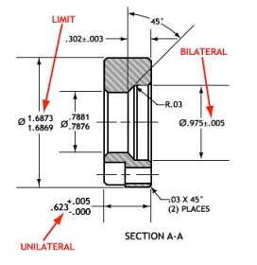
Different types of tolerance notations

Slide 15
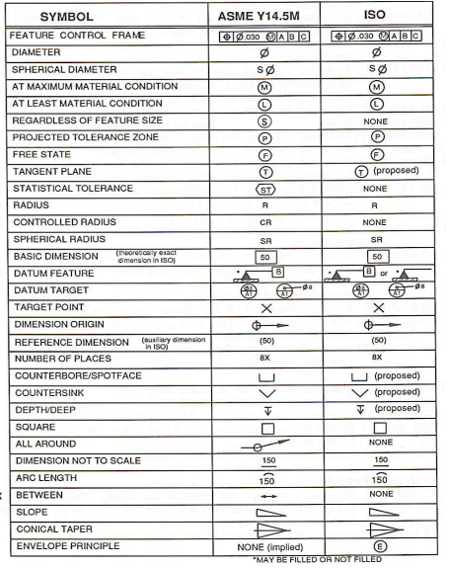
GD & T symbols

Slide 16
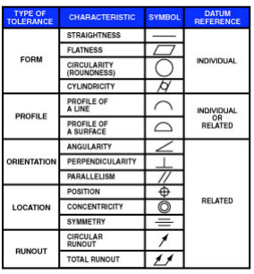
Common
shape
tolerance symbols

Slide 17
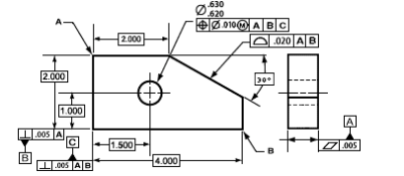
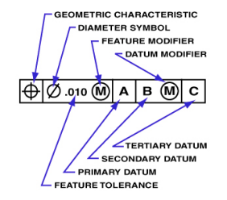
Use of feature control frame:
The feature control frame organizes the GD&T information into a series of symbols that fit into standardized compartments.

Slide 18
QUAlity Standards
Covered in ISyE 315 and ISyE 520

Slide 19
Common Quality Standards
Quality Management System Standards
ANSI/ISO/ASQ(E) Q9001 (Often referred to as ISO 9001)
Sampling Inspection Standards
ANSI/ASQ Z1.4-2008 Sampling Procedures and Tables for Inspection by Attributes
ANSI/ASQ Z1.9-2008 Sampling Procedures and Tables for Inspection by Variables
ANSI is the American National Standards Institute
ISO is the International Organization for Standardization
ASQ is the American Society for Quality

Slide 20
The ISO 9001 Standard
IS0 9001 is a voluntary international standard containing requirements for establishing and maintaining a company’s quality management system (QMS).
A QMS is set up as a “Process Model” by a company to:
establish a quality policy and quality objectives, and
establish the means to achieve those objectives.

Slide 21
The QMS Process Model
CONTINUAL IMPROVEMENT OF THE
QUALITY MANAGEMENT SYSTEM
Clause 4 - Documentation
MANAGEMENT
RESPONSIBILITY
Customers
Clause 5
Customers
RESOURCE
Clause 6
Clause 8
MEASUREMENT,
MANAGEMENT
ANALYSIS,
Satisfaction
IMPROVEMENT
Clause 7
Requirements
Input
PRODUCT
Output
REALIZATION
Product

Slide 22
Benefits of Implementing ISO 9001
Competitive advantages in marketing an improved “quality” image
Better performance of internal operations (less scrap / rework)
Better quality
Fewer customer audits
A stronger focus on customer satisfaction and continual improvement
Better company-wide communication
Reduced costs
Better documentation (see “What’s the value of all this documentation?”)
And all of the above changes can lead to higher levels of financial security for the company and its employees.

Slide 23
Z1.4 and Z1.9 Inspection Standards *
Define standardized inspection plans (sample size, acceptance and rejection numbers) at agreed upon acceptable quality levels for various batch/lot sizes.
Protect the supplier from having good lots or product rejected based on an inspection of a limited sample if the defects are within specified limits.
* Taught in ISyE 315 and ISyE 512

Slide 24
Z1.4 Example
Suppose a batch of 1000 parts arrive at receiving from a vendor and need to be inspected prior to acceptance and use. The acceptable quality level has been agreed upon as 2.5 (maximum percent defective), and a normal level II attribute sample plan will be used.
The standard would then specify that 80 parts be sampled and inspected, and the entire lot would be accepted if 7 or less parts were found to be defective. Likewise the lot would be rejected if 8 or more parts were found to be defective.
These standards are voluntary, but often specified as required per contract specifications.

Slide 25
Ergonomics and safety Standards
Covered in ISyE 349 and ISyE 564

Slide 26
Ergonomic standards in the workplace promote worker productivity, safety and health. The standards outline practices for improving accessibility, and visibility. They provide standardized procedures and practices for measuring and reducing physical stress and mental fatigue from motion, vibration, shock, sounds.

Slide 27
Representative standards for ergonomics include
Hand Held Tool Ergonomics
Office Ergonomics
Vehicle Ergonomics
Thermal Ergonomics
Machine Ergonomics
Human System Interaction Ergonomics
Control Centres Ergonomics
Accessibility Ergonomics
Software Ergonomics
General Ergonomics
http://webstore.ansi.org/ergonomics/Default.aspx#.USlrEB3Whlc

Slide 28
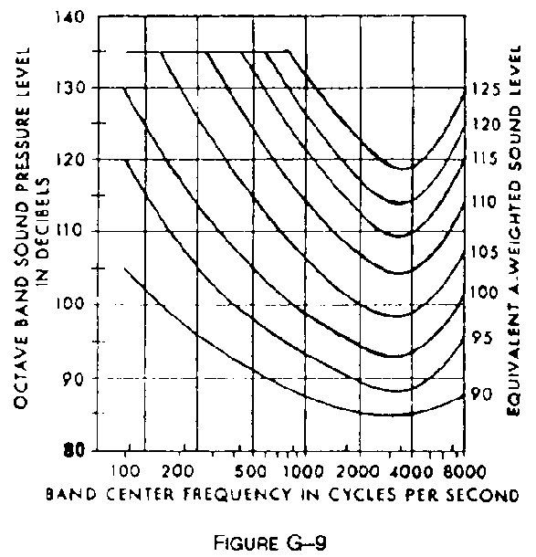
OSHA Standard for Protection against the effects of noise exposure
OSHA requires hearing protectors for workers exposed to 8-hour TWA noise levels of 85 dB or above
If they have incurred standard threshold shifts that demonstrate they are susceptible to noise
If they are exposed to noise over the permissible exposure limit of 90 dB over an 8-hour TWA
Mandatory standard 1910.95
Notes:
OSHA Standard 1910.95 for Protection against the effects of noise exposure. Mandatory standard enforced by OSHA

Slide 29
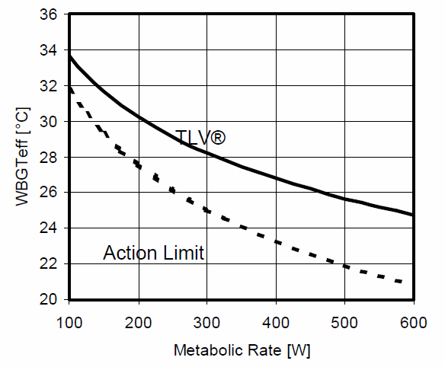
ACGIH Threshold Limit Value for heat stress
American Conference of Government Industrial Hygienists TLV Voluntary standard for environmental exposure in the workplace
97
93
90
86
82
WBGTeff [˚F]
79
75
Acclimatized
72
Un-acclimatized
68
Work below the Action Limit is presumptively low stress for any healthy worker
Notes:
American Conference of Government Industrial Hygienists TLV Voluntary standard for environmental exposure in the workplace

Slide 30
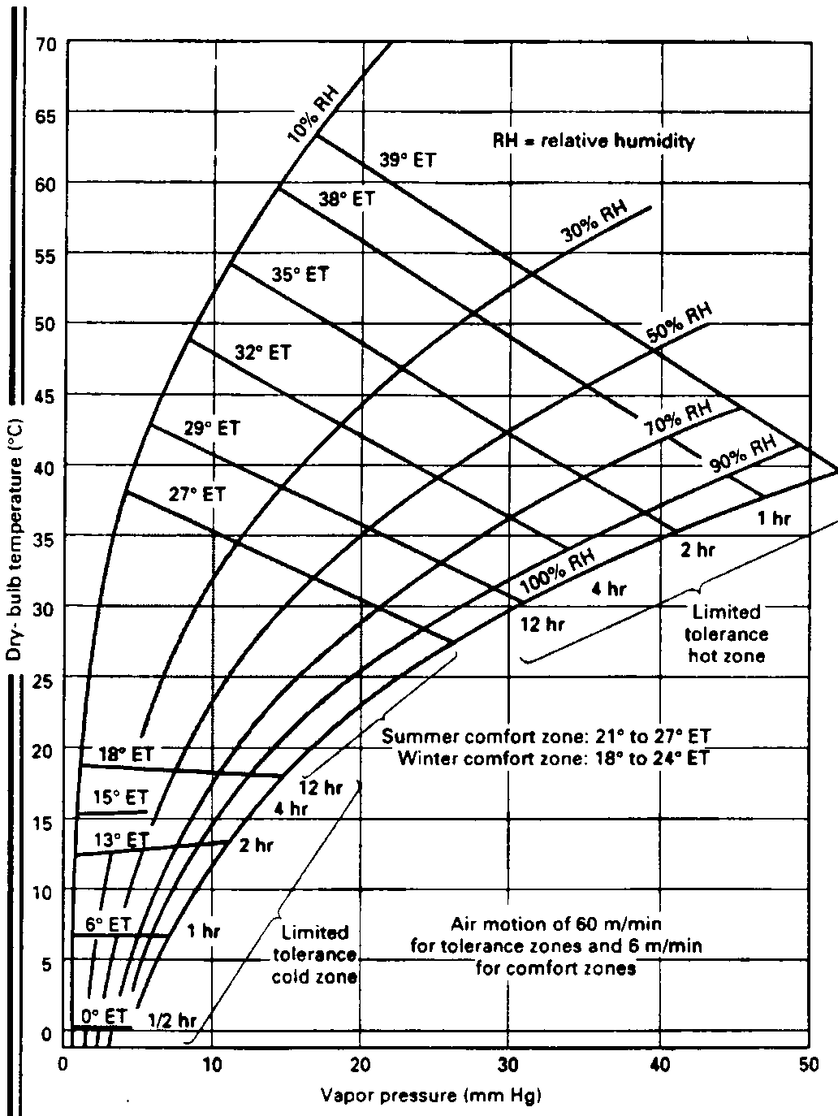
MIL Standard for thermal environments while appropriately dressed and doing light seated work
Indoor summer and winter comfort zones and thermal tolerance for appropriately dressed, sitting persons doing light work
MIL-HDBK 759 Military standard mandated by US Government contracts.
Notes:
MIL Standard for thermal environments while appropriately dressed and doing light seated work MIL-HDBK 759
Military standard mandated by US Government contracts.

Slide 31
Various standards and guidelines exist for addressing occupational hazards and risks and safety considerations in designing systems and processes.
An example is the ANSI/ASSE Z590.3 standard developed by the American Society of Safety Engineers
The Z590.3 standard focuses specifically on the avoidance, elimination, reduction and control of occupational safety and health hazards and risks in the design and redesign process. Through the application of the concepts presented in the standard, decisions about occupational hazards and risks can be incorporated into the process of design and redesign of work areas, tools, equipment, machinery, substances and work processes. Design and redesign also includes construction, manufacture, use, maintenance and disposal of reuse of equipment used on-the-job.

Slide 32
Accessibility Standards
Covered in ISyE 349 and ISyE 662

Slide 33
Physical Accessibility Standards
American Disabilities Act standards for accessible design set minimum requirements for newly designed and constructed or altered State and local government facilities, public accommodations, and commercial facilities to be readily accessible to and usable by individuals with disabilities.
They include requirements for
Curb ramps
Accessible Routes
General Site And Building Elements
Plumbing Elements And Facilities
Communication Elements And Features
Built-In Elements
Etc.
http://www.access-board.gov/adaag/html/adaag.htm
http://www.access-board.gov/adaag/checklist/a16.html
http://www.ada.gov/regs2010/2010ADAStandards/2010ADAstandards.htm

Slide 34
Information and Communication Technology Accessibility Standards
Section 508 requires that all Web site content be equally accessible to people. This applies to Web applications, Web pages and all attached files. It applies to intranet as well as public-facing Web pages. The law covers all types of electronic and information technology in the Federal sector and is not limited to assistive technologies used by people with disabilities. It applies to all Federal agencies when they develop, procure, maintain, or use such technology.
Section 255 of the Telecommunications Act of 1996 requires telecommunications products and services to be accessible to people with disabilities.
https://www.section508.gov/
http://www.access-board.gov/about/laws/telecomm.htm
http://www.access-board.gov/telecomm/rule.htm

Slide 35
Information and Communication Technology Accessibility Standards (contd.)
W3C standards define an Open Web Platform for application development that has the unprecedented potential to enable developers to build rich interactive experiences, powered by vast data stores, that are available on any device.
http://www.w3.org/standards/

Slide 36
Human-Computer Interaction and Usability Standards
A variety of standards exist that are related to software engineering, interface design, and usability.
Standards in this category are primarily concerned with:
the use of the product (effectiveness, efficiency and satisfaction in a particular context of use)
the user interface and interaction
the process used to develop the product
user-centered design
http://www.usabilitynet.org/tools/r_international.htm

