Slide 1
History of Psychology
Modified from -Paula Pilarska

Slide 2
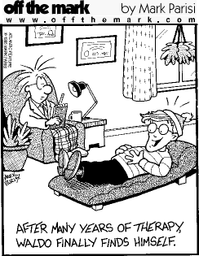
What is Psychology?
The scientific study of human and animal behavior

Slide 3
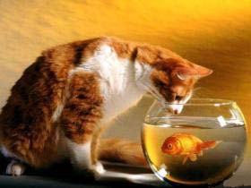
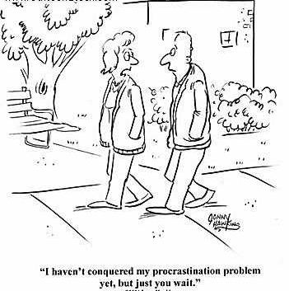
What is Behavior?
Pretty much ANYTHING that you do, think or feel.

Slide 4
Types of Psychology
Research:
Studies why things happen.
Deals with theories and lab experiments
“Lab tests show people’s anxiety level increases when surrounded by the color red.”
Applied:
Figures out how to USE information found by researchers
“NASA scientists study which colors to paint the inside of the International Space Station”

Slide 5
History of Psychology
Separated from philosophy in the middle of 19th century
with roots in biology
Psychology" comes from the Greek words:
"psyche" meaning mind or soul,
and "logos", meaning reason.
Reasoning about soul – philosophy of the mind

Slide 6
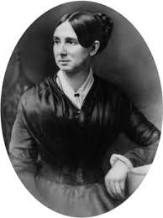
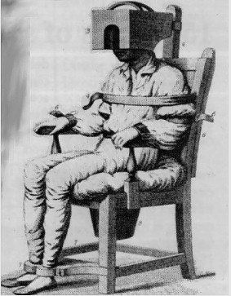
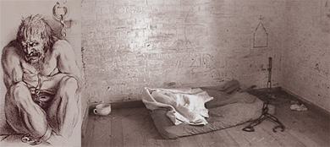
Dorothea Dix
Starting in the 1840’s fought for humane treatment of people with psychological disorders, in the US
Holding
Chair
Dorothea Dix 1802-1887

Slide 7
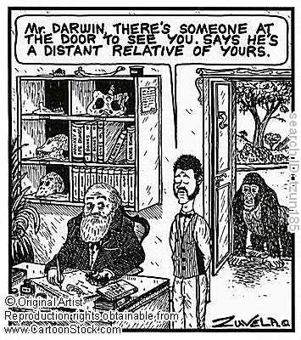
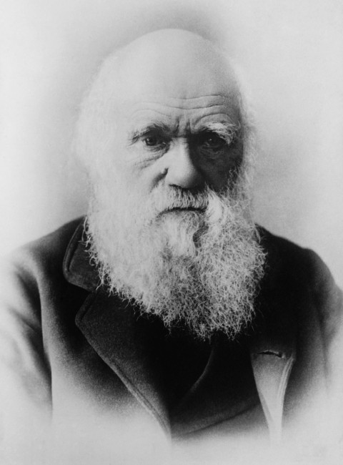
Charles Darwin
Not a psychologist
Developed theory of evolution
Believed we can study animals to understand ourselves
Explained animal diversity as evolutionary process: “natural selection”
Charles Darwin (1809-1882)

Slide 8
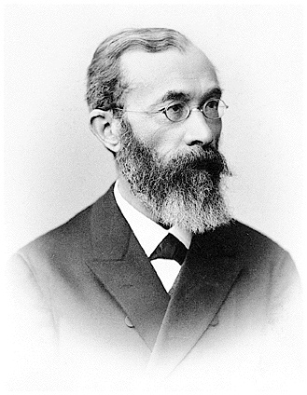
Wilhelm Wundt (Vundt)
Germany 1880’s
The “father of psychology”
Founder of modern psychology
Opened the first psychology lab in 1879
applied laboratory techniques to study of the mind
was using scientific research methods to investigate reaction times
use the process known as introspection
Wilhelm Wundt (1832–1920)

Slide 9
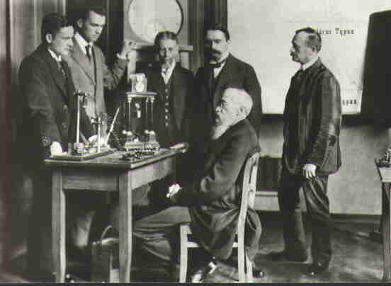
First Lab of its kind…

Slide 10
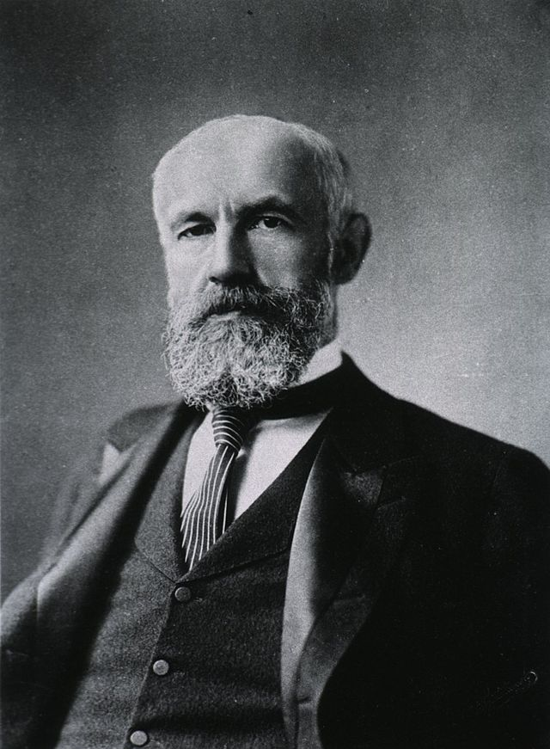
G. Stanley Hall
American graduate student of Wilhem Wundt
Established first formal US psych lab at Johns Hopkins University
G. Stanley Hall
1844-1924

Slide 11
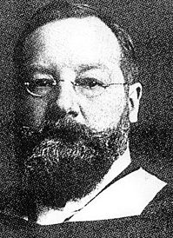
Structuralism
the founder was Edward B. Titchener
the first school of psychology
focused on breaking down mental processes to understand the “structure” of the mind
researchers were using a method known as “introspection” (people reported on their experiences in experiments)
there were flaws in reports and required subjects with good communication and intellect
faded away with introspection
influenced experimental psychology
Edward B. Titchener (1867-1923)

Slide 12
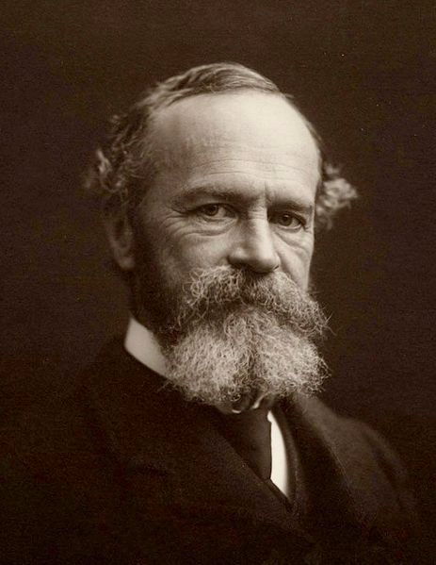
Functionalism
1880’s-1900’s
formed as a reaction to the structuralism and was heavily influenced by the work of William James and the evolutionary theory of Charles Darwin
focused on the function of consciousness
emphasized individual differences, which had a profound impact on education
William James (First American Psychologist)
1842 - 1910

Slide 13
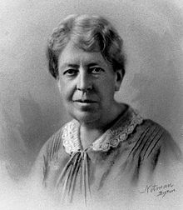
Mary Whiton Calkins
Denied admission to Harvard
William James let her take his classes anyway and she passed all exams
Harvard denied her Ph.D.
Became a memory researcher and first female president of APA
Mary Whiton Calkins
1863-1930

Slide 14
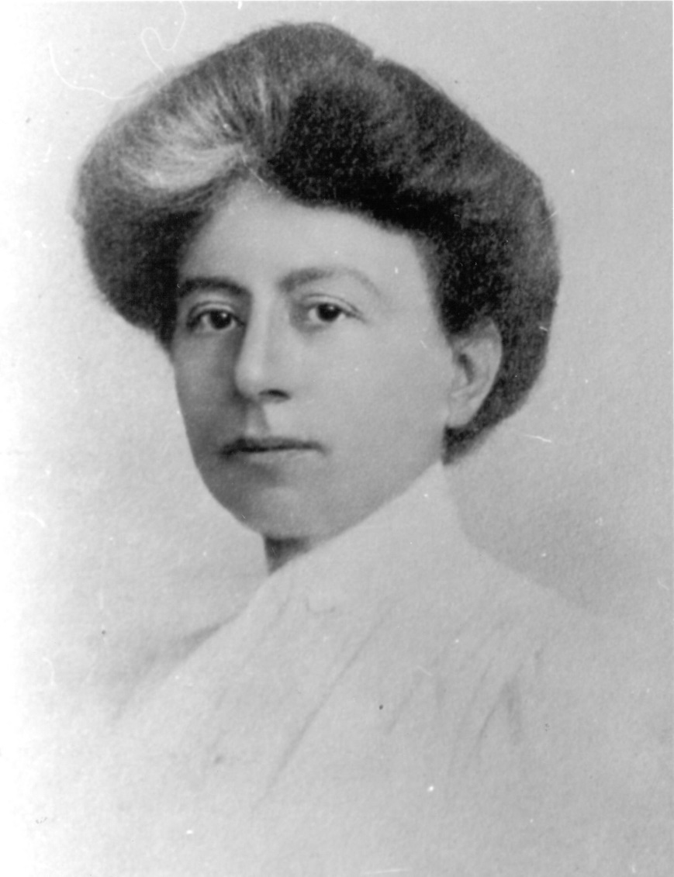
Margaret Floy Washburn
First woman to earn psychology Ph.D.
Second female APA president
Margaret Floy Washburn
1871-1939

Slide 15
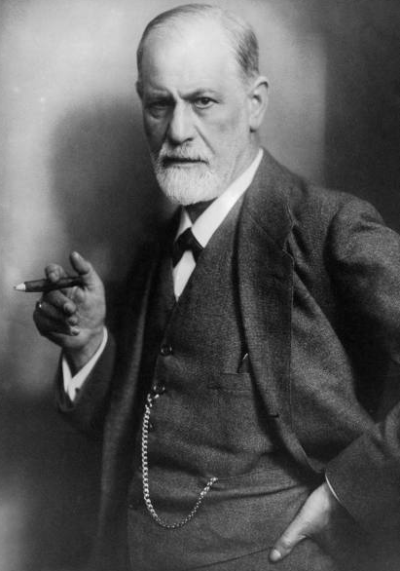
Sigmund Freud
Austrian late 1800s – 1930s
Physician that focused on illness
Founder of the psychoanalytic perspective
Developed the Use of "Talk Therapy"
Believed that abnormal behavior originated from unconscious drives and conflicts
Psychoanalysts believe that childhood events and unconscious feelings, thoughts and motivations play a role in mental illness and maladaptive behaviors.
Sigmund Freud (1856-1939)

Slide 16
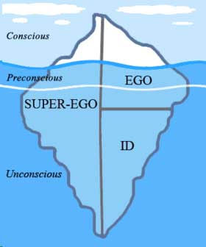
Psychoanalysis
Personality is composed of three elements:
ID - includes the instinctive and primitive behaviors, id is driven by the pleasure principle
EGO - is responsible for dealing with reality, and is driven by the reality principle, which strives to satisfy the id's desires in realistic and socially appropriate ways
SUPEREGO - holds all of our internalized moral standards that we acquire from both parents and society - our sense of right and wrong

Slide 17
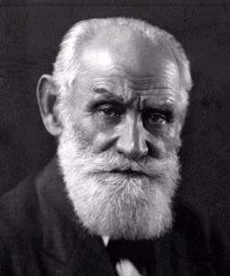
Ivan Pavlov
Behaviorist
Russian Physiologist early 1900s
Pavlov's research on the digestive systems of dogs led to his discovery of the classical conditioning process, which demonstrated that behaviors could be learned via conditioned associations.
Emphasized the study of observable behaviors
Ivan Pavlov, 1849 –1936

Slide 18
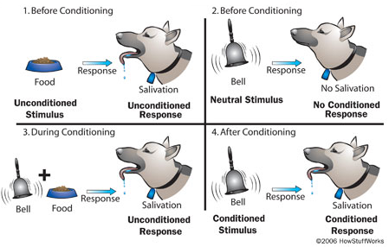
CLASSICAL CONDITIONING

Slide 19
John B. Watson
Founder of Behaviorism
Studied only observable and objectively described acts
Emphasized objective and scientific methodology
Believed consciousness
was irrelevant to ppsychology
John B. Watson (1878–1958)

Slide 20
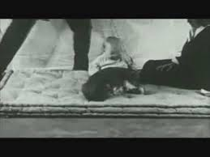
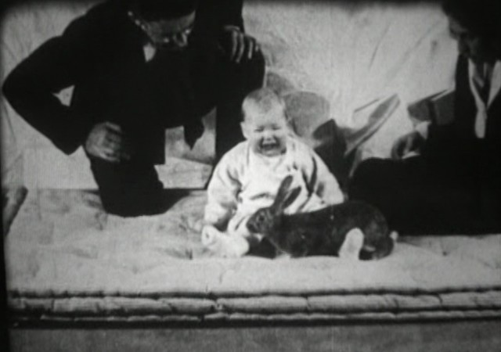
Little Albert Experiment
After: “Aaah! Get this horrible, fuzzy bunny away from me!
Before: “Oh, look! What a sweet fuzzy doggie.”

Slide 21
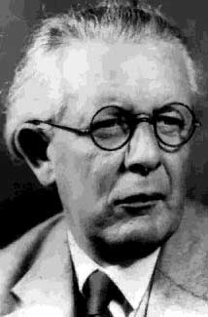
Jean Piaget
Studied children's’ thinking
Observed and questioned them
Created a theory of human cognitive development
Jean Piaget 1896-1980

Slide 22
Burrhus F. Skinner
American -Mid – late 1900s
Behaviorist, famous for his research on operant conditioning
Focused on learning through rewards and observation
studied learning and effect of reinforcement
"The consequences of behavior determine the probability that the behavior will occur again" --B. F. Skinner
B. F. Skinner (1904–1990)

Slide 23
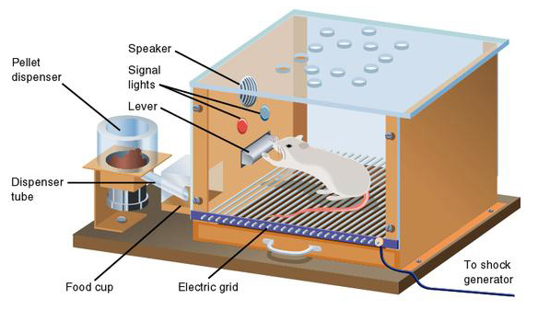
Operant conditioning

Slide 24
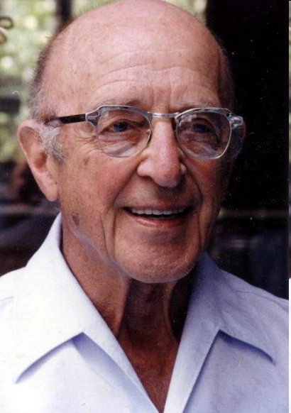
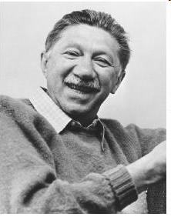
Humanistic Psychology
felt that both psychoanalysis and behaviorism were too pessimistic
emphasized the importance of self-actualization, which is a process of growing and developing as a person to achieve individual potential
healthy persons strive to reach his / her own potential
stressed the study of conscious experience and an individual’s free will
Founders
Carl Rogers 1902 – 1987
Abraham Maslow 1908 – 1970

Slide 25
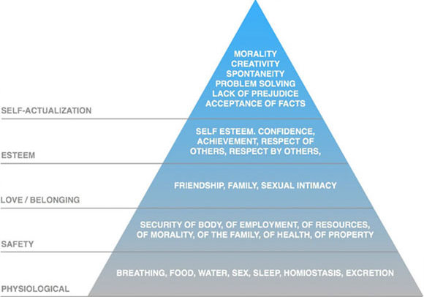
Maslow’s hierarchy of needs
This hierarchy suggests that people are motivated to fulfill basic needs before moving on to other needs.

Slide 26
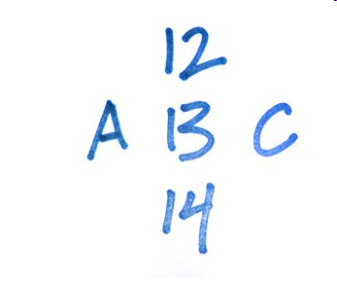
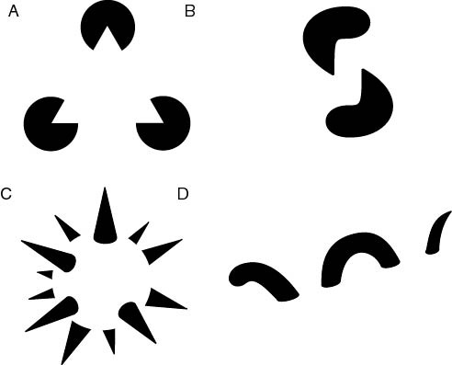
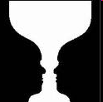
Gestalt Psychology
Gestalt – German, means a “form” or a “whole”
the whole is greater than the sum of the individual parts
Integrate pieces of information into meaningful wholes
Principles about how information is organized

Slide 27
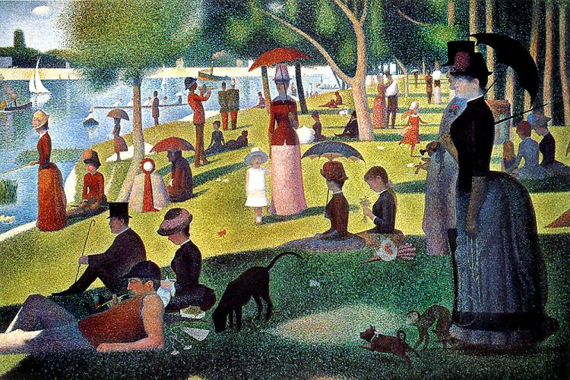
What do you see?
Georges-Pierre Seurat
“Sunday Afternoon on the Island of Grande Jatte” 1884-85

Slide 28
Over time… What has been the biggest argument?
What do you think?

Slide 29
Psychology’s Big Question
Nature vs. Nurture
Something occurred in life to make you that way
OR
You came out of the womb that way

