Slide 1
Transpiration of Leaves & Canopies

Slide 2
Transpiration
Definition
The process of water movement through a plant and its evaporation from aerial parts, especially from leaves but also from stems and flowers is called transpiration.

Slide 3
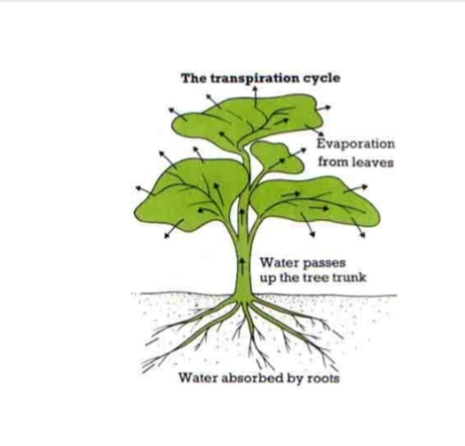

Slide 4
Transpiration
Transpiration in leaves and canopies (higher branches of tree) of plants occur through different processes which are following
Cuticular Transpiration
Lenticular Transpiration
Stomatal Transpiration

Slide 5
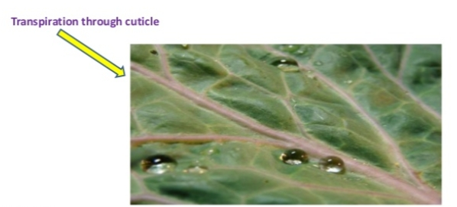
Cuticular Transpiration
The loss of water in the form of water vapours through the cuticle is known as cuticular transpiration

Slide 6
Lenticular Transpiration
The loss of water in form of water vapours taking place through the lenticels present in woody stem and fruits is called as lenticular transpiration.
It amounts 1-5 percent of the total water loss by the plant.

Slide 8
Stomatal Transpiration
The loss of water takes place through stomata is called stomatal transpiration.
Stomata are minute pores confined to epidermis of green leaves. Opening and closing of stomata are controlled by guard cells.
Maximum loss ( 80-90 percent of the total water loss) of water from the plant tissues takes place through the "stomatal openings".

Slide 9
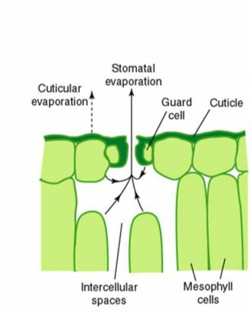
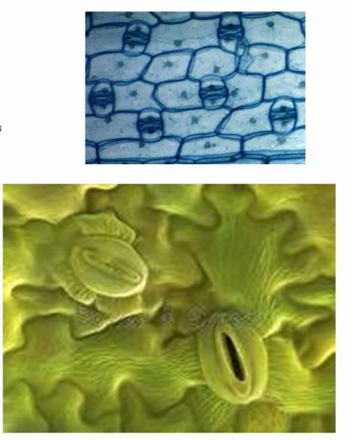
Stomatal Transpiration

Slide 10
Leaves
In leaves the exchange of oxygen and carbon dioxide as well as loss of water vapours in transpiration occurs through pores called stomata.Hence, stomatal transpiration is common in leaves.
Normally stomata open when the light strikes the leaf in the morning and close during the night.

Slide 11
Internal factors affecting on Transpiration
Number of leaves:
More leaves (or other photosynthetic organs) means a bigger surface area and more stomata for gaseous exchange. This will result in greater water loss.
Number of stomata:
More stomata will provide more pores for transpiration.

Slide 12
Size of leaf:
A leaf with a bigger surface area will transpire faster than a leaf with a smaller surface area.
Presence of plant cuticles:
A waxy cuticle is relatively impermeable to water and water vapours and reduces evaporation from the plant surface except via stomata.

Slide 13
External factors affecting Transpiration
Temperature:
Transpiration rates go up as the temperature goes up, especially during the growing season, related to open and closed stomata.
Relative humidity:
As the relative humidity of the air surrounding the plant rises the transpiration rate falls. It is easier for water to evaporate into dryer air than into more saturated air.

Slide 14
Wind and air movement:
Increased movement of the air around a plant will result in a higher transpiration rate. This is somewhat related to the relative humidity of the air.
Soil-moisture availability:
When moisture is lacking,plants can begin premature aging which can result in leaf loss and transpire less water.
Types of plant:
Plants transpire water at different rates. Some plants which grow in arid regions, such as cacti &

Slide 15
succulents,conserve precious water by transpiring
less water than other plants.
Light
Plants transpire more rapidly in the light than in the dark.This is largely because light stimulates the opening of the stomata.
Light also speeds up transpiration by warming the leaf.

Slide 16
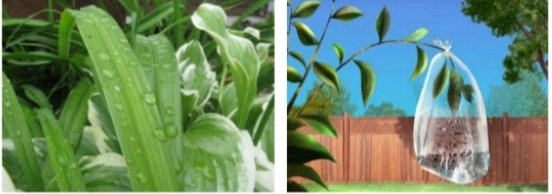
How much water do plants transpire
During a growing season,a leaf will transpire many times more water than its own weight.
An acre of corn gives off about 3000-4000 gallons of water each day and a large oak tree can transpire 40,000 gallons per year.

Slide 17
Importance
Transpiration is not simply a hazard of plant life.
It is the "engine" that pulls water up from the roots to:
Supply photosynthesis (1-2% of the total)
Bring minerals from the roots for biosynthesis within the leaf
Cool the leaf

Slide 18
Anti-Transpirants
Anti-transpirants are the materials or chemicals that applied to transpiring plant surfaces for reducing water loss from the plant.
The purpose of ATs is to maintain the growth and productivity under stress condition.
They are used on Christmas trees, on cut flowers, on newly transplanted shrubs and in other applications to preserve and protect plants from drying out too quickly.
They have also been used to protect leaves from fungal diseases.

Slide 19
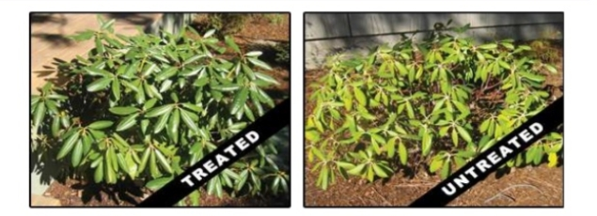
other applications to preserve and protect plants from driving out too quickly.
They have also been used to protect leaves from fungal diseases.

Slide 20
Examples of ATs
Chloroflurenol
Flurenol
Methyl benzilate
Methyl chloroflurenol
Methyl dichloroflurenol

Slide 21
