Slide 1
Lesson 3 (Firearm Injuries)
By
Dr Nadir Ali

Slide 2
B). External Ballistics
“ It is the study of the forces
acting on the projectile from the
moment it leaves the barrel to
the moment of its impact on the
target ”
by Nasib R. Awan

Slide 3
External Ballistics(contd.)
1- Forces originating from the bullet motion
( Kinetic Energy = ½ mv2 )
A) Forward velocity
B) Rotational velocity
2- Forces present in the medium
A) Air resistance
B) Gravity

Slide 4
Velocity of the bullet at the muzzle end for various firearms(muzzle velocity)
a. Revolver:
600-900 feet per second.
b. Pistol:
1200-1440 feet per second.
c. Rifle:
2000-3500 feet per second.
Rotational motion varies (Length of the barrel).

Slide 5
Behavior of the bullet
(From the muzzle end of the barrel to the target)
As soon as the bullet leaves the barrel, lateral support of the barrel walls ends.
The bullet is subjected to the resistant forces in the medium which are air resistance and gravity.

Slide 6
Behavior of the bullet (contd…)
Air resistance is negligible but the gravity force affects the bullet in two ways.
1. Movement of the bullet
(Tail wag phenomenon).
2. Trajectory of the bullet.

Slide 7
1. Tail wag phenomenon
After leaving the muzzle end, the bullet becomes unstable due to gravity force for some distance in which tip of the bullet follows the axis while tail starts describing circles around the line of flight. This is called “Tail-Wag”. After this distance, bullet settles down into gyroscopic progression and becomes stable.

Slide 9
The distance of the tail-wag for a pistol is 60 yards and for a rifle 200 yards.

Slide 10
Tail wag phenomenon
Inside barrel projectile is supported by walls of barrel
Entering new medium loses balance due to air resistance & force of gravity
Regains balance after covering some distance
Tail wag
Initial
tail wag
Terminal
tail wag
Intermediate tail wag

Slide 11
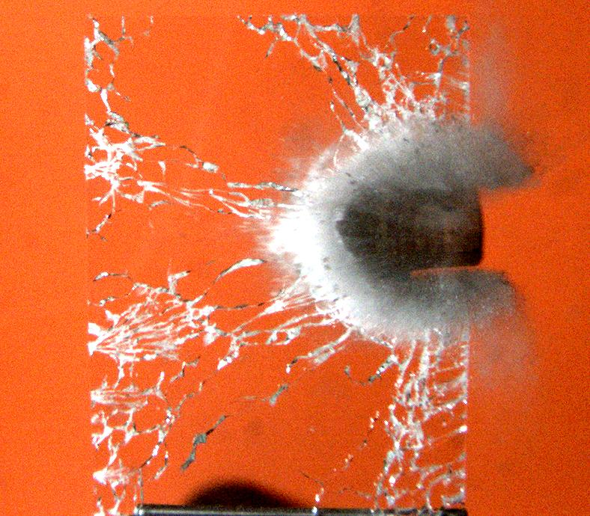
Bullet through a glass
Intermediate tail wag
Secondary missiles

Slide 13
2. Trajectory of the bullet
After leaving the muzzle end of the barrel, the gravity forces the bullet to follow a curved path directed towards ground called –“Trajectory of the bullet”.
This curve is apparent in long distance but not in short distance.

Slide 14
Forces present in the medium
1- Air resistance
2- Gravity
Projectile
Follows..
Curved path
Trajectory of bullet

Slide 15
Trajectory of bullet

Slide 16
WOUND (TERMIANL) BALLSITICS
It is the study of effects of fireblast including projectile on the target.
Effect of shot charge/projectile (bullet/lead pellets) – includes damage
At the point of entrance,
In the track and
At the wound of exit or
Point of resting of the shot charge.

Slide 17
Mechanism of wounding
(Interaction of weapon and body part struck)
Impact force with countre force
Kinetic energy VS Tissue resistance
(KE= ½ mv² )
Greater the impact force, greater will be the damage.
The most important factor is the velocity of the bullet (weapon).

Slide 18
A) Low velocity bullet
To soft tissues
Forward velocity causes pushing & stretching the skin inward with underlying tissue producing indentation.
With rotational velocity it results in perforation of skin and underlying tissue (hole, track) which allows passage to the bullet through it.
While passing, the energy of the bullet radiates laterally causing damage (hole, track) proportionate to the diameter of the bullet.

Slide 19
B) High velocity bullet
a) In soft tissues
It pushes the skin and underlying tissues inward and laterally causing more damage than low velocity bullet.
Energy in the bullet is very high and dissipates in the surrounding tissues in radial fashion creating a temporary cavitation.
Period of cavitation is extremely short and soon after the passage of the bullet, tissues recoil and collapse back leaving a permanent cavity or damage which is larger than the diameter of bullet.

Slide 20
B) High velocity bullet
b) When the high velocity bullet strikes a
bone
It fractures bones into many parts
Every fragment act as secondary projectile & spread in various directions causing many secondary tracks
It ruptures other tissues also situated even at considerable distance from the bullet path

Slide 21
c) When high velocity bullet strikes hollow viscus containing fluid
The contents of a hollow viscus get separated into small particles which get displaced in all directions away from the bullet path and behave as secondary projectile.

Slide 22
Components of a Shot Responsible for Damage
Shot charge/projectile (bullet / pellet).
Hot explosive gases.
Flame and heat.
Smoke.
Wad.

Slide 23
Components of a Shot Responsible for Damage (contd.)
vi. Unburnt powder.
vii. Grease from the barrel.
All the above components produce characteristic damage on the wound of entry but wound of exit lacks most of them.

Slide 24
FIREARM WOUND COMPLEX
Wound of entry.
Track of wound/bullet
Place of resting of bullet. OR
Wound of exit.

Slide 25
MEDICOLEGAL IMPORTANCE OF EXAMINATION OF FIREARM WOUND COMPLEX:
Recognition of wound of entry/exit.
Track and direction of fire.
Cause of death.
Determination of manner of death (suicide / homicide / accidental).
Identification of weapon.

Slide 26
Distance travelled by the components of rifled firearm discharge and the effects produced by them at the target
Components Distance travelled Effects
1 Gases contact shot Blast effects
Facial distortion
Cherry red discoloration
2 Gun flame 6--12 inches Heat combustion effects (burning of clothes, skin and hairs)

Slide 27
Components Distance travelled Effects
3. Gun smoke 3 feet Blackening (old 12 inches)
4. Unburned partials 6 feet *Tattooing/
(Gun powder) (old 24 inches) stippling
*Note:
Tattooing: Unburnt particles of gunpowder are embedded in and under the skin through the force of their impact.
Stippling: When the distance increases to the point that the powder particles don’t embed but leave a visible mark on the skin.

Slide 28
Components Distance travelled Effects
5. Grease At any distance Grease collar (in barrel)
6 Bullet At any distance Abrasion collar
wound of entry
wound of exit
7 All above gun powder signs are seen in the track of wound in case of tight contact fire. Imprint of muzzle end of barrel can be found around the entry wound in this case

Slide 29
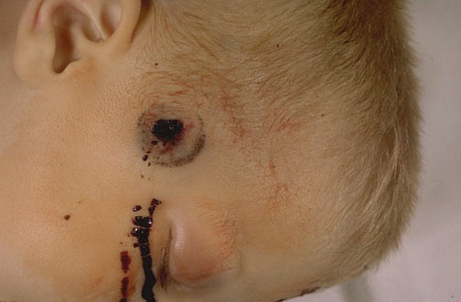
Muzzle end imprint Abrasion

Slide 30
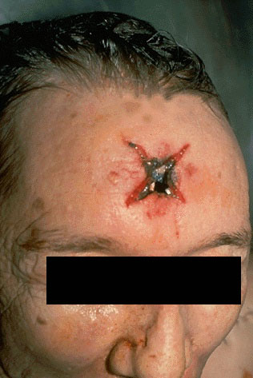
Contact Firearm Entry wound
Stellate or star-like entry wound
Stellate Firearm wound
Muzzle of firearm pressed hard on some hard bony area as forehead / skull
Gases can’t enter skull & escape from sides causing lacerations in the scalp
Star shaped projections in scalp
Components of shot present inside skull in the track

