Slide 1
Human Physiology,
Motor System
Dr. Shahid Javed
MBBS; PhD

Slide 2
Somatic Nervous System
Motor neurons supply skeletal muscle
Motor neurons are final common pathway
Motor neurons and skeletal muscle fibers are chemically linked at neuromuscular junctions
Release of Ach at neuromuscular junction
Formation of an end plate potential
Initiation of an action potential
Acetylcholinesterase (AChE) ends Ach activity at the neuromuscular junction

Slide 3
Comparison of ANS and Somatic Nervous System
Site of origin
Number of neurons from origin in CNS to the effecter organ
Organs involved
Type of innervation
Neurotransmitter at effecter organ
Effects on effecter organs
Types of control
Higher centers involved in control

Slide 4
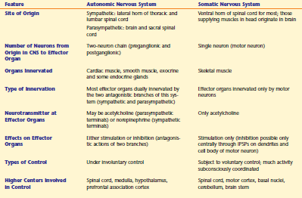

Slide 5
Clinical Pathologies
Black widow spider venom causes explosive release of ACh
Botulinum toxin blocks release of ACh
Curare blocks action of Ach at receptor-channels
Organophosphates prevent inactivation of Ach by inhibiting AChE
Myasthenia gravis inactivates Ach receptor-channels
Loss of muscle mass:A plight of spaceflight

