Slide 1
Sociology ^{BBA} Semester: 3rd ^{Lecture No. 04} ^{Instructor: Mumtaz Hussain} University of Sargodha Sb Campus ^{Bhakkar}

Slide 2
Measurement of social interaction:
Social interaction is social process and influence the interacting bodies in a tangible manner. Interaction is process of change. The following are the factors of measuring interaction:
Frequency:
The interaction among the people can be measured in terms of its numbers. As how many times an interaction took place between two persons. The more the number of interaction the more the influence among them.
Duration:
This factor measures the time spent on the interaction. One interaction ends in five minutes and the other extends up to hours. The more the time spent on interaction the more will be the influence on interacting persons.

Slide 3
Measurement of social interaction:
Intensity:
The intensity of interaction can be measured in term of its importance. How far tis has affected the situation can be measured by its result. If the results are positive we can say that there was intensity in the interaction. It means they mostly agree on the issue under discussion.
Focus:
As interaction must have a subject matter for focusing the attention of the interacting individuals. The subject matter is common to them to form common opinion. If the subject matter is contradictory there is little focus in the interaction.
By calculating the above factors, we are able to judge the influence of an interaction on the interacting persons.

Slide 4
Social Processes :
The society contains hundreds and perhaps thousands of socially defined relationship. These relationships are beyond measurement. Instead they must be classified and dealt with as ‘general types’. For this reason social relationship have been classified and discussed in terms of the ‘kinds of interaction’ they manifest. These kinds of interaction or social processes details are as under.
According to Mciver and Page a process mean “continuous change taking place in a definite manner through the operation of forces present from the first within the situation”. Social processes are the products of social interaction which can be classified into two groups:
Associative
Disassociate

Slide 5
Social Processes :
Associate
These forms of social processes are includes; Cooperation, accommodation, assimilation, acculturation and amalgamation.
2. Disassociate
These forms of social processes are includes; Competition and conflict.
Definition of Social processes:
Horton & Hunt: “the term social process refers to the repetitive forms of behavior which are commonly found in social life”.
F.E. Merill defined: “ social processes refer to the recurrent forms that social interaction takes. He further said the social processes involve forms of social interaction that occur again and again in the group.

Slide 6
Meaning of Cooperation:
Cooperation is one of most basic, and continuous social processes. It is the very basis of social existence. Cooperation generally means working together for the pursuit of a common goal.
The term ‘cooperation’ is derived form the two ‘Latin words: ‘Co’ meaning together and ‘operari’ meaning to work. Literary, cooperation means joint work or working together for common rewards.
Definition of cooperation:
According to Merill and Elderdge: ‘Cooperation is a form of social interaction wherein two or more persons work together to gain a common end.’
According to A.W.Green: ‘ Cooperation is the continuous and common attempt of two or more persons to perform a task or to reach a goal that is commonly.’

Slide 7
Types of Cooperation
There are two types of cooperation
Direct cooperation
The task unable to be performed by an individual need cooperation of other people. Those things which are common to the people and they share in such things is called direct cooperation. It is the cooperation in which the participants have common interest. For example, playing and working together in a farm or road building and house building are the examples of direct cooperation. All the activities of social life in which interest of a group of people is involved falls in direct cooperation.
Examples
Some examples of direct cooperation form Pakistani society are given below;

Slide 8
Continue…………..
In watering the fields the neighboring farmers cooperate in giving and taking surplus water for their farms.
The people cooperate in carrying the ill person to the doctor with his cot on their heads in rural areas of Pakistan.
The people cooperate on marriage, birth, Eids and other occasion of celebrations.
Form these examples, it is clear that direct cooperation is found in similar social conditions which exist in our social life.

Slide 9
2. Indirect Cooperation:
People do unlike things for the achievement of similar goals. Division of labour and specialization in a complex society, create impersonality in human behavior and the people of one category cooperate with the people of other categories.
In this way, labour and the material products are exchange to the satisfaction of mutual needs and this process involves cooperation among people.
Examples:
Some examples from Pakistani society are given below:
The owners of a mill and its workers cooperate with one another.
The businessmen and the customers cooperate on the selling rates of the products.
It means indirect cooperation exists mostly in urban social life.

Slide 10
2. Meaning of Competition
Competition is the most fundamental form of social struggle. It is a natural result of universal struggle for existence. It is based on the fact that all people can never satisfy all their desires.
Competition takes place whenever there is an insufficient supply of things that human being commonly desire. Whenever and wherever commodities which people want are available in a limited supply, there is competition.
Definition of competition
According to Park and Burgess: “Competition is an interaction without social contact”.
According to Horton and Hunt: “Competition is the struggle for possession of rewards which are limited in supply, goods, status, power, love anything.”

Slide 11
2. Forms of Competition
Absolute and Relative Competition
In the some of the cultural situation, the competition is for only one item among all the people. As in the competition of body building there is one man to be called as Mr. Pakistan, are the example of absolute competition.
The other competitions ranging alone the continuum of wealth, prestige and fame are relative to one another hence called relative competition.
2. Personal and impersonal competition:
In personal competition, the competitor strives to defeat his rival in various fields of life. In courts, the people fight in retaliation of their rival’s harmful acts. The competition in which collective, instead of personal, interest is involved is called in personal competition.
In most of competition activities, any form of cooperation is needed for the aggregate of resources to attain the competitive end.

Slide 12
Continue…..
In most of competition activities, any form of cooperation is needed for the aggregate of resources to attain the competitive end. Socially one wants support and cooperation form his family members, friends, and associate and from those with whom he is emotionally attached.
Similarly, the opponent accumulates his resources. Hence competition mostly involves cooperation from fellows. That is why it is said that competition is not always pure.
Culture and competition
Some cultures are mostly highly competitive than the others and attach high prestige to the victors in competition. In our culture, the emphatic value is Izzat and highest rank is accorded. Like. CSS, PMS and other exams etc.

Slide 13
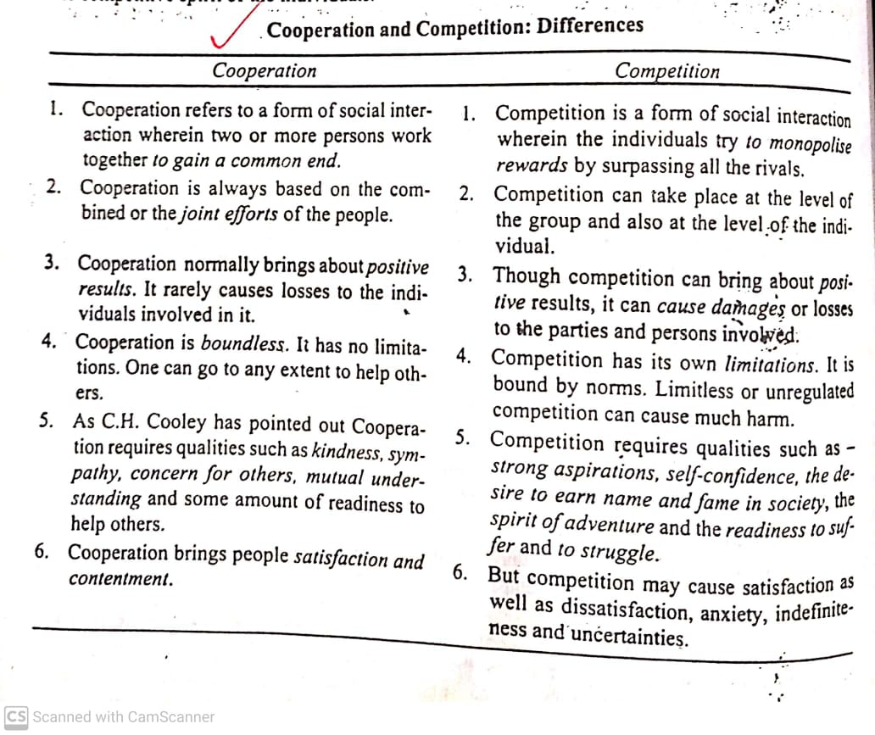
Difference b/w cooperation and competition

Slide 14
Thank You

