Slide 1
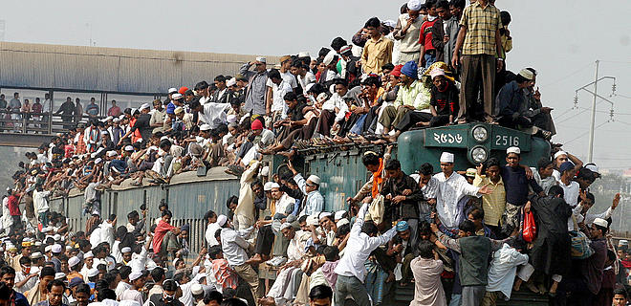
Population Explosion

Slide 2
Population Explosion
Over population or population explosion is a condition when an organism number exceeds the carrying capacity of its habitat.
DENSE HUMAN POPULATION
ENVIRONMENT
(The Earth)
OVER-POPULATION

Slide 3
Introduction
“Population explosion means effects of day by day increasing population to environment, commerce and education etc”.
Over population is not a function of size or density but it is determined using the ratio of population to available resources.
It is one of the major problems, the planet is facing today and it directly or indirectly fuels other problems, ranging from pollution to global warming.

Slide 4
Population Growth
“Population growth is the change in population overtime and can be quantified as the change in number of individuals in a population per unit time of measurement”.
According to population clock, every second on an average 4-5 children are born, and 2 persons die, thus resulting increase is of 2.5 persons every second. That means every hour there is a growth of 9000 persons and in one day population increase is in the order of 2,14,000. Hence, over 95 million babies are born per year.

Slide 5
There are about 6.6 billion people in the world. It is estimated to peak at 11 billion in 2200.
World population day on 11 July.
A graph showing the rate of increasing world’s population from 1900‑2050 is given as below:

Slide 6
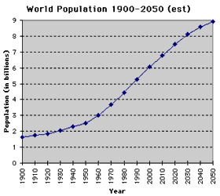

Slide 7
Pattern of Population Distribution
“The way in which people spread across the globe is known as the pattern of population distribution”.
More than 90% of the world’s population lives in about 10% of the land surface. The distribution of population is uneven on the globe. Almost ¾ of the world population lives in only 2 continents i.e. Asia and Africa. The crowded areas of the globe are Europe, North America, South and Southeast Asia.

Slide 8
World’s most Populous Countries:
China
India
USA
Indonesia
Brazil
Pakistan
Bangladesh
Russia
Nigeria

Slide 9
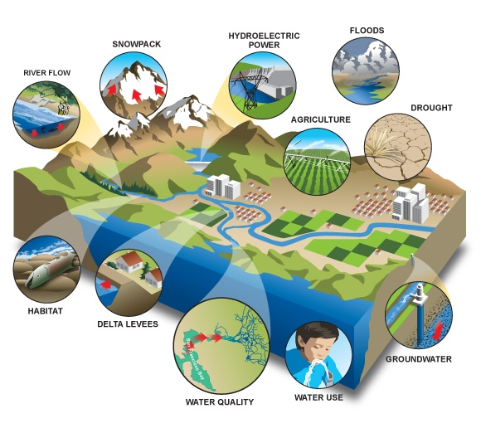
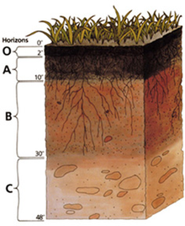
Factors affecting Distribution of Population
Topography Climate
Soil Water Minerals

Slide 10
Pakistan
Pakistan is world’s 6th most populous country.
With an estimated population of 180.54 million.
Natural growth rate is 2.05%.
With the same growth rate Pakistan will become the 4th largest nation in 2050.

Slide 11
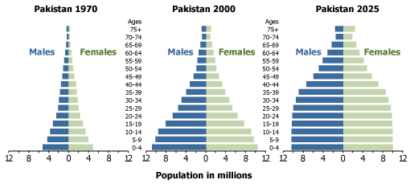

Slide 12
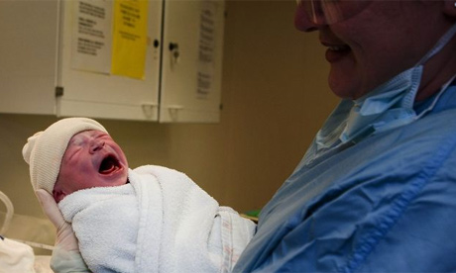
Causes of Population Explosion
Increase in Birth rate:
Birth rate is the no of
child born/1000 people/year.
With the advent of better
medical facility, economic
prosperity, social beliefs the
birth rate increases which causes increase in population.
Decrease in Death rate:
Death rate is expressed in units of deaths/1000 persons per year. The development of technologies

Slide 13
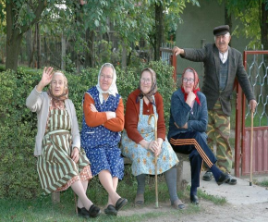
has resulted in decrease in death
rate. Good and clean atmosphere,
sufficient nutrients, better medial
facility has provided longer
and healthy life.
Better Medical facility:
New inventions of medicines,
awareness towards better health
and control of various diseases
like TB, Small pox, cancer etc has
resulted in increase of
population.

Slide 14
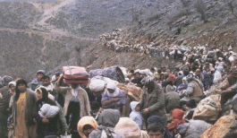
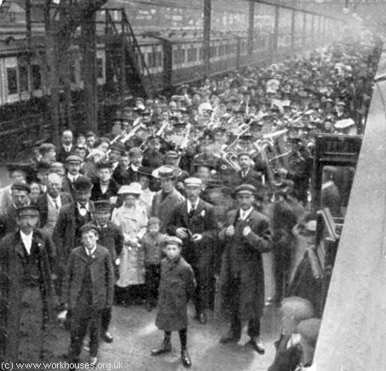
Increase Immigration:
The countries like USA where the development had brought good environment for citizens to stay, earn and enjoy had resulted in increase in immigration
Decrease Emigration:
In case of Developing Countries the basic requirement of citizens like peace, development opportunities are satisfied hence migration is avoided this may cause over population.

Slide 15
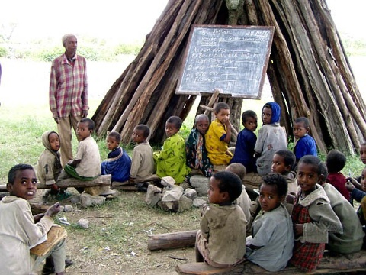
Illiteracy:
Due to some social beliefs,
lack of knowledge towards
family planning and desire
for male child are some
of the factors which cause
increase in population.
Polygamy:
Some people prefer to
have more than one wife and such polygamy system gives birth more children.

Slide 16
Inconsistent government policies
Increases in food production and distribution
Gains in education and standards of living within many developing nations.
are also responsible for increase in population in an area.

Slide 17
Effects of Population Explosion

Slide 18
Over use of natural resources
Increase in food demand
Increase in waste generation
Unemployment
Poverty
Increase in crime rate
Energy crisis
Over crowding of cities(lack
of transports)
Pollution (air, noise and water)
Education sector

Slide 19
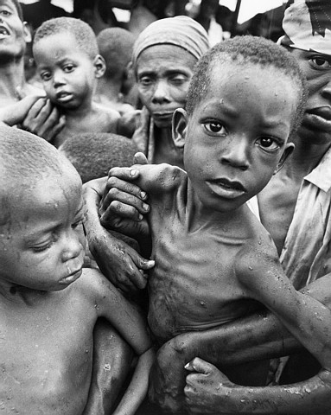
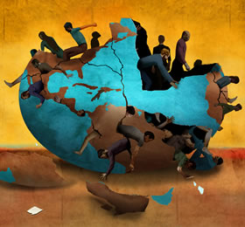
No advanced technology for developments
Health and housing problem
Inflation
Political instability
Impact on environment
Human Phycology
Economic issues

Slide 20
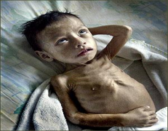
World’s Food Problem
During last 50 years, food production has increased by 50%, at the same time the population growth has out stripped food production. The FAO estimated that about 840 million people remain chronically hungry, nearly 820 million of them in the developing
countries. Scarcity of food causes:
Undernourishment
Malnutrition
Every year 40 million people die of
undernourishment and malnutrition.

Slide 21
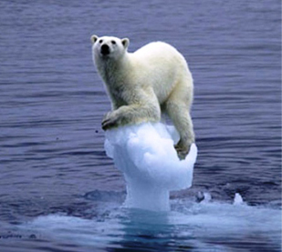
Human Impact on the Environment
Reduce the land available for plants and animals
Raw materials (inc. non-renewable) resources are being used up
More waste is produced which (if not handled properly) may pollute air, water & land

Slide 22
Pollution
The rapid growth of population creates pollution, unplanned colonies and environmental problems. Overpopulation causes air, water as well as noise pollution. There is not any effective system to control the pollution. Capitalists install industries with billion dollars of resources but do not install treatment plants of million rupees.

Slide 23
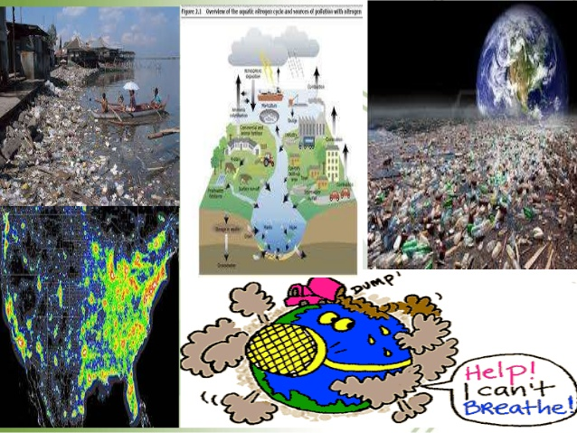

Slide 24
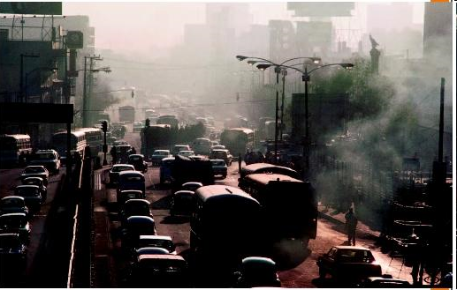
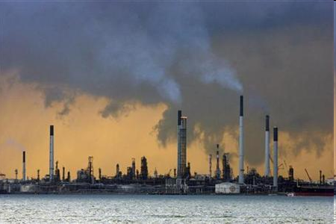
Air Pollution
Increase in industries
Increase in vehicles

Slide 25
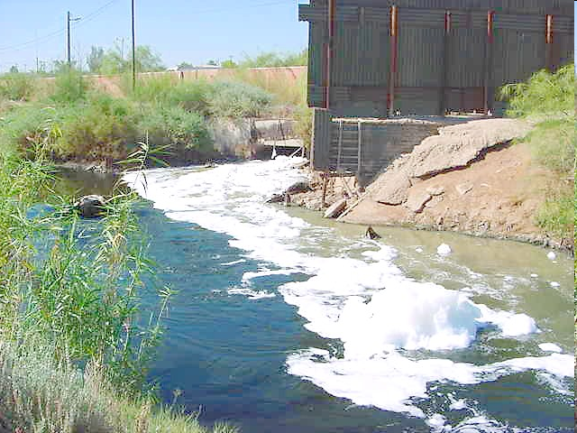
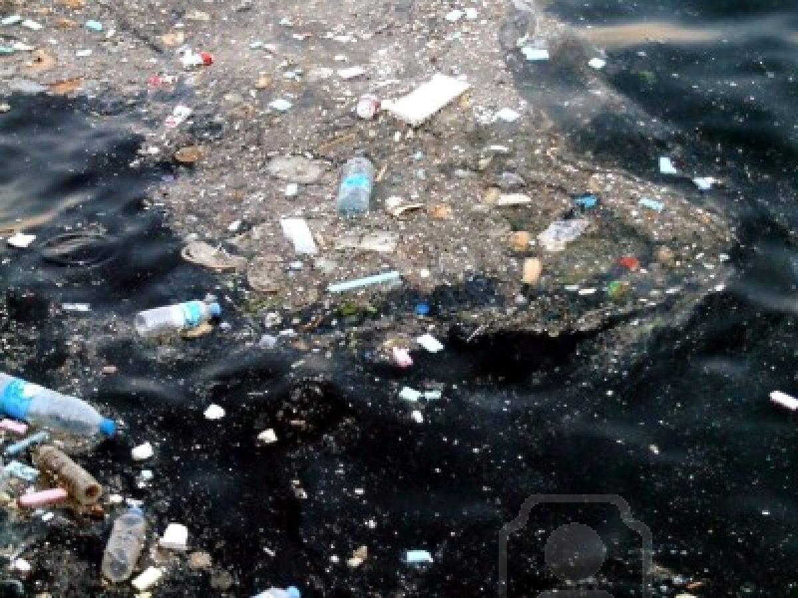
Water Pollution
Raw sewage and industrial waste flows directed to main River or Sea. Bathroom and garbage sewage flow directed to the River or Sea.

Slide 26
Increase in Demand For Food Resources
As the population increases, demand for food resources also increases.

Slide 27
Effects on Economy
Positive effects:
labour force & production.
demand in the market.
capital formation.
Negative effects:
mass poverty, hunger & joblessness.
decrease in per capita income.

Slide 28
Effects on Education
Increase in child labour thus school drop-outs.
Huge disparity in teacher-student ratio – affecting quality & care in education.
Immigration of knowledge due to lack of job opportunities.

Slide 29
Effects on Health Care
Over crowded govt. hospitals due to low economic status and lack of affordability.
Lack of health care infrastructure.
Increasing rate of health-care touts.
Low funding by govt. in health care sectors.

Slide 30
Effects on Job Sector
Increasing rate of unemployment.
Anyone is ready to do any job against any price.
Increase of job agencies as well as job related frauds.

Slide 31
Effects on Human Phycology
Depriving others to its highest extent is now the way of life.
Oversized population is the only factor for this phycological evolution.
Increasing amount of crimes in different sectors.
Increasing amount of wealth accumulation created a parallel economy.
Change of man-to-man behaviour – going towards rudeness.
Overall degradation of self-esteem, quality of life & economy.

Slide 32
Unemployment
Unemployment is also a symbol of over population. It is difficult to adjust the huge population in economic activities. Rate of unemployment is 5.6 % in Pakistan.
Low Per Capital Income
The population growth reduces per capita income of the people because national income is divided by a big size of population.

Slide 33
High Rate of Inflation
There is more demand for goods due to more population. More demand results in more prices and inflation in the country. Rate of inflation is 14.1 % in Pakistan.
Low Living Standard
Rising population cannot be provided the basic facilities of life in developing countries like Pakistan. So, rising population means low living standard. About 21 % population is living below poverty line.

Slide 35
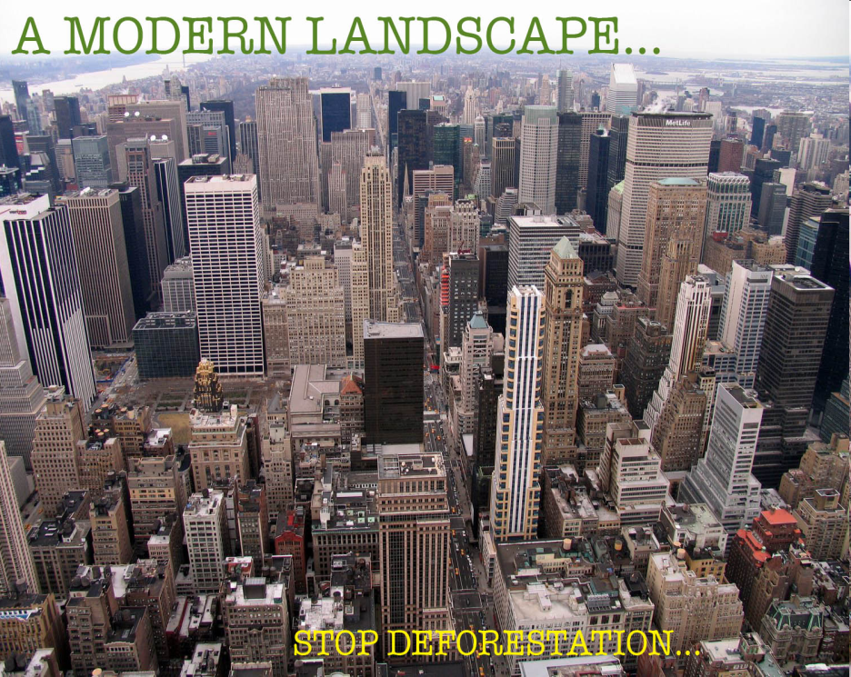
Increase in Deforestation for occupying land for day by day increase in population
For Agriculture
For Urbanization

Slide 36
Control of Population Growth
Education: Literacy plays a major role in checking population growth. Improving the literacy rate particularly in woman, can help in population control.
Incentives: Certain Incentives in the form of government benefits, scholarships to children, subsidies, exemptions from tax, promotion In jobs, should be offered.

Slide 37
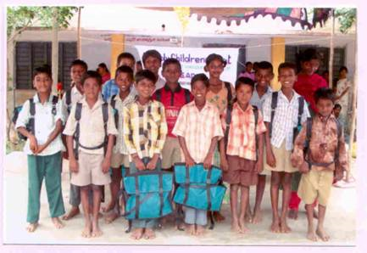
Government Benefits:
The government benefits should be allowed only for those having smaller families.
Publicity:
The Importance of birth control methods for family planning, the significance of small families and related information should be published through various media, schools, books, and other sources.

Slide 38
Social Measures:
Population explosion is as much a social problem as it is an economic problem. Many of the causes of population explosion are deep rooted in the social life of the country, For bringing down the birth rate, the following social measures should be undertaken.
Spread of education.
Improving the status of women.
Restricting early marriages
Economic Measures:
Following economic measures should be adopted

Slide 39
Modernization of agriculture.
Expansion of the industrial sector.
Creation of employment opportunities in rural areas
Fair distribution of income.
Avoid overexploitation:
Building more institutions
Best hospital facilities
Promote tree growth (agriculture sector)

Slide 40
Conclusion
Population Growth must be there but for some extent.
Population is necessary for Government Development of Countries.
Population also doing various researchers in the world.
So population is not Harmful for world but it should be used properly.

