Slide 1
Lytic cycle

Slide 2
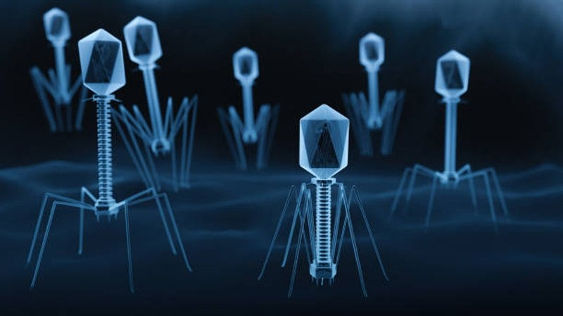
Definition of lytic cycle
The lytic cycle involves the reproduction of viruses using a host cell to manufacture more viruses; the viruses then burst out of the cell.

Slide 3
Origin of LYTIC cycle
The seminal experiments of George and Eva Klein helped to define the two life cycles of Epstein-Barr Virus (EBV), namely latency and lytic or productive infection. Their laboratories described latent nuclear antigens expressed during latency and discovered several chemicals that activated the viral lytic cycle.

Slide 4
George and Eva Klein

Slide 5
MECHANISM OF LYTIC CYCLE

Slide 6
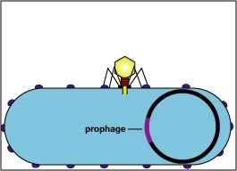
Attachment
the phage attaches itself to the surface of the host cell in order to inject its DNA into the cell
. The binding is due to electrostatic interactions and is influenced by pH and the presence of ions

Slide 7
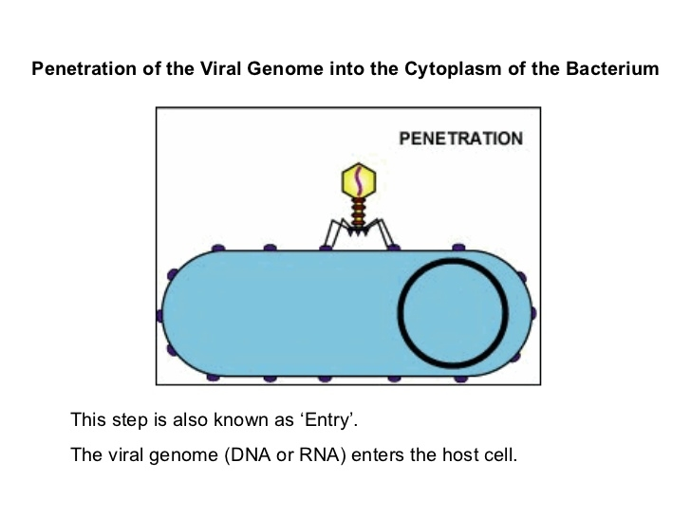
2. PENETRATION
the phage injects its DNA into the host cell by penetrating through the cell membrane

Slide 8
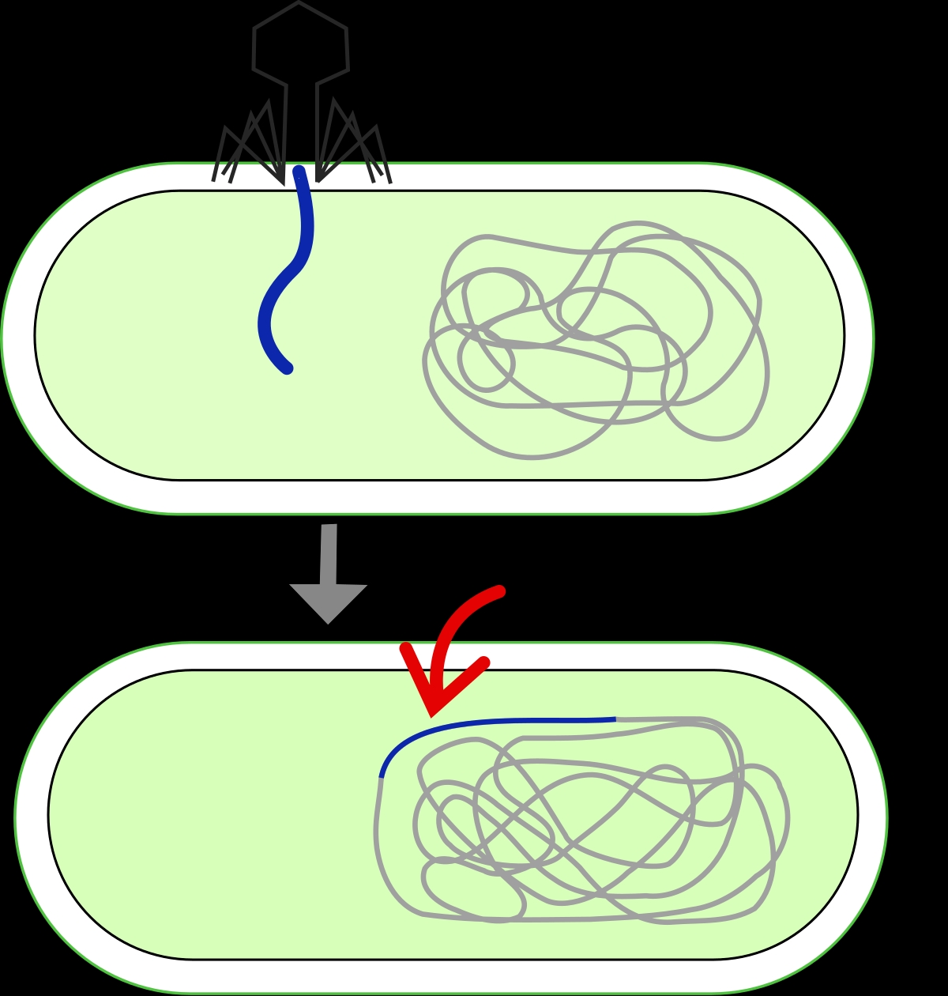
TRANSCRIPTION
the host cell's DNA is degraded and the cell's metabolism is directed to initiate phage biosynthesis.

Slide 9
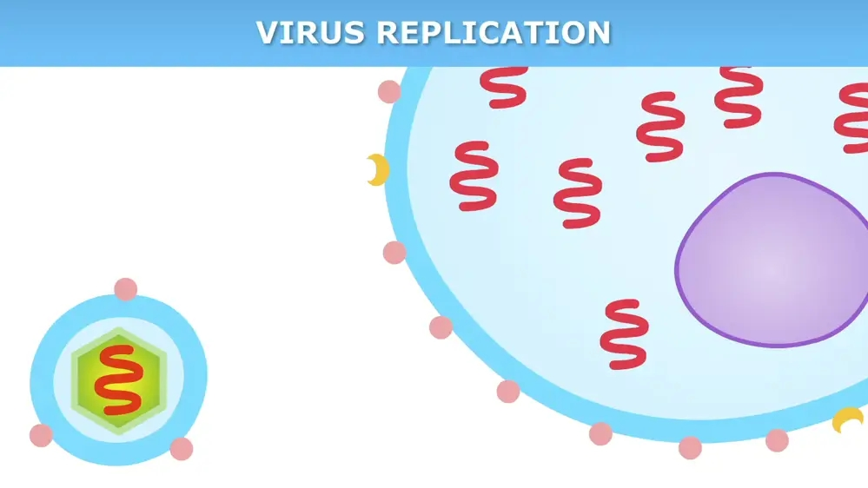
BIOSYNTHESIS
the phage DNA replicates inside the cell, synthesizing new phage DNA and proteins

Slide 10
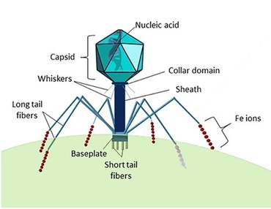
MATURATION
he replicated material assembles into fully formed viral phages (each made up of a head, a tail and tail fibers.

Slide 11
Release
the newly formed phages are released from the infected cell (which is itself destroyed in the process) to seek out new host cells to infect.
This releases progeny virions into the surrounding environment, where they can go on to infect other cells and another lytic cycle begins

Slide 13
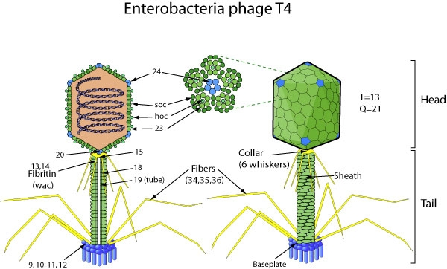
Example
Example of a lytic bacteriophage is T4, which infects E. coli found in the human intestinal tract. Lytic phages are more suitable for phage therapy.

Slide 14
POSITIVE EFFECTS OF LYTIC CYCLE
as agents of horizontal gene transfer (HGT),
sources of genetic variation for evolutionary innovation.
as weapons of bacterial competition.

