Slide 2
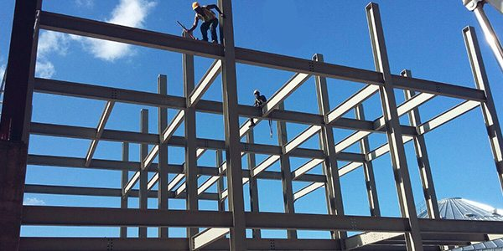
COLLEGE OF ENGINEERING AND TECHNOLOGY UNIVERSITY OF SARGODHA DESIGN OF STRUCTURES (CE-409) 01-Credit Hour
LECTURE-1
INTRODUCTION

Slide 3
COURSE OUTLINES
Specifications and codes of practice.
Choice and forms of structures for Various Conditions.
Drawing office practice for preparation of Detailed Drawings.
Analysis, design and preparation of working drawings of Steel and Concrete structures.
Introduction to Basics of Earthquake Resistant Design.

Slide 4
RECOMMENDED BOOKS AND PRE- REQUSISTE COURSES
READINGS
1 .Reinforced Concrete Design by Chu Kia (CK) Wang, Charles G. Salmon.
2. Design of Reinforced Concrete 7th edition by McCormac J.C.
3. Structural Concrete, Theory and Design, 4th edition by M. Nadeem Hassoun.
PRE-REQUISITE COURSES:
Engineering Mechanics
TOS-I & TOS-II
STRENGTH OF MATERIALS I & II
RCC-I & RCC-II.

Slide 5
REVIEW
STRUCTURAL DESIGN
The structural Design of Buildings, whether of Structural Steel or reinforced concrete requires the determination of the overall proportions and dimensions of the supporting frame work and the selection of the cross section of individual members.
In most cases the functional design including the establishment of number of stories and the floor plan will have been done by an Architect and the Structural Engineer must work within the constraints imposed by this Design.
Ideally, the engineer and architect will collaborate throughout the design process to complete the project in an efficient manner.
The design can be summed up as follows:
The architect decides how the building should look-
The Structural Engineer must make sure that it does not fall down.

Slide 6
REVIEW
STRUCTURAL DESIGN…………..
Although this distinction is oversimplification, it affirms the first priority of the structural engineer: safety.
Other important considerations include serviceability (how well the structure performs in terms of appearance and deflection) and economy.
An economical structure requires an efficient use of materials and construction labor.
Although this economy objective can usually be accomplished by a design that requires a minimum amount of material, savings can often be realized by using more material if it results in a simpler, more easily constructed project.
In fact, materials account for a relatively small portion of the cost of a typical steel structure as compared with labor and other costs (Cross, 2005).

Slide 7
REVIEW
STRUCTURAL DESIGN………….
A good design requires the evaluation of several farming plans- that is, different arrangements of members and their connections.
In other words, several alternative designs should be prepared and their costs compared.
For each framing plan investigated, the individual components must be designed. To do so requires the structural analysis of the building frames and the computation of forces and bending moments in the individual members.
Armed with this information, the structural designer can then select the appropriate cross section.
Before any analysis, however, a decision must be made on the primary building material to be used; it will usually be reinforced concrete, Structural Steel or both.
Ideally, alternative designs should be prepared with each other.

Slide 8
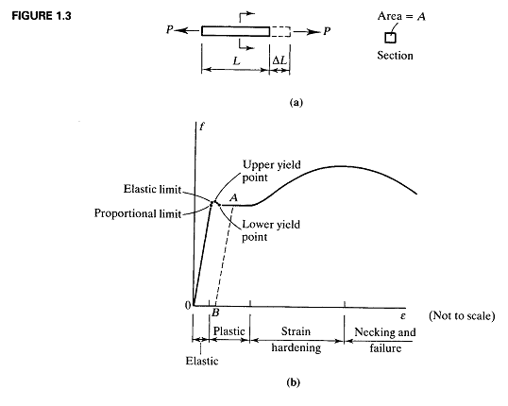
Stress-Strain Curve for Mild Steel under uniaxial Tension

Slide 9
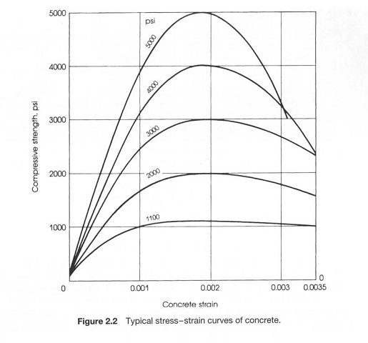

Slide 10
REVIEW
ADVANTAGES OF REINFORCED CONCRETE AS A STRUCTURAL MATERIAL
Reinforced concrete may be the most important material available for construction.
It is used in one form or another for almost all structures, great or small—buildings, bridges, pavements, dams, retaining walls, tunnels , drainage and irrigation facilities, tanks, and so on.
The tremendous success of this universal construction material can be understood quite easily if its numerous advantages are considered.
It has considerable compressive strength per unit cost compared with most other materials.
Reinforced concrete has great resistance to the actions of ﬁre and water and, in fact, is the best structural material available for situations where water is present. During ﬁres of average intensity, members with a satisfactory cover of concrete over the reinforcing bars suffer only surface damage without failure.

Slide 11
REVIEW
ADVANTAGES OF REINFORCED CONCRETE AS A STRUCTURAL MATERIAL……….
It is a low-maintenance material.
As compared with other materials, it has a very long service life. Under proper conditions, reinforced concrete structures can be used indeﬁnitely without reduction of their load carrying abilities. This can be explained by the fact that the strength of concrete does not decrease with time but actually increases over a very long period, measured in years, because of the lengthy process of the solidiﬁcation of the cement paste (Hydration).
It is usually the only economical material available for footings, ﬂoor slabs, basement walls, piers and similar applications.
A special feature of concrete is its ability to be cast into an extraordinary variety of shapes from simple slabs, beams and columns to great arches and shells.
A lower grade of skilled labor is required for erection as compared with other materials
Such as structural steel.

Slide 12
REVIEW
DISADVANTAGES OF CONCRETE AS A STRUCTURAL MATERIAL……….
To use concrete successfully, the designer must be completely familiar with its weak points as well as its strong ones. Among its disadvantages are the following:
Concrete has a very low tensile strength, requiring the use of tensile reinforcing.
Forms are required to hold the concrete in place until it hardens sufﬁciently. In addition, false work or shoring may be necessary to keep the forms in place for roofs, walls, ﬂoors and similar structures until the concrete members gain sufﬁcient strength to support themselves. Form work is very expensive. In the United States, its costs run from one-third to two-thirds of the total cost of a reinforced concrete structure, with average values of about 50%.
It should be obvious that when efforts are made to improve the economy of reinforced concrete structures, the major emphasis is on reducing formwork costs.

Slide 13
REVIEW
DISADVANTAGES OF CONCRETE AS A STRUCTURAL MATERIAL……….
The low strength per unit of weight of concrete leads to heavy members. This becomes an increasingly important matter for long span structures, where concrete’s large dead weight has a great effect on bending moments. Light weight aggregates can be used to reduce concrete weight, but the cost of the concrete is increased.
Similarly, the low strength per unit of volume of concrete means members will be relatively large, an important consideration for tall buildings and long-span structures.
The properties of concrete vary widely because of variations in its proportioning and mixing. Furthermore, the placing and curing of concrete is not as carefully controlled as is the production of other materials, such as structural steel and laminated wood.

Slide 15
REVIEW
COMPARISON OF REINFORCED CONCRETE AND STRUCTURAL STEEL FOR BUILDINGS AND BRIDGES
When a particular type of structure is being considered, the student may be puzzled by the question, “Should reinforced concrete or structural steel be used?”
There is much joking on this point, with the proponents of reinforced concrete referring to steel as that material that rusts and those favoring structural steel referring to concrete as the material that, when overstressed, tends to return to its natural state- that is sand and gravel.
There is no simple answer to this question, in as much as both of these materials have many excellent characteristics that can be utilized successfully for so many types of structures.
In fact, they are often used together in the same structures with wonderful results.

Slide 16
REVIEW
COMPARISON OF REINFORCED CONCRETE AND STRUCTURAL STEEL FOR BUILDINGS AND BRIDGES…
The selection of the structural material to be used for a particular building depends on the height and span of the structure, the material market, foundation conditions, local building codes and architectural considerations.
For buildings of less than 4 stories, reinforced concrete, structural steel, and wall-bearing construction are competitive.
From 4 to about 20 stories, reinforced concrete and structural steel are economically competitive, with steel having been used in most of the jobs above 20 stories in the past.
Today, however, reinforced concrete is becoming increasingly competitive above 20 stories, and there are a number of reinforced concrete buildings of greater height around the world.

Slide 17
REVIEW
COMPARISON OF REINFORCED CONCRETE AND STRUCTURAL STEEL FOR BUILDINGS AND BRIDGES…
The Foundation conditions can often affect the selection of the material to be used for the structural frame. If foundation conditions are poor, using a lighter structural steel frame may be desirable.
The building code in a particular city may favor one material over the other. For instance, many cities have ﬁre zones in which only ﬁre proof structures can be erected—a very favorable situation for reinforced concrete.
Finally, the time element favors structural steel frames, as they can be erected more quickly than reinforced concrete ones.
The time advantage, however, is not as great as it might seem at ﬁrst because, if the structure is to have any type of ﬁre rating, the builder will have to cover the steel with some kind of ﬁre prooﬁng material after it is erected.

Slide 18
REVIEW
COMPARISON OF REINFORCED CONCRETE AND STRUCTURAL STEEL FOR BUILDINGS AND BRIDGES…
Making decisions about using concrete or steel for a bridge involves several factors, such as span, foundation conditions, loads, architectural considerations, and others.
In general, concrete is an excellent compression material and normally will be favored for short-span bridges and for cases where rigidity is required (as, perhaps, for railway bridges).

