Slide 1
Spinal Cord Injury Management

Slide 2
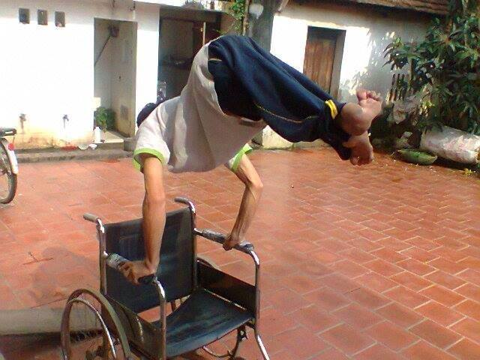
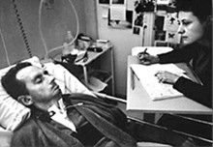
????
https://www.facebook.com/photo.php?v=713291652050347
Jean-Dominique Bauby

Slide 3
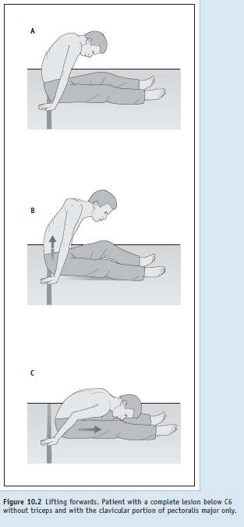
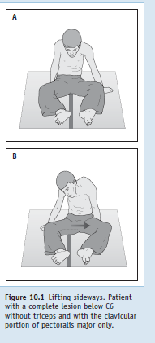
Lift and move side and forwards

Slide 4
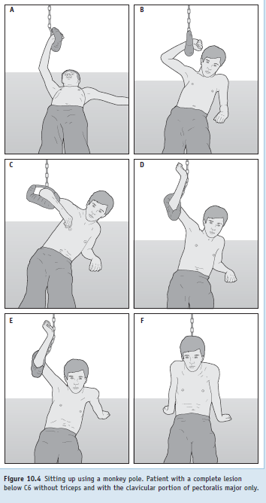
Sitting using monkey pole

Slide 5
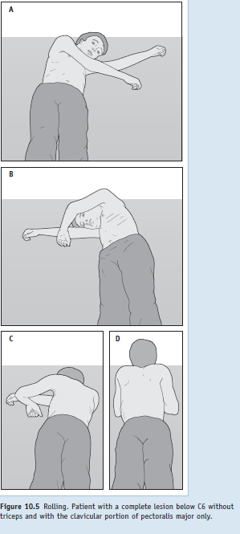
Supine to prone roll

Slide 6
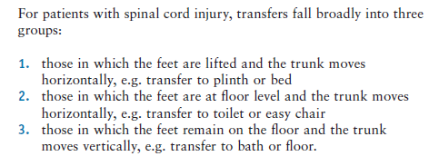

Slide 7
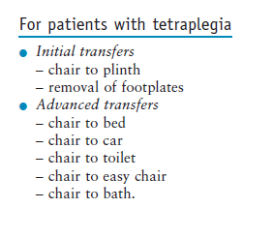
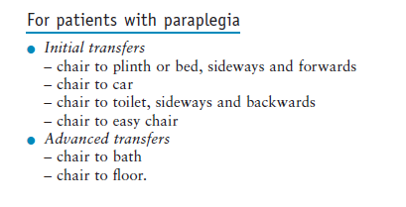

Slide 8
Therapist transfer
Chair 30 degree
Back straight
Belt

Slide 9
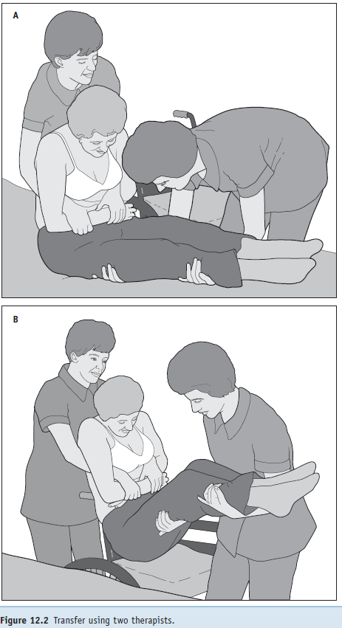
Two therapist

Slide 10
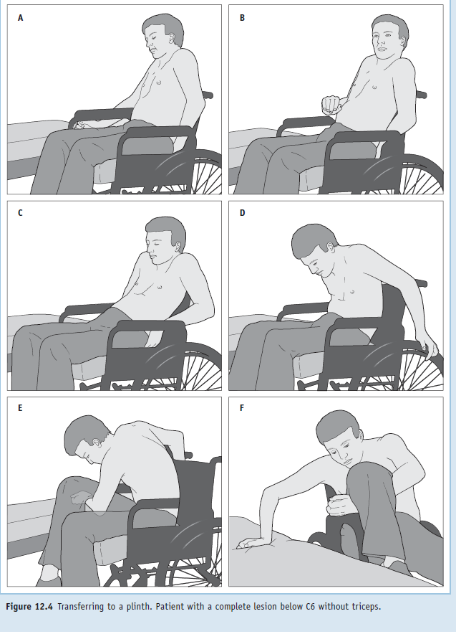
Independent transfer

Slide 11
Transfer
Lower surface easier than higher
Techniques
Legs up
Legs down
One leg up one leg down

Slide 12
Legs up
Extended knee causes passive tension in hamstring
Avoid to lift or lower leg…pt can lift or lower when on sitting WC
Moving forward and backward
Feet dig or drag

Slide 13
Legs down
Foot plates
Floor….some prefer
Increase tendency to slide off if feet on floor
If feet on WC than tip forward
Rotating the castors forward

Slide 14
Lateral transfer
Rotatory strategy
Inclination forward trunk
Head goes down and buttocks go up
Weight through paralyzed legs

Slide 15
Translatory strategy
Upright position while moving laterally
Poor shoulder strength
Inability to rotate the trunk
Large Torque generated by
LD, Pect, SA, Ant. Deltiod
Lateral transfer bicep active than triceps
Importance of biceps

Slide 16
WC lock one of important part of training and for safety purpose
Head-hips relationship
Head and shoulder move in one direction
Buttocks move in opposite direction
Transfer
30-45 degree
90 degree

Slide 17
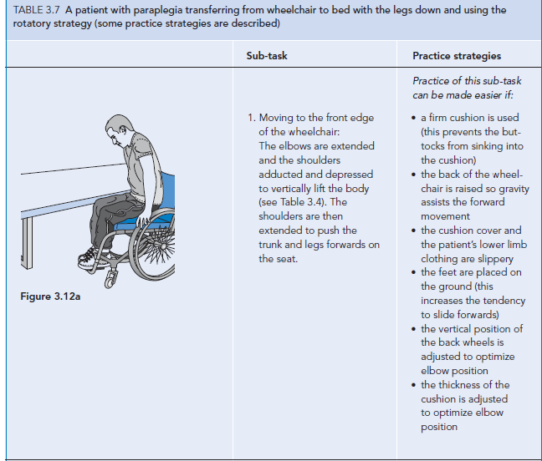

Slide 18
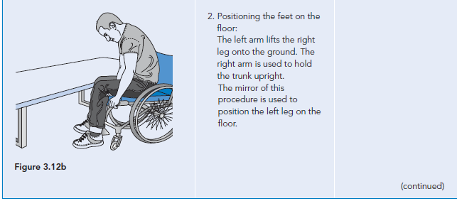

Slide 19
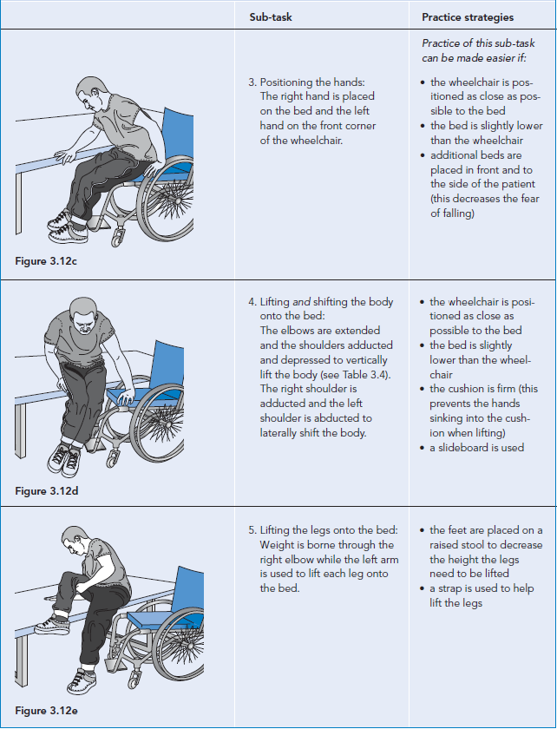

Slide 20
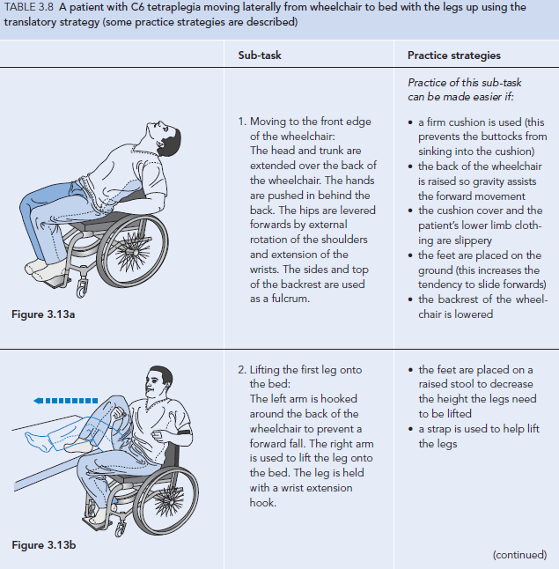

Slide 21
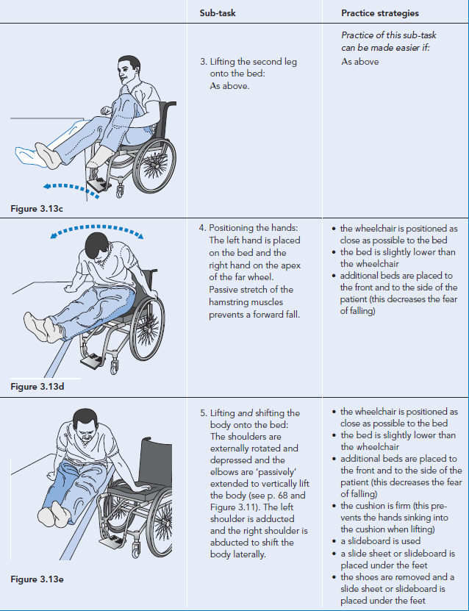

Slide 22
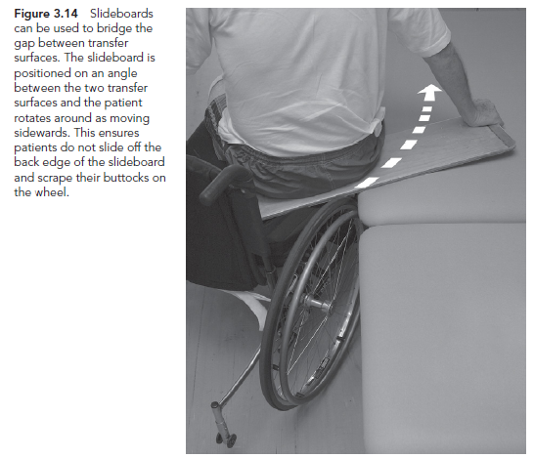

Slide 23
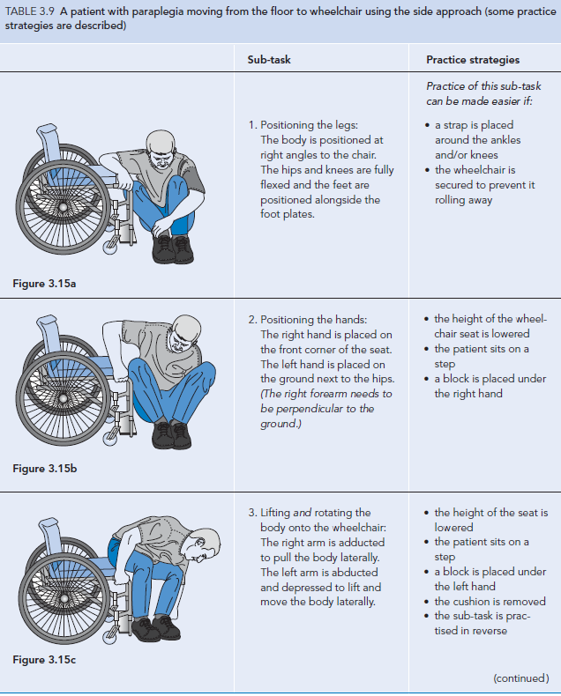

Slide 24
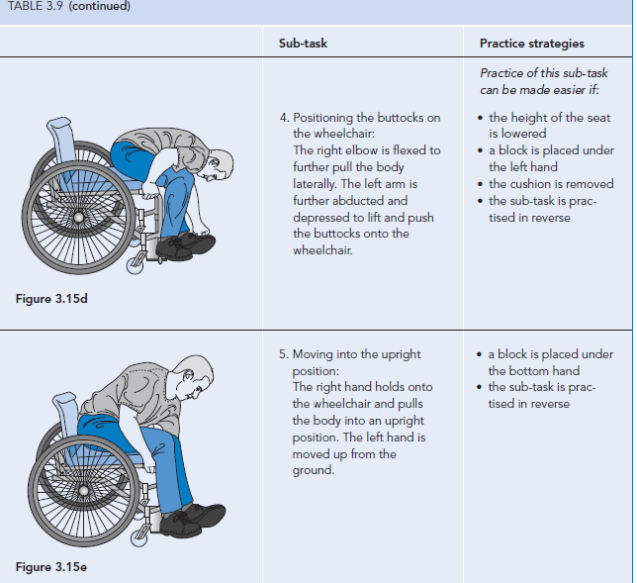

Slide 51
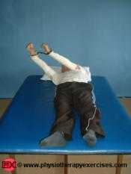
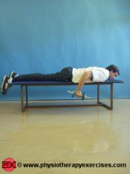
Rolling---pressure relief---weight exercises

Slide 52
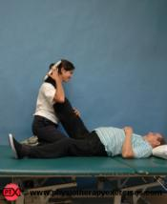
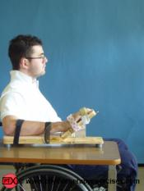
Triceps wt exe---Hamstring stretching---Functional position

Slide 53
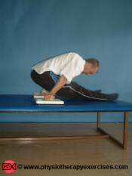
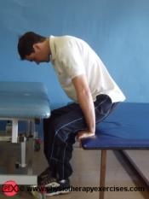
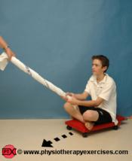
Hiking---lifting---standing---standing e assistance

Slide 54
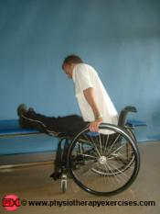
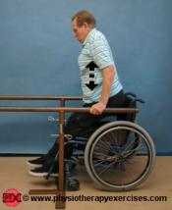
W/c to bed--------W/c to parallel bar

Slide 55
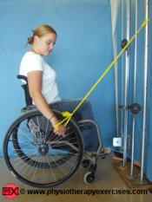
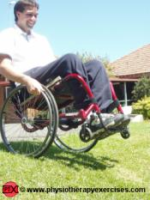
Resisted exercise------------Wheeling

