Slide 1
GENIC BALANCE THEORY

Slide 2
Genic balance theory
The theory of genic balance given by Calvin Bridges (1926) states that instead of XY chromo­somes, sex is determined by the genic balance or ratio between X-chromosomes and autosome genomes.

Slide 3
Contd...
According to this theory, sex is determined by the autosomes as well as by the X chromosomes, the ratio of autosomes to X's being the significant relation.
In Drosophila the X chromosome carries more genes for femaleness while the autosomes carry more genes for maleness.

Slide 4
Contd....
Which sex actually develops is decided by the balance between the two sets of genes.

Slide 5
Sex Determination in Drosophila melanogaster
D. melanogaster has 8 chromosomes: 3 pairs of autosomes + 1 pair of sex chromosomes
Genic balance system: in D. melanogaster, the dosage of X chromosomes determines sex.
For example, both XY and XO flies are phenotypically male. In contrast, both XX and XXY flies are phenotypically female.
X : A ratio (X, number of X chromosomes;
A, number of haploid sets of autosomes)

Slide 6
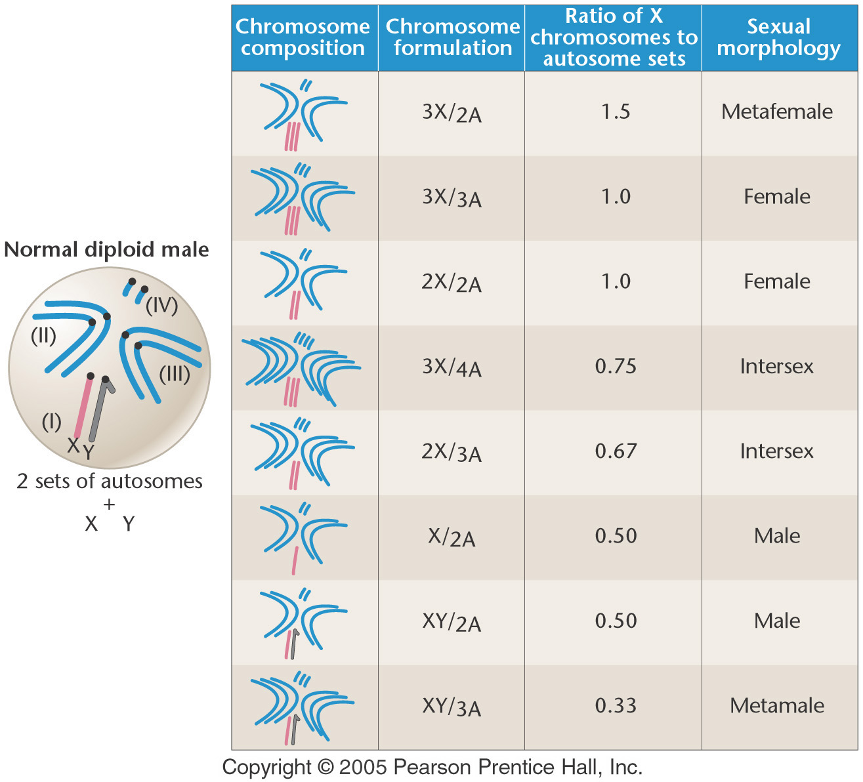
The ratios of X chromosomes to sets of autosomes, and the resultant sexual morphology in Drosophila melanogaster.
The normal diploid male chromosome composition is shown as a reference on the left (XY/2A).
Notes:
Figure: 5.11
Title:
Sexual Morphology in Drosophila melanogaster
Caption:
Chromosome compositions, the ratios of X chromosomes to sets of autosomes, and the resultant sexual morphology in Drosophila melanogaster. The normal diploid male chromosome composition is shown as a reference on the left (XY/2A).

Slide 7
SEX and GENDER
The terms ‘sex' and ‘gender' are closely linked, yet they are not synonyms. Robert Stoller, in the 1960s, has drawn the distinction between them.

Slide 8
Contd...
He suggested that the word ‘sex' be used to refer to the physical differences between men and women,
while the term ‘gender' be used in connection to the behaviour and cultural practices of men and women.

Slide 9
SEX
Definition of "Sex" The term ‘sex' is easy to understand. It simply refers to the natural biological differences between men and women, for example, the differences in the organs related to reproduction.

Slide 10
GENDER
Definition of "Gender" "Gender refers to the cultural, socially-constructed differences between the two sexes. It refers to the way a society encourages and teaches the two sexes to behave in different ways through socialisation."

