Slide 1
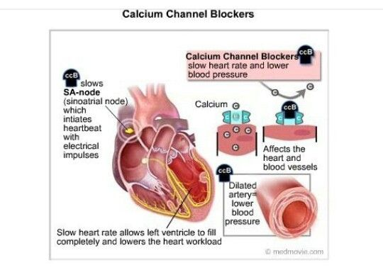
ANTI-HYPERTENSIVE DRUGS
calcium channels blockers
Notes:
Multifactorial and heterogeneous disorder

Slide 2
Voltage-sensitive Ca²⁺ channels (L-type or slow channels) mediate the entry of extracellular Ca²⁺ into smooth muscle and cardiac myocytes and sinoatrial (SA) and atrioventricular (AV) nodal cells in response
to electrical depolarization.
In both smooth muscle and cardiac myocytes, Ca²⁺ is a trigger for contraction, albeit (awl·bee·uht) by different mechanisms. Ca²⁺ channel antagonists, also called Ca²⁺ entry blockers, inhibit Ca²⁺ channel function.

Slide 3
Classes of calcium channel blockers
Diphenylalkylamines: Verapamil
Significant effects on both cardiac and vascular smooth muscle cells
Benzothiazepines: Diltiazem
Diltiazem affects both cardiac and vascular smooth muscle cells, but it has a less pronounced negative inotropic effect on the heart compared to that of verapamil
Dihydropyridines: This class of calcium channel blockers includes nifedipine, (the prototype), amlodipine, felodipine, isradipine, nicardipine, and nisoldipine
All dihydropyridines have a much greater affinity for vascular calcium channels than for calcium channels in the heart
Notes:
Discovery and Development of Calcium Channel Blockers doi: 10.3389/fphar.2017.00286

Slide 4
Notes:
The first-generation nicardipine and nifedipine have proven efficacy against hypertension. However, because of their short duration and rapid onset of vasodilator action, these drugs were more likely to be associated with adverse effects
Nifedipine has a rapid onset of action (buccal, 10-15 minutes; oral, 30-45 minutes) and peak effect (buccal, 30 minutes, oral, 60 minutes). The duration of effects is four to six hours regardless of the route of administration, with a mean arterial pressure reduction of 21.6% (248/134 mm Hg to 165/87 mm Hg).

Slide 5
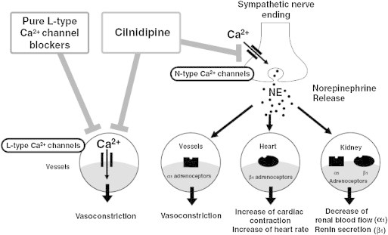
Cilnidipine is a promising 4th generation Ca2+ channel blocker with a rational pharmacological profile; i.e. dual L/N-type Ca2+ channel-blocking action.
The blockade of N-type Ca2+ channels effectively suppresses neurohumoral regulation in the cardiovascular system, including sympathetic nervous system and renin–angiotensin–aldosterone system.
doi: 10.1016/j.ihj.2013.11.001

Slide 6
Actions
The intracellular concentration of calcium plays an important role in maintaining the tone of smooth muscle and in the contraction of the myocardium.
Calcium enters muscle cells through special voltage sensitive calcium channels.
This triggers release of calcium from the sarcoplasmic reticulum and mitochondria, which further increases the cytosolic level of calcium.
Calcium channel antagonists block the inward movement of calcium by binding to L-type calcium channels in the heart and in smooth muscle of the coronary and peripheral arteriolar vasculature.
This causes vascular smooth muscle to relax, dilating mainly arterioles.
Calcium channel blockers do not dilate veins. (no effect on preload)

Slide 7
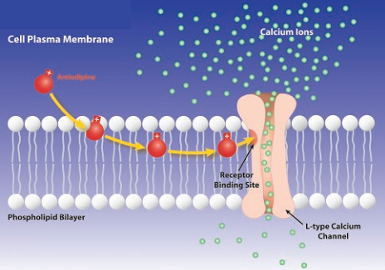

Slide 8
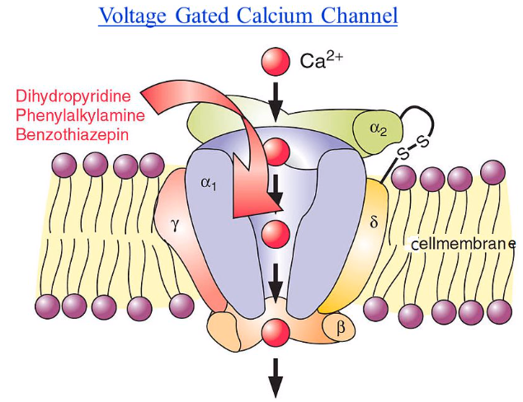

Slide 9
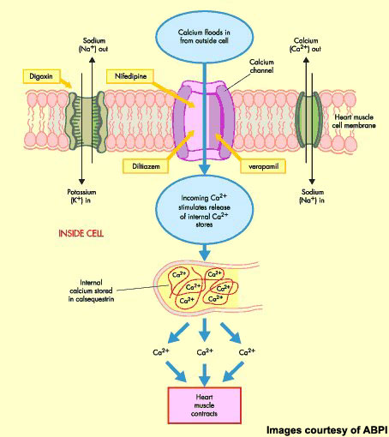

Slide 10
Therapeutic uses
In the management of hypertension, CCBs may be used as an initial therapy or as add-on therapy.
In the treatment of hypertensive patients who also have asthma, diabetes, and/or peripheral vascular disease, Advantage:
unlike β-blockers, they do not have the potential to adversely affect these conditions.
All CCBs are useful in the treatment of angina.
In addition, diltiazem and verapamil are used in the treatment of atrial fibrillation.

Slide 11
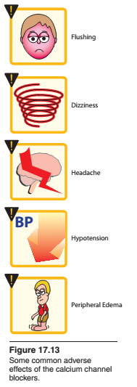
Nifedipine-Induced Gingival Hyperplasia

Slide 12
Notes:
Calcium antagonists like nifedipine block the input of calcium ions, thereby affecting homeostasis of collagen. The synthesis and degradation of the collagen being altered lead to the abnormal growth [10]. Factors like age, genetic predisposition, pharmacological actions, dose, plaque, and oral hygiene have been attributed for gingival enlargement in nifedipine-induced gingival hyperplasia. The age is indirectly proportional to the severity of the enlargement. Younger age people show more enlargements because they have greater fibroblastic metabolism and hormonal change than the elderly
Gingival enlargement is an increase in the size of the gingiva (gums).

