Slide 1
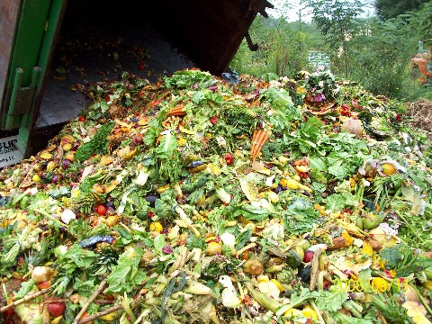
FOOD INDUSTRIAL WASTES MANAGEMENT
COURSE CODE:-Bot 735
COURSE TITLE:-Food industrial waste management
CREDIT HOUR:-3(2+1)
University of Sargodha
(Dept. of Botany)
BY:-
Dr. Abdul Ghani

Slide 2
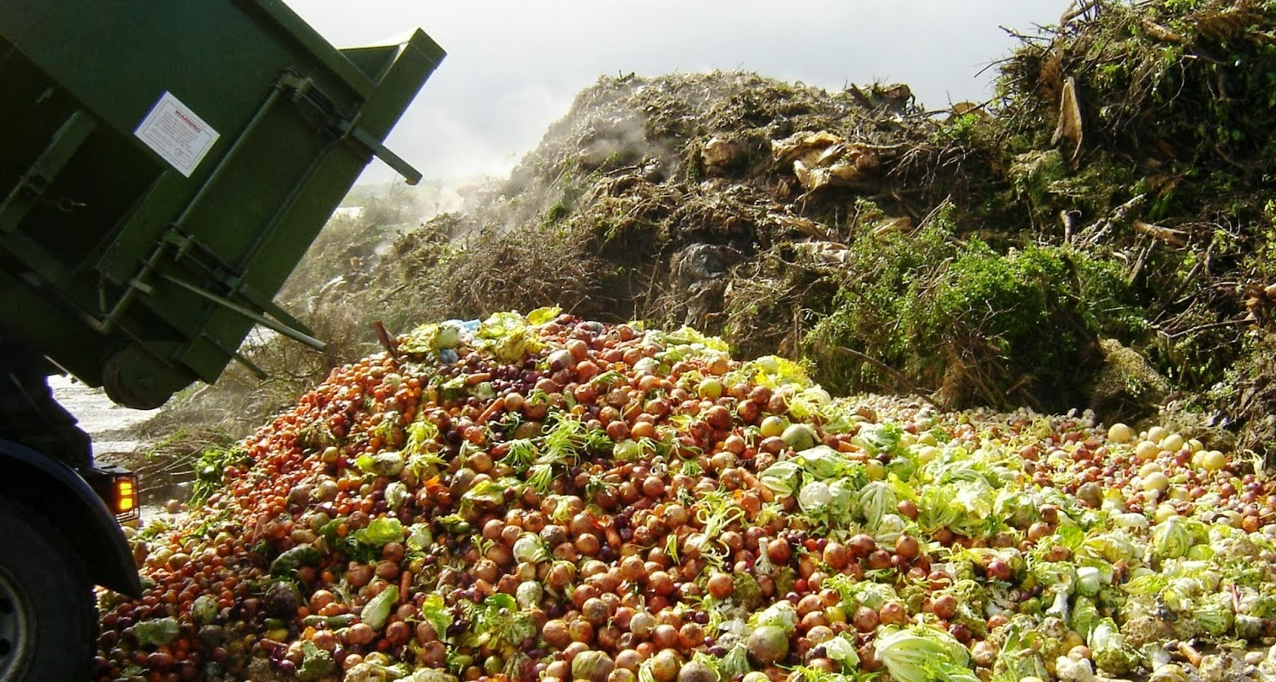
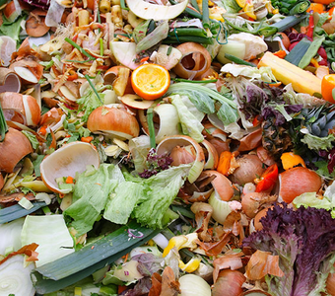
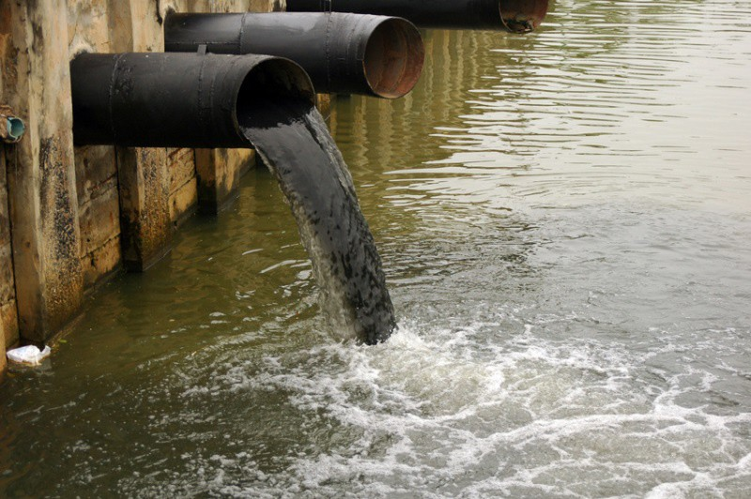
Waste
1- Wastes is any substances or objects that holder tend to discard.
2- Unwanted or unusable material, substances, or by-products is also known as wastes.
Solid waste
It can be defined as: the useless and unwanted products in the solid state, derived from the activities of society.

Slide 3
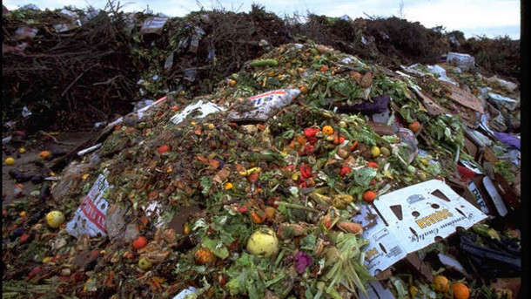
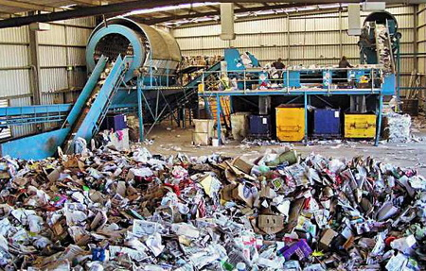
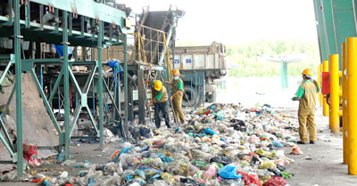
Industrial Waste
Industrial waste is the waste produced by industrial activity which includes any solids, liquids or gaseous residual and unwanted from industrial operations.
Food Industrial Waste
Food industrial wastes are those end products of various food processing industries that have not been recycled or used for other purposes.

Slide 4
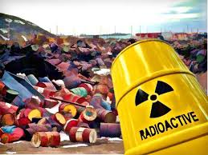
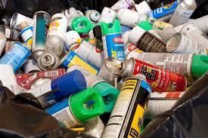
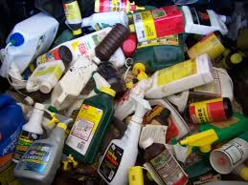
Hazardous Waste
These types of waste that have potential danger immediate or not to human life, wildlife and plants is called hazardous wastes.
Some hazardous waste generators are larger companies such as chemical manufacturers, electroplating companies, and oil refineries
Examples; Radioactive wastes, antifreeze substances, batteries, brake fluid, chemical strippers, chlorine bleach, contact cement, drain cleaners and fire extinguishers.

Slide 5
Common terminologies
1= Rubbish: All combustible and noncombustible solid waste, except food wastes is called rubbish.
2= Trash: Inorganic things that thrown away, such as empty bottles,
used papers.
3= Garbage: Food waste and degradable organic wastes is known as garbage.

Slide 6
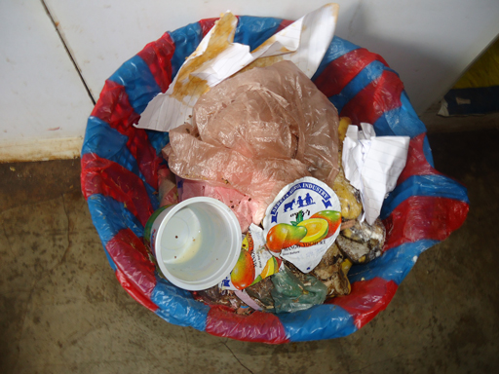
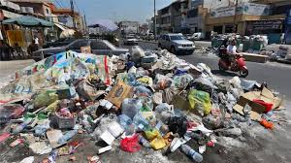
Common terminologies
4= Refuse: The collective term for solid wastes, includes both garbage and rubbish.
5= Litter: Odds and ends (A collection containing a variety of sorts of things) bits of paper, discarded wrappings, bottles etc. Left lying around in public places.

Slide 7
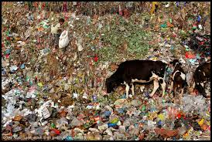
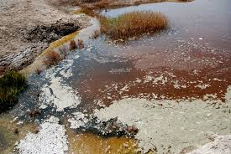
IMPACTS OF WASTES
Affects our health
Affects our socio-economic conditions
Affects our coastal and marine environment
Affects our climate

Slide 8
Common Components in Waste
Paper Products Glass Aluminum Ferrous Metals Other Nonferrous Metals Plastics Rubber and Leather Textiles Food Wastes Household Hazardous Wastes
Toxic Metals
Organic Compounds

Slide 9
Classification of Wastes
Wastes
Bio-degradable
Any substance or object capable of being decomposed by bacteria or other living organisms (paper, wood, fruits and others).
Non-biodegradable
waste that can not be broken down into its simple compounds by micro-organisms (plastics, bottles, old machines, cans, containers and others).

Slide 10
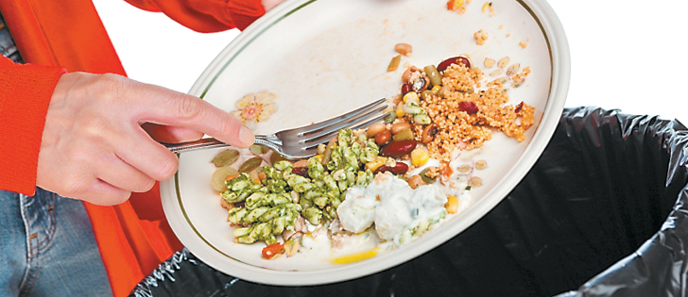
TYPES OF INDUSTRIAL WASTE
Solid waste
Liquid waste
Gaseous waste
Coffee waste
Commercial waste
Electronic waste
Food waste
Mineral waste
Human waste
Industrial waste
Municipal solid waste
Packaging waste

Slide 11
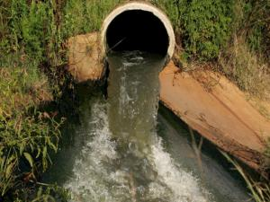
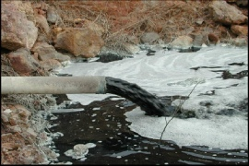
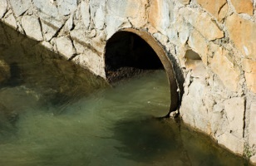
Types of waste Generally, waste could be liquid or solid waste. Both of them could be hazardous. Liquid and solid waste types can also be grouped into organic, re-usable and recyclable waste.
1= Liquid wastes:
It can be defined as such fluids as wastewater, fats, oils or grease used oil, and hazardous household liquids.
Waste can come in non-solid form. Some solid waste can also be converted to a liquid waste form for disposal.
Examples of liquid waste include wash water from homes, liquids used for cleaning in industries and waste detergents.

Slide 12
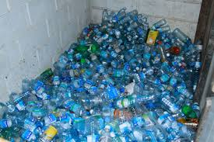
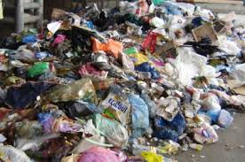
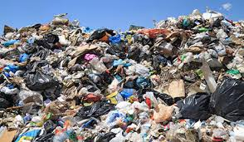
2= Solid waste:
Solid waste predominantly, is any garbage, refuse or rubbish that we make in our homes and other places.
These include
Old car tires,
Old newspapers,
Broken furniture and even
Food waste.
They may include any waste that is non-liquid.

Slide 13
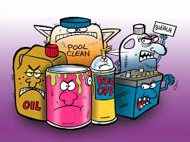
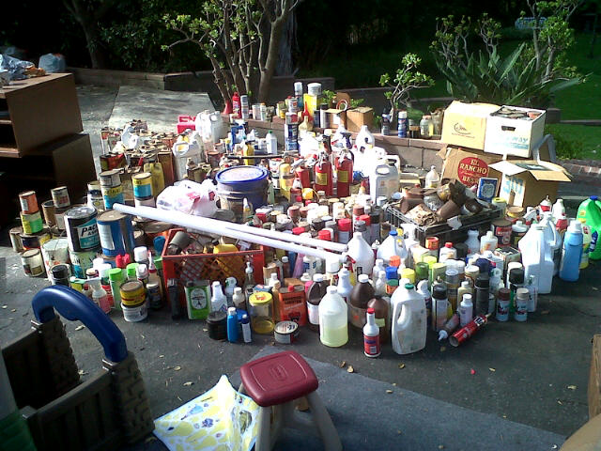
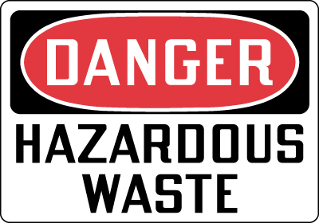
3= Hazardous type:
Hazardous or harmful waste are those that potentially threaten public health or the environment.
Such waste could be;
1- Inflammable (can easily catch fire),
2- Reactive (can easily explode),
3- Corrosive (can easily eat through metal)
4- Toxic (poisonous to human and animals.
Examples include fire extinguishers, old propane tanks, pesticides, mercury-containing equipment (Thermostats) and lamps (e.g. fluorescent bulbs) and batteries.

Slide 14
CATEGORIES OF WASTES
Consumers, manufacturers, utilities, and industries generate a wide spectrum of wastes possessing drastically different chemical and physical properties.
Some major classes of waste include:
● Municipal solid wastes ● Hazardous wastes ● Industrial wastes ● Medical wastes ● Universal wastes ● Construction and demolition wastes ● Radioactive wastes ● Mining wastes

Slide 15
1= Municipal solid wastes
Also known as domestic waste or sometimes household waste, is generated within a community from several sources, and not simply by the individual consumer or a household.
MSW originates from residential, commercial, institutional, industrial, and municipal sources.
Municipal wastes are highly heterogeneous and include durable goods (e.g., appliances), nondurable goods (newspapers, office paper), packaging and containers, food wastes, yard wastes, and miscellaneous inorganic wastes.

Slide 16
Further types of municipal solid waste
1- Residential wastes.
It includes food scraps, food packages, cans, bottles, news papers and clothing.
2- Commercial wastes(Office, building, companies)
It includes office papers, boxes, food wastes and wood pallets
3- Institutions wastes (School, hospitals, Prisons).
It includes class room wastes, papers, rappers
4- Industrial wastes (Packages).
It includes straws, by products of foods, disposable pallets. etc.

Slide 17
2= HAZARDOUS WASTE
“Any waste or combination of wastes which pose potential hazard to human health or living organisms” is called hazardous wastes.
Because such wastes are non-degradable or persistent in nature as well as they can be biologically magnified or may be lethal or tend to cause detrimental cumulative effects.
Examples of hazardous wastes include .
Residues from solvent manufacture
Electroplating
Metal treating
Wood preserving
Petroleum refining

Slide 18
3= INDUSTRIAL WASTE
Billions of tons of industrial solid waste are generated and managed on-site at industrial facilities each year.
Many (but not all) of these wastes are of low toxicity.
Examples of an industrial waste stream are,
Coal combustion solids.
Ash.
Fly ash.
Flue gas (A way to carry off smoke).
Desulfurization sludge.

Slide 19
4= MEDICAL WASTE
Medical waste is defined as wastes generated during the administration of healthcare by medical facilities and home healthcare programs, or as a result of research by medical institutions.
Medical wastes include:
Cultures and stocks of infectious agents (e.g., Cultures from medical, pathological, research, and industrial laboratories);
Pathological wastes (tissues, organs, body parts, body fluids);
Waste human blood and blood products; sharps (both used and unused hypodermic needles, syringes, scalpel blades, etc.)

Slide 20
5= UNIVERSAL WASTE
Universal wastes are hazardous wastes that are widely produced by households and many different types of businesses.
Universal wastes include:
Batteries such as nickel–cadmium and small lead–acid batteries found in electronic equipment, mobile telephones, and portable computers.
Agricultural pesticides.
Televisions, computers and other electronic devices as well as fluorescent lamps.
Lamps that contain mercury or lead. Thermostats that contain liquid mercury

Slide 21
6= CONSTRUCTION AND DEMOLITION DEBRIS
Construction and demolition debris is “waste material produced during construction, renovation, or demolition of structures”
Components of C&D debris includes;
Concrete
Asphalt
Wood
Metals
gypsum
wallboard
Roofing.
Land-clearing debris such as tree stumps and rocks

Slide 22
7= RADIOACTIVE wastes
Radioactive wastes is define as, unstable atoms with nuclei that undergo radioactive decay and emits harmful radiation (The spontaneous emission of a stream of electromagnetic rays in nuclear decay materials) .
Low-level radioactive wastes comprise many diverse materials generated from industrial, research, educational, and other processes
High-level radioactive wastes are generated in nuclear plants by the fission of uranium nuclei in a controlled reaction .
Spent uranium fuel is an example of a highly radioactive waste and contains many other radionuclides

Slide 23
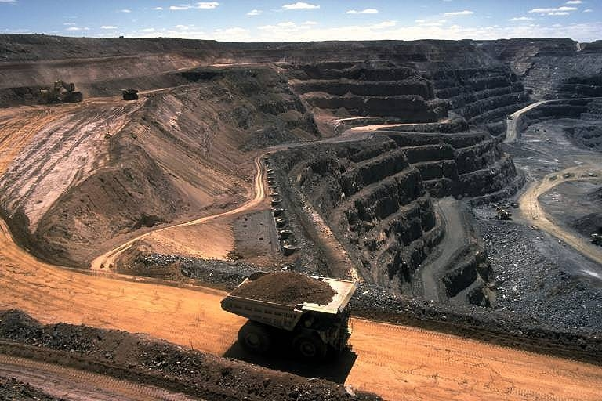
8= Mining Wastes
Mine waste defines as the wastes generated during the physical removal of a desired resource (coal, precious metals, etc.) from the subsurface of Earth.
Mine waste also includes the tailings or spoils that are produced during the processing of minerals

Slide 24
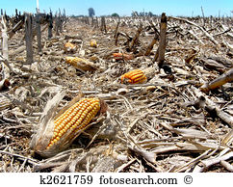
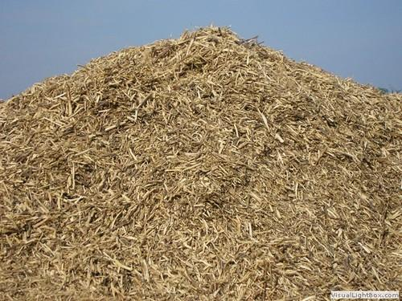
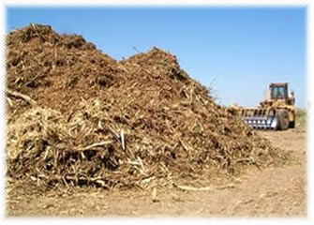
9= AGRICULTURAL WASTE
The largest proportion of agricultural wastes includes animal manures and crop residues, pesticide containers and packaging.
Problems related to odor, pathogen content, salt concentration, and ammonia production are also present.

Slide 25
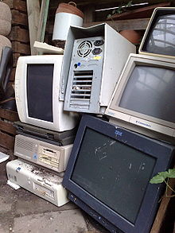
10= Electronic waste
Electronic waste or e-waste describes discarded electrical or electronic devices.
Used electronics which are destined for reuse, resale, salvage, recycling, or disposal are also considered e-waste.
Informal processing of e-waste in developing countries can lead to adverse human health effects and environmental pollution.

Slide 26
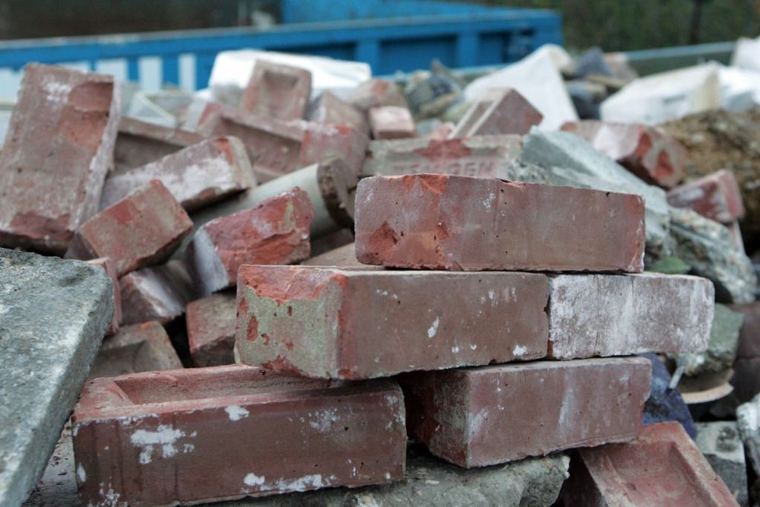
11= Inert waste
Inert waste is waste which is neither chemically or biologically reactive and will not decompose.
Examples of this are sand and concrete. This has particular relevance to landfills as inert waste typically requires lower disposal fees than biodegradable waste or hazardous waste.

Slide 27
12- Metabolic waste
Metabolic wastes or excretes are substances left over from metabolic processes which cannot be used by the organism (they are surplus or toxic), and must therefore be excreted.
This includes nitrogen compounds, water, CO₂, phosphates, sulfates, etc. Animals treat these compounds as excretes

Slide 28
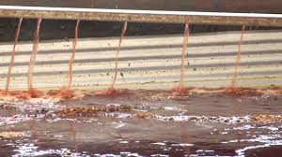
13= Slaughterhouse waste
Slaughterhouse waste is defined as any material derived from the body of an animal which are discarded as unwanted and un useful purposes.
It includes bones, organs, hooves and blood

Slide 29
A list of possible types of wastes
Agricultural waste
Biodegradable waste
Biomedical waste
Bulky waste
Business waste
Chemical waste
Clinical waste
Coffee wastewater
Commercial waste
Composite waste
Construction and demolition waste
Consumable waste
Controlled waste
Demolition waste
Domestic waste
Electronic waste (e-waste)
17. Food waste
18. Gaseous wastes
19. Household waste
20. Human waste
21. Sewage sludge
22. Industrial waste
23. Inert waste
24. Kitchen waste
25. Liquid waste
26. Marine debris
27. Medical waste
28. Metabolic waste
29. Mineral waste
30. Mixed waste
31. Municipal solid waste
32. Nuclear waste

