Slide 1
Introduction To Demography ^{BS Sociology} Semester: 5th ^{Lecture No. 09 & 10} ^{Instructor: Mumtaz Hussain} University of Sargodha Sb Campus ^{Bhakkar}

Slide 2
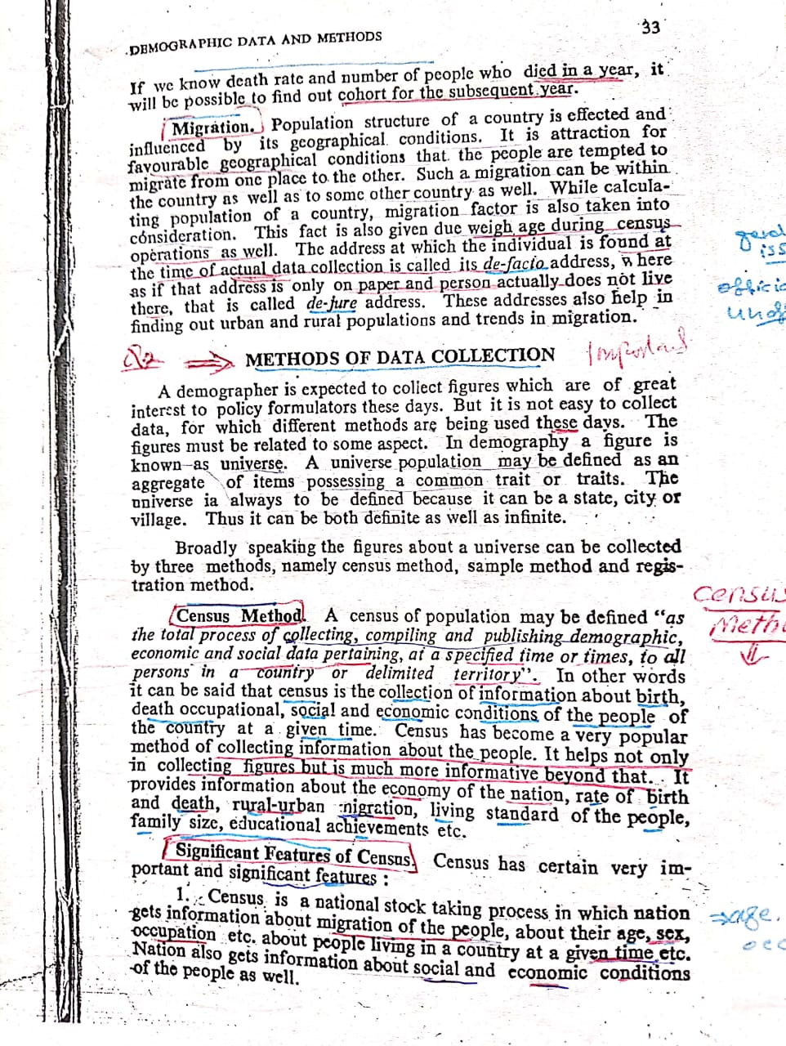

Slide 3
.

Slide 8
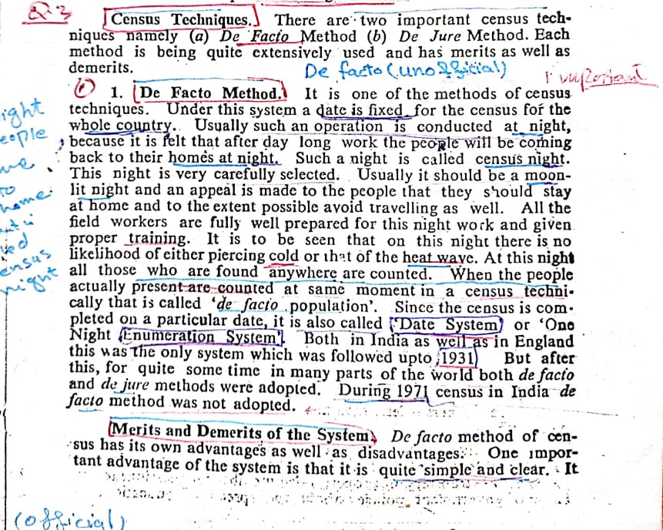

Slide 9
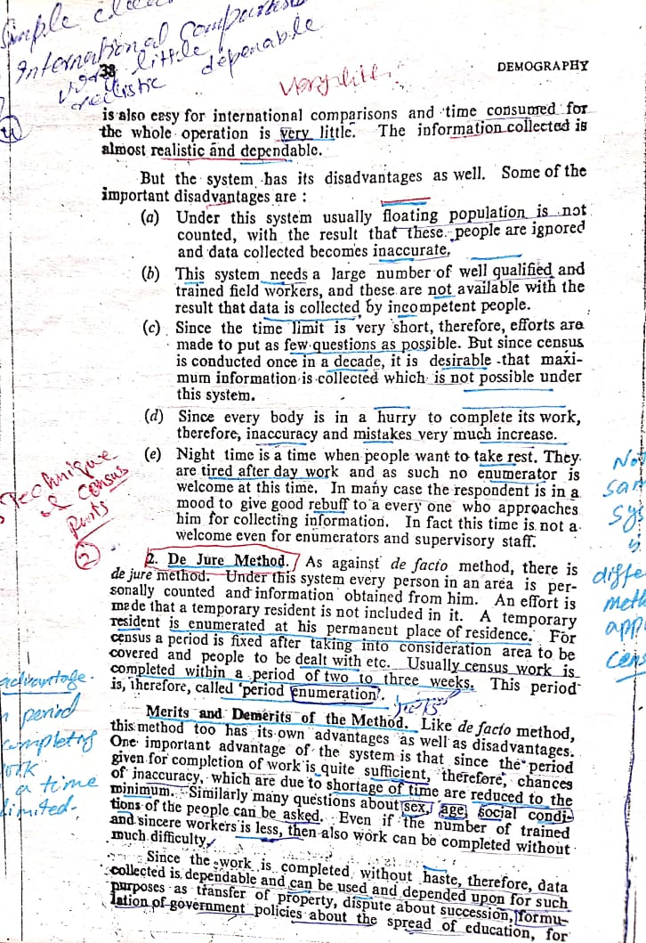

Slide 11
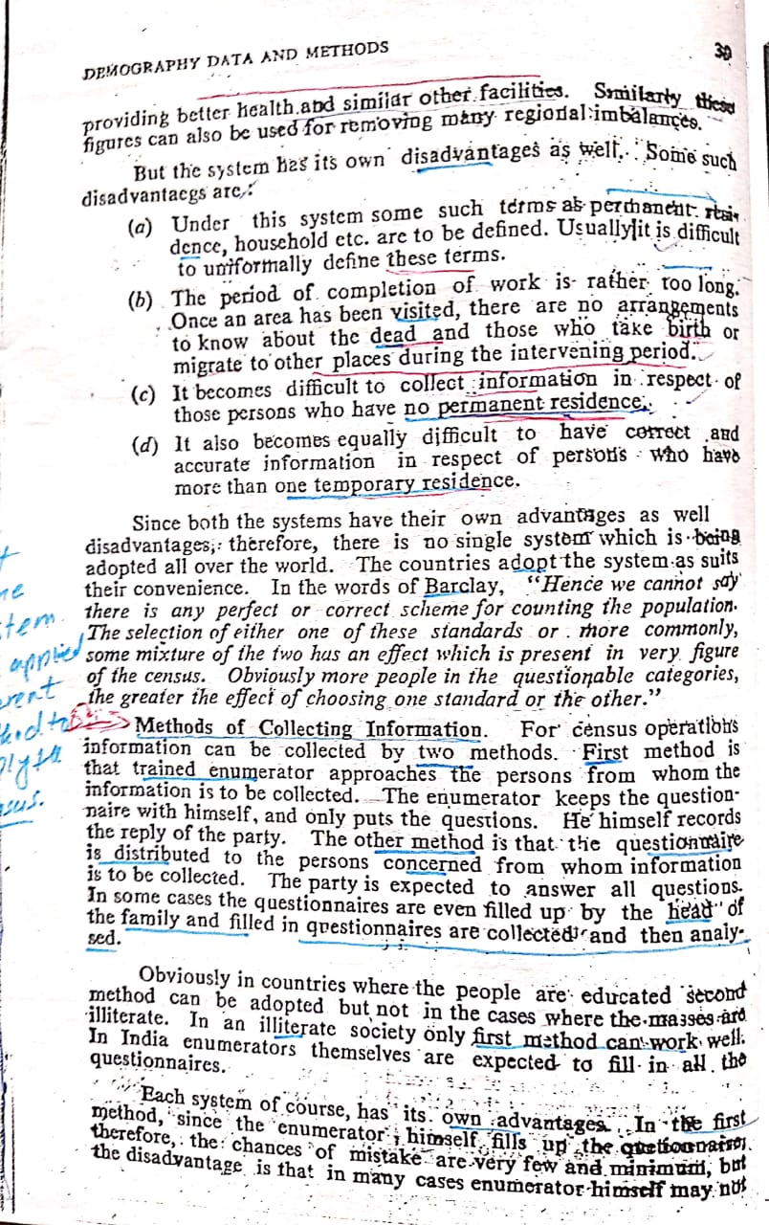

Slide 14
Thank You

