Slide 1
BOT-717 Economic Botany Cr. 3(2+1)
Introduction Economic Botany
Plants as sources of food, feed, fiber, timber, vegetable, phytochemicals and medicine;
Study of cryptogams and phanerogams for their economic uses;
Geographic distribution taxonomy and nomenclature of plants according to the nature and type of their economic products.
Cultural, physiological and molecular approaches to the improvement of economic plants for better yield of economic products.
Strategies for the domestication and preservation of economic plants;
Environmental and eco-physiological considerations of the economic plants;
Human and veterinary medicinal plants;
Plant toxins and their applications;

Slide 2
Practicals: Cr. 01
Collection, identification and preservation of the economic plants both from cryptogams and phanerogams (field visits).
Extraction and measurement of phytochemicals from important plants species

Slide 3
Assignments
Historical and cultural aspects of medicinal plants;
History of medicinal plant usage;
Systematics of medicinal plants;
Diversity of medicinal plants;
Growth habit and ecology of important indigenous medicinal plants;
Poisonous Plants;
Psychoactive plants;
Chemical composition of commonly used medicinal plants in terms of their general effect on the human body;
Potential dangers involved in dealing with medicinal plants;
Herbal therapeutic properties;
Chemical, structural and nutritional aspects of plant products

Slide 4
Suggested Readings:
Bhattachargee, S.K. 2000. Handbook of Aromatic Plants. Pointer Publishers, Jaipur, India.
Cook, M.T. 2008. Applied Economic Botany. Read Books, Verona, New Jersey.
Elevitch. C.R. 2004. Cultivating Connections with Trees. Permanent Agriculture Resources. The Overstory Book, New York
Li, T.S.C. 2000. Medicinal Plants. Culture, Utilization and Phytopharmacy. CRC Press, Florida.
Ross, I.A. 2003. Medicinal Plants of the World. Vol. 1. Chemical Constituents, Tradition and Modern Medicinal Uses, 2nd edition. Humana Press, Laurel, Maryland.
Simpson, B.B. and Ogorzaly, M.C. 2001. Economic Botany, 3rd edition. McGraw Hill, New York.
Sutton, M.Q. and Anderson, E.N. 2009. Introduction to Cultural Ecology. Rowman Altamira.
Vaughan, J. and Geissler, C. 2009. The New Oxford Book of Food Plants. Oxford University Press, Oxford.
Wickens, G.E. 2004. Economic Botany: Principles and Practices. Springer, The Netherlands.

Slide 5
Economic botany
Economic botany is the study of the relationship between people and plants
Economic botany intersects many fields including established disciplines such as agronomy, anthropology, archaeology, chemistry and conservation Botany
Economic botany is the study of how people use plants. Economic botanists study how plants are used as food, medicines, and in other ways. It is also study ways to use plants that are sustainable
Economic botany is the commercial exploitation of plants by people. This link between botany and anthropology explores the ways humans use plants for food, shelter, medicines, textiles, and much more
Economic Botany bridges the gap between pure and applied botany by focusing the uses of plants by people

Slide 6
Plants as sources of: food, feed, fiber, timber, vegetable, phytochemicals and medicine

Slide 7
Fruits of Tropical & Sub-Tropical Regions
There are thousands of tropical fruits. Many of them are consumed locally on a daily basis. There are over 250 edible fruits in the Philippines alone.
The tropics have the capacity to produce large quantities of fruit and international trade is adding new kinds as rapid shipment possibilities increase.
Some tropical fruits such as the banana, mango and pineapple are now as familiar as the apple and pear in temperate regions.
In comparison with fruits of temperate regions, many tropical species have been much neglected in international markets.
Tropical edible fruits are particularly important in the families Anacardiaceae, Annonaceae, Myrtaceae, Rutaceae, Sapotaceae and Sapindaceae.
Of these the Rutaceae is the best known and most important for it includes the citrus fruits.

Slide 8
Citrus Fruits
Citrus was domesticated from wild ancestors in Eastern and Southern Asia in ancient times. Some species have been cultivated since before 1,000 B.C. They were at times grown for other reasons than as food.
There are over 100 species of Citrus described, many of which are undoubtedly of hybrid origin. However, only a few ever became of commercial importance.
Citrus trees are thorny aromatic with leathery evergreen leaves that are dotted glandularly.
The white or purplish flowers are solitary, but produced in great abundance, and they are often very fragrant. The fruit is a modified berry known as a hesperidium.

Slide 9
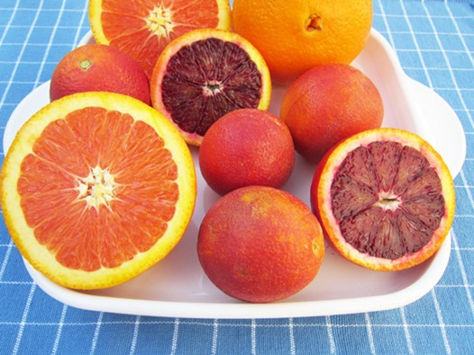
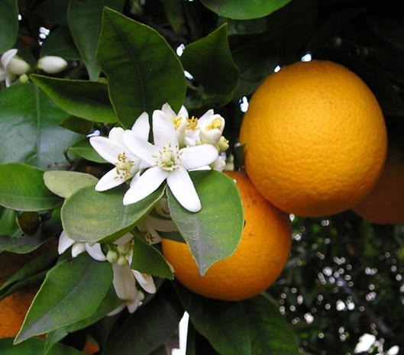
Sweet Orange
Citrus sinensis is indigenous to Southeastern Asia, most likely China or Cochin China. It was first cultivated sometime between 1,500 and 1,000 B.C.
Several types of sweet oranges have been developed: Spanish oranges, with large coarse-grained fruits; Mediterranean varieties, with fine-grained fruits; blood oranges with a red pulp, or streaked red and white; and the navel oranges, which are mostly seedless and characterized by the navel at one end. Oranges contain 5-10 percent sugar, 1-2 percent citric acid and Vitamin C.
The principal use of sweet oranges is for fresh fruit and juice. The peel is candied and oil of orange is extracted from the rind. This essential oil is used in the perfume and soap industries, in medicine and for flavoring.

Slide 10
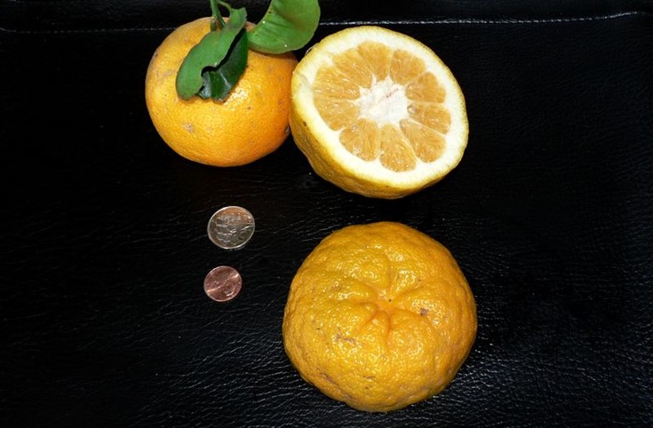
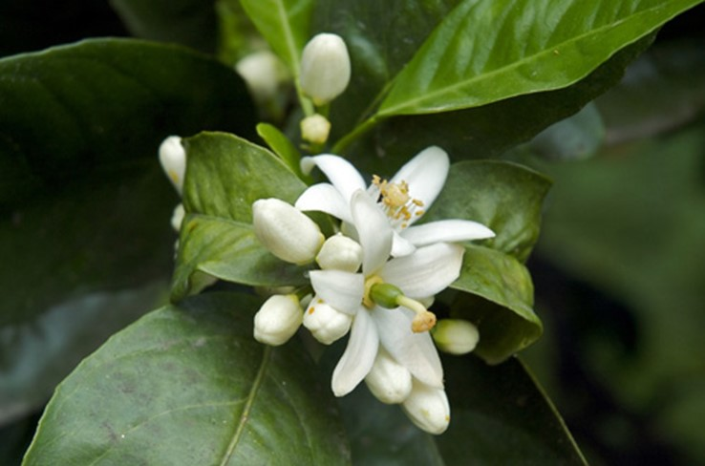
Sour Orange
Sour orange, Citrus aurantium, also called the Bitter, Bigarade or Seville orange, is also native to Southeastern Asia.
It is grown in Spain extensively where the fruits are used for marmalade, orangeade and candied orange peel. The essential oil obtained from the rind is used in perfumery, medicine, and in the manufacture of the liqueur Curaçao.

Slide 11
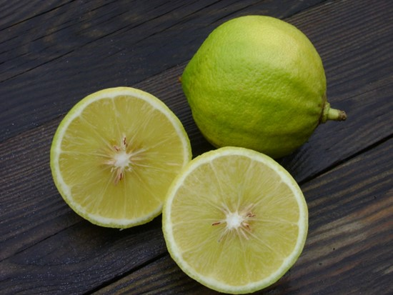
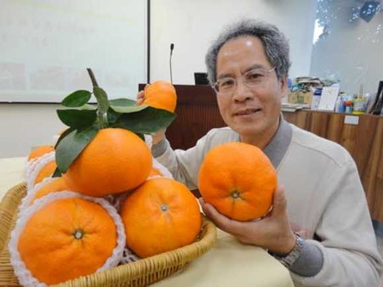
Bergamot Orange
Bergamot Orange, Citrus aurantium subsp. bergamia, is a small spiny tree with golden-yellow pear-shaped fruit. The pulp is very acid and inedible. This variety is grown in the Mediterranean region as a source of the essential oil of bergamot.
King Orange
Often named as a separate species, Citrus nobilis, the King Orange is probably a hybrid between a sweet orange and a mandarin.
It bears heavily, is frost tolerant and the sweet slightly acid flesh with broad blunt juice sacs is very palatable.

Slide 12
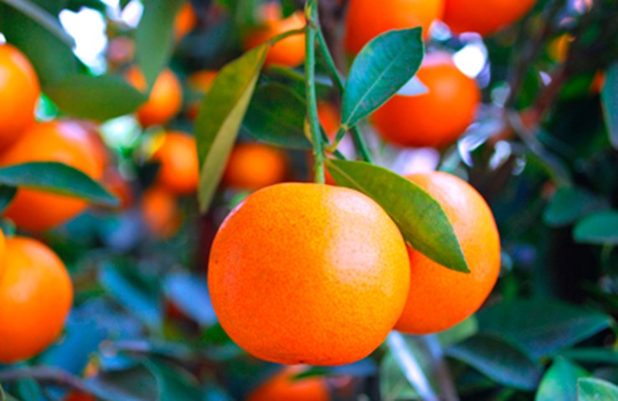
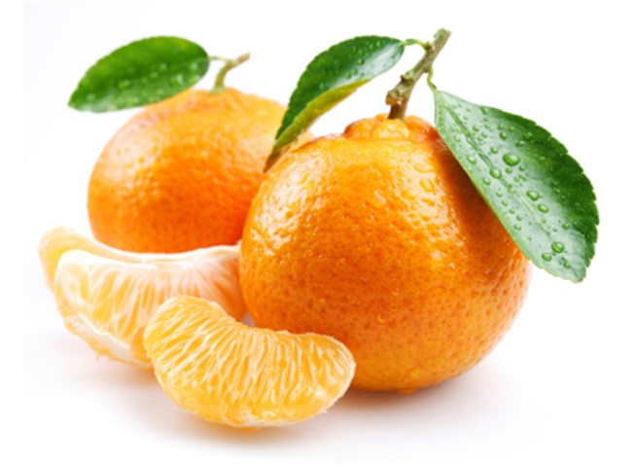
Mandarin Orange
Mandarin Orange, Citrus reticulata, comprises the so-called glove oranges: the orange-yellow mandarins and the reddish-orange tangerines.
The tree is native to China and Cochin China.
They are widely grown in Pakistan, Japan, South Europe and the Gulf States of America, mainly Florida, Alabama and Mississippi.

Slide 13
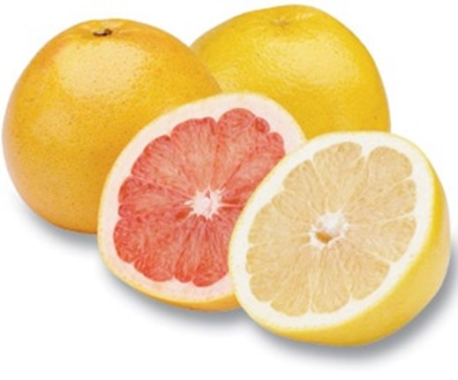
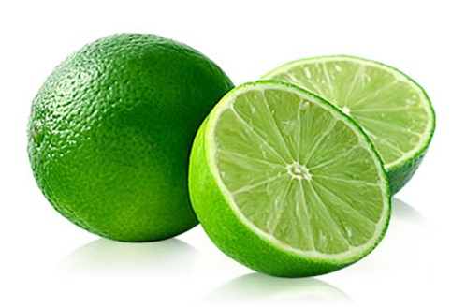
Grapefruit
The origin of the grapefruit, Citrus paradisi, is somewhat doubtful. But there is some consensus that it originated in Barbados, West Indies as a sport of the shaddock or possibly as a hybrid with the sweet orange.
The fruit skin is thin with many inconspicuous oil glands. The flesh is acid or sub acid and mildly bitter, with large spindle-shaped juice sacs.
Lime
Lime, Citrus aurantifolia, was first domesticated in the East Indies.
They are thin skinned with an abundant acid pulp and oval pointed juice sacs.
The lime is one of the sourest fruits and is not eaten directly.
concentrated form.
Lime juice is used in beverages, as a source of citric acid and medicinally to prevent scurvy.

Slide 14
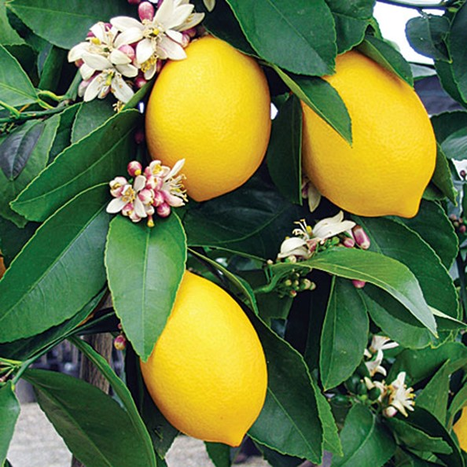
Lemon
Lemon, Citrus limon, is believed to be native to Southeastern Asia where it has been grown since ancient times.
It has been grown in the Mediterranean region since the days of the Greek and Roman civilizations, and ahs always been especially well adapted to that area.
The fruit should be picked when yellow when it has peaked in flavor. Lemons contain 1/2 percent sugar and 5 percent citric acid.
The juice is used for lemonade and other beverages and as a flavoring, bleaching agent and stain remover.

Slide 15
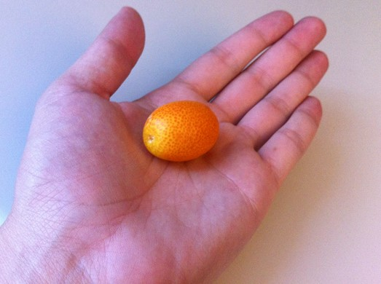
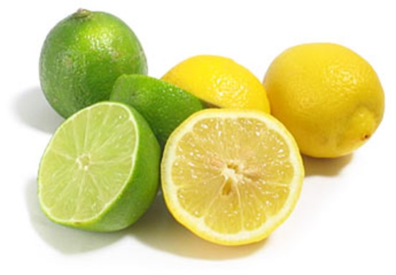
Kumquat
Kumquats, Fortunella spp., are the smallest of the citrus fruits.
They are grown for ornamental purposes and for their fruit, either eaten whole or preserved.
Two species that are commercially grown are F. japonica with globose fruits and F. margarita with oval fruits.
Citron
Citron, Citrus medica, is the oldest of the citrus fruits and the first to be known in Europe as early as the 4th Century B.C.
It is believed to have originated in Northern India and has long been cultivated in Southeastern Asia.
Citron is one of the best and most expensive of the condiments.

