Slide 1
Role of Vitamins and Minerals as an Antioxidants

Slide 2
Vitamin Facts
Vitamins are essential organic nutrients, required in small amounts.
They cannot be synthesized by the body. Must be obtained by outside sources like diet, rumen bacteria & sun.
Required for growth, maintenance, reproduction and lactation.

Slide 3
Classes of Vitamins
Fat Soluble Vitamins: stored in tissues
Examples
A
D
E
K
Water Soluble Vitamins:
not stored in tissues, must have constant supply
Examples
B, B1, B2, B6 & B12
Niacin
Folic Acid
C

Slide 4
Function, Deficiency Signs & Sources
Vitamin A
Function: development healthy skin and nerve tissue. Aids in building up resistance to infection. Functions in eyesight and bone formation. ALL ANIMALS require a source of Vitamin A. It is important in the ration of pregnant females.
Deficiency signs: retarded growth in the young, the development of a peculiar condition around the eyes known as Xerophthalmia, night blindness and reproductive disorders.
Sources: whole milk, carotene, animal body oils (cod fish and tuna), legume forages and can be synthetically produced.

Slide 5
Vitamin E
Function: normal reproduction.
Deficiency signs: poor growth, "crazy chick" disease, Muscular Dystrophy, "white muscle" disease in ruminants and swine and "stiff lamb" disease (affects the nerves and muscles).
Sources: synthetic for poultry and swine, cereal grains and wheat germ oil, green forages, protein concentrates, oil seeds (peanut and soybean oil).
Vitamin E rapidly destroyed in rancid or spoiled fats. That is why these may cause white muscle disease. Utilization of Vitamin E is dependent on adequate selenium.

Slide 6
Vitamin D
Function: is essential for the proper utilization of calcium and phosphorus to produce normal, healthy bones.
Deficiency signs: retarded growth, misshapen bones (rickets), lameness and osteoporosis.
Sources: Whole milk, sun-cured hays, forage crops, fish liver oils, irradiated yeast.

Slide 7
Vitamin K
Function: necessary for the maintenance of normal blood coagulation.
Deficiency signs: blood loses its power to clot or the time needed for clotting is longer and serious hemorrhages can result from slight wounds or bruises.
Sources: green leafy forages, fish meal, liver, soybeans, rumen and intestinal synthesis, and the synthetic compounds.

Slide 8
Vitamin C (Ascorbic acid)
Function: has an effect on the metabolism of calcium in the body (Not required in rations of farm animals.).
Deficiency signs: none demonstrated in livestock. Human deficiency: scurvy (swollen and painful joints and bleeding gums) and brittleness of bones.
Sources: citrus fruits, tomatoes, leafy vegetables and potatoes.

Slide 9
Vitamin B₁ (Thiamin)
Function: required for the normal metabolism of carbohydrates.
Deficiency signs: loss of appetite, muscular weakness, severe nervous disorders, general weakness and wasting (BeriBeri).
Sources: raw, whole grains and especially their seed coats and embryos; fresh green forage; and yeast, milk and rumen synthesis.

Slide 10
Vitamin B₂ (Riboflavin)
Function: necessary for normal embryo development, important in the metabolism of amino acids and carbohydrates.
Deficiency signs: poor reproduction characterized by small litters and deformed young (cleft palate and club-footedness) curly toe paralysis in chicks, digestive disturbances, general weakness and eye abnormalities.
Sources: milk and dairy by-products, yeast, green forages, well cured hay (especially alfalfa), whole grains, wheat bran and synthetic riboflavin rumen synthesis.

Slide 11
Contents
Oxidation
Free Radical
Antioxidants
Classification
Vitamins which are Antioxidants
Minerals which are Antioxidants
Use of Antioxidants

Slide 12
Oxidation
The chemical reactions in which atoms lose electrons.
Stable atoms contain an even number of paired electrons.
As a result free radical formation occurs.

Slide 13
Free Radical
An atom that has lost an electron and is left with an unpaired electron.
Free radicals are highly reactive and can cause damage to molecules in the cell.

Slide 14
How Free Radicals are Formed
Normally, bonds don?t split in a way that leaves a molecule with an odd, unpaired electron. But when weak bonds split, free radicals are formed. Free radicals are very unstable and react quickly with other compounds, trying to capture the needed electron to gain stability. Generally, free radicals attack the nearest stable molecule, "stealing" its electron. When the "attacked" molecule loses its electron, it becomes a free radical itself, beginning a chain reaction. Once the process is started, it can cascade, finally resulting in the disruption of a living cell.

Slide 15
Free Radical attack Sites
Cell membrane
LDL
Cell Protein
DNA

Slide 16
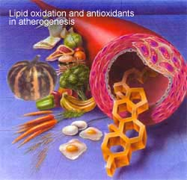
Antioxidants

Slide 17
Antioxidants
Substances that are able to neutralize reactive molecules and reduce oxidative damage.
Result of metabolic processes and environmental sources
Vitamin C, Vitamin E, beta-carotene, Vitamin A, selenium, iron, zinc, copper and manganese.

Slide 18
Classification
Hydrophilic
They are react with oxidants present in cell cytosol and blood plasma.
Lipophilic
They protect cell membranes from lipid peroxidation.

Slide 19
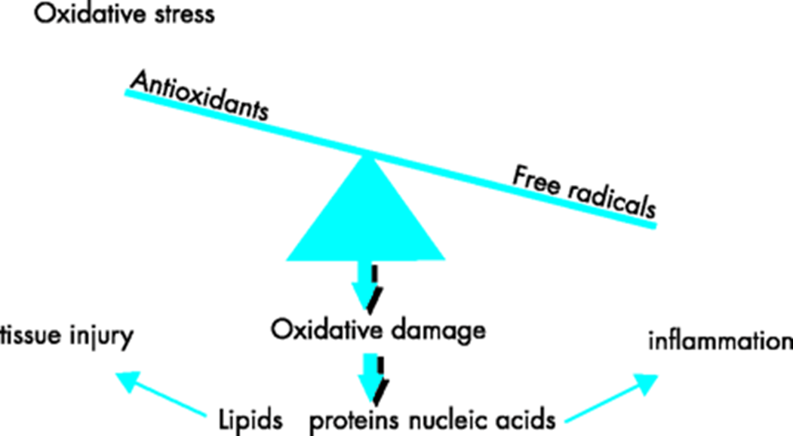

Slide 20
Vitamin E(Tocopherol)
Functions: Anti-oxidant
Guards against damage to membranes from oxidizing compounds.
Breaks fatty acid peroxidation chain reaction.

Slide 21
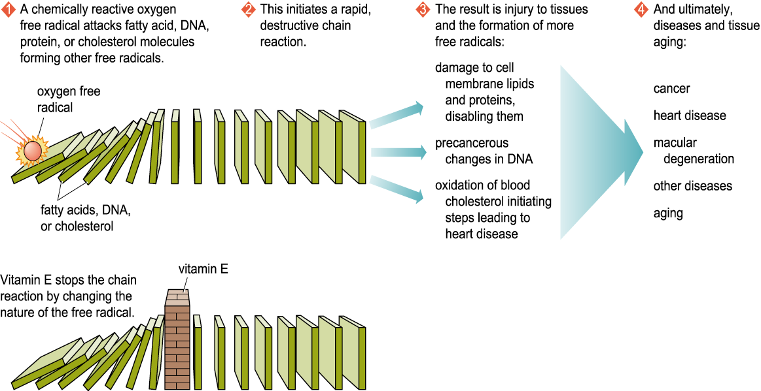
Free Radicals and Diseases

Slide 22
Deficiency
Rare (premature infants under 3.5 pounds, people unable to absorb fat or metabolize fat properly
Suppresses the immune system because vitamin E protects White Blood Cells

Slide 23
Vitamin E
Toxicity: Rare
Sources:
Almonds(1ounce 7.4mg),Swiss chard(1cup17%)
Raw seeds(1/4 cup 90.5%),Plant oils(1 tablespoon 100%)
Papaya(1 papaya 17%),Mustard green(1 cup 14%)
Hazelunts(1 ounce 20%),Pine nuts(1 ounce 2.6mg)
Broccoli(1 cup 4%),Olives(1 cup 20%)

Slide 24
Vitamin C Functions
Location in cell Cytosol
Collagen Formation
Antioxidant
reduce cancer risk
helps absorb iron from food
Reduces risk of cold.
Vitamin C intake offers protection against stomach cancer

Slide 25
Vitamin C
Deficiency: called scurvy
poor formation of collagen in blood vessels
weak vessels result in hemorrhages
can be severe and result in lots of blood loss and death
Toxicity: may result in
kidney stones
rebound scurvy
Destruction of B12
Problems with acid/base balance

Slide 26
Vitamin C: RDA 90/75 mg/day
Foods rich in vitamin C:
Berries
Cabbage family
Citrus fruits
Melons
Peas
Peppers
Turnips
Pineapple
Turnips

Slide 27
Beta-Carotene-provitamin
Functions
Prevents initiation of fatty acids peroxidation chain reaction.
Weak antioxidant
Enhance immune system
Protect skin and eyes
Deficiency/toxicity

Slide 28
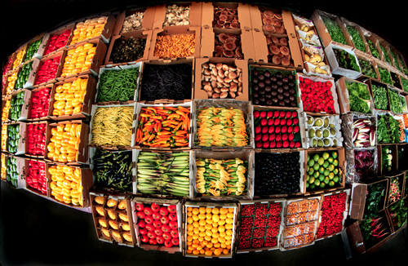
Beta-Carotene-provitamin
No RDA
Sources

Slide 29
Vitamin A Functions
Vision: helps with conversion of light energy to electrical energy in eye
Cell differentiation-maintenance of linings:
helps produce the CHO normally found in mucous
Bone growth:
helps with remodeling growing bones

Slide 30
Vitamin A Deficiency
One year supply in fat and liver of most people: So deficiencies are rare
Bone growth and remodeling problems
shape changes
Linings deteriorate
GI tract: diarrhea
Respiratory tract: infections
urogenital tract: infections, kidney stones
Impaired night vision and day vision

Slide 31
Vitamin A Toxicities
Bones:
decalcification, joint pain
Nervous system
loss of appetite, irritability, muscle weakness
Liver enlargement
Blood: RBCs loose hemoglobin
Bleeding induced easily

Slide 32
Selenium
Functions
Antioxidant system
Thyroxine and immune function
Deficiency
Keshan disease
Impaired immune response, cognitive function, muscle pain, wasting.

Slide 33
Selenium – RDA 55 mg/day
Sources
Nuts
Seafood
Pasta

Slide 34
Se,Cu,Zn,Mn and Fe
Selenium as part of glutathione peroxidase (GSH)
Superoxide dismutase (Cu, Zn, and Mn)
Catalase(Fe)

Slide 36
Uses of Antioxidants
Food preservatives
Antioxidants are used as food additives to help guard against food deterioration. Exposure to oxygen and sunlight are the two main factors in the oxidation of food, so food is preserved by keeping in the dark and sealing it in containers.
But oxygen is also require…………………..

