Slide 1
Intrauterine fetal death/ stillbirth

Slide 2
Intrauterine fetal death
stillbirth is defined as a baby delivered after 24 completed weeks of pregnancy , which does not breath or show any signs of life at any time after being completely expelled from mother.

Slide 3
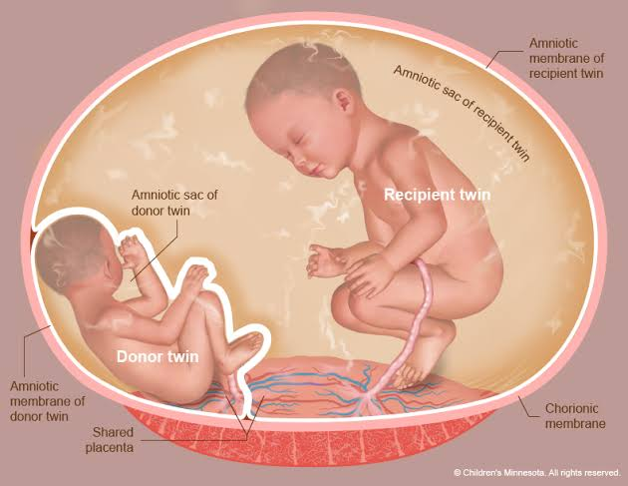
Causes of IUFD
Fetal
Cord accidents (knots, thrombosis, strangulation and torsion)
Feto–fetal transfusion
Feto–maternal haemorrhage
Chromosomal and genetic disease
Structural abnormality
Infection –bacterial, viral ( TORCH)
Anaemias of fetal origin e.g. alpha-thalassaemia
Direct maternal effects
Obstetric cholestasis
diabetes
Antibody production e.g. rhesus disease, platelet alloimmunisation, congenital heart block
Hypertension
Any disorder causing septicemia with hypoperfusion

Slide 4
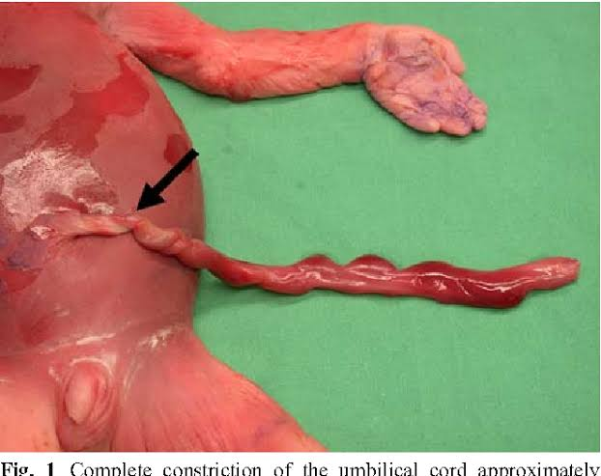
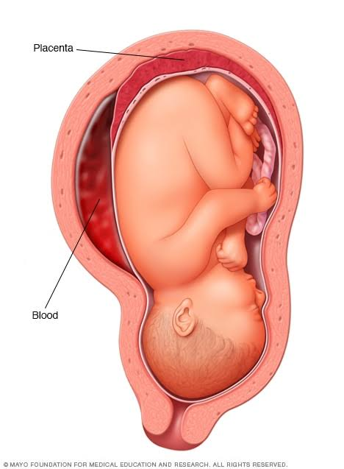
placental causes
Placental dysfunction causing hypoxemia i-e FGR
Placental abruption
Placental infarction

Slide 5
Diagnosis of the death
Clinical feature
Decreased/absent fetal movement--- 50 per cent of cases
Disapperance or reduction of pregnancy symptom
Failure of fundal height to rise
Fetal heart not audible on pinard scope
antenatal visit
signs of an acute event such as abruption, ruptured membranes or the onset of labour
Doppler apparatus
CTG and auscultation can be very misleading.
Inability to detect fetal heart on sonicaid

Slide 6
ultrasound
Fetal death must be diagnosed by ultrasound.
must be performed by a trained practitioner
Colour-flow mapping can be very useful, especially in the obese woman.
features.:
Absent fetal heart activity
Spalding’s sign (overlapping of the fetal skull bones when the fetus has been dead for some time);
Retraction of brain tissue
oligohydramnios;
signs of fetal hydrops;
Empty fetal bladder
intrafetal gas.

Slide 7
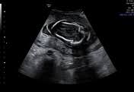
X-RAY
Spalding’s sign
Robert’s sign
Presence of gas shadows in fetal circulatory system.

Slide 8
Prevention of rhesus (d) isoimmunisation
If the woman is RhD negative-- blood for Kleihauer testing
Anti-RhD immunoglobulin should be given as soon as possible after presentation and not delayed.
Delivery may not occur until after the 72-hour watershed beyond which immunoprophylaxis is less effective.
A further dose of anti-RhD immunoglobulin might be necessary once the Kleihauer result is known and clearance of fetal cells should be rechecked at 48 hours where a large fetomaternal haemorrhage has been encountered.

Slide 9
Management
Breaking the news
History
Examination
Investigation

Slide 10
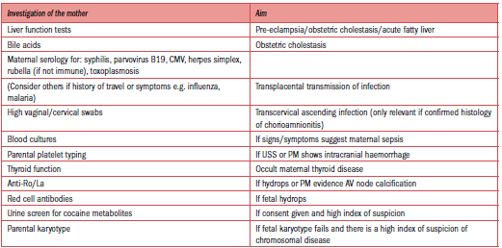

Slide 11
HOW TO DELIVER
sympathetic approach
vaginal delivery
CS
major placenta praevia
Severe cephalopelvic disproportion
Previous classical CS
2 or more previous CS
Neglected /obstructed labour
Uterine rupture
Transverse /shoulder presentation

Slide 12
TIMING OF DELIVERY
over 85 per cent of women will deliver spontaneously within 3 weeks
The risk of coagulation problems is 30 % if the fetus has been retained for 4 weeks.
Conditions that pose a risk to maternal safety
(abruption, pre-eclampsia, infection)
then advice on expediting delivery needs.
conservative management can be offered
testing for DIC twice weekly.

Slide 13
INDUCTION OF LABOUR
If the woman appears to be physically well, her membranes intact, no evidence of infection or bleeding--choice of immediate IOL or expectant management.
If there is ruptured membranes, infection or bleeding, immediate IOL.
third-trimester induction ---prostaglandin E2 preparations.
Now, the combination of the anti-progesterone mifepristone and the prostaglandin analogue misoprostol is recommended.
A standard protocol for mifepristone/misoprostol induction is shown below.
Mifepristone: 200 mg 24–48 hours before induction.
Misoprostol: 50–100 mcg pv 6 hourly for 24 hours.
membranes should be left intact for as long as possible, as ascending infection can rapidly develop.
previous CS, the risk of uterine rupture is increased in IOL.-- careful surveillance -- Mechanical methods

Slide 14
Immediate postnatal care
PPH
pre-eclampsia, abruption, prolonged fetal death or infection.
retained placenta ---Prolonged chorioamnionitis and repeated small abruptions
Risk of thrombosis risk
(pre-eclampsia, infection, immobility)
LMWH

Slide 15
Evaluation of still born baby
Photographs
Gross structural abnormality
Radiology
Grossly malformed baby
Karyotyping
Obvious fetal anamoly
IUGR
Family H/O abnormal children
Recurrent preg loss
Non immune hydrops fetalis
Potter syndrome
Autopsy examination
Congenital malformation
Actual cause of death

Slide 16
Investigation of the fetus
Postmortem examination
written and verbal information
aim of PM examination,
the extent of the examination,
how samples of tissue are dealt with afterwards
whether samples are kept for research or audit.
They also need to know how long the process will take and whether there will be any delay in releasing the baby for burial or cremation.

Slide 17
What is postmortem examination and how it is performed?
Postmortem examinations may take up to 5–7 working days to complete when the brain needs to be fixed for proper examination.
Examinations should be completed within 3 days after receipt of the body if no special examination is required.
There will then be additional time for histopathological analysis, microbiology, metabolic studies, etc., which can add significant delays to the final report.
It is recommended that at least 60 per cent of reports are issued within 42 days and 90 per cent within 56 days.
The baby is always treated with dignity and respect.
The incisions are closed and do not involve the face or limbs.
In most cases the baby when dressed will look no different from the way it did before the PM. The exception may be the very small macerated fetus whose skin is so thin that suturing is not possible. In these cases, the baby is wrapped.

Slide 18
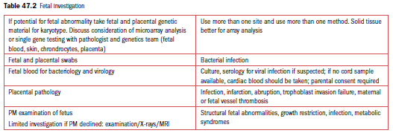

Slide 19
AFTER DELIVERY
Depression, which can become post-traumatic stress disorder (PTSD)
SUPPRESSION OF LACTATION
good supportive bra, NSAIDs if there is discomfort, and time will be enough.
single dose (1 mg) of cabergoline, a long-acting dopamine agonist, is highly effective.
CONTRACEPTION
leaflet on contraception

Slide 20
FOLLOW-UP
schedule a visit once all information is available.
encourage parents to talk spontaneously and to be honest in replies.
When an underlying cause for the fetal death has been identified, this must be clearly explained.
a clear plan of management for the next pregnancy should be outlined.
Early conception may be associated with very marginally higher risks of preterm birth and SGA babies, but these risk increases are not great enough to recommended delayed conception
Finally, parents must be given the opportunity to come back if they are unclear about certain aspects and, for some, a pre-conceptual visit is helpful.

Slide 21
Management of Subsequent Pregnancy after Stillbirth
Preconceptional or Initial Prenatal Visit
Detailed medical and obstetrical history
Review evaluation of prior stillbirth
Determination of recurrence risk
Discuss recurrence of comorbid obstetric complications
Smoking cessation
Preconceptional weight loss in obese women
Genetic counseling if family genetic condition exists
Diabetes screen
Thrombophilia screen: antiphospholipid antibodies (only if history indicates)
Support and reassurance

Slide 22
First Trimester
Dating sonography
First-trimester screen: PAPP -A, hCG, NT
Support and reassurance
Second Trimester
Fetal sonographic anatomical survey at 18–20 weeks’ gestation
Maternal serum screening (quadruple) or single-marker alpha fetoprotein if firsttrimester
Possible uterine artery Doppler studies at 22–24 weeks’ gestationa
Support and reassurance
Third Trimester
Sonographic screening for fetal-growth restriction, starting at 28 weeks
Kick counts starting at 28 weeks
Antepartum fetal surveillance starting at 32 weeks or 1–2 weeks earlier than prior stillbirth
Support and reassurance
Delivery
Elective induction at 39 weeks
Delivery before 39 weeks only with documented fetal lung maturity by amniocentesis

Slide 23
Thank you

