Slide 1
Vet. First Aid Procedure For Controlling Hemorrhages, Dressing Wounds And Artificial Respiration.

Slide 2
What is First Aid?
“ FIRST AID IS THE IMMEDIATE TREATMENT OF
INJURED ANIMALS OR THOSE SUFFERING
FROM SUDDEN ILLNESS “

Slide 3
Hemorrhages:-
Hemorrhages is name used to describe blood loss.
Blood loss can occur in almost any area of the body.
External bleeding.
External bleeding happens when blood come out from body injured parts.

Slide 4
Hemorrhages:-
Internal bleeding.
Internal bleeding occurs when blood leaks out through a damaged blood vessel or organ.

Slide 5
Controlling Of Hemorrhages:-
Stop the bleeding.
Place a sterile bandage or clean cloth on the wound.
Press the bandage firmly with your palm to control bleeding.
Maintain pressure by binding the wound with a thick bandage or a piece of cloth.

Slide 6
Controlling Of Hemorrhages:-
Remove the cloth when bleeding stops.
If bleeding seeps through the material add more material and pressure.
At last use tourniquet.
It is use to stops the flow of blood from an artery by applying pressure.

Slide 7
Dressing Wound:-
Wounds.
Wound is caused when any tissue is cut by an injury.
Depth and area of wound are important.
Clean the wound under sterile conditions.

Slide 8
Dressing Wound:-
Clean the wound from contaminated or infected things.
Assessment of overall stability of the animal.
Save the wound from any contamination.
Now dressing the wound with bandage or cloth.

Slide 9
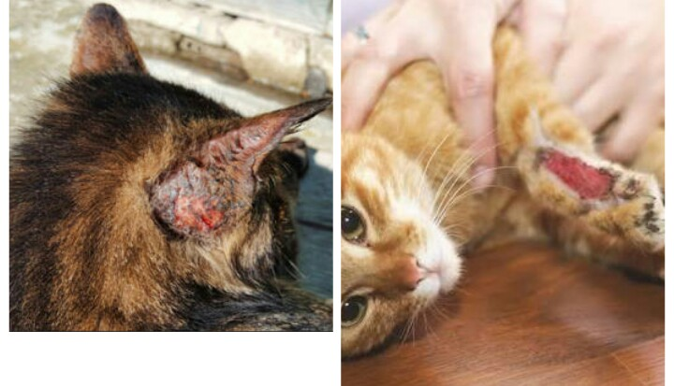

Slide 10
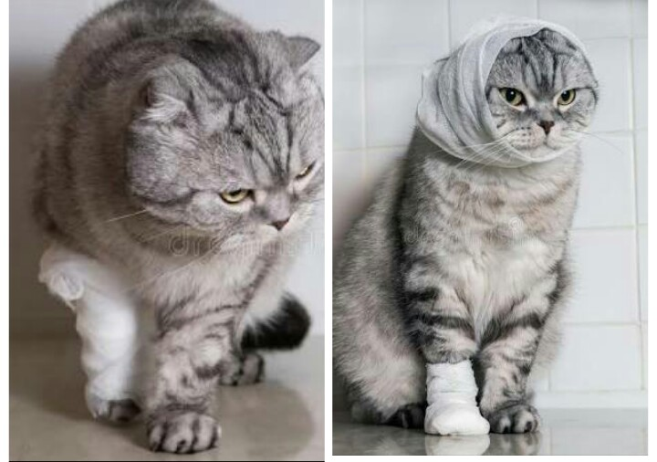

Slide 11
Dressing Wound:-
Use gloves to prevent from bacterial and viral infection.
Clean and dry wounded near skin.
Use non sticky material to dressing the wound and lay pad directly on wound.
Use clean cloth or bandage to dress the wound ,tie the ends together over the pad to secure it.

Slide 12
Artificial Respiration:-
The artificial respiration technique applies force to the chest walls, thereby moving the air out.
The elastic recoil of the chest will draw air back in.

Slide 13
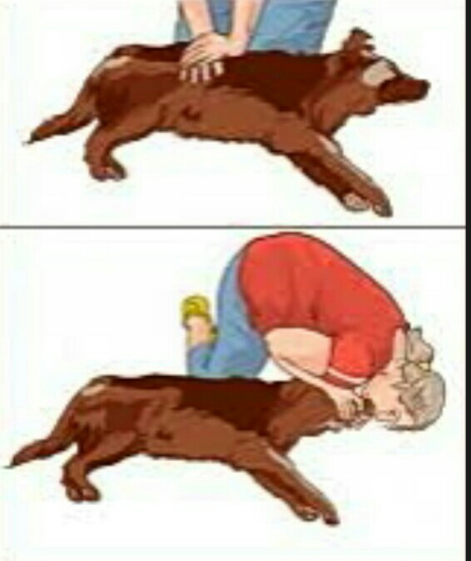

Slide 14
Artificial Respiration:-
Check the pulse or heartbeat of the dog
Lay the dog on his/her right side.
Pull the tongue out to the front of the mouth.
Check the mouth and throat no any particles and clear the airway.
Place your hands on the chest and press down and able to hear air moving air out.

Slide 15
Artificial Respiration:-
Stop pressing and listen for the air to move in.
Repeat until the dog starts to breath on their own.

