Slide 1
Fundamentals of Multimedia, Chapter 2
Chapter 2
Multimedia Authoring and Tools
2.1 Multimedia Authoring
2.2 Some Useful Editing and Authoring Tools
2.3 VRML
2.4 Further Exploration
1
Li & Drew c Prentice Hall 2003

Slide 2
Fundamentals of Multimedia, Chapter 2
2.1 Multimedia Authoring
• Multimedia authoring: creation of multimedia productions,
sometimes called “movies” or “presentations”.
– we are mostly interested in interactive applications.
– For practicality, we also have a look at still-image editors
such as Adobe Photoshop, and simple video editors such
as Adobe Premiere.
• In this section, we take a look at:
– Multimedia Authoring Metaphors
– Multimedia Production
– Multimedia Presentation
– Automatic Authoring
2
Li & Drew c Prentice Hall 2003

Slide 3
Fundamentals of Multimedia, Chapter 2
– Multimedia Authoring Metaphors
1. Scripting Language Metaphor: use a special language to
enable interactivity (buttons, mouse, etc.), and to allow con-
ditionals, jumps, loops, functions/macros etc. E.g., a small
Toolbook program is as below:
-- load an MPEG file
extFileName of MediaPlayer "theMpegPath" =
"c:\windows\media\home33.mpg";
-- play
extPlayCount of MediaPlayer "theMpegPath" = 1;
-- put the MediaPlayer in frames mode (not time mode)
extDisplayMode of MediaPlayer "theMpegPath" = 1;
-- if want to start and end at specific frames:
extSelectionStart of MediaPlayer "theMpegPath" = 103;
extSelectionEnd of MediaPlayer "theMpegPath" = 1997;
-- start playback
get extPlay() of MediaPlayer "theMpegPath";
3
Li & Drew c Prentice Hall 2003

Slide 4
Fundamentals of Multimedia, Chapter 2
2. Slide Show Metaphor: A linear presentation by default,
although tools exist to perform jumps in slide shows.
3. Hierarchical Metaphor: User-controllable elements are or-
ganized into a tree structure — often used in menu-driven
applications.
4. Iconic/Flow-control Metaphor: Graphical icons are avail-
able in a toolbox, and authoring proceeds by creating a ﬂow
chart with icons attached (Fig. 2.1):
4
Li & Drew c Prentice Hall 2003

Slide 5
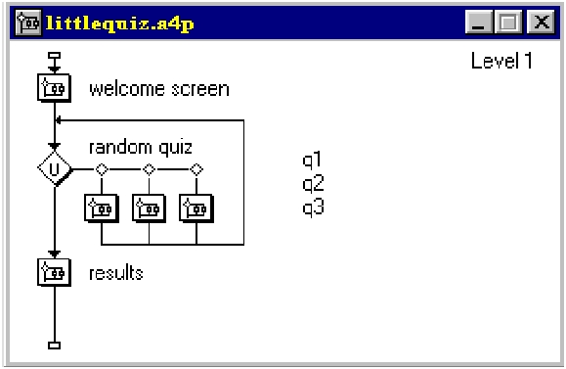
Fundamentals of Multimedia, Chapter 2
Fig. 2.1: Authorware ﬂowchart
5
Li & Drew c Prentice Hall 2003

Slide 6
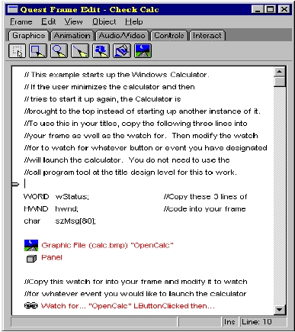
Fundamentals of Multimedia, Chapter 2
5. Frames Metaphor: Like Iconic/Flow-control Metaphor; how-
ever links between icons are more conceptual, rather than
representing the actual ﬂow of the program (Fig. 2.2):
Fig. 2.2: Quest Frame
6
Li & Drew c Prentice Hall 2003

Slide 7
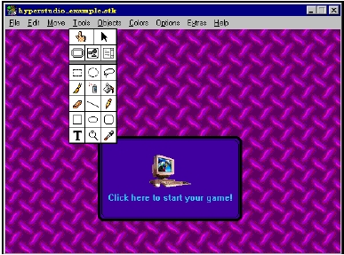
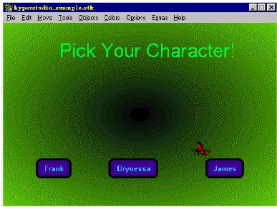
Fundamentals of Multimedia, Chapter 2
6. Card/Scripting Metaphor: Uses a simple index-card
structure — easy route to producing applications that use
hypertext or hypermedia; used in schools.
Fig. 2.3: Two Cards in a Hypermedia Stack
7
Li & Drew c Prentice Hall 2003

Slide 8
Fundamentals of Multimedia, Chapter 2
7. Cast/Score/Scripting Metaphor:
• Time is shown horizontally; like a spreadsheet: rows, or
tracks, represent instantiations of characters in a multi-
media production.
• Multimedia elements are drawn from a cast of characters,
and scripts are basically event-procedures or procedures
that are triggered by timer events.
• Director, by Macromedia, is the chief example of this
metaphor. Director uses the Lingo scripting language,
an object-oriented event-driven language.
8
Li & Drew c Prentice Hall 2003

Slide 9
Fundamentals of Multimedia, Chapter 2
– Multimedia Presentation
• Graphics Styles: Human visual dynamics impact how pre-
sentations must be constructed.
(a) Color principles and guidelines: Some color schemes
and art styles are best combined with a certain theme or
style. A general hint is to not use too many colors, as
this can be distracting.
(b) Fonts: For eﬀective visual communication in a presenta-
tion, it is best to use large fonts (i.e., 18 to 36 points),
and no more than 6 to 8 lines per screen (fewer than on
this screen!). Fig. 2.4 shows a comparison of two screen
projections:
9
Li & Drew c Prentice Hall 2003

Slide 10
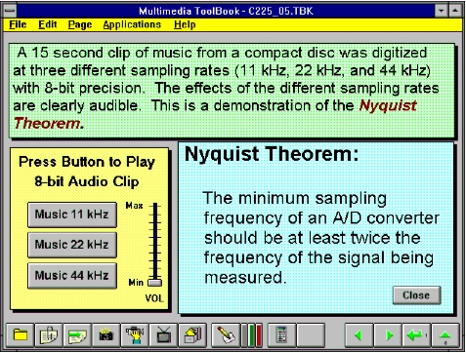
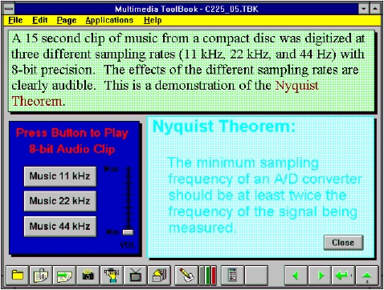
Fundamentals of Multimedia, Chapter 2
Fig 2.4: Colors and fonts [from Ron Vetter].
10
Li & Drew c Prentice Hall 2003

Slide 11
Fundamentals of Multimedia, Chapter 2
(c) A color contrast program: If the text color is some triple
(R,G,B), a legible color for the background is that color
subtracted from the maximum (here assuming max=1):
(R, G, B) ⇒ (1 − R, 1 − G, 1 − B)
(2.1)
– Some color combinations are more pleasing than others;
e.g., a pink background and forest green foreground, or
a green background and mauve foreground.
11
Li & Drew c Prentice Hall 2003
Notes:
CMY system. Color is determined by the three independent components Cyan (C=1-R), Magenta (M=1-G), and Yellow (Y=1-B).

Slide 12
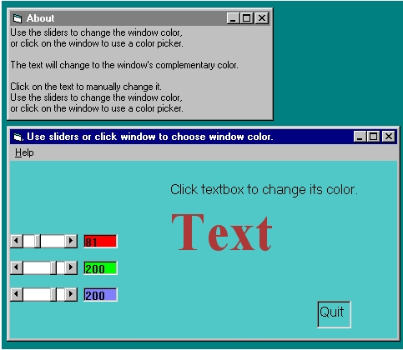
Fundamentals of Multimedia, Chapter 2
Fig. 2.5: Program to investigate colors and readability.
12
Li & Drew c Prentice Hall 2003

Slide 13
Fundamentals of Multimedia, Chapter 2
– Fig. 2.6, shows a “color wheel”, with opposite colors
equal to (1-R,1-G,1-B):
Fig. 2.6: Color wheel
13
Li & Drew c Prentice Hall 2003

Slide 14
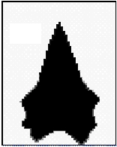
Fundamentals of Multimedia, Chapter 2
Sprite Animation
• The basic idea: Suppose we have an animation ﬁgure, as in
Fig. 2.7 (a). Now create a 1-bit mask M , as in Fig. 2.7 (b),
black on white, and accompanying sprite S , as in Fig. 2.7
(c).
Fig. 2.7: Sprite creation: Original, mask image M , and sprite
S (“Duke” ﬁgure courtesy of Sun Microsystems.)
14
Li & Drew c Prentice Hall 2003
Notes:
a mask is data that is used for bitwise operations, particularly in a bit field.

Slide 15
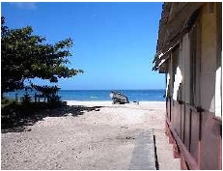
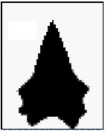
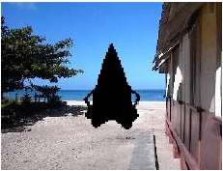
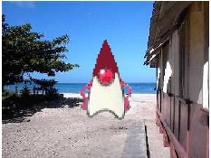
Fundamentals of Multimedia, Chapter 2
• We can overlay the sprite on a colored background B, as in
Fig. 2.8 (a) by ﬁrst ANDing B and M , and then ORing the
result with S , with ﬁnal result as in Fig. 2.8 (e).
Fig. 2.8: Sprite animation: (a): Background B. (b): Mask M . (c): B AND
M . (d): Sprite S . (e): B AND M OR S
15
Li & Drew c Prentice Hall 2003

Slide 16
Fundamentals of Multimedia, Chapter 2
Video Transitions
• Video transitions: to signal “scene changes”.
• Many diﬀerent types of transitions:
1. Cut: an abrupt change of image contents formed by abut-
ting two video frames consecutively. This is the simplest
and most frequently used video transition.
16
Li & Drew c Prentice Hall 2003

Slide 17
Fundamentals of Multimedia, Chapter 2
2. Wipe: a replacement of the pixels in a region of the
viewport with those from another video. Wipes can be
left-to-right, right-to-left, vertical, horizontal, like an iris
opening, swept out like the hands of a clock, etc.
3. Dissolve: replaces every pixel with a mixture over time
of the two videos, gradually replacing the ﬁrst by the sec-
ond. Most dissolves can be classiﬁed as two types: cross
dissolve and dither dissolve.
17
Li & Drew c Prentice Hall 2003

Slide 18
Fundamentals of Multimedia, Chapter 2
Type I: Cross Dissolve
• Every pixel is aﬀected gradually. It can be deﬁned by:
D = (1 − α(t)) · A + α(t) · B
(2.2)
where A and B are the color 3-vectors for video A and
video B. Here, α(t) is a transition function, which is often
linear:
Notes:
- Laplace transform

Slide 19
Fundamentals of Multimedia, Chapter 2
Type II: Dither Dissolve
• Determined by α(t), increasingly more and more pixels in
video A will abruptly (instead of gradually as in Type I)
change to video B.
α(t) = k · t,
with k · tmax ≡ 1
18
(2.3)
Li & Drew c Prentice Hall 2003
19
Li & Drew c Prentice Hall 2003

Slide 20
Fundamentals of Multimedia, Chapter 2
• Fade-in and fade-out are special types of Type I dissolve:
video A or B is black (or white). Wipes are special forms of
Type II dissolve in which changing pixels follow a particular
geometric pattern.
• Build-your-own-transition: Suppose we wish to build a spe-
cial type of wipe which slides one video out while another
video slides in to replace it: a slide (or push).
20
Li & Drew c Prentice Hall 2003

Slide 21
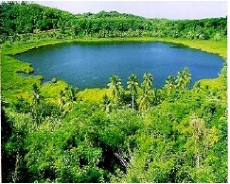
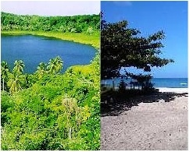
Fundamentals of Multimedia, Chapter 2
(a) Unlike a wipe, we want each video frame not be held in
place, but instead move progressively farther into (out of)
the viewport.
(b) Suppose we wish to slide VideoL in from the left, and push
out VideoR. Figure 2.9 shows this process:
Fig. 2.9: (a): VideoL. (b): VideoR. (c): VideoL sliding into place
and pushing out VideoR.
21
Li & Drew c Prentice Hall 2003

Slide 22
Fundamentals of Multimedia, Chapter 2
Slide Transition (Cont’d)
• As time goes by, the horizontal location x_{T} for the transition
boundary moves across the viewport from x_{T} = 0 at t = 0
to x_{T} = x_{max} at t = t_{max}. Therefore, for a transition that is
linear in time, x_{T} = (t/t_{max})x_{max}.
• So for any time t the situation is as shown in Fig. 2.10 (a).
Let’s assume that dependence on y is implicit since we use
the same y as in the source video. Then for the red channel
(and similarly for the green and blue), R = R(x, t).
22
Li & Drew c Prentice Hall 2003
Notes:
- R is a function of position in the frame, (x, y), as well as of time t.

Slide 23
Fundamentals of Multimedia, Chapter 2
• Suppose that we have determined that pixels should come
from VideoL. Then the x-position x_{L} in the unmoving video
should be x_{L} = x + (x_{max} − x_{T} ), where x is the position we
are trying to ﬁll in the viewport, x_{T} is the position in the
viewport that the transition boundary has reached, and x_{max}
is the maximum pixel position for any frame.
• From Fig. 2.10(b), we can calculate the position x_{L} in VideoL’s
coordinate system as the sum of the distance x, in the view-
port, plus the diﬀerence x_{max} − x_{T} .
23
Li & Drew c Prentice Hall 2003

Slide 24
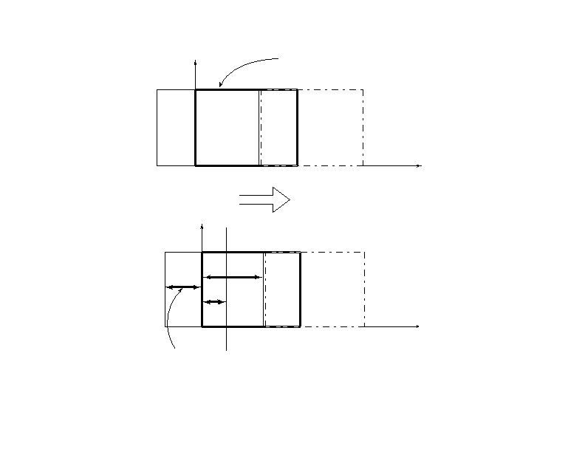
Fundamentals of Multimedia, Chapter 2
y
VideoL
Viewport
VideoR
0
xT
xmax
x
y
xT
x
0
xmax
x
xmax − xT
Fig. 2.10: (a): Geometry of VideoL pushing out VideoR. (b): Calculating
position in VideoL from where pixels are copied to the viewport.
24
Li & Drew c Prentice Hall 2003

Slide 25
Fundamentals of Multimedia, Chapter 2
Slide Transition (Cont’d)
• Substituting the fact that the transition moves linearly with
time, xT = xmax(t/tmax), a pseudocode solution in shown in
Fig. 2.11.
25
Li & Drew c Prentice Hall 2003

Slide 26
Fundamentals of Multimedia, Chapter 2
Some Technical Design Issues
1. Computer Platform: Much software is ostensibly “portable”
but cross-platform software relies on run-time modules which
may not work well across systems.
2. Video format and resolution: The most popular video for-
mats — NTSC, PAL, and SECAM— are not compatible, so
a conversion is required before a video can be played on a
player supporting a diﬀerent format.
3. Memory and Disk Space Requirement: At least 128 MB
of RAM and 20 GB of hard-disk space should be available
for acceptable performance and storage for multimedia pro-
grams.
26
Li & Drew c Prentice Hall 2003
Notes:
as appears or is stated to be true
NTSC, named after the National Television System Committee, 30 frames are transmitted each second.
Phase Alternation Line (PAL) and Sequential Couleur avec Memoire (SECAM) 25 frames are transmitted each second.

Slide 27
Fundamentals of Multimedia, Chapter 2
4. Delivery Methods:
• Not everyone has rewriteable DVD drives, as yet.
• CD-ROMs: may be not enough storage to hold a mul-
timedia presentation. As well, access time for CD-ROM
drives is longer than for hard-disk drives.
• Electronic delivery is an option, but depends on network
bandwidth at the user side (and at server). A streaming
option may be available, depending on the presentation.
27
Li & Drew c Prentice Hall 2003

Slide 28
Fundamentals of Multimedia, Chapter 2
– Automatic Authoring
• Hypermedia documents: Generally, three steps:
1. Capture of media: From text or using an audio digi-
tizer or video frame-grabber; is highly developed and well
automated.
2. Authoring: How best to structure the data in order to
support multiple views of the available data, rather than
a single, static view.
3. Publication: i.e. Presentation, is the objective of the mul-
timedia tools we have been considering.
28
Li & Drew c Prentice Hall 2003

Slide 29
Fundamentals of Multimedia, Chapter 2
• Externalization versus linearization:
(a) Fig. 2.12(a) shows the essential problem involved in com-
municating ideas without using a hypermedia mechanism.
(b) In contrast, hyperlinks allow us the freedom to partially
mimic the author’s thought process (i.e., externalization).
(c) Using, e.g., Microsoft Word, creates a hypertext version
of a document by following the layout already set up in
chapters, headings, and so on. But problems arise when
we actually need to automatically extract semantic con-
tent and ﬁnd links and anchors (even considering just text
and not images etc.) Fig. 2.13 displays the problem.
29
Li & Drew c Prentice Hall 2003

Slide 30
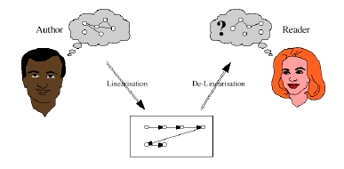
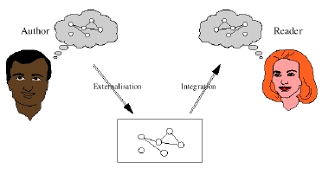
Fundamentals of Multimedia, Chapter 2
(a)
(b)
Fig. 2.12: Communication using hyperlinks [from David Lowe].
30
Li & Drew c Prentice Hall 2003

Slide 31
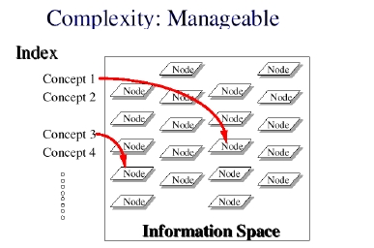
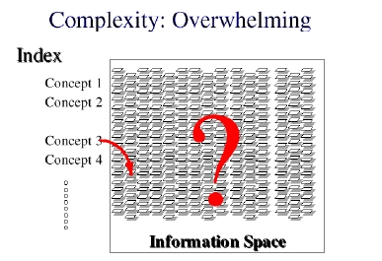
Fundamentals of Multimedia, Chapter 2
Fig. 2.13: Complex information space [from David Lowe].
(d) Once a dataset becomes large we should employ database
methods. The issues become focused on scalability (to a
large dataset), maintainability, addition of material, and
reusability.
31
Li & Drew c Prentice Hall 2003

Slide 32
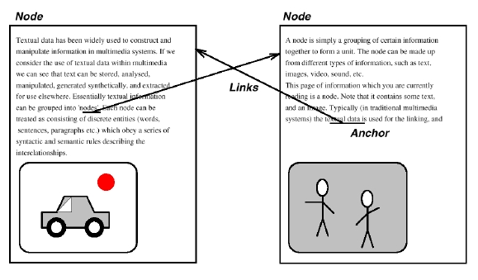
Fundamentals of Multimedia, Chapter 2
Semi-automatic migration of hypertext
• The structure of hyperlinks for text information is simple:
“nodes” represent semantic information and these are an-
chors for links to other pages.
Fig. 2.14: Nodes and anchors in hypertext [from David Lowe].
32
Li & Drew c Prentice Hall 2003

Slide 33
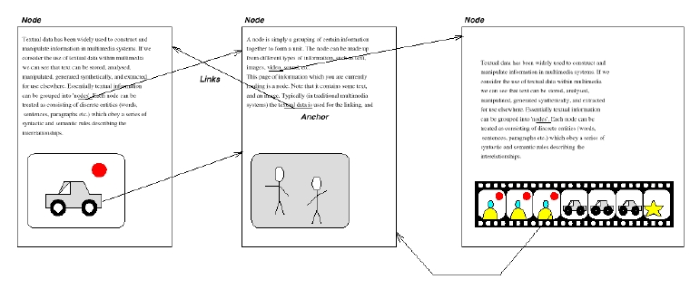
Fundamentals of Multimedia, Chapter 2
Hyperimages
• We need an automated method to help us produce true hy-
permedia:
Fig. 2.15: Structure of hypermedia [from David Lowe].
33
Li & Drew c Prentice Hall 2003

Slide 34
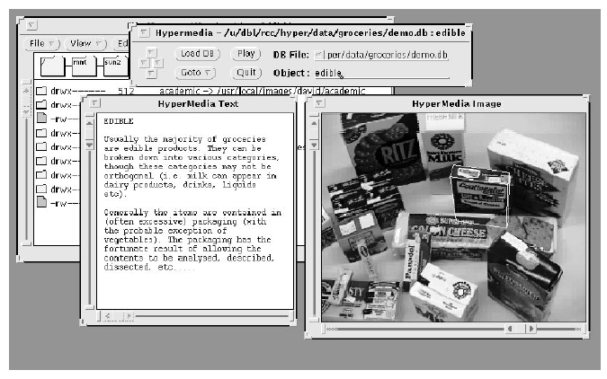
Fundamentals of Multimedia, Chapter 2
• Can manually delineate syntactic image elements by masking
image areas. Fig. 2.16 shows a “hyperimage”, with image
areas identiﬁed and automatically linked to other parts of a
document:
Fig. 2.16: Hyperimage [from David Lowe].
34
Li & Drew c Prentice Hall 2003

Slide 35
Fundamentals of Multimedia, Chapter 2
2.2 Some Useful Editing and Authoring Tools
• One needs real vehicles for showing understanding principles
of and creating multimedia. And straight programming in
C++ or Java is not always the best way of showing your
knowledge and creativity.
• Some popular authoring tools include the following:
– Adobe Premiere 6
– Macromedia Director 8 and MX
– Flash 5 and MX
– Dreamweaver MX
• Hint for Studying This Section: Hands-on work in a Lab
environment, with reference to the text.
35
Li & Drew c Prentice Hall 2003

Slide 36
Fundamentals of Multimedia, Chapter 2
2.2.1 Adobe Premiere
2.2.2 Macromedia Director
2.2.3 Macromedia Flash
2.2.4 Dreamweaver
Cakewalk Pro Audio
36
Li & Drew c Prentice Hall 2003

Slide 37
Fundamentals of Multimedia, Chapter 2
2.3 VRML (Virtual Reality Modelling
Language)
Overview
(a) VRML: conceived in the ﬁrst international conference of the
World Wide Web as a platform-independent language that
would be viewed on the Internet.
(b) Objective of VRML: capability to put colored objects into
a 3D environment.
(c) VRML is an interpreted language; however it has been very
inﬂuential since it was the ﬁrst method available for displaying
a 3D world on the World Wide Web.
37
Li & Drew c Prentice Hall 2003

Slide 38
Fundamentals of Multimedia, Chapter 2
History of VRML
• VRML 1.0 was created in May of 1995, with a revision for
clariﬁcation called VRML 1.0C in January of 1996:
– VRML is based on a subset of the ﬁle inventor format
created by Silicon Graphics Inc.
– VRML 1.0 allowed for the creation of many simple 3D
objects such as a cube and sphere as well as user-deﬁned
polygons. Materials and textures can be speciﬁed for ob-
jects to make the objects more realistic.
38
Li & Drew c Prentice Hall 2003

Slide 39
Fundamentals of Multimedia, Chapter 2
• The last major revision of VRML was VRML 2.0, standard-
ized by ISO as VRML97:
– This revision added the ability to create an interactive
world. VRML 2.0, also called “Moving Worlds”, allows
for animation and sound in an interactive virtual world.
– New objects were added to make the creation of virtual
worlds easier.
– Java and Javascript have been included in VRML to allow
for interactive objects and user-deﬁned actions.
– VRML 2.0 was a large change from VRML 1.0 and they
are not compatible with each other. However, conversion
utilities are available to convert VRML 1.0 to VRML 2.0
automatically.
39
Li & Drew c Prentice Hall 2003

Slide 40
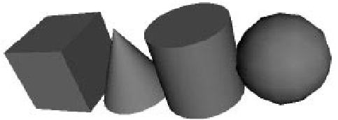
Fundamentals of Multimedia, Chapter 2
VRML Shapes
• VRML contains basic geometric shapes that can be combined
to create more complex objects. Fig. 2.28 displays some of
these shapes:
Fig. 2.28: Basic VRML shapes.
– Shape node is a generic node for all objects in VRML.
– Material node speciﬁes the surface properties of an ob-
ject. It can control what color the object is by specifying
the red, green and blue values of the object.
40
Li & Drew c Prentice Hall 2003

Slide 41
Fundamentals of Multimedia, Chapter 2
• There are three kinds of texture nodes that can be used to
map textures onto any object:
1. ImageTexture: The most common one that can take an
external JPEG or PNG image ﬁle and map it onto the
shape.
2. MovieTexture: allows the mapping of a movie onto an
object; can only use MPEG movies.
3. PixelTexture: simply means creating an image to use
with ImageTexture within VRML.
41
Li & Drew c Prentice Hall 2003

Slide 42
Fundamentals of Multimedia, Chapter 2
VRML world
• Fig. 2.29 displays a simple VRML scene from one viewpoint:
→ Openable-book VRML simple world!:
−→ Link to mmbook/examples/vrml.html.
– The position of a viewpoint can be speciﬁed with the
position node and it can be rotated from the default view
with the orientation node.
– Also the camera’s angle for its ﬁeld of view can be changed
from its default 0.78 radians, with the fieldOfView node.
– Changing the ﬁeld of view can create a telephoto eﬀect.
42
Li & Drew c Prentice Hall 2003

Slide 43
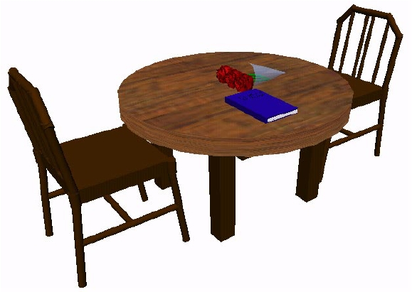
Fundamentals of Multimedia, Chapter 2
Fig. 2.29: A simple VRML scene.
43
Li & Drew c Prentice Hall 2003

Slide 44
Fundamentals of Multimedia, Chapter 2
• Three types of lighting can be used in a VRML world:
– DirectionalLight node shines a light across the whole
world in a certain direction.
– PointLight shines a light from all directions from a certain
point in space.
– SpotLight shines a light in a certain direction from a
point.
– RenderMan: rendering package created by Pixar.
• The background of the VRML world can also be speciﬁed
using the Background node.
• A Panorama node can map a texture to the sides of the
world. A panorama is mapped onto a large cube surrounding
the VRML world.
44
Li & Drew c Prentice Hall 2003

Slide 45
Fundamentals of Multimedia, Chapter 2
Animation and Interactions
• The only method of animation in VRML is by tweening —
done by slowly changing an object that is speciﬁed in an
interpolator node.
• This node will modify an object over time, based on the six
types of interpolators: color, coordinate, normal, orientation,
position, and scalar.
(a) All interpolators have two nodes that must be speciﬁed:
the key and keyValue.
(b) The key consists of a list of two or more numbers start-
ing with 0 and ending with 1, deﬁnes how far along the
animation is.
(c) Each key element must be complemented with a keyValue
element: deﬁnes what values should change.
45
Li & Drew c Prentice Hall 2003

Slide 46
Fundamentals of Multimedia, Chapter 2
• To time an animation, a TimeSensor node should be used:
(a) TimeSensor has no physical form in the VRML world and
just keeps time.
(b) To notify an interpolator of a time change, a ROUTE is
needed to connect two nodes together.
(c) Most animation can be accomplished through the method
of routing a TimeSensor to an interpolator node, and then
the interpolator node to the object to be animated.
• Two categories of sensors can be used in VRML to obtain
input from a user:
(a) Environment sensors: three kinds of environmental sen-
sor nodes: VisibilitySensor, ProximitySensor, and Collision.
(b) Pointing device sensors: touch sensor and drag sensors.
46
Li & Drew c Prentice Hall 2003

Slide 47
Fundamentals of Multimedia, Chapter 2
VRML Speciﬁcs
• Some VRML Speciﬁcs:
(a) A VRML ﬁle is simply a text ﬁle with a “.wrl" extension.
(b) VRML97 needs to include the line #VRML V2.0 UTF8 in the
ﬁrst line of the VRML ﬁle — tells the VRML client what
version of VRML to use.
(c) VRML nodes are case sensitive and are usually built in a
hierarchical manner.
(d) All Nodes begin with “{” and end with “}” and most can
contain nodes inside of nodes.
(e) Special nodes called group nodes can cluster together
multiple nodes and use the keyword “children” followed
by “[ ... ]”.
47
Li & Drew c Prentice Hall 2003

Slide 48
Fundamentals of Multimedia, Chapter 2
(f) Nodes can be named using DEF and be used again later
by using the keyword USE. This allows for the creation of
complex objects using many simple objects.
• A simple VRML example to create a box in VRML: one can
accomplish this by typing:
Shape {
Geometry Box{}
}
The Box defaults to a 2-meter long cube in the center of the
screen. Putting it into a Transform node can move this box
to a diﬀerent part of the scene. We can also give the box a
diﬀerent color, such as red.
48
Li & Drew c Prentice Hall 2003

Slide 49
Fundamentals of Multimedia, Chapter 2
Transform { translation 0 10 0 children [
Shape {
Geometry Box{}
appearance Appearance {
material Material {
diffuseColor 1 0 0
}
}
}
]}
49
Li & Drew c Prentice Hall 2003

Slide 50
Fundamentals of Multimedia, Chapter 2
2.4 Further Exploration
−→ Link to Further Exploration for Chapter 2.
• Good general references for multimedia authoring are intro-
ductory books [3,1] and Chapters 5-8 in [4].
• A link to the overall, and very useful, FAQ ﬁle for multimedia
authoring is in the textbook website’s “Further Exploration”
section for Chapter 2.
• A link to a good FAQ collection for Director, plus a simple
Director movie:
−→ Link to mmbook/examples/director.html.
50
Li & Drew c Prentice Hall 2003

